Slide 1
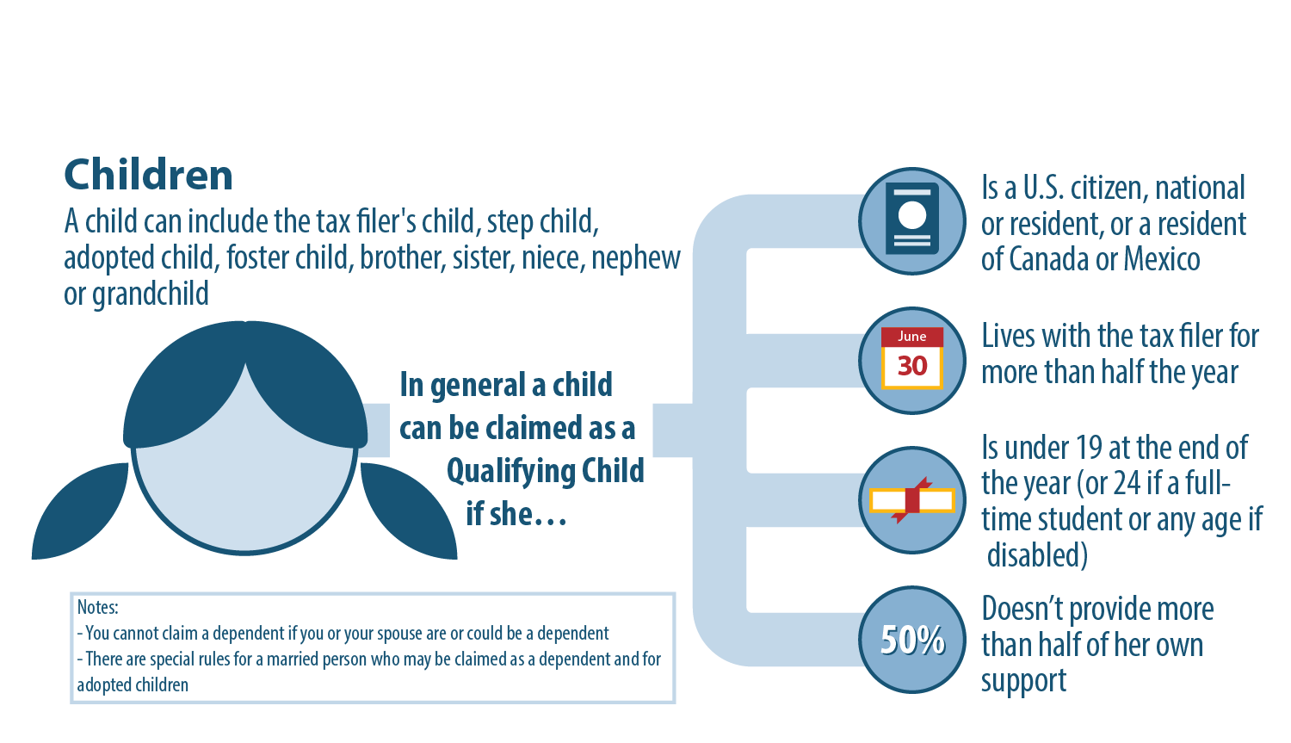
Determining Tax Dependents
Who Can Be Claimed as a Qualifying Child?

Slide 2
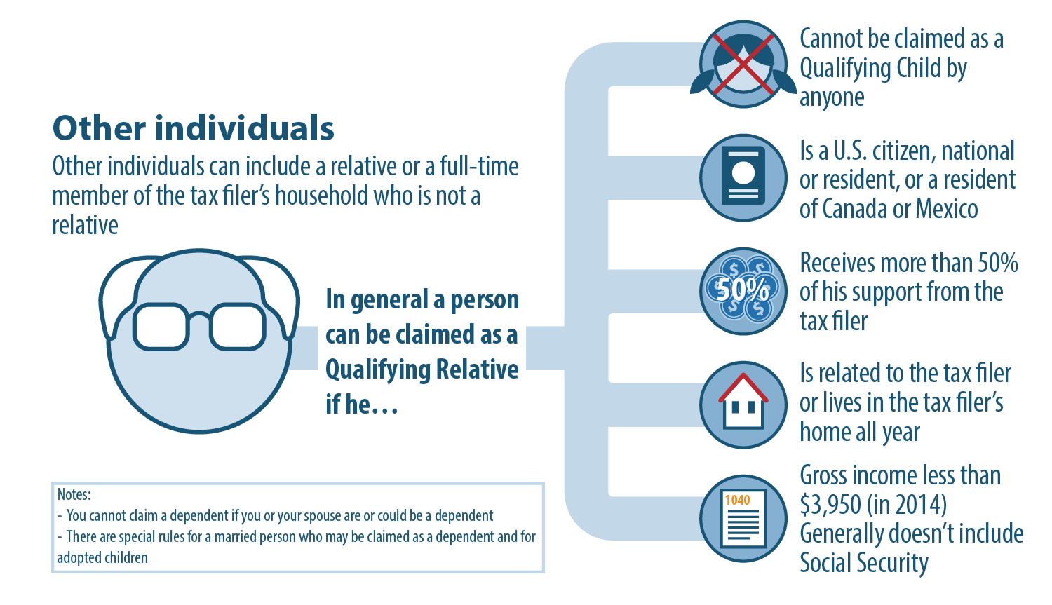
Determining Tax Dependents
Who Can Be Claimed as a Qualifying Relative?

