Slide 1
Part II – Advanced Certification:
Premium Tax Credits
Current as of November 2, 2015

Slide 2
Agenda
Basics of the premium tax credit
Understanding Forms 1095-A and 8962
Common questions
Example
Draft forms and instructions:
Form 8962, Premium Tax Credit https://www.irs.gov/pub/irs-dft/f8962--dft.pdf
Form 8962 Instructions https://www.irs.gov/pub/irs-dft/i8962--dft.pdf

Slide 3
What is the Premium Tax Credit?

Slide 4
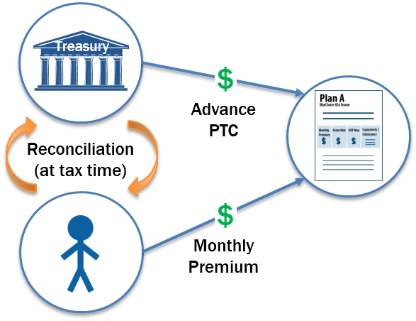
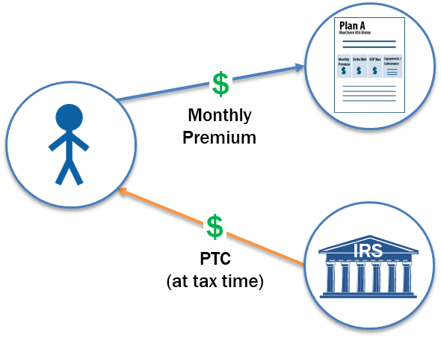
What is a Premium Tax Credit (PTC)?
The PTC is a tax credit that helps lower the cost of private health coverage for people purchasing insurance in a federal or state Health Insurance Marketplace.
Advanced payments of the PTC are made based on the taxpayer’s expected household and income (modified AGI, or MAGI) for the year during the application process.
The actual PTC is claimed on the tax return.
PTCs can be taken in advance: Forwarded to insurer monthly to reduce premiums | OR at tax time: Claimed as a lump sum at the end of the year

Slide 5
Eligibility Criteria for the Premium Tax Credit (PTC)
To receive a premium tax credit for 2015, a person must:
Enroll in a Marketplace plan
Have income between 100 and 400 percent of the federal poverty line (FPL)
Individual: $11,670 - $46,680 Family of four: $23,850 - $95,400
Exceptions for some people below 100% FPL
Have an eligible filing status
PTC cannot be claimed by a person who is Married Filing Separately *Exceptions for abused or abandoned spouses
PTC cannot be claimed on a dependent return (whoever claims an individual’s personal exemption can claim their PTC)
Be ineligible for other minimum essential coverage (MEC)
Not eligible for Medicare or most Medicaid/CHIP or affordable employer-sponsored coverage (regardless of whether the person is actually enrolled)

Slide 6
Receiving Too Much or Too Little in Advance Payments of PTC
If no PTC is taken in advance, or if only a portion of the PTC is claimed in advance, the remainder may be claimed on the tax return. The PTC is refundable.
If a taxpayer receives excess advance payments of the PTC, some or all of it must be paid back.
REPAYMENT LIMITS ON APTC
Income (as % of FPL) | SINGLE taxpayers will pay back no more than … | OTHER taxpayers will pay back no more than….
Under 200% | $300 | $600
At least 200% but less than 300% | $750 | $1,500
At least 300% but less than 400% | $1,250 | $2,500
400% and above | None: Full repayment | None: Full repayment

Slide 7
Failure to Reconcile for 2014
A person who receives APTC agrees to file a tax return and reconcile
1.8 million consumers who received APTC in 2014 failed to reconcile the credit by the end of May.
If a person has not reconciled, they need to file a tax return ASAP to retain or reinstate their APTC for 2016. (Even if the IRS has not yet processed the return, the applicant can attest to filing on their Marketplace application once they've done so.)
File the tax return and return to the Marketplace by Dec. 15 for January 1 coverage.
File the tax return and return to the Marketplace between Dec. 16 – Jan. 15 for APTC to begin February 1.
File the tax return and return to the Marketplace between Jan. 16 – Feb. 15 for APTC to begin March 1.
If a taxpayer failed to file for TY 2014, consider preparing the prior-year return early in the season, even if those returns would normally be delayed until a less-busy time. It may affect a person’s ability to get or keep health insurance.

Slide 8
Form 1095-A

Slide 9
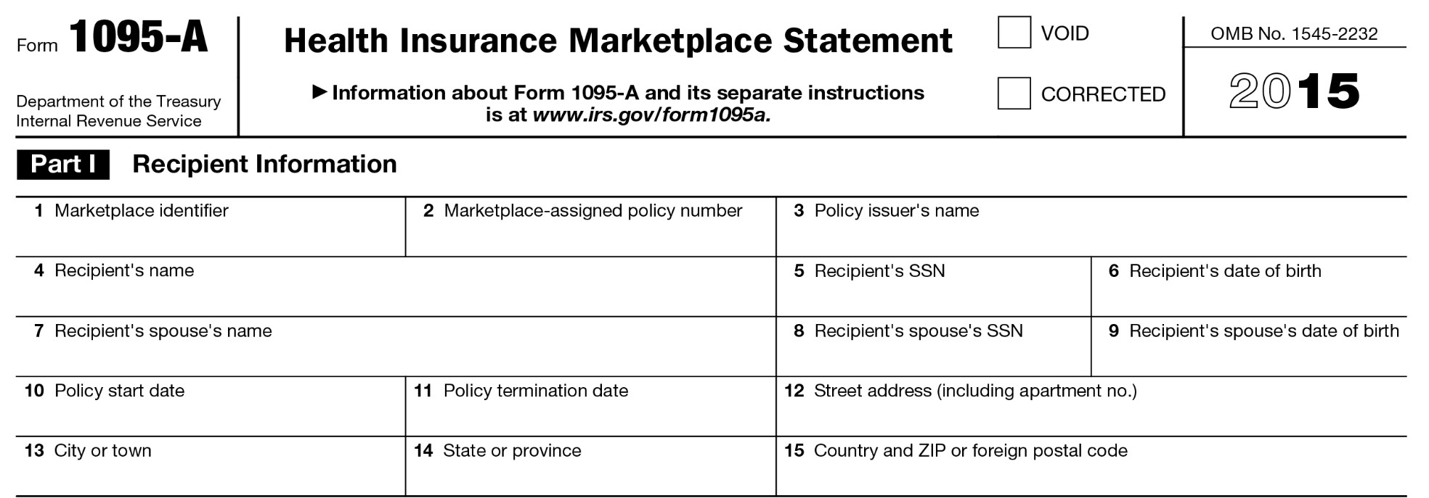
Form 1095-A
This includes the actual premium paid plus the APTC (minus certain “extra” benefits, such as dental)
This is the benchmark plan that helps establish the PTC amount. It may be incorrect if:
(1) no APTC was paid, or (2) a change in circumstance was not reported.
Advance payment of PTC

Slide 10
Form 1095-A Corrections
What if the 1095-A is wrong?
The taxpayer should call the Marketplace for an amended form
Requests for amended forms don’t always require filing delays
If an error doesn’t affect the PTC calculation (e.g., incorrect address, social security number or birth date), seek a correction, but the consumer should file anyway.
If an error does affect the PTC calculation, wait for corrected information before filing. The consumer may be able to get the information over the phone.
Note: Second lowest cost silver plan (SLCSP) is often not amended.
If it’s wrong, use the look-up tool to find the correct one to use on Form 8962 (FFM tool: https://www.healthcare.gov/taxes/tools/silver/)

Slide 11
Form 8962

Slide 12
Form 8962
In general, a taxpayer cannot claim PTC if Married Filing Separately.
Two exceptions (if applicable, check the box and complete Form 8962):
Domestic abuse: The taxpayer lives apart from the spouse and is unable to file a joint return because of domestic abuse
Abandoned spouse: The taxpayer lives apart from the spouse and is unable to locate spouse after using due diligence.
Note: Each exception can be used for a maximum of three consecutive years
The taxpayer does not have to produce proof to the tax preparer, but, as with other claims on a tax return, the IRS could ask for verifying documents later.
If neither exception applies, a person who is MFS is not eligible for PTC.

Slide 13
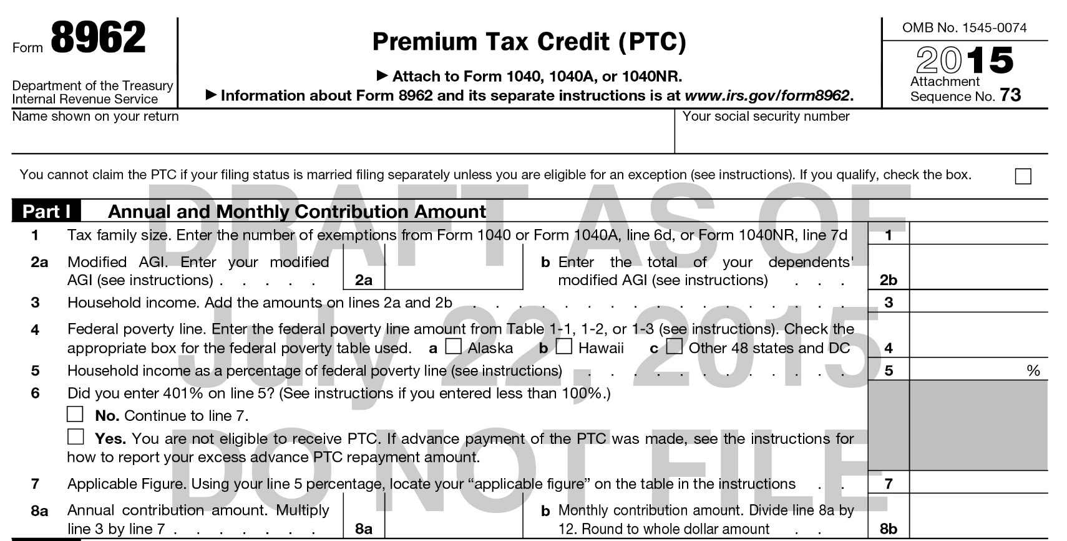
Form 8962
Part I: Computes the amount a household is expected to contribute toward the cost of insurance, based on income.
Line 2b: Enter dependent’s income only if dependent has a filing requirement.
Line 4: Check a box to indicate where the taxpayer lived during the tax year.
Line 6: Simplified questions. Number can be below 100% if:
Exception 1: A person was estimated to have income between 100-400% FPL at the time of application, enrolled in a plan, and received APTC, but had income below 100% FPL at the end of the year.
Exception 2: The person is a lawfully present immigrant who is ineligible for Medicaid because of their immigration status. For example, some Lawful Permanent Residents (LPR) who have been in the U.S. for fewer than 5 years.

Slide 14
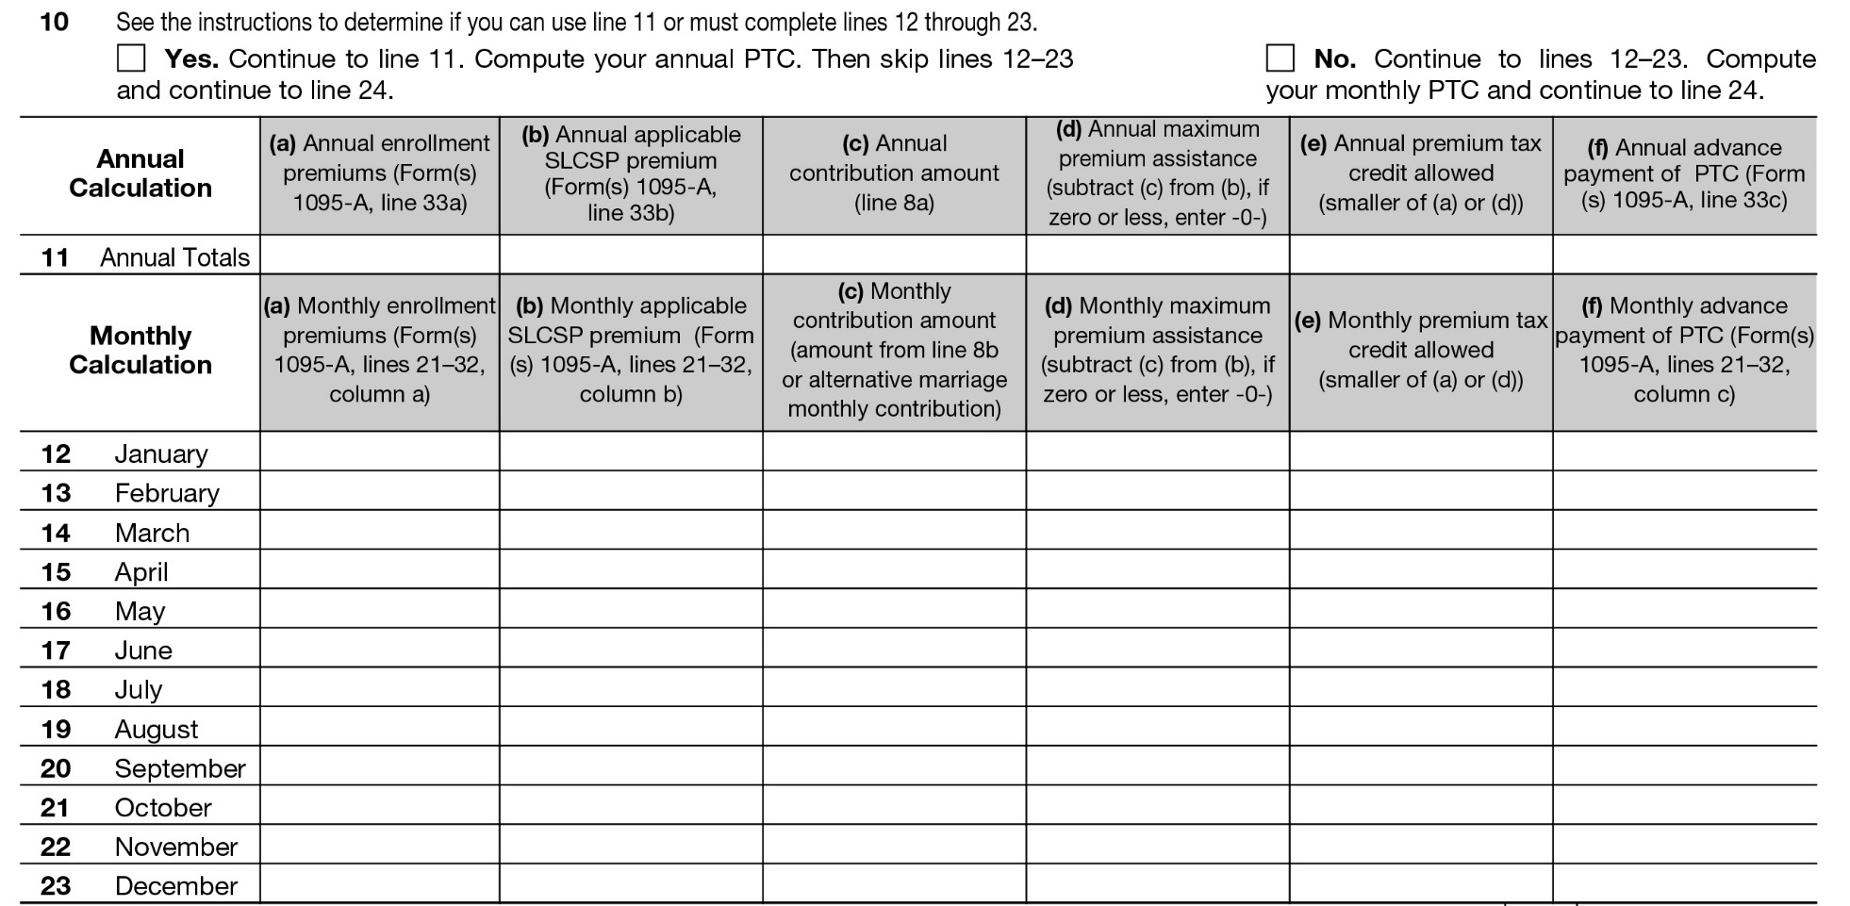
Form 8962
Part II: Calculates PTC based on information on Form 1095-A.
Use either Line 11 (annual) or Lines 12-23 (monthly). Don’t use both! Enter information from Form 1095-A.

Slide 15
Form 8962
Part II/III: Compares annual PTC with APTC.
Can result in either additional net credit (Line 26) or repayment of excess APTC (Line 29) limited to the repayment cap.

Slide 16
Determining if the Return is in Scope

Slide 17
Who Must File Form 8962
File Form 8962 if:
Any member of the tax family received PTC in advance (indicated on a 1095-A), or
A member of the tax family purchased insurance in the Marketplace and did not receive PTC in advance but wishes to claim it now, or
The taxpayer received advanced payment of PTC for someone they thought would be claimed as a dependent but is not claimed and no one else claims that individual’s personal exemption.
Example: In December 2014, Diane enrolls her 18 year old son, Dan, in 2015 coverage, assuming she will claim him as a dependent. At the end of the year, Dan cannot be claimed as a dependent. Dan can file taxes, including Form 8962. But if he doesn’t file and no one claims his personal exemption, Diane must reconcile the PTC.
If a person received any advance payments of PTC, they must file a tax return!

Slide 18
Determining Whether a Return is in Scope
Most tax returns with a Form 1095-A and PTC (Form 8962) are in scope for volunteers certified as advanced
Advanced reconciliation scenarios are out of scope
Shared policy allocation (Part IV)
Alternative marriage calculation (Part V)
Do not prepare a return if the answer to Line 9 is Yes

Slide 19
Alternative Calculation for the Year of Marriage
Because APTC is applied based on a projection of income, marriage can greatly affect the calculation and may lead to significant repayment
This is because marriage adds one or more people to the household and may add income
The alternative calculation can lead to a higher allowable PTC than the traditional calculation (i.e., lower repayment).
Minimum requirements to use the alternative marriage calculation:
They were unmarried at the beginning of the year
Were married by the last day of the year
Are filing a joint return
One person was enrolled in a Marketplace plan prior to marriage
APTC was paid in 2015
See Form 8962 Instructions (draft), page 10, table 4

Slide 20
Alternative Calculation for the Year of Marriage
Recommendation for taxpayers who got married during the year:
Prepare Form 8962.
If the taxpayers receive a net premium tax credit (Form 1040, Line 69), the return is in scope.
If the taxpayers have a repayment, they may benefit from the alternative calculation.
Let the taxpayers know that there is an alternative calculation, that it is out of scope for VITA/TCE, but that they may have a lower repayment if used. Taxpayer can decide whether to continue.

Slide 21
Shared Policy Allocations
Advance payments of PTC were determined based on projections of future filing plans.
If married, will you file jointly with a spouse?
Who will be your dependents in 2015?
What will be your 2015 income?
Throughout the year, things happen.
Taxpayers should report changes, but not all changes are reported in a timely way (or at all)
The change may not be obvious until tax filing (ex. divorced parents may change their plans about who will claim a child)

Slide 22
What is a Shared Policy?
In general: A shared policy allocation occurs when a Marketplace policy covers someone in the taxpayer’s family and someone not in the taxpayer’s family who is being claimed on someone else’s tax return. See Form 8962 Instructions, p. 9
The return is out of scope if:
The 1095-A includes someone who is not on the client’s tax return (e.g., an ex-spouse or a child who becomes a non-dependent)
OR
A person who is on the tax return but was enrolled in Marketplace coverage with another taxpayer (e.g., a non-custodial father enrolls himself and his son in Marketplace coverage but custodial mother claims the child)

Slide 23
What is a Shared Policy?
In general: A shared policy allocation occurs when a Marketplace policy covers someone in the taxpayer’s family and someone not in the taxpayer’s family who is being claimed on someone else’s tax return. See Form 8962 Instructions, p. 9
The return is in scope when:
No Marketplace coverage!
OR
Divorce or separation but everyone on the policy is on one taxpayer’s return and no one on the policy is on the other taxpayer’s return.
OR
“Shifting enrollee” (enrolled by one taxpayer but claimed by another) if that dependent is the only person on the policy.

Slide 24
Common Problems

Slide 25
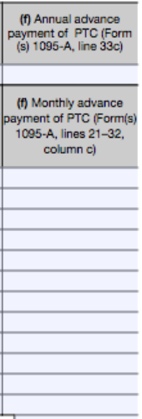
Married Filing Separately
If a person is MFS and no exception applies, APTC received must be repaid, up to the repayment cap.
In TaxWise, complete the following lines:
Lines 1-5 to find household FPL.
Line 9 to determine if the return is in scope.
Line 10 and column (f) of line 11 or lines 12-23.
The rest of the form to determine repayment.

Slide 26
Income Over 400% FPL
400% FPL is $46,680 for a single person
No PTC is available if income is above 400% FPL and all APTC must be repaid. The repayment cap does not apply.
One dollar can make a big difference!
Complete line 9 (to determine if the return is in scope)
Complete line 10 and column (f) of Line 11 (annual) or Lines 12-23 (monthly)
Enter that amount on Lines 25, 27 and 29
This amount will also be entered on Line 46 of the 1040

Slide 27
Income Over 400% or Any Large Repayment
There are a few permissible strategies taxpayers may consider to lower household income:
If taxpayers are newly married, can the alternative marriage calculation prevent or reduce repayment for the months before marriage?
If the taxpayer does not have a retirement plan offer through their employer, could the taxpayer contribute to a traditional IRA and claim the adjustment to reduce income?
Consider filing as Married Filing Separately. The credit will be disallowed, but the repayment cap will apply based on only that spouse’s income.

Slide 28
What Can a Tax Preparer Tell a Person with a Repayment?
Try to determine why the taxpayer’s advance payment was too high:
Did they make an error in estimating their or their dependent’s income?
Was there an error in calculating family size?
Has their filing status changed?
Has a dependent joined or left the family?
Do you suspect the Form 1095-A is incorrect?
Encourage taxpayers to take less than the maximum APTC in future years.
Remind taxpayers to promptly report changes in income and family size to the Marketplace.
If the taxpayer has Marketplace coverage for 2016, encourage them to report their most recent income/dependent information to improve the accuracy of the 2016 income and household projection.
Many people who enrolled in Marketplace coverage in 2015 will be auto-enrolled at (roughly) the same PTC level for 2016. If that PTC amount was incorrect in 2015, it may be incorrect for 2016, too.

Slide 29
Duplicate Months on Forms 1095-A, -B, and -C
A person cannot claim PTC if they had other minimum essential coverage. This may be indicated by duplicate months of coverage or offers of coverage on Form 1095-A and Forms 1095-B or -C.
However, do not assume that any conflicts between Form 1095-A and Form 1095-B and –C mean denial of PTC for duplicate months.
There are many circumstances where PTC is allowable despite coverage or an offer of coverage
These will be explained more in Pub. 974 (forthcoming)

Slide 30
Example

Slide 31
Example: Josephine (Single Filer)
Josephine is a nanny for a family in Washington, DC. The family paid her health insurance premiums until September, when Josephine was no longer needed. Josephine couldn’t afford the premium for the rest of the year. She received a notice in early January that her coverage was cancelled, effective 10/31/15.
Single | Projected Household Income: $26,000 | Has 1095-A
102444444XIC777
Big Ins. Co
John Smith
###-##-####
2-10-90
4/1/2014
Josephine Obagu
XXX-11-1111
03/24/73
03/01/2015
10/31/2015
Josephine Obagu
XXX-11-1111
03/24/73
03/01/2015
10/31/2015

Slide 32
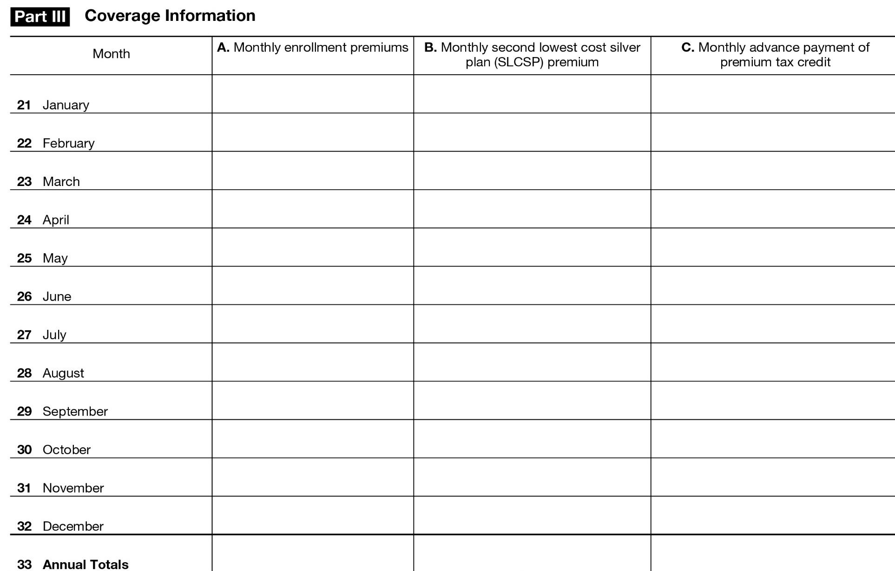
Example: Josephine (Single Filer)
Form 1095-A (cont)
310
294
137
310
294
137
310
294
137
310
294
137
310
294
137
310
294
137
310
294
137
294
137
2170
2352
1096

Slide 33
Example: Josephine (Single Filer)
Josephine Obagu
XXX-11-1111
1
19,000
19,000
x
11,670
163
x
0.0462
878
73

Slide 34
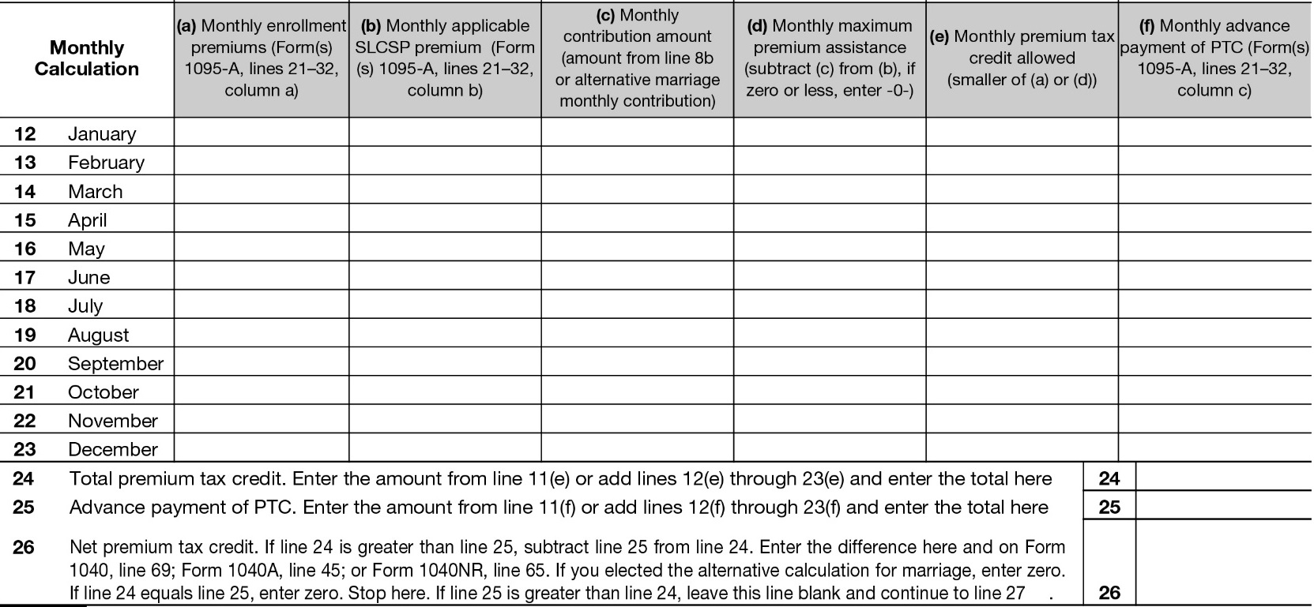
Example: Josephine (Single Filer)
310
310
310
310
310
310
310
294
294
294
294
294
294
294
294
73
73
73
73
73
73
73
73
221
221
221
221
221
221
221
221
221
221
221
221
221
221
221
0
137
137
137
137
137
137
137
137
1547
1096
451
Enter on Form 1040, Line 69

Slide 35
But wait…there’s more!
In which months did Josephine have MEC?
March to September ( when her premiums were paid, even though someone else paid them)
October( when she still had coverage, even though the premium was not paid and she is not eligible for PTC for that month )
Does Josephine qualify for an exemption for Jan-Feb and Nov-Dec?
Her income is not below the filing threshold
She’s in a Medicaid non-expansion state but income is above 138% FPL
She can use the short coverage gap for the first gap
Affordability exemption? Though she had no income Nov-Dec, remember that the affordability exemption is based on annual income.
Look up her lowest cost bronze plan (LCBP). It is $215.
You’ve already calculated her allowable PTC of $221, but that would be capped at the actual premium cost of $215.
The affordability exemption does not apply because she could have enrolled at a $0 premium.

Slide 36
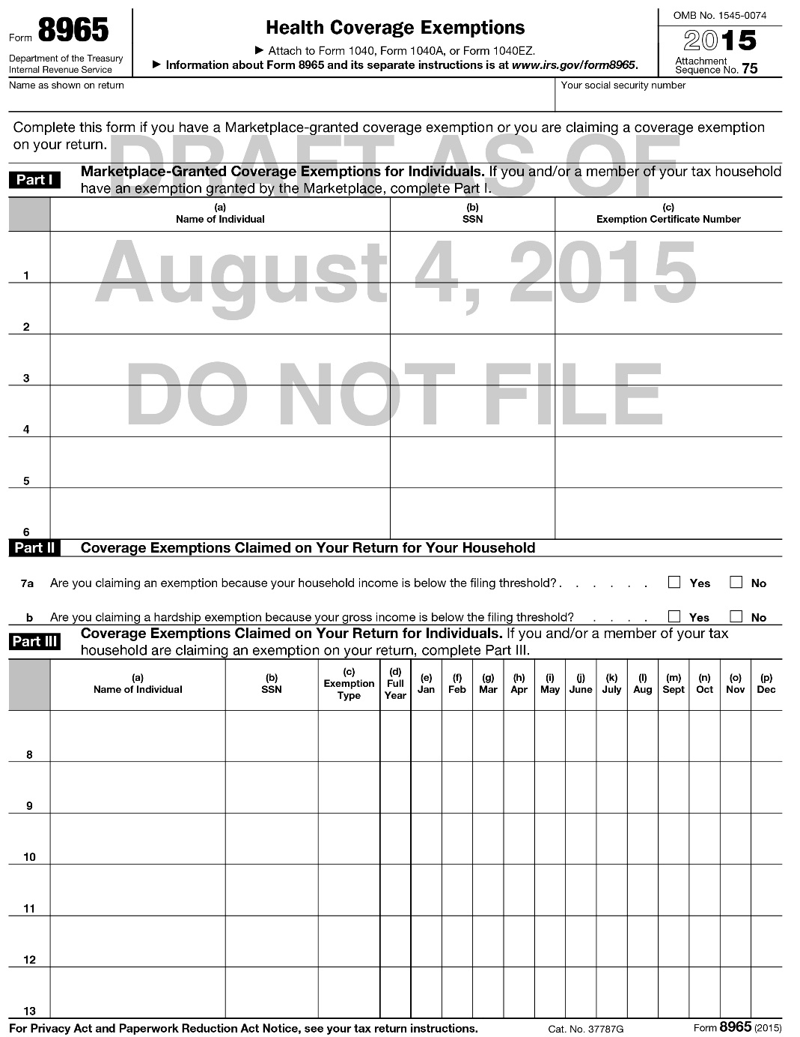
But wait…there’s more!
Josephine had Marketplace insurance from March to October 2015.
Which exemptions apply in Jan–Feb and Nov-Dec?
Josephine Obagu
XXX-11-1111
B
X X

Slide 37
But wait…there’s more!
Income: | $19,000
Filing Status: | Single
Adults: | 1
Children: | 0
2015 Tax Filing Threshold: | $10,300
Months Uninsured: | 2
Payment Calculation:
1. $19,000 - $10,300 =
2. $325 x 1 adult =
$8,700
x 2%
$174 / 12 = $15/mo
$325 /12 = $27/mo x 2 = $54
vs.
Report on F1040, Line 61
Form 1040
$54

