Slide 1
Part V: Common Errors & Introduction to Advanced Reconciliation
Presented January 29, 2015
(Revised February 12, 2015)

Slide 2
Agenda
Common Errors
Coverage Requirement & Individual Shared Responsibility Payment ( ISRP)
The devil is in the details of the ACA Worksheet
Exemptions
New tools for lowest cost bronze plan and Second Lowest Cost Silver Plan ( SLCSP) (affordability exemption, Code A)
Premium Tax Credit
Advanced Reconciliation
Know your limits

Slide 3
Common Errors

Slide 4
Review: Definitions of Income (PTC – Form 8962)
Several different definitions of income are used on Forms 8962 and 8965. Some are calculated by TaxWise and some are not!
Modified Adjusted Gross Income (MAGI) for Determining Eligibility for PTCs
Adjusted Gross Income (AGI)
Non-Taxable Social Security Benefits
Tax-Exempt
Interest
Excluded Foreign Income
Form 1040, Line 37
Form 1040, Line 20a minus 20b
Form 1040, Line 8b
Form 2555, Lines 45, 50
Notes:
Calculated by TaxWise on Form 8962, line 2a.
When asked for dependent income on line 2b, only enter dependent income if that dependent has a tax-filing requirement, according to Pub. 4012, A-2. (Use these filing threshold levels, even if a special rule creates a requirement to file at a different income level, e.g., self-employment income of more than $400.)
If no dependent has a tax-filing requirement, clear the “red” with F3.

Slide 5
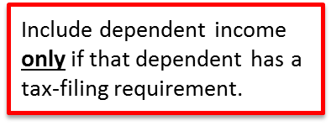
Review: Definitions of Income (Exemptions – Form 8965)
Household income for Line 7a (household income below filing threshold) and ISRP
Adjusted Gross Income (AGI)
Tax-Exempt
Interest
Excluded Foreign Income
Form 1040, Line 37
Form 1040, Line 8b
Form 2555, Lines 45, 50
Gross income for Line 7b (gross income below the filing threshold)
All income received in the form of money, goods, property and services that is not exempt from tax, including any income sources outside the U.S. or from the sale of your main home (even if you can exclude part or all of it)
Include only the taxable portion of Social Security benefits
Include income or gains but not expenses or losses from Schedules C, D and F
Do not include income of any dependents
Household Income for Determining Unaffordability Exemption
Adjusted Gross Income (AGI)
Tax-Exempt
Interest
Excluded Foreign Income
Any pre-tax deduction for employer-sponsored coverage
Form 1040, Line 37
Form 1040, Line 8b
Form 2555, Lines 45, 50
Include dependent income only if that dependent has a tax-filing requirement.

Slide 6
Review: Definitions of Income (Exemptions – Form 8965)
Modified Adjusted Gross Income (MAGI) for Determining Eligibility for Medicaid Coverage Gap Exemption
Adjusted Gross Income (AGI)
Non-Taxable Social Security Benefits
Tax-Exempt
Interest
Excluded Foreign Income
Form 1040, Line 37
Form 1040, Line 20a minus 20b
Form 1040, Line 8b
Form 2555, Lines 45, 50
Notes:
This is the same definition that is used for premium tax credit eligibility.
Tip: To confirm your calculation of income for this exemption, you can open Form 8962 (PTC) and check the amount calculated by TaxWise on line 2a. (Remember to add dependent income only if that dependent had a tax-filing requirement.)

Slide 7
Problem: Why is TaxWise Calculating a Penalty?
TaxWise is calculating a shared responsibility payment, even though the taxpayer had an exemption all year. Make it stop!
TaxWise does not default to a penalty. Check the ACA Worksheet – a box is checked in error.
Reviewer Tip:
On every return, look at Line 61.
Did everyone have coverage all year? If so, make sure the box is checked.
Does anyone have no coverage and no exemption? Make sure there is an amount on Line 61.
Is a penalty appearing on Line 61 for a covered or exempt person? Check the ACA Worksheet

Slide 8
TaxWise ACA Worksheet
Check to indicate that the individual had MEC all year.
Tricky! Check only the months where the person had no coverage and no exemption, i.e., the penalty months.
Check to indicate the person had no coverage and no exemption for all 12 months.
Do not select “None” for a person who was born or died during the year; coverage requirement applies only in FULL months alive.
Do not select “None” if a person had coverage or an exemption for any month.
Check to indicate that the individual qualifies for an exemption for at least one month.
Also complete Form 8965.
Check to indicate that the individual had coverage in the Marketplace for at least one month. Also complete Form 8962.
TaxWise will check these boxes (based on DOB) to indicate people under age 18.

Slide 9
Problem: Does this employer-sponsored plan qualify as MEC?
Example
My client had coverage at work. A premium amount is listed on his W-2, Box 12, DD. But he got a letter from his employer saying his coverage did not meet some minimum standard.
Does the client still have MEC?
YES. If a person enrolls in coverage offered by an employer, it is MEC. (Rare exception: dental or vision insurance only)
The letter probably said that the insurance was not minimum value (MV). This means that the plan is below the standard for employer coverage that would keep an employee from qualifying for PTC.
The employee has the option to turn down a sub-MV plan and get PTC in the Marketplace. But if he takes the sub-MV plan, it still counts as insurance.

Slide 10
FAQs on Exemptions (Part I – Marketplace)
What is an ECN?
An ECN is an “exemption certificate number.” It’s reported in Part I of Form 8965 for exemptions that were previously granted by the Marketplace.
Marketplace exemptions require applications.
Exception: If someone lived in a state that did not expand Medicaid, and the person applied for Medicaid and was found to be in the “gap” (below PTC eligibility), an exemption was granted automatically.
What if the taxpayer received an ECN but lost it?
The client can call the Marketplace call center at 1-800-318-2596.
Connecticut residents call: 1-855-805-4325.
Note: 1095-As can be found in the taxpayer’s Marketplace account but ECNs that the client received are not in their accounts except for the ECN for a Medicaid coverage exemption.

Slide 11
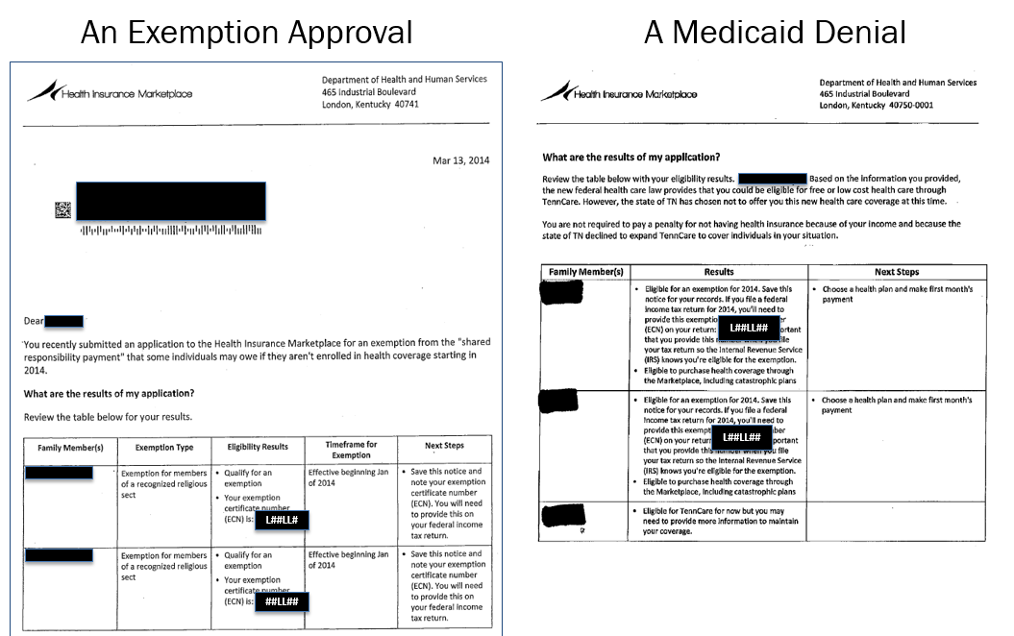
What does an ECN look like?

Slide 12
Pending exemptions
If someone on the tax return was uninsured and is not eligible for an exemption that is claimed directly on the tax return, screen them for eligibility for a hardship exemption from the Marketplace.
If they are eligible, they need to mail an application (including documentation) to the Marketplace. (Connecticut residents – contact your own Marketplace)
Mark “pending” on Form 8965, where it requests the ECN, and e-file!
Billy Joel
xxx-xx-xxxx
pending

Slide 13
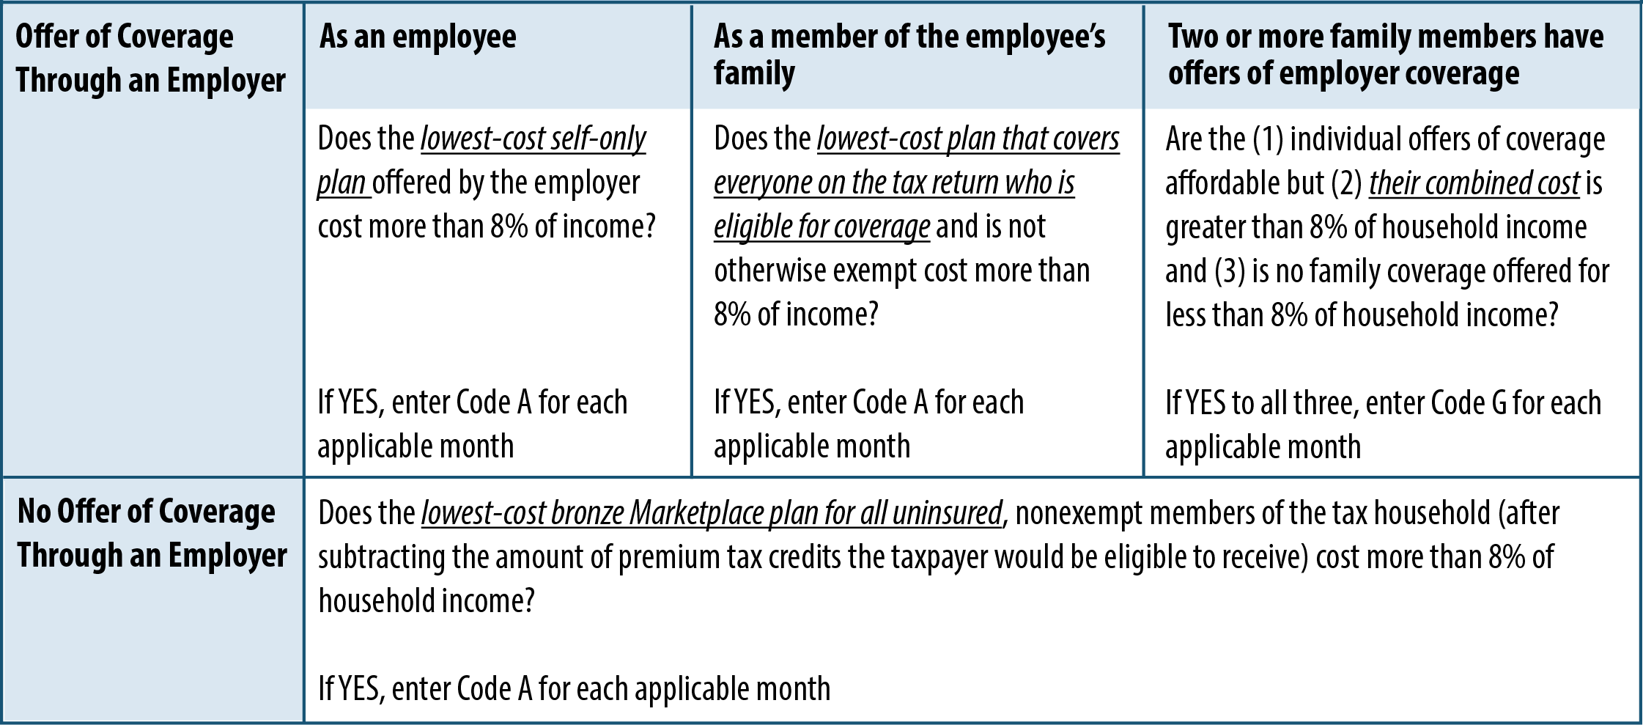
Affordability Exemption
Which plan cost should be compared to household income when calculating the affordability of an offer of coverage?
Household Income = AGI (line 37) +
Tax-exempt interest (line 8b) +
Foreign income (F2555, lines 45 & 50) +
Any pre-tax deduction for employer-sponsored coverage

Slide 14
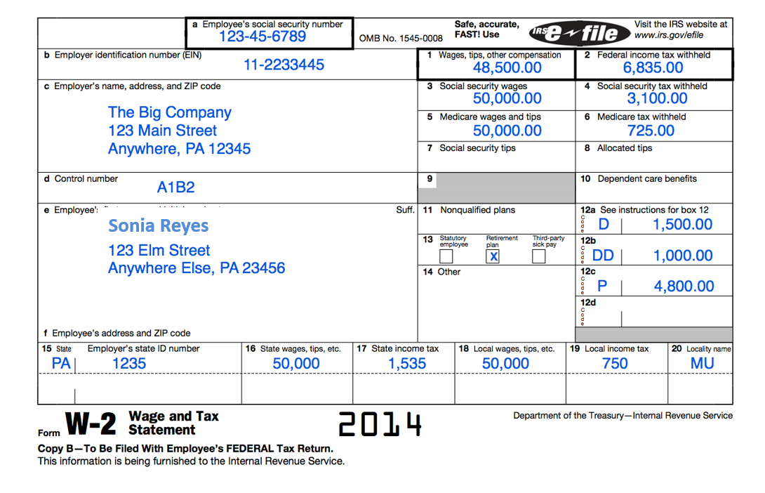
Example: Affordability Exemption
Sonia and Gilberto Reyes are Married Filing Jointly. They have two children, Marco and Gaby, who are their dependents and have no income. They live in Pennsylvania.
Sonia Reyes:
Wages of $48,500
They have no other income.

Slide 15
Example: Affordability Exemption
Sonia and her children enrolled in insurance through Sonia’s employer at a cost to Sonia of $300/mo.
Gilberto was not offered insurance coverage through Sonia’s job.
Sonia and the children were insured all 12 months and Gilberto was uninsured.
Does Gilberto qualify for an exemption based on affordability?

Slide 16
Example: Affordability Exemption
Test for Gilberto (a person without an offer of ESI)
Household Income: $48,500
No offer of employer-sponsored coverage
Does the lowest-cost bronze plan covering only Gilberto in the Marketplace, after accounting for premium tax credits, cost more than 8% of household income?
Use the Marketplace Coverage Affordability Worksheet in the Form 8965 instructions, page 11. A few pieces of information not already on the tax return are required.
What was the lowest-cost bronze plan available to Gilberto in 2014?
Use the new Marketplace look-up tool (if in a FFM-platform state)
How much in premium tax credits would Gilberto have qualified for?
Use the Second Lowest Cost Silver Plan look-up tool

Slide 17
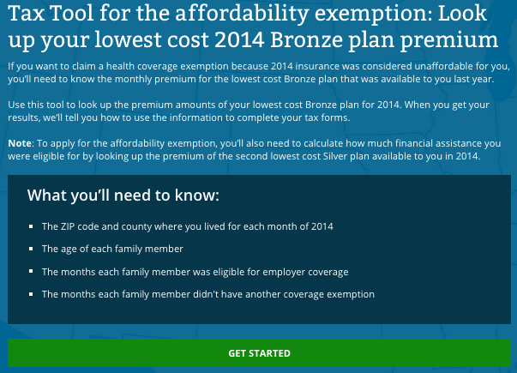
Example: Affordability Exemption
Test for Gilberto (a person without an offer of ESI)
Lowest Cost Bronze Plan
Go to: healthcare.gov/taxes/tools/#bronzeplan
Note: If your state does not use healthcare.gov, go to your state’s Marketplace for equivalent information.

Slide 18
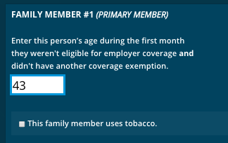
Example: Affordability Exemption
Enter only the family members:
without an offer of employer-sponsored coverage, and
without other insurance or exemption.
What is tobacco use? Use of a tobacco product 4 or more times per week within no longer than the past 6 months by legal users of tobacco products (generally those 18 years and older). Includes all tobacco products.

Slide 19
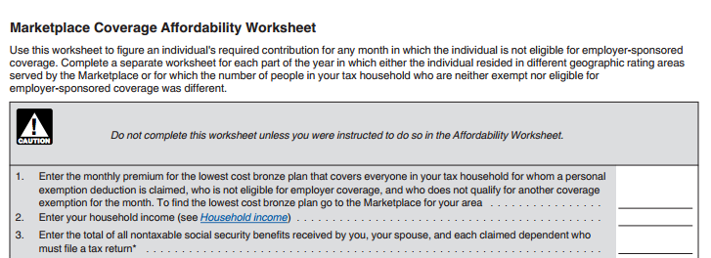
Example: Affordability Exemption
Form 8965 Instructions, p.11
154

Slide 20
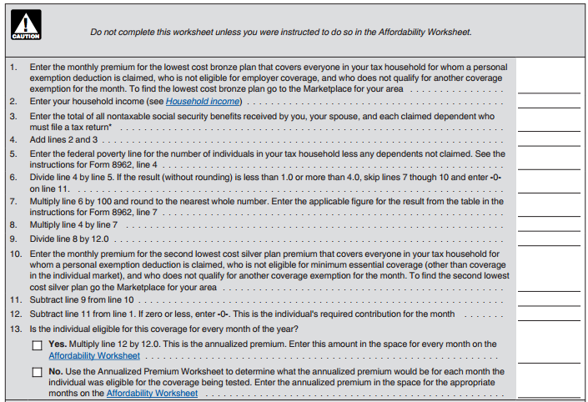
Example: Affordability Exemption
154
48,500
0
48,500
23,550
2.06
0.0651
3,157
3,157
263
180
0
154
1848

Slide 21
Example: Affordability Exemption
154
48,500
0
48,500
23,550
2.06
0.0651
3,157
3,157
263
180
0
154
1848

Slide 22
Example: Affordability Exemption
Is there a shortcut?
Lowest cost bronze plan = $154/month($1,848/year)
Household income = $48,500
$1,848 / $48,500 = 0.038, or 3.8% of household income.
The rest of the affordability worksheet is for determining PTC, which could further lower the family contribution for coverage . But even without extra help from PTC, in this case Gilberto is not eligible for an exemption based on affordability.
Note: This shortcut can only rule out the affordability exemption, not show that someone is eligible for it. If the LCBP costs more than 8% of income, complete the full worksheet to calculate the amount of PTC a person would have been eligible for to determine affordability.

Slide 23
Premium Tax Credits
I haven’t received my 1095-A.
If someone received premium tax credits in advance, you can’t prepare the return without the 1095-A.
For FFM (healthcare.gov) states:
Forms available online
Mailed by Feb. 2
If the form is incorrect, call the Marketplace
The Call Center will investigate
Corrected forms will be mailed in March

Slide 24
Premium Tax Credits
How do I know if Form 1095-A is wrong?
Monthly Premium: The taxpayer may not recognize this number. Note that:
This is the unsubsidized cost of coverage (before PTC)
The cost of “extra” benefits (like adult dental) is subtracted
Actual premium will be higher than column A if any adult uses tobacco
SLCSP:
This column might be blank. If so, use the SLCSP tool to find the SLCSP that covers all members of the family in the plan. In some cases, the state will send a table with the information.
FFM: https://www.healthcare.gov/taxes/tools/silver/

Slide 25
Advanced Reconciliation

Slide 26
Advanced Reconciliation
Additional information yet to come in IRS Pub. 974
Right now, VITA is advised to hold these returns
We’ll briefly address:
How to identify these scenarios
Preview how to handle them
Draft – awaiting publication of Pub 974

Slide 27
When Does Marriage Matter?
In general: There is a special rule for people who have married during the tax year if:
Both spouses were single on January 1, married during the year and are filing jointly for the year.
AND
Someone in the tax family was enrolled in a Marketplace plan before the marriage.
AND
Someone collected advance payment of PTC in a month prior to marriage.
AND
Excess APTC was paid (Form 8962 Instructions, p.8, Worksheet 2)
Draft – awaiting publication of Pub 974

Slide 28
Why Use the Alternative Marriage Calculation?
Example
Carrie had income of $24,000 (209% FPL); Larry had income of $24,000 (209% FPL). Carrie and Larry marry! Their income MFJ is $48,000 (309% FPL).
If each enrolled in PTC as a single person, Carrie and Larry would each have an expected contribution of 6.61% of household income. In their zip code, each could receive up to $1,321 in PTC if unmarried ($2,642 total).
As married people at 309% FPL, their expected contribution is 9.5% of household income. In their zip code, their combined PTC could be up to $1,255 as a married couple.
Under the standard reconciliation method, they would have a PTC overpayment of $1,387.
Draft – awaiting publication of Pub 974

Slide 29
Alternative Marriage Calculation
Solution? Calculate pre-marriage months in one way and their married months in another to lower the amount of PTC they must repay (see Pub 974)
Calculate PTC for pre-marriage months:
Income: Each taxpayer claims one-half of year-end MFJ income
Family size: Pre-marriage family size, except if a dependent could qualify as a dependent of both spouses, they can allocate the dependent in any way agreed upon.
Calculate PTC for married months:
Use standard calculation
Draft – awaiting publication of Pub 974

Slide 30
How do shared policies happen?
Advance payments of PTC were determined based on projections about key tax considerations.
If married, will you file jointly with a spouse?
Who will be your dependents in 2014?
What is your 2014 income?
Throughout the year, things happen.
Taxpayers should report changes, but not all changes are reported in a timely way (or at all)
The change may not be obvious until tax filing (ex. divorced parents may change their plans about who would claim a child)

Slide 31
What is a Shared Policy?
In general: A shared policy allocation occurs when a Marketplace policy covers someone in the taxpayer’s family and someone not in the taxpayer’s family who is being claimed on someone else’s tax return. See Form 8962 Instructions, p. 7
The 1095-A includes someone who is not on the client’s tax return (e.g., an ex-spouse or a child who becomes a non-dependent)
OR
A person who is on the tax return but was enrolled in Marketplace coverage with another taxpayer (e.g., a non-custodial father enrolls himself and his son in Marketplace coverage but custodial mother claims the child)
Draft – awaiting publication of Pub 974

Slide 32
What is a Shared Policy?
No shared policy allocation when:
No Marketplace coverage!
OR
Divorce or separation but everyone on the policy is on one taxpayer’s return and no one on the policy is on the other taxpayer’s return.
OR
“Shifting enrollee” (enrolled by one taxpayer but claimed by another) if that dependent is the only person on the policy.
Draft – awaiting publication of Pub 974

Slide 33
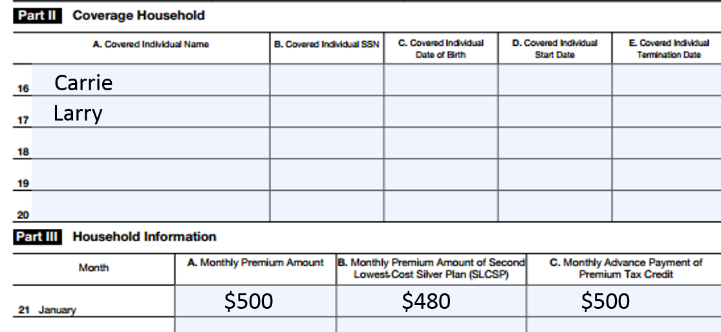
Divorce
When does divorce create a Shared Allocation?
When a person (TP or dependent) on the taxpayer’s return shares a Marketplace policy with a person (TP or dependent) on the former spouse’s tax return
If the policy isn’t shared across tax returns, there’s no need for a special allocation.
Now divorced, Carrie and Larry need to allocate (divide) their premiums paid, SLCSP, and APTC.
Can choose any allocation (default is 50%).
Draft – awaiting publication of Pub 974

Slide 34
Separation
When does separation create a Shared Allocation?
When a person (TP or dependent) on the taxpayer’s return shares a Marketplace policy with a person (TP or dependent) on the separated spouse’s tax return
If the policy isn’t shared across tax returns, there’s no need for a special allocation.
Now separated, Carrie and Larry need to allocate (divide) in half their premiums paid and APTC. But they will need to figure out a new SLCSP.
Note: In separation, at least one spouse who received PTC may now be ineligible as MFS. Their advance credit must still be reconciled.
Draft – awaiting publication of Pub 974

Slide 35
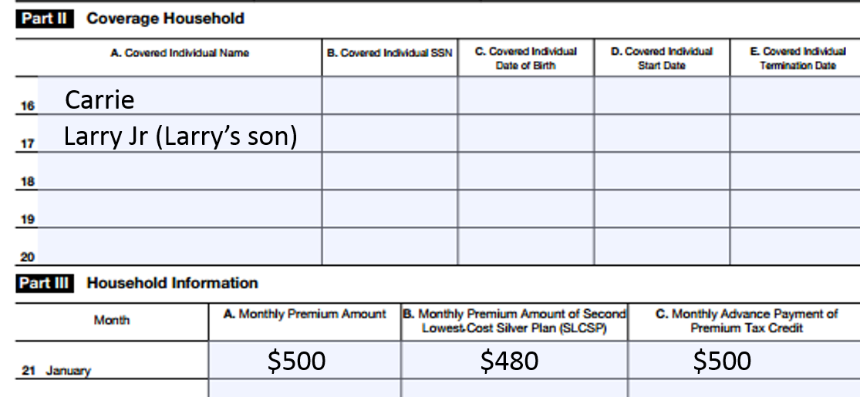
“Shifting” Enrollee
When does a “shifting enrollee” create a Shared Allocation?
When a person enrolls someone in coverage but another person claims them on their tax return.
If the policy isn’t shared across tax returns, there’s no need for a special allocation.
Carrie and Larry need to allocate (divide) their premiums paid, SLCSP, and APTC.
Can choose any allocation (default is proportional division).
Draft – awaiting publication of Pub 974

Slide 36
Awaiting Publication 974
Examples after release of Publication 974!

