Slide 1
VITA/TCE Advanced Topic:
Premium Tax Credits
Current as of November 9, 2016

Slide 2
Agenda
Webinar #1 -- Health Insurance Coverage, Including PTC
Best practices for intake
Using TaxSlayer to report coverage and PTC
Complex 1095-A issues
Review tips for PTC
Webinar #2 – Exemptions & Shared Responsibility Payment
Exemption rules
Using TaxSlayer to report exemptions
Exemption examples (focusing on affordability)

Slide 3
What’s New?
2016 Shared Responsibility Payment
The higher of:
$695/adult (capped at $2,085), or
2.5% of income above filing threshold (capped at national average LCBP, by person)
Exemption Changes
As of September 1, 2016, certain exemptions can now only be claimed on the tax return, not from the marketplace
Incarceration
Health care sharing ministry*
Member of a federally-recognized Indian tribe*
*May continue to use legacy Exemption Certificate Numbers (ECNs that are valid for multiple years)

Slide 4
Intake

Slide 5
Intake
Q1: Include virtually any source of coverage.
When in doubt, check Pub. 4012 ACA-4
No proof of coverage is needed.
A person is covered for a month if they are covered for at least one day of the month

Slide 6
Intake
Q2: Forms 1095-B and –C may be useful to see months covered but are not required for tax prep
1095-B: Issued by coverage issuers (Medicaid, Medicare, insurers)
1095-C: Issued by large employers
If Form 1095-B or –C is missing or incorrect, the taxpayer should contact the form issuer but do not delay in preparing the tax return.
*Note: On November 18, the IRS announced that issuers are not required to issue Forms 1095-B and -C until March 2. Do not delay filing because the form are delayed. Form 1095-A should be received by January 31.

Slide 7
Intake
Q3 may be misleading. In a marketplace, taxpayers are steered to Medicaid or premium tax credits based on their income. If they applied at the marketplace but enrolled in Medicaid, they won’t get a 1095-A.
3a. A person who received APTC must file, regardless of income.
3a. A person who purchased insurance in the marketplace will get a 1095-A and may be eligible for PTC on the tax return whether or not they received the credit in advance.
3b. If the answer is No, this is a shared policy allocation (out of scope).

Slide 8
Intake
Take good notes about months and type of coverage at intake.
The preparer can continue that conversation and mark exemption months.

Slide 9
Intake Triage on Scope
 | BASIC | ADVANCED Plus Basic Topics | OUT OF SCOPE
Insurance Status | Insurance from any source except marketplace No insurance* | Marketplace coverage (1095-A), unless out of scope | 1095-A special circumstances Shared policy allocation: A person on Form 1095-A is not a taxpayer or dependent on the tax return. (Optional) Alternative calculation for year of marriage: If she (1) received APTC, (2) got married in 2016 and is filing jointly, and (3) received excess APTC (owes back) under the standard calculation. Self-employed health insurance tax deduction
Forms | Form 1095-B Form 1095-C | Form 1095-A(s) covering one or more people in the tax household | Form 1095-A that includes a person who is not on the tax return (shared policy).
*Since most taxpayers have coverage all year, and some exemptions are complex, you may decide to assign uninsured taxpayers to more senior tax preparers.

Slide 10
PTC Refresher

Slide 11
Eligibility Criteria for the Premium Tax Credit (PTC)
To receive a premium tax credit, a person must:
Enroll in a Marketplace plan
Have income between 100 and 400 percent of the federal poverty line (FPL)
Individual: $11,770 - $47,080 Family of four: $24,250 - $97,000
*Exception for people with income below 100% FPL can claim PTC if they received APTC under the belief that they would be income-eligible for the credit.
Have an eligible filing status
PTC cannot be claimed by a person who is Married Filing Separately *Exceptions for abused or abandoned spouses
PTC cannot be claimed on a dependent return (whoever claims an individual’s personal exemption can claim their PTC)
Not eligible for (or enrolled in) other minimum essential coverage (MEC)
Not eligible for Medicare or most Medicaid/CHIP or affordable employer-sponsored coverage (regardless of whether the person is actually enrolled) *Many exceptions allow a person who received APTC to claim the credit despite eligibility for other coverage

Slide 12
Who Must File Form 8962
File Form 8962 if:
Any member of the tax family received PTC in advance (indicated on a 1095-A), or
A member of the tax family purchased insurance in the Marketplace and did not receive PTC in advance but wishes to claim it now, or
The taxpayer received advanced payment of PTC for someone they thought would be claimed as a dependent but is not claimed and no one else claims that individual’s personal exemption.
Example: In December 2015, Diane enrolls her 18 year old son, Danny, in 2016 coverage, assuming she will claim him as a dependent. At the end of the year, Danny cannot be claimed as a dependent. Danny can file taxes, including Form 8962. But if he doesn’t file and no one claims his personal exemption, Diane must reconcile the PTC.
If a person received any advance payments of PTC, they must file a tax return!

Slide 13
Reconciliation
If no PTC is taken in advance, or if only a portion of the PTC is claimed in advance, the remainder is refundable and may be claimed on the tax return.
If a taxpayer receives excess advance payments of the PTC, some or all of it must be paid back.
REPAYMENT LIMITS ON APTC (2016)
Income (as % of FPL) | SINGLE taxpayers will pay back no more than … | OTHER taxpayers will pay back no more than….
Under 200% | $300 | $600
At least 200% but less than 300% | $750 | $1,500
At least 300% but less than 400% | $1,275 | $2,550
400% and above | None: Full repayment | None: Full repayment

Slide 14
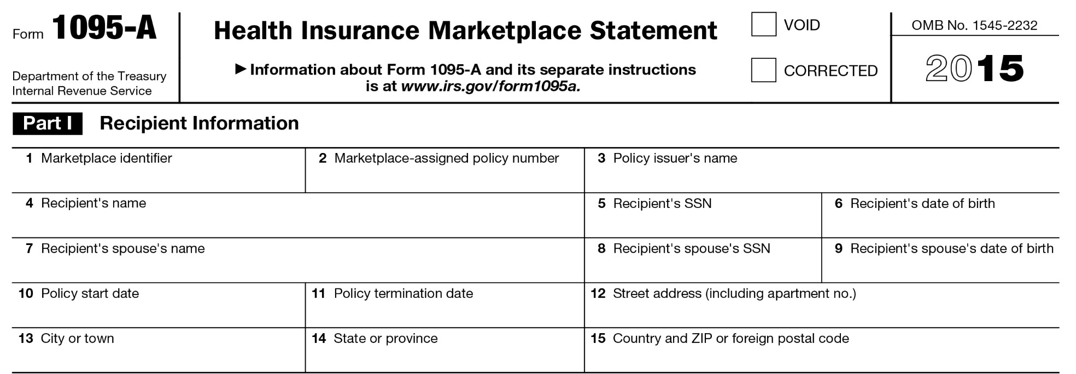
Form 1095-A
This includes the actual premium paid plus the APTC (minus certain “extra” benefits, such as adult dental)
This is the benchmark plan that helps establish the PTC amount. It may be incorrect if:
(1) no APTC was paid, or (2) a change in circumstance was not reported.
Advance payment of PTC

Slide 15
Form 1095-A Corrections
What if the 1095-A is wrong?
The taxpayer should call the Marketplace for an amended form
Requests for amended forms don’t always require filing delays
If an error doesn’t affect the PTC calculation (e.g., incorrect address, social security number or birth date), seek a correction, but the consumer should file anyway. Don’t wait.
If an error does affect the PTC calculation, get corrected information before filing. The consumer may be able to get the information over the phone.
Note: An incorrect second lowest cost silver plan (SLCSP) will not be amended.
If the SLCSP is wrong, use the look-up tool to find the correct one to use on Form 8962 (FFM tool: www.healthcare.gov/tax-tool/)

Slide 16
2016 Filing Season*
PTC Reconciliation for 2015
4.8 million returns included Form 8962
Average credit was $2,987
Delays in Return Processing
Many taxpayers received Letter 12C to request more information (1095-A, Form 8962, page 2 of 1040)
If someone did not respond, their return may have been sent to exams for review and assessment.
Consider amending the tax return if the result of the exam seems inaccurate
*Return data through April 30, 2016

Slide 17
Failure to File in 2015
Failure to File and Reconcile APTC for 2015
People who did not file for 2015 will not have their marketplace coverage auto-renewed with APTC.
Instead, the TP should file for TY2015, return to the marketplace, and attest to filing. This will reinstate APTC.
Consider preparing the prior-year return early in the season, even if those returns would normally be delayed until a less-busy time. It may affect a person’s ability to get or keep health insurance.

Slide 18
Forms 1095-A, B, and C
Form 1095-A
Form 1095-A
Issued by the Marketplace to people who enrolled in Marketplace coverage.
Necessary to prepare Form 8962, which is required for people who received Advance Premium Tax Credits
Corrections? Call the Marketplace that issued the form
Form 1095-B
Form 1095-B
Issued by Medicaid, Medicare, insurers, and others who offer coverage.
Individuals with coverage should receive this form.
Useful in determining the months a person had coverage.
Form 1095-C
Form 1095-C
Issued only by large employers (employers with 50 or more full-time EEs)
Useful in determining the months a person had coverage or an offer of coverage and the cost of the offer of coverage. (May be helpful to calculate the affordability exemption.)
Serves a dual purpose in (1) confirming that a taxpayer had coverage and (2) helping IRS determine whether an employer owes a shared responsibility payment for failure to offer affordable coverage.

Slide 19
Overlapping Coverage
In general, to be eligible for PTC, the taxpayer must not be eligible for (or enrolled in) other minimum essential coverage (MEC).
Many exceptions!
For any coverage conflict:
People who are eligible for PTC on the first day of the month are considered eligible for the full month (even if they become eligible for other coverage later that month, for instance.)
If a person is enrolled in APTC but later determined eligible Medicaid:
The person is generally eligible for PTC for the entire calendar year even if also enrolled in Medicaid for some of those months.
www.irs.gov/PUP/taxpros/best-_practices_resolving_1095_conflicts.pdf

Slide 20
Overlapping Coverage
More exceptions!
Eligibility for Medicare: A person loses eligibility for PTC when they become Medicare-eligible, even if they fail to enroll in Medicare. But the loss of eligibility doesn’t occur until the first day of the fourth full month after the person became eligible for Medicare.
Example: Freddie is enrolled in Marketplace coverage with APTC. His 65th birthday is May 17 and he is eligible to enroll in Medicare.
If he continues in the marketplace the APTC all year:
He’ll owe back APTC for Sept–Dec.
And when he enrolls in Medicare Part B, he’ll pay a higher premium.
May
Jun
Jul
Aug
Sep
Eligible for Medicare
Three full months
NOT eligible for PTC
www.irs.gov/PUP/taxpros/best-_practices_resolving_1095_conflicts.pdf

Slide 21
Overlapping Coverage
More exceptions!
Eligibility for Employer-Sponsored Coverage: In general, a person is not eligible for PTC if they have an affordable, minimum value offer of coverage from an employer. If the employer is large, the coverage offer will be indicated on Form 1095-C. (There is no similar record for small employers.)
It’s an affordable offer if: Line 14 says 1A
Or Line 14 says 1B, 1C, 1D, or 1E and the cost on line 15 is less 9.66% of income
This only tells you the cost of self-only coverage; family coverage may still be unaffordable.
www.irs.gov/PUP/taxpros/best-_practices_resolving_1095_conflicts.pdf

Slide 22
Overlapping Coverage
More exceptions!
Eligibility for Employer-Sponsored Coverage: A person is not eligible for PTC if they have an affordable, minimum value offer of coverage from an employer. If the employer is large, the coverage offer will be indicated on Form 1095-C. (There is no similar record for small employers.)
SAFE HARBOR: If the taxpayer informed the marketplace of the cost of employer-sponsored coverage and they awarded APTC anyway, the taxpayer can claim PTC.
Ask: Did you provide accurate information about the cost of employer-sponsored coverage? If so, and the person received APTC, disregard the offer of coverage – they are eligible for PTC (if all other requirements are met).
www.irs.gov/PUP/taxpros/best-_practices_resolving_1095_conflicts.pdf

Slide 23
Example 1: Overlapping Coverage
Sammie is offered health insurance at work.
She reports the cost of coverage and the marketplace determined it was unaffordable.
Sammie enrolls in marketplace coverage and receives APTC.
At tax filing, she receives a Form 1095-C indicating she had affordable coverage.
Is Sammie required to repay her APTC?
No, Sammie is protected by the safe harbor.

Slide 24
Example 2: Overlapping Coverage
Sammie is auto-renewed. She doesn’t report her employer-sponsored coverage at all.
Form 1095-C indicates affordable coverage.
Is Sammie required to repay her APTC?
Yes, the safe harbor does NOT apply because Sammie didn’t accurately report the cost of employer-sponsored coverage.

Slide 25
TaxSlayer

Slide 26
Enter Insurance Status
TaxSlayer 2016 in Practice Lab as of 11/9

Slide 27
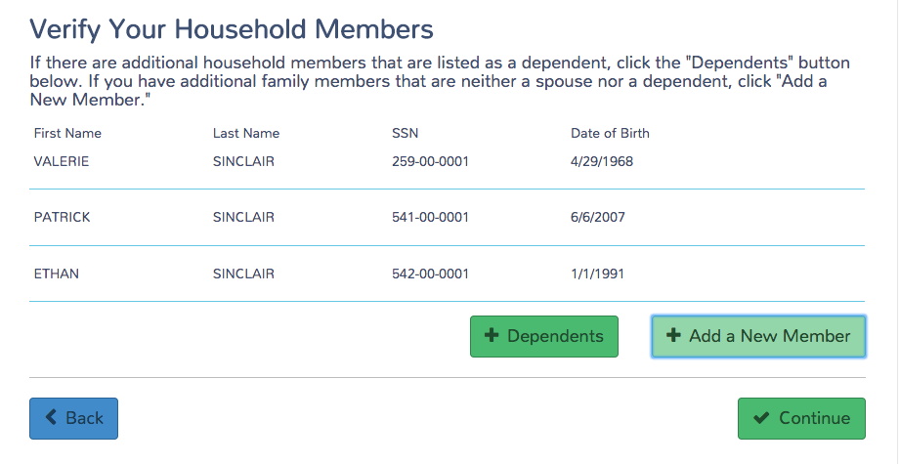
Verify Household
This box will add a dependent to the tax return.
This box will add a person to the tax return for ACA coverage and penalty purposes.
Rule: The TP is responsible for coverage for any person they claim or could claim as a dependent.
Warning: Do not add a person who is on Form 1095-A but not on the tax return (shared policy). That’s not an accurate way to reconcile APTC.
TaxSlayer 2016 in Practice Lab as of 11/9

Slide 28
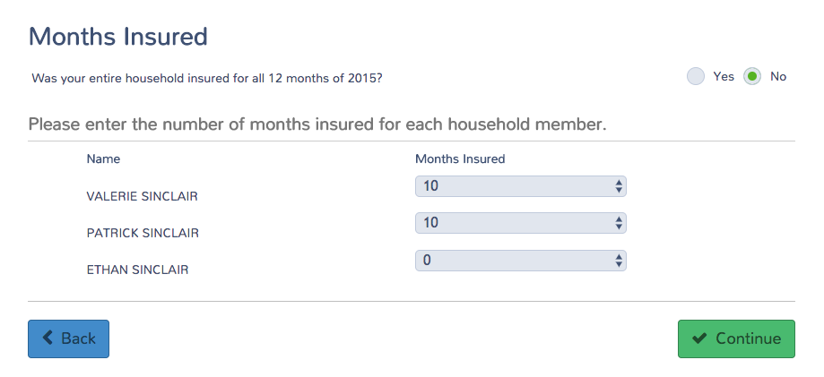
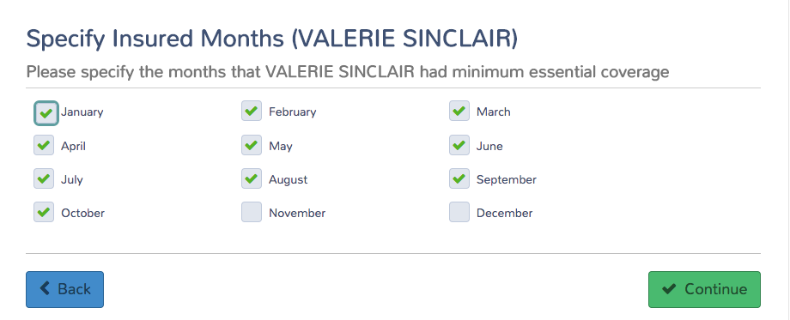
Enter Insured Months
TaxSlayer 2016 in Practice Lab as of 11/9

Slide 29
Form 1095-A
If you answer No, you won’t be asked additional questions about marketplace insurance.
TaxSlayer 2016 in Practice Lab as of 11/9

Slide 30
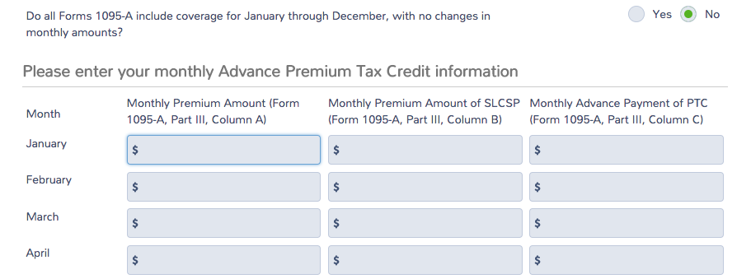
Enter Form 1095-A Information
Enter annual or monthly information from Form 1095-A.
TaxSlayer 2016 in Practice Lab as of 11/9

Slide 31
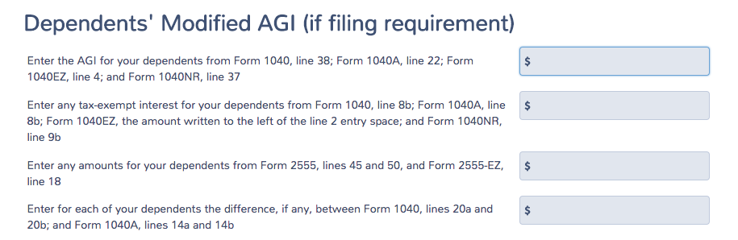
Dependent MAGI
Dependent income is rarely needed because few dependents are required to file taxes.
The income of a dependent with a tax filing requirement is included in the calculation of HHI (household income) for:
PTC
Income-based exemptions (income below filing threshold, Medicaid coverage gap) except gross income below filing threshold.
Shared responsibility payment (penalty)
TaxSlayer 2016 in Practice Lab as of 11/9

Slide 32
Complex 1095-A Issues

Slide 33
Issue: I thought I would file jointly, but I’m MFS
In general, a taxpayer cannot claim PTC if Married Filing Separately.
Two exceptions:
Domestic abuse: The taxpayer lives apart from the spouse and is unable to file a joint return because of domestic abuse
Abandoned spouse: The taxpayer lives apart from the spouse and is unable to locate spouse after using due diligence.
Note: Each exception can be used for a maximum of three consecutive years
The taxpayer does not have to produce proof to the tax preparer, but, as with other claims on a tax return, the IRS could ask for verifying documents later.

Slide 34
Example: MFS with APTC
Alma hasn’t seen her husband in over a year. When she applied for health coverage, she said she was single. She was awarded APTC.
At tax filing, Alma learned from her tax preparer that she is married filing separately.
Explain that a person cannot claim PTC if MFS, and ask if the domestic violence or abandonment exceptions apply
Abandonment might apply. Has she used due diligence to locate him?
Alma: He lives with his new girlfriend in Mason City. I could call him on his cell phone. But I don’t have any interest in filing taxes with him.
Exception does not apply. Enter 1095-A as it appears. TaxSlayer will trigger payback of the APTC received (up to the repayment cap).
Form 8962

Slide 35
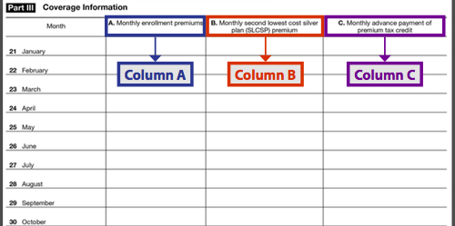
Issue: Multiple Forms 1095-A
Many people have multiple 1095-As.
Sometimes it’s because of an actual change in plan selection. Or other changes, like a change in income, triggered a new “policy” in the enrollment system.
Form 1095-A
Add the premiums together
If same state, SLCSP should be the same.
If different states, add them.
Or use tool.
Add the APTC together
See Form 8962 Instructions for details.

Slide 36
Example: Multiple Forms 1095-A
Felicia and Murphy claim their 27-year-old daughter, Gwen, as a dependent. They enroll together as a household in the same plan but cannot be in the same “policy” (because Gwen is not a minor child and the plan won’t allow it.) They get separate Forms 1095-A.
Form 1095-A for Felicia and Murphy
$10,800
$10,800
$4,800
Form 1095-A for Gwen
$3,600
$10,800
$1,200
14,400
$10,800 + $3,600
10,800
6,000
$4,800 + $1,200

Slide 37
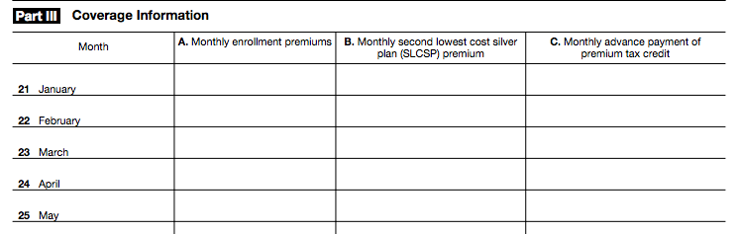
Issue: Failure to Pay Premiums
Form 1095-A
$300
$300
$200
$300
$300
$200
$300
$300
$200
$300
$300
$200
$300
$200
There is a 3-month grace period for nonpayment. If the taxpayer doesn’t catch up on all missed premiums, coverage is terminated retroactively as of the end of the first month of nonpayment.
Taxpayer will owe back the APTC for that month of nonpayment.
OR the taxpayer can pay the premium for the month prior to the tax deadline.
If there are multiple months of APTC without a premium in column A, this is an error.

Slide 38
Example: Failure to Pay Premiums
Greg had an unexpected car repair in April and could not afford to make his $100 May premium for his marketplace insurance. He paid half of his June premium ($50), which the insurer applied to May’s overdue premium.
Form 1095-A
$300
$300
$200
$300
$300
$200
$300
$300
$200
$300
$300
$200
$300
$200
Enter this into TaxSlayer and the program will trigger a repayment of the $200 in APTC received in May.
Even though Greg didn’t pay his premium for May, he is still considered covered for that month!
Alternative to repayment: Greg can pay his portion of the May premium ($50), request a new 1095-A, and avoid APTC repayment for that month.

Slide 39
Issue: Only Column A of Form 1095-A is Completed
Form 1095-A
$300
$300
$200
$300
$300
$200
$300
$300
$200
$300
$300
Warning! If you enter the Form 1095-A exactly as written, no PTC will be awarded.
Instead:
Determine eligibility for the credit for the months a premium was paid.
If she is eligible for the PTC, use the Tax Tool to look up the SLCSP for Column B (or call your state marketplace)

Slide 40
Example: Only Column A of Form 1095-A is Completed
Carolina received APTC for marketplace coverage beginning January 1. At enrollment, she had a data-matching inconsistency on her income. It wasn’t resolved in time and she lost her APTC but continued to pay the full premium for two months.
Even though she didn’t receive APTC in April and May, she meets all of the eligibility criteria for PTC.
In TaxSlayer, enter the SLCSP for April and May. (If you’re not sure of the SLCSP, look it up.)
Form 1095-A
$300
$300
$200
$300
$300
$200
$300
$300
$200
$300
$300
$300
$300
Leave the APTC column BLANK for those months

Slide 41
Review Tips

Slide 42
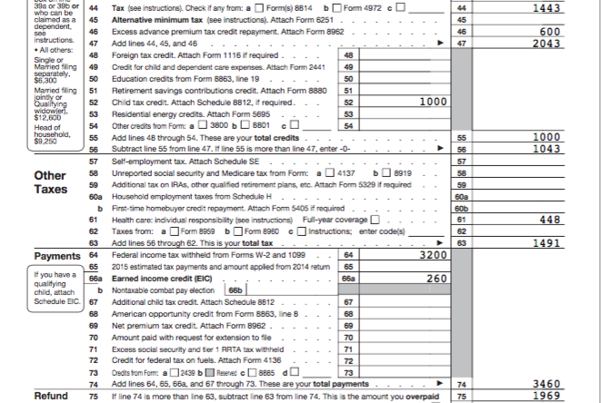
Review the Return Carefully

Slide 43
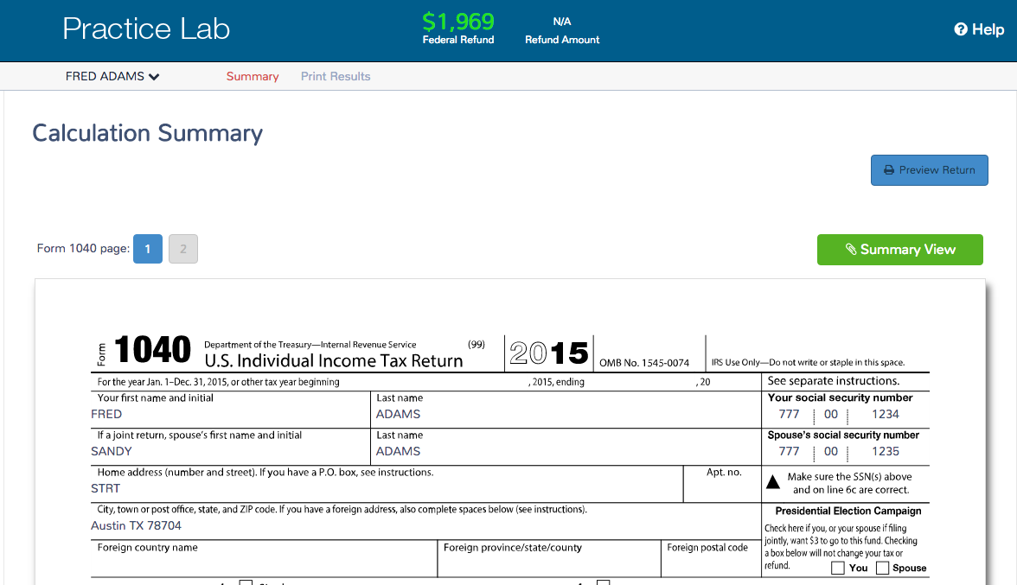
Always Preview the Return!

Slide 44
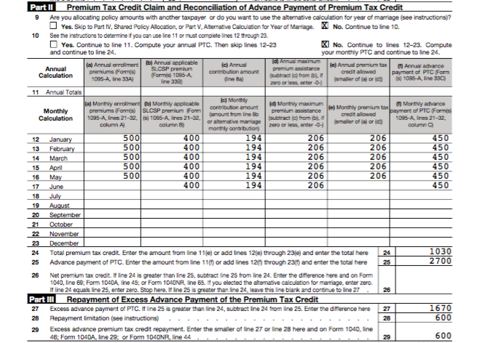
Does Form 8962 Seem Correct?
Form 8962
That can’t be right
??????

Slide 45
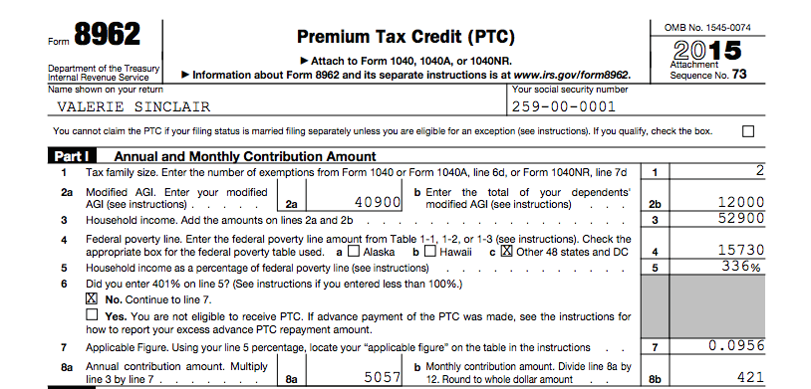
Form 8962 Review
If MFS, PTC is disallowed and all APTC is repaid. Does this taxpayer qualify for an exception?
Spousal abandonment
Domestic abuse

Slide 46
Form 8962 Review
Did I enter dependent income inappropriately?
Only enter if dependent has a filing requirement

Slide 47
Form 8962 Review
Line 4 (FPL Table) will be populated according to data entered in the Basic Information section (Resident state as of 12/31)
Form 8962
Line 6: TaxSlayer will assume that a person is eligible for PTC if their income is below 100% FPL.
If income is 401% FPL, the taxpayer must repay all APTC.
Did you consider:
Married filing separately?
Adjustments such as making a deductible IRA contribution, contributing to a health savings account, taking the tuition and fees deduction instead of an education credit?

Slide 48
Form 8962 Review
Line 9: TaxSlayer assumes that there is no out-of-scope issue.
Double check that everyone on Form 1095-A is on the tax return (no shared policy allocation)
If the taxpayer must repay PTC, did he or she get married in 2016? If so, the person may qualify to use the alternative marriage calculation.

Slide 49
What Can a Tax Preparer Tell a Person with a Repayment?
Try to determine why the taxpayer’s advance payment was too high:
Did they make an error in estimating their or their dependent’s income?
Was there an error in calculating family size?
Has their filing status changed?
Has a dependent joined or left the family?
Do you suspect the Form 1095-A is incorrect?
Encourage taxpayers to take less than the maximum APTC in future years.
Remind taxpayers to promptly report changes in income and family size to the Marketplace.
If the taxpayer has Marketplace coverage for 2017, encourage them to report their most recent income/dependent information to improve the accuracy of the 2017 income and household projection.

