Slide 1
Part III – Premium Tax Credits
November 18, 2014

Slide 2
Agenda
Basics on the premium tax credit
Walk through Form 8962
Show examples and common situations you are likely to encounter
New!
Final forms are posted for:
Form 8962, Premium Tax Credit http://www.irs.gov/pub/irs-pdf/f8962.pdf
Form 8965, Exemptions http://www.irs.gov/pub/irs-pdf/f8965.pdf

Slide 3
What are Premium Tax Credits?

Slide 4

What are premium tax credits (PTC)?
The PTC is a tax credit that helps lower the cost of private health coverage for people purchasing insurance in a Health Insurance Marketplace
  Some states rely on the federal Marketplace (healthcare.gov). Other states have their own Marketplace. The same rules apply.
Who can buy insurance in the Marketplace?
  Most people can purchase insurance in the Marketplace, but not everyone qualifies for PTC.
    A person cannot buy Marketplace insurance if they are incarcerated or an undocumented immigrant.
  Insurance can be purchased only:
    During open enrollment, or
    Based on specific changes in circumstances, such as marriage, birth of a child or losing job-based coverage.

Slide 5
Eligibility Criteria for Premium Tax Credits (PTC)
To receive a premium tax credit, a person must:
  Enroll in a Marketplace plan
  Have income between 100 and 400 percent of the federal poverty line (FPL)
    Individual: $11,690 - $46,760 Family of four: $23,850 - $95,400
    Exception 1: People who are estimated to have income between 100-400% FPL at the time of application, enroll in a plan, and receive advanced payments of PTC, but who have income below 100% FPL at the end of the year.
    Exception 2: Lawfully present immigrants with income under the poverty line are eligible for PTCs if they are ineligible for Medicaid because of their immigration status. For example, some Lawful Permanent Residents (LPR) who have been in the U.S. for fewer than 5 years.
  Have an eligible filing and dependent status
    Cannot be Married Filing Separately (*exceptions for abused or abandoned spouses)
    Cannot be a dependent (whoever claims the child’s exemption can claim their PTC)
  Be ineligible for other minimum essential coverage (MEC)
    Not eligible for Medicare or most Medicaid/CHIP or most employer-sponsored coverage (regardless of whether the person is actually enrolled)

Slide 6


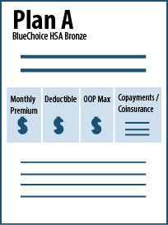
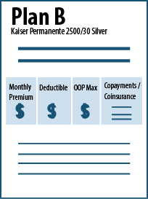
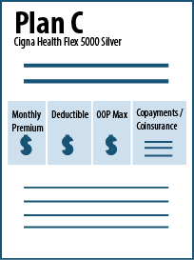

Application Process
STEP 1:
Application
STEP 2:
Determine PTC Amount
STEP 3:
Compare plans
Verification of information
Use PTC to buy a plan
Calculating the PTC

Slide 7
How is the PTC amount determined?
The PTC is not calculated based on the plan the taxpayer buys; instead, it is based on a mid-tier benchmark plan for the family, given the ages and geographic location of the people who wish to enroll.
The benchmark is the second-lowest cost silver plan in the Marketplace (SLCSP)
The PTC helps make insurance more affordable by filling the gap between the family’s contribution and the cost of the benchmark plan.
Premium Tax Credit
A benchmark is determined based on who in the family needs insurance, their ages and where they live.
The benchmark is the second-lowest cost plan available to the taxpayer in the “silver” tier of coverage in the Marketplace that would cover this family (based on age and location).
Expected Premium Contribution
The taxpayer is expected to pay some of the cost of coverage, based on their income. The more the taxpayer earns, the greater percentage of income they are expected to pay. This is called the Annual/Monthly Contribution for Health Care on Form 8962.
Total Benchmark Plan Cost

Slide 8


Calculating the PTC
PTC Varies Based on Your Benchmark
Age 24
SLCSP Premium (benchmark): $2,535
John’s Contribution: $1,480
Premium Credit: $1,055
Age 64
SLCSP Premium (benchmark): $7,606
John’s Contribution: $1,480
Premium Credit: $6,126
John:
Income: $23,340 (200% FPL)
John’s Contribution: 6.34% or $1,480
This number is based on tax family’s FPL.

Slide 9



How is a PTC claimed?
Advanced payment of the PTC are made based on the Marketplace’s determination of the taxpayer’s expected household and income (modified AGI, or MAGI) for the year during the application process.
The actual PTC is claimed on the tax return.
The credits can be taken:
In advance
  Forwarded to the insurer
  monthly to reduce premiums
or
At tax time
  Claimed as a lump
  sum at the end of the year
Reconciliation

Slide 10
Receiving Too Much or Too Little in Advance Payments of PTC
If no PTC is taken in advance, or if only a portion of the PTC is claimed in advance, the remainder may be claimed on the tax return. The PTC is refundable.
If a taxpayer receives excess PTC in advance, some or all of it must be paid back.
REPAYMENT LIMITS ON APTC
Income (as % of FPL) | SINGLE taxpayers will pay back no more than … | OTHER taxpayers will pay back no more than….
Under 200% | $300 | $600
At least 200% but less than 300% | $750 | $1,500
At least 300% but less than 400% | $1,250 | $2,500
400% and above | Full repayment | Full repayment

Slide 11
PTC at Tax Filing

Slide 12
Who Must File Form 8962
File Form 8962 if:
Any member of the tax family received PTC in advance, or
The taxpayer received advanced payment of PTC for someone they thought would be claimed as a dependent but is not claimed and no one else claims that individual’s personal exemption, or
A member of the tax family purchased insurance in the Marketplace and did not receive PTC in advance but wishes to claim it now.
If a person received any PTC in advance, they must file a tax return!

Slide 13
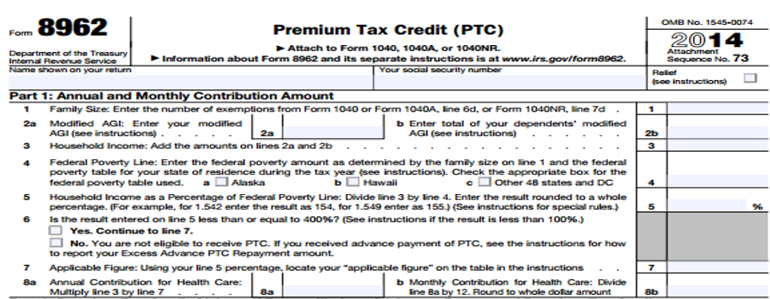
Form 8962, Part I
Family size: Taxpayer, spouse and dependents

Slide 14
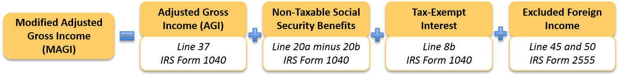
Form 8962, Part I
Modified AGI:
Include the income of a dependent in 2b only if the dependent has a filing requirement
Family size: Taxpayer, spouse and dependents

Slide 15
Form 8962, Part I
Measure income on the Federal Poverty Line scale.
Income must be above 100% but below 400% FPL
If income is below 100% FPL, PTC is allowable if:
The Marketplace estimated income above 100% at application and PTC was received in advance based on this estimate, or
Lawfully present individual is ineligible for Medicaid due to immigration status.
Modified AGI:
Include the income of a dependent in 2b only if the dependent has a filing requirement
Family size: Taxpayer, spouse and dependents

Slide 16
Form 8962, Part I
Annual contribution for health care:
The amount a family is expected to contribute toward their own premium cost
Also calculated on a monthly basis
Family size: Taxpayer, spouse and dependents

Slide 17
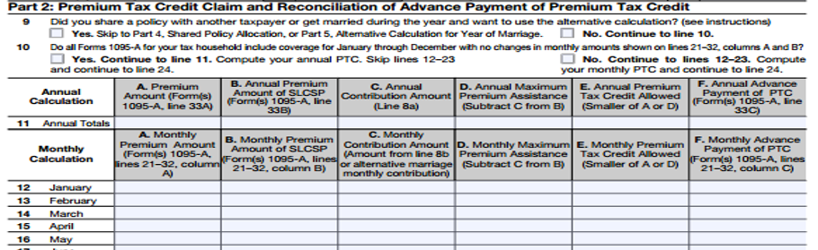
Form 8962, Part II
Line 9
Shared policies: Might happen when an older child (<26) is on the same policy as his parents but is not their dependent, or when someone was predicted to be a dependent at application but is not.
Marriage: The change in household and income can substantially change the PTC. There is a special calculation.

Slide 18
Form 8962, Part II
Line 10
Determines whether PTC can be calculated on an annual basis or must be done monthly
Most people who have PTC will need a monthly calculation

Slide 19
PTC Terminology on Form 8962
The monthly premium cost of the tax family’s insurance
The monthly benchmark premium cost for the tax family
The amount the family is expected to pay, based on their income and family size
Subtract the family’s contribution from the cost of the benchmark plan
But the PTC can’t be higher than the actual premium paid
This is the PTC that was received in advance

Slide 20
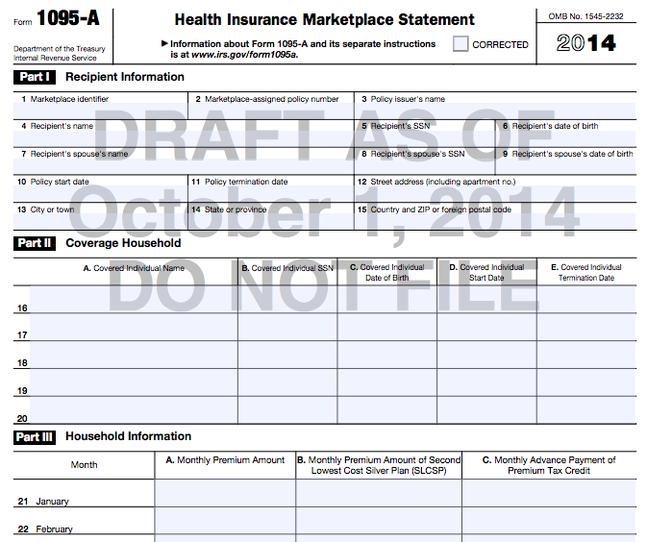
How will a tax preparer know any of this information?
What should the taxpayer do if the form is wrong?
Call the Marketplace, not the IRS!

Slide 21
Form 8962, Part II
Line 24
Total Premium Tax Credit: The credit the taxpayer is entitled to receive
Line 25
Advance Payment of PTC: The amount of PTC already received

Slide 22
Form 8962, Part II
Line 26
If Line 24 is greater than Line 25, the taxpayer will receive the excess as a payment.
If Line 25 is greater than Line 24, the taxpayer will repay some or all of the amount received in advance.

Slide 23
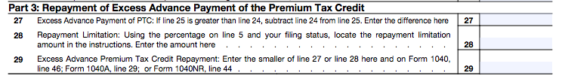
Repayment of PTC Received in Advance
REPAYMENT LIMITS ON APTC
Income (as % of FPL) | SINGLE taxpayers will pay back no more than … | OTHER taxpayers will pay back no more than….
Under 200% | $300 | $600
At least 200% but less than 300% | $750 | $1,500
At least 300% but less than 400% | $1,250 | $2,500
400% and above | Full repayment | Full repayment

Slide 24
Examples

Slide 25

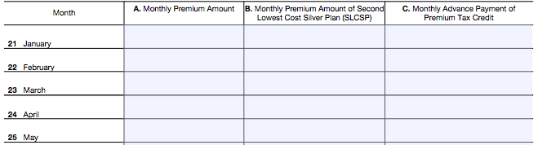
Example: John (Single Filer)
John:
Single | Modified AGI: $23,340 | Has 1095-A
John Smith
#####
Big Ins Co.
John Smith
###-##-####
2-10-90
4/1/2014
12/31/2014
$220
$211
$75
$220
$211
$75

Slide 26
Example: John (Single Filer)
1
23,340
23,340
11,490
203
.0641
1,496
125

Slide 27
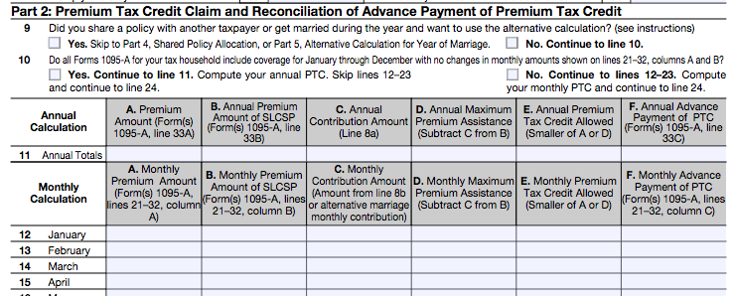

Example: John (Single Filer)
220
211
125
86
86
75
774
675
99
Enter on Form 1040, Line 69

Slide 28
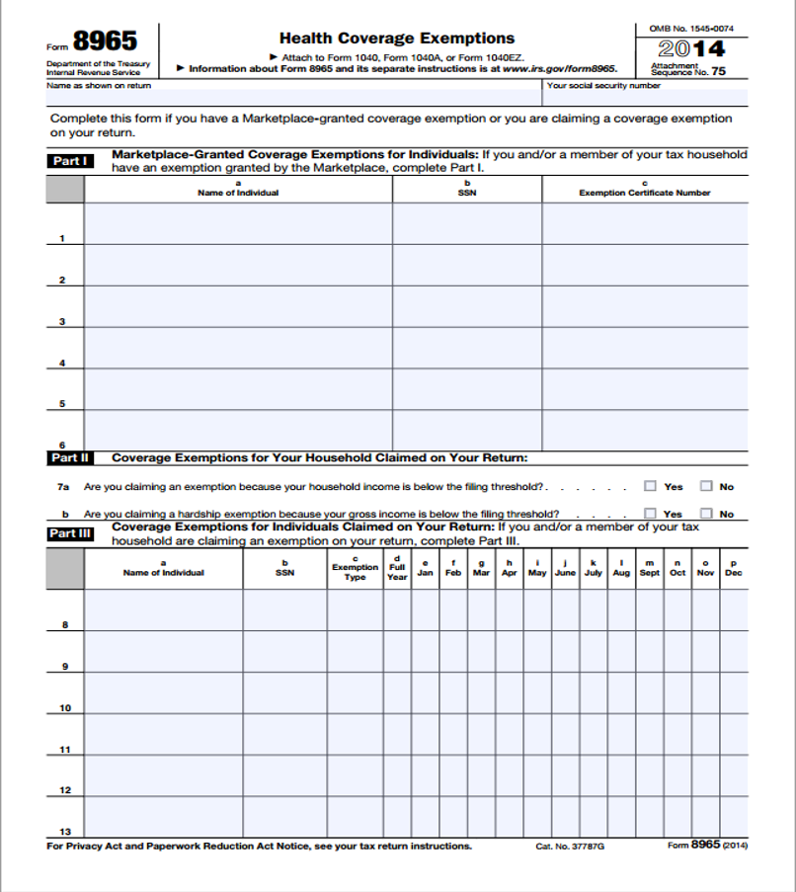
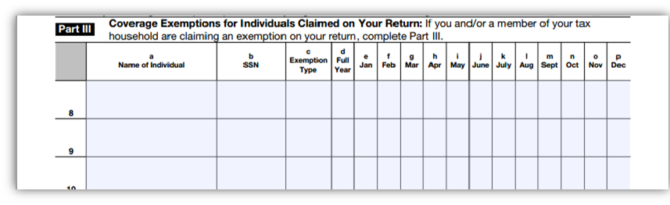
But wait…there’s more!
John only had Marketplace insurance from April to December 2014. Did he have insurance January, February and March?
If uninsured, consider exemptions:
Code G – Gap before insurance effective before May 1.
John Smith
###-##-####
G
X
X
X

Slide 29
Why Might the Projected PTC to Differ from the Final PTC
Income
  Especially people with multiple jobs, part-time work, or self-employment
Household
  Size
  Composition
Change in marital status
Filing status

Slide 30

Example: Income Higher than Initial Projection
When He Applied:
Household MAGI: $27,000 (235% FPL)
Expected contribution: 7.52% of income ($2,032)
Benchmark (SLCSP): $2,756
Projected PTC Calculation:
$2,756 (benchmark) - $2,032 (expected contribution) = $724
PTC taken in advance: $724
John wins $5,000 in a fantasy football prize league!
He doesn’t realize it’s taxable and doesn’t report the change.
On His 1040:
Household MAGI: $32,000 (279% FPL)
Expected contribution: 8.88% of income ($2,842)
Benchmark (SLCSP): $2,756
PTC calculation:
$2,756 (benchmark) - $2,842 (expected contribution)= 0
PTC: $0
Advanced payments: $724
Repayment cap: $750
Result: He needs to repay the full amount of $724.
[Calculated on Form 8962]
[Transferred from Form 1095-A to 8962, Lines 11-23, Col. B]
[Form 8962, Line 24 – Total PTC]
[Form 8962, Line 25 – Advance Payments]
[Form 8962, Line 28 – Repayment Limitation]

Slide 31

Example: Income Falls Under 100% FPL
Lisa lives with her son, Jackson. She is divorced from Jackson’s dad, David. Lisa and David alternate claiming Jackson as a dependent on their tax returns. Lisa expects David to claim their son in 2014.
When She Applied:
Family size: 1 (Lisa)
Household income: $15,400 (134% FPL for a household of 1)
Expected contribution: 3.06%
PTC Taken in Advance: $2,668
David fails to pay child support. As a result, Lisa does not permit David to claim their son as a dependent.
On Her 1040:
Family size: 2 (Lisa & Jackson)
Household income: $15,400 (99% FPL for a household of 2)
Expected contribution: 2%
PTC: $2,831
Net Premium Tax Credit: $163
Result: An additional $163 added to Lisa’s tax payments.
Lisa’s income fell below 100% FPL, but this doesn’t cause her to lose her PTC because:
She enrolled through the Marketplace
When she applied, her income was estimated at >100% FPL

Slide 32

Example: Dependent income
Jill (62) lives with Ryan, her 16-year-old grandson, and claims him as a tax dependent. She files as head of household. (Jill lives in a non-expansion state.)
$18,000 – Jill’s income
$7,000 – Ryan’s income from Social Security survivors’ benefits (not counted)
Jill is uninsured; Ryan is enrolled in Medicaid
When She Applied:
Household income: $18,000 (116% FPL for a HH of 2)
Expected contribution: 2%
PTC Taken in Advance: $6,924
Ryan works during the summer and earns $6,500! Now he has a filing requirement and all of his income is included in MAGI.
On Her 1040 (at tax time):
Household income: $31,500 (203% FPL for a HH of 2)
Expected contribution: 6.41%
PTC: $5,265
Result: Jill has a final PTC of $5,265. Because of the increase in MAGI, she received $1,659 in excess PTC. Her repayment is capped at $1,500.

Slide 33

Example : Married person, separated
Chuck is separated from his wife but not divorced. They will not file taxes together in 2015. Chuck has an adult son, Michael, who is unemployed, has no income and is living with Chuck. They both need health insurance.
When Chuck applies for Marketplace coverage:
Chuck assumes that he will qualify as Head of Household because he supports his dependent son, who plans to live with him for more than half the year, and he plans to be living apart from his wife in the last six months of 2014.
Chuck and Michael qualified for PTC and enrolled in a QHP.
At the end of the year:
Michael doesn’t qualify as Chuck’s dependent. He gets a job and earns too much to be Chuck’s dependent for the tax year.
Because his son is no longer his dependent, Chuck no longer qualifies as Head of Household. His filing status is Married Filing Separately.
What do you do?

Slide 34
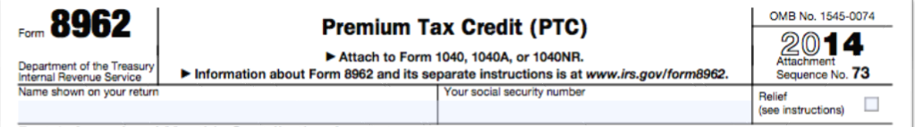
Example: Married person, separated
How do we help Chuck?
He isn’t Head of Household.
Confirm that he doesn’t qualify for an exception to the joint filing requirement
  Is he a victim of abuse? To qualify for the abuse exception, he must:
    Live apart from his spouse, and
    Be unable to file a joint return because the taxpayer is a victim of domestic abuse
  Is he abandoned? To qualify for the abandonment exception, he must:
    Live apart from his spouse
    Be unable to locate spouse after using due diligence
If he meets either qualification to take PTC despite being Married Filing Separately, check the box for “Relief” at the top of the 8962.

Slide 35
Example: Married person, separated
How do we help Chuck?
You determine that neither exception applies.
Chuck is ineligible for PTC and will need to repay it.
His repayment depends on:
  How the premium is divided between Chuck and his son, Michael, who is now a taxpayer and was also covered under the plan, and
  His repayment cap, based on income.
Allocation
  Chuck receives a 1095-A that covers him and his son.
  The benchmark (SLCSP) is for a family of two.
  As separate households now, they need to recalculate their benchmarks as separate households, so each has a benchmark for a single person.
How? Stay tuned….
Special rules come into play when:
Taxpayers marry, divorce or separate
An individual is enrolled by one taxpayer but claimed as a personal exemption by another taxpayer

Slide 36
What can a tax preparer tell a person with a repayment?
Try to determine why their advanced payment was too high:
  Did they make an error in estimating their or their dependent’s income?
  Was there an error in calculating family size?
  Do you suspect the Form 1095-A is incorrect?
  Has their filing status changed?
  Has a dependent joined or left the family?
Encourage taxpayers to take less than the maximum advance payment of PTC.
Remind taxpayers to report mid-year changes in income and family size to the Marketplace.
If the taxpayer has Marketplace coverage for 2015, encourage them to report their most recent income/dependent information to the Marketplace to prevent a repeat for tax year 2015!
  Many people who enrolled in Marketplace coverage in 2014 were auto-renewed at their 2014 PTC level. If that PTC amount was incorrect, it will be incorrect for 2015, too.

