Slide 1
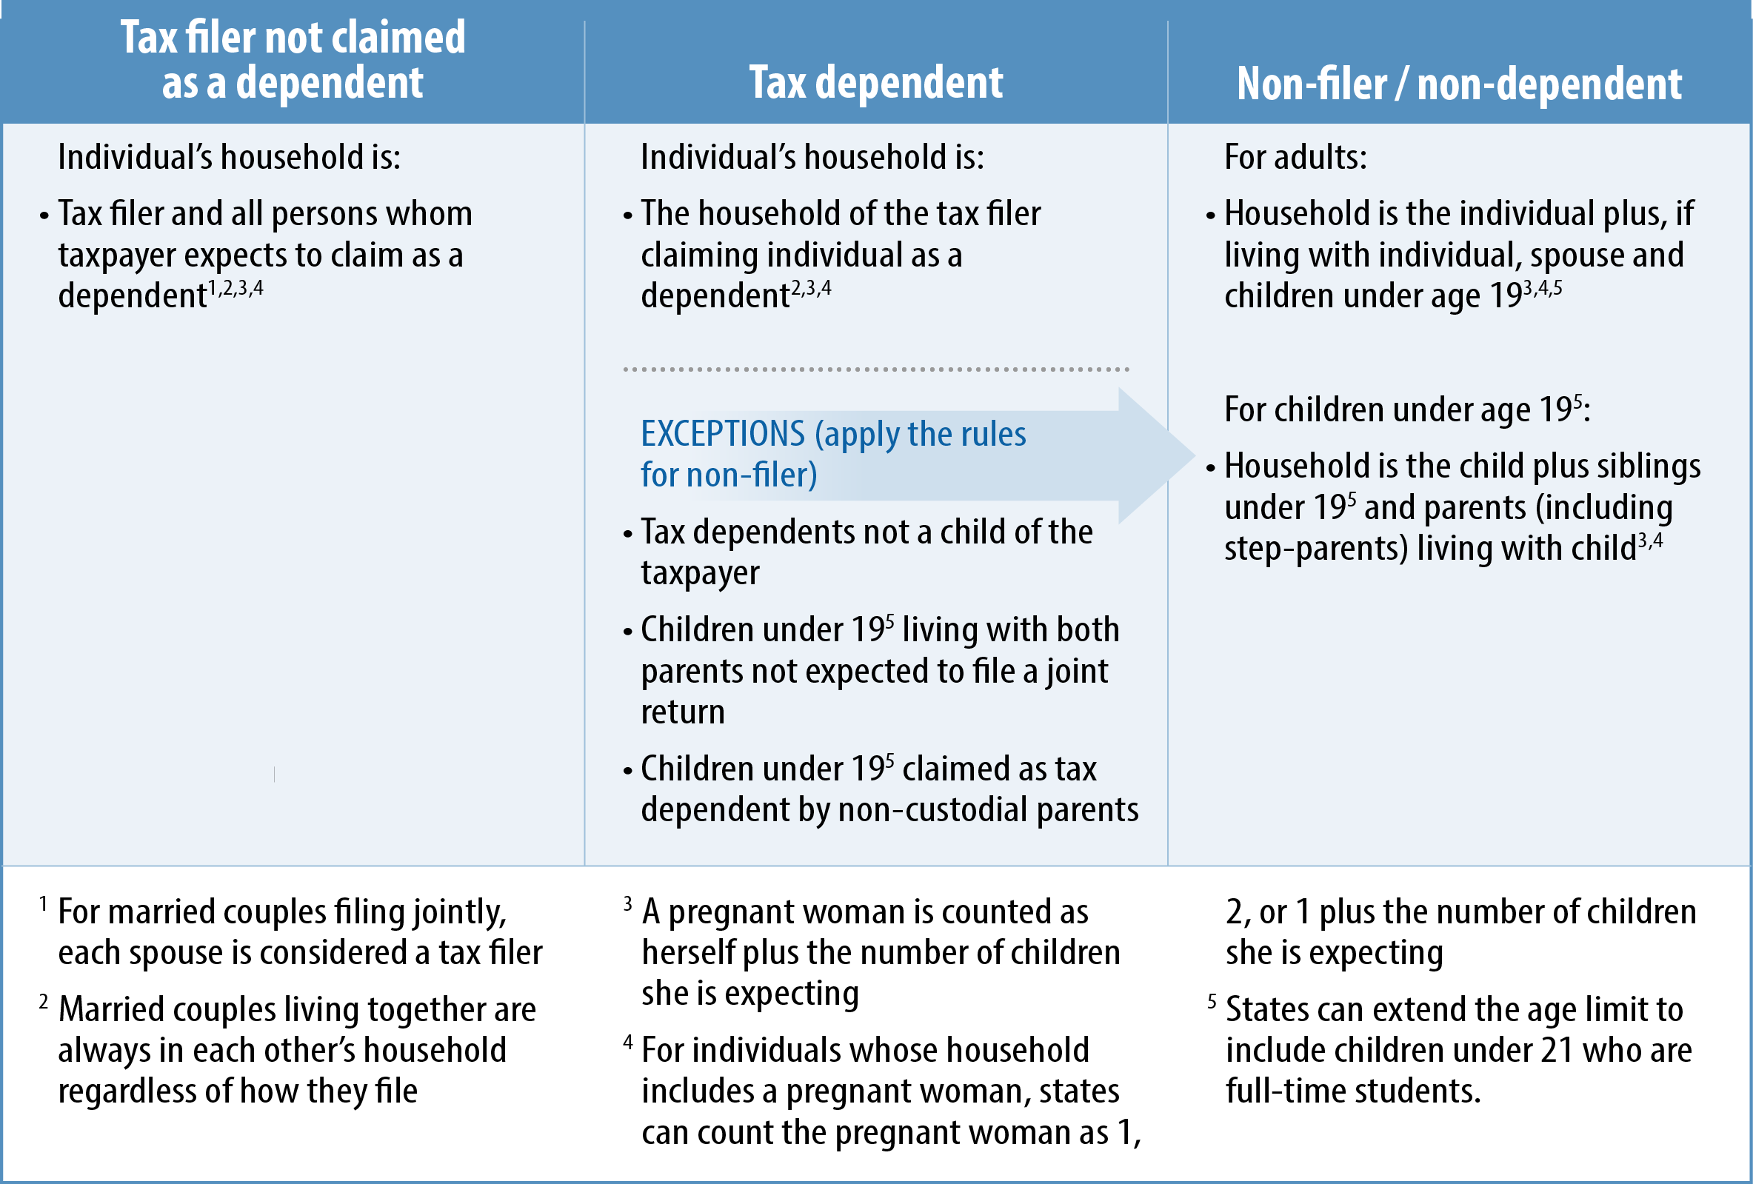
Summary of Medicaid Household Rules

