Slide 1
Part II – Exemptions & the Individual Shared Responsibility Payment
November 4, 2014

Slide 2
Steps in the Tax Return Related to the ACA
There is a requirement to have health insurance coverage starting Jan. 1, 2014. People without coverage may pay a shared responsibility payment.
 | Did everyone on the tax return have coverage all year?
YES
Step 1
NO
Go to Step 2.
 | Is anyone on the tax return eligible for an exemption from the coverage requirement for any month during the year?
Step 2
Can this exemption be granted by the IRS on the tax return?
OR
Does this exemption require approval from the Marketplace?
 | If no coverage and no exemption, calculate Individual Responsibility Payment using tax worksheet.
Step 3
 | If someone on the tax return purchased coverage in the Marketplace and qualifies for a premium tax credit, complete Form 8962.
Step 4

Slide 3
Exemptions

Slide 4
What is minimum essential coverage (MEC)?
QUALIFIES AS MEC
Employer sponsored coverage
Employee coverage
COBRA
Retiree coverage
Individual health insurance
Purchased from a health insurance company
Purchased through the Marketplace
Provided through a student health plan
Government-sponsored plans
Medicare
Most Medicaid
CHIP
Most TRICARE
Most VA
State high-risk insurance pools
Peace Corps
Refugee Medical Assistance
LIMITED BENEFITS THAT ARE NOT MEC
Single-benefit coverage (e.g., dental-only or vision-only plans)
Accident or disability insurance
Workers’ compensation
AmeriCorps/AfterCorps coverage
Limited-benefit Medicaid
Family planning services
Tuberculous treatment
Pregnancy-related
Emergency medical condition
1115 demonstrations
Medically needy
Limited-benefit TRICARE
Space-available care
Line-of-duty care
Exemption available for 2014 – no penalty

Slide 5
Who needs an exemption?
Most people have minimum essential coverage (MEC) all year
The vast majority tax filers will be able to check the box on Line 61
Each individual on the tax return who did not have MEC for the entire year should be screened for exemption eligibility
Start with the exemptions that can be claimed on the tax return
Much simpler than applying for Marketplace applications on paper!
Some exemptions cover specific months; some are good all year
Some exemptions can be claimed directly on the tax return; others need advance approval from the Marketplace
Some exemptions represent “transition relief” to help taxpayers in 2014 only

Slide 6
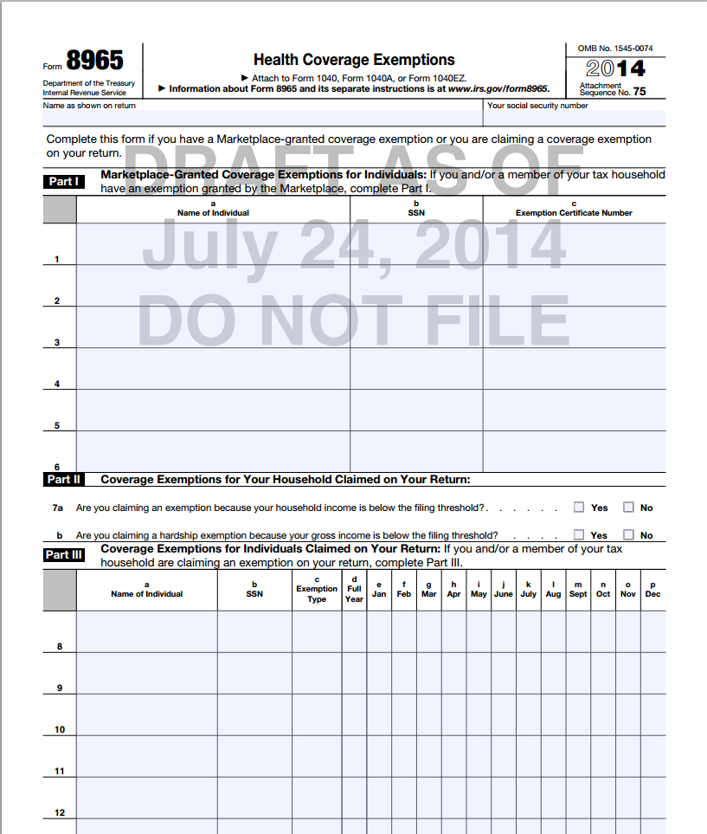
Form 8965 at a Glance
Form 8965 – Part I
Exemptions Granted by the Marketplace
Types of Exemption
Hardship (14+ types)
Member of certain religious sects
Incarceration*
Membership in a Federally-recognized Indian tribe*
In general, taxpayers must apply for these exemptions via paper application.
People who were granted an exemption will receive an ECN (exemption certificate number), a 6 digit letter/number code, that must be entered on Form 8965.
*Can also be claimed directly on the tax return!

Slide 7
Form 8965 at a Glance
Form 8965 – Part II
Coverage Exemptions for Your Entire Household
Type of Exemption
Household income below filing threshold
Gross income below filing threshold
Expect tax software to calculate this
This is the only exemption that applies to the entire household for the entire year
The taxpayer does not need to file a return just to claim a coverage exemption if not otherwise required to file and income is below filing threshold

Slide 8
Form 8965 at a Glance
Form 8965 – Part III
Coverage Exemptions for Individuals on Your Return
Types of Exemption
Insurance is unaffordable (>8% of income)
Certain noncitizens
Short coverage gap (< 3 months)
Months prior to effective date of MEC that is effective on or before May 1, 2014
Incarceration
Membership in a Federally-recognized Indian tribe or eligibility for services of Indian Health Service
Transition relief for 2014 for certain limited benefit and non-calendar year plans
People who are eligible for an exemption from the IRS will enter an exemption type (A-G).

Slide 9
Types of Exemptions
Does the taxpayer already have an exemption from the Marketplace?
YES
Enter on Form 8965, Part I
NO
Does the taxpayer have income below the filing threshold?
Applies to the entire household for the entire year.
YES
Enter on Form 8965, Part II
NO
Exemptions for individuals (duration varies):
Exemptions for individuals that have a limited duration:
Exemption | IRS Code
Certain noncitizens and citizens living abroad | Code C
Health care sharing ministry | Code D
Federally-recognized Indian tribe or eligible for IHS | Code E
Limited benefit Medicaid | Code H
Incarceration | Code F
Insurance is unaffordable | Code A
Aggregate cost of insurance is unaffordable | Code G
Individuals in a state that did not expand Medicaid | Code G
Exemption | IRS Code
Short coverage gap | Code B
Coverage by May 1 or “in-line” | Code G
Non-calendar year coverage | Code H
NO
NO
Does anyone qualify for a Marketplace hardship exemption?
YES
Enter on Form 8965, Part I
apply

Slide 10
Exemptions for the Household
Part II of Form 8965

Slide 11
Income Below Tax Filing Threshold
Line 7a: Household income below filing threshold
What is household income?
Household income is modified adjusted gross income (MAGI) for each individual on the tax return with a tax filing requirement.
Include dependent income if dependent has a filing requirement
For exemptions and individual responsibility payment:
Line 7b: Gross income below filing threshold
What is gross income?
Gross income is all income received from all sources (unless exempt from tax)
Include the taxable portion of social security benefits and income (but not losses) on Schedules C, D or F.
Do not include income of dependents with a filing requirement.
Part II: Filing Threshold

Slide 12
Income Below Tax Filing Threshold
Who should claim this exemption?
A taxpayer that does not have a filing requirement and does not file gets the exemption automatically for everyone properly claimed on the tax return
There is no need to file only to report health coverage or claim the exemption
A taxpayer that does not have a filing requirement but chooses to file anyway should file a Form 8965 if one or more people on the tax return are uninsured
A taxpayer that has a tax filing requirement should report coverage and check for exemption eligibility in Parts I or III of Form 8965
A dependent with a filing requirement doesn’t need to report coverage, exemptions or individual responsibility payment
Part II: Filing Threshold

Slide 13
Exemptions for Individuals
Part III of Form 8965

Slide 14
Part III – Exemptions for Individuals Claimed on the Return
A-H
Mark applicable months
Sonia Reyes
111-22-3333
B
X X
Part III: Exemptions Granted on Return

Slide 15
Individuals in a State that Did Not Expand Medicaid (Code G)
New!
as of 11/21/14
This exemption applies to:
Individuals who resided at any time during the year in a state that did not expand Medicaid, and
Had income below 138% FPL (i.e., would have been eligible for Medicaid if the state had expanded).
Available on the return in 2014 only. In future years, must apply for (and be denied) Medicaid to claim this exemption!
Example
Rashid was uninsured for all of 2014. His wife, Miriam, had insurance all year through work. Leila was born in November, was covered by Medicaid. Their household income was $25,000 (128% FPL for a family of 3) and they live in Texas, a non-expansion state. They are all U.S. citizens.
Does Rashid qualify for an exemption?
Yes, Rashid’s household income is below 138% FPL and he lived in a non-expansion state. Rashid qualifies for this exemption for the entire year even if he had other insurance options, such as coverage through his wife’s employer or insurance in the Marketplace with PTC.

Slide 16
U.S. Citizens Living Abroad and Certain Noncitizens (Code C)
This exemption applies to:
Individuals who are not U.S. citizens, U.S. nationals or lawfully present (i.e., undocumented immigrants)
1040NR (or 1040NR-EZ) filers
Individuals who are residents of U.S. territories
U.S. citizens or residents who are absent from the U.S. for at least 330 full days within a 12-month period
U.S. citizens who are bona fide residents of another country for the entire tax year.
Example
Fatima has an ITIN and files taxes but she is not lawfully present in the U.S. Her husband and daughter are U.S. citizens
Fatima Diallo
999-11-1111
C
X
Part III: Exemptions Granted on Return

Slide 17
Short Coverage Gap (Code B)
Short coverage gap (< 3 months)
If the coverage gap is 3 months or longer, none of the months in the gap qualify for exemption.
If there are multiple gaps in a year, only the first gap qualifies.
Example
John doesn’t have insurance in January, February or March.
He gets a new job in March and his insurance starts April 1.
John is uninsured.
April 1
Coverage Begins
JAN
MAR
APR
John does not qualify for the exemption for a short coverage gap because the gap is not less than three full calendar months.
Part III: Exemptions Granted on Return

Slide 18
Coverage Gap Prior to Obtaining MEC (Code G)
Coverage gap prior to obtaining MEC that is effective by May 1, 2014
For a person who enrolls in Marketplace coverage, Medicaid or CHIP, or other individual or group insurance with an effective date on or before May 1, 2014, or
For people who were “in line” for Marketplace coverage at the end of open enrollment, even if their coverage effective date was after May 1.
Example
John doesn’t have insurance in January, February or March.
He gets a new job in March and his insurance starts April 1.
April 1
Coverage Begins
John is uninsured.
JAN
MAR
APR
John qualifies for an exemption for months prior to the effective date of MEC that is effective on or before May 1.
Part III: Exemptions Granted on Return

Slide 19
Non-Calendar Year Employer-Sponsored Plan (Code H)
Exemption is available if:
The person was eligible for, but did not enroll in, coverage offered by an employer, and
The coverage began in 2013 and ended in 2014
Available for 2014 only
Example
John’s employer offers health coverage with a plan year of July 1 – June 30.
John is offered coverage starting July 1, 2013 and turns it down. He is uninsured.
John is eligible for this exemption (Code H) for January – June 2014.
Part III: Exemptions Granted on Return

Slide 20
Exemption for Particular Individuals
Exemption for incarcerated individuals (Code F or Marketplace exemption)
Can be claimed for any months someone on the tax return was incarcerated for at least one day in the month
What is incarceration?
Confinement in a jail, prison or similar penal institution or correctional facility
Does not include time in jail pending disposition of charges (being held but not convicted of a crime)
Does not include time in probation, parole, or home confinement
Reminder:
Some exemptions can be claimed either from the Marketplace or on the tax return.
If someone already has a Marketplace exemption in hand, use it on Form 8965.
If not, claim the exemption directly on the tax return rather than attempting to get the same exemption through the Marketplace.
Part III: Exemptions Granted on Return

Slide 21
Exemption for Particular Individuals
Exemptions based on religion
Members of a health care sharing ministry (Code D or Marketplace exemption)
Members of certain religious sects (Marketplace exemption)
Exemptions based on Indian tribe affiliation
Members of a Federally-recognized Indian tribe (Code E or Marketplace exemption)
An American Indian, Alaska Native, spouse or dependent of either who is eligible for services through the Indian Health Services (Code E or Marketplace exemption)
Part III: Exemptions Granted on Return

Slide 22
Limited Benefit Medicaid and TRICARE (Code H)
Some government coverage options are not MEC because they offer limited benefits
Exemptions are available for:
Family planning services Medicaid
Pregnancy-related services Medicaid
Tuberculosis-related services Medicaid
Emergency medical condition Medicaid
Section 1115 Medicaid (limited-benefit coverage provided in some states to people who were not eligible for comprehensive Medicaid)
Medicaid for the medically needy (requires beneficiaries to “spend down” income into Medicaid range by paying for medical expenses)
Limited-benefit TRICARE coverage for space-available care
Limited-benefit TRICARE coverage for line-of-duty care
Part III: Exemptions Granted on Return

Slide 23
Coverage is Unaffordable (Code A)
In many cases, this is the most complex exemption to claim
Because of this, consider using this exemption only when no other exemption applies.
For insurance to be unaffordable, the cost of coverage must exceed 8 percent of household income.
Household income:
The key is understanding which plan cost to measure against household income
Part III: Exemptions Granted on Return

Slide 24
Coverage is Unaffordable (Code A)
Which plan cost should be compared to household income?
Is the taxpayer or family member eligible for coverage through an employer?
Does the taxpayer or family member have no offer of employer-sponsored coverage?
As an employee?
If yes, does the lowest-cost bronze Marketplace plan for all uninsured, nonexempt members of the tax household cost more than 8% of household income?
Find the lowest cost bronze plan at the Marketplace
Account for any PTCs the person would have been eligible to receive
If yes, does the lowest-cost self-only plan cost more than 8% of household income?
Enter Code A for each applicable month
As a member of the employee’s family?
If yes, does the lowest-cost plan that covers everyone on the return who is eligible for coverage and is not otherwise exempt cost more than 8% of household income?
Enter Code A for each applicable month
Do two or more family members have offers of employer coverage?
(1) Individual coverage offers are affordable but (2) their combined cost is greater than 8% of income and (3) no family coverage is offered for less than 8% of income?
Enter Code G for the entire year
Part III: Exemptions Granted on Return

Slide 25
Coverage is Unaffordable (Code A)
Which plan cost should be compared to household income?
What information does the taxpayer need?
For employer offer: The employee premium for the lowest cost employee or family plan (as applicable) offered during the 2014 plan year(s)
For no employer offer: The lowest cost bronze plan in the Marketplace after subtracting the amount of PTCs a person would be eligible to receive
The problem: This information may be hard to obtain
Part III: Exemptions Granted on Return

Slide 26
Example: Affordability Exemption
Sonia Reyes is offered health insurance at work but she doesn’t accept it.
Household Income: $47,000
Sonia’s premium for employee-only plan:
$196/month ($2,350/year)
5% of income
Sonia’s premium for employee plus children:
$392/month ($4,700/year)
10% of income
No spousal coverage is offered
Do Sonia or her family qualify for exemptions based on affordability?
Part III: Exemptions Granted on Return

Slide 27
Example: Affordability Exemption
Test for Sonia (an employee with an offer of ESI)
Household Income: $47,000
Sonia’s premium for employee-only plan: $2,350/year (5% of income)
Sonia’s premium for employee plus children: $4,700/year (10% of income)
No spousal coverage is offered
Does the lowest-cost plan that covers only the employee cost more than 8% of household income?
No, the lowest cost employee-only plan is 5% of income. The plan is considered affordable. Sonia does not qualify for exemption on the basis of affordability.
Part III: Exemptions Granted on Return

Slide 28
Example: Affordability Exemption
Test for the kids (family members with an offer of ESI)
Household Income: $47,000
Sonia’s premium for employee-only plan: $2,350/year (5% of income)
Sonia’s premium for employee plus children: $4,700/year (10% of income)
No spousal coverage is offered
Does the lowest-cost plan that covers the kids cost more than 8% of household income?
Yes, the kids are eligible for an exemption because the cost of coverage is greater than 8% of household income.
On Form 8965, the kids will be listed in Part III and Code A will be entered for each month.
What about Medicaid or CHIP?
The children may be eligible for Medicaid or CHIP, but eligibility for those programs is not taken into account in awarding this exemption.
Part III: Exemptions Granted on Return

Slide 29
Example: Affordability Exemption
Test for Gilberto (a person without an offer of ESI)
Household Income: $47,000
Sonia’s premium for employee-only plan: $2,350/year (5% of income)
Sonia’s premium for employee plus children: $4,700/year (10% of income)
No spousal coverage is offered
Does the lowest-cost bronze plan covering only Gilberto in the Marketplace, after accounting for premium tax credits, cost more than 8% of household income?
His lowest cost bronze plan is $2,000 (4% of household income), taking into account premium tax credits. The plan is considered affordable. He is not eligible for this exemption.
Part III: Exemptions Granted on Return

Slide 30
Exemption: Aggregate Cost of Coverage
Bob and Joan have jobs that offer health coverage to the employee only.
Household Income: $45,000
Premium cost for Bob: $2,400/year 5.3% of income
Premium cost for Joan: $2,100/year 4.6% of income
Aggregate cost: $4,500/year 10% of income
Neither is offered family coverage that would cover them both for less than 8% of income
They can claim the Code G exemption because the total cost of coverage exceeds 8% of income.
Part III: Exemptions Granted on Return

Slide 31
Marketplace Exemptions

Slide 32
Why apply for an exemption through the Marketplace?
A list of exemptions are available from the Marketplace but most are either:
Duplicative of exemptions that can be claimed directly on the tax return, or
Aren’t available retrospectively
At the time of tax filing in 2015, three types of exemptions will be available through the Marketplace:
Religious conscience
Members of religious sects that object to insurance coverage, including Medicare and Social Security (e.g., Mennonite, Amish)
Membership in an Indian Tribe (also available on the tax return)
Hardship
Many categories of hardship
Part I: Exemptions from the Marketplace

Slide 33
Marketplace Exemptions: Hardship
Hardship Exemptions Granted by Marketplace | Duration
Financial or domestic circumstances Homelessness Eviction in the last 6 months or facing eviction or foreclosure Utility shut-off notice Domestic violence Recent death of a close family member Disaster that resulted in significant property damage Bankruptcy in the last 6 months Debt from medical expenses in the last 24 months High expenses caring for ill, disabled or aging relative Failure of another party to comply with a medical support order for a dependent child who is determined ineligible for Medicaid or CHIP Through an appeals process, determined eligible for a Marketplace QHP, PTC, or CSR but was not enrolled Determined ineligible for Medicaid because the state did not expand Individual health insurance plan was cancelled and you believe Marketplace plans are considered unaffordable Other hardship in obtaining coverage (including for people in AmeriCorps, VISTA and NCCC who are enrolled limited duration or self-funded coverage)
At least one month before and after hardship
When to Apply
Up to 3 years after the month of the hardship (but documentation is required in most circumstances so earlier is better)
Part I: Exemptions from the Marketplace

Slide 34
Marketplace Exemptions: Hardship #12
Update 11/21/14
A taxpayer can still apply for this exemption through the Marketplace (below) but it can also be claimed directly on the tax return as a Code G hardship by a person who lived in a non-expansion state and had household income below 138% FPL. People who meet these criteria can claim the exemption on their tax returns even if they did not apply for Medicaid and receive a denial in 2014.
Ineligible for Medicaid based on state decision not to expand
Available to low-income adults (<138% FPL)
To receive this exemption from the Marketplace, the taxpayer must:
Have applied for Medicaid before December 31, 2014, and
Be denied Medicaid because the state did not expand coverage
Problem: Few people understood that a denial was required in order to get the exemption from the Marketplace
For those who did apply for and were denied Medicaid:
Many will receive an automatic exemption without applying for the exemption at the Marketplace
A person will not get an automatic exemption if he or she:
Applied directly at the state Medicaid agency instead of the Marketplace
Applied at the Marketplace but had income above the poverty line
Part I: Exemptions from the Marketplace

Slide 35
Applying for a Hardship Exemption
Consider a Marketplace exemption if a member of the household is:
Uninsured for one or more months, and
Not eligible for an exemption that is claimed directly on the tax return.
A Marketplace exemption application must be printed, completed and mailed
Processing takes 2+ weeks (may be significantly longer)
Should I Make a Referral to Complete a Hardship Application?
A referral to a health care assister is one option but it causes additional delay
Consider helping the client complete the hardship application at your tax site
No special health care knowledge is needed. Application requires:
Name and contact info
Dependents
Documentation of exemption
Taxpayer’s signature
Hardship application
https://marketplace.cms.gov/applications-and-forms/hardship-exemption.pdf
Part I: Exemptions from the Marketplace

Slide 36
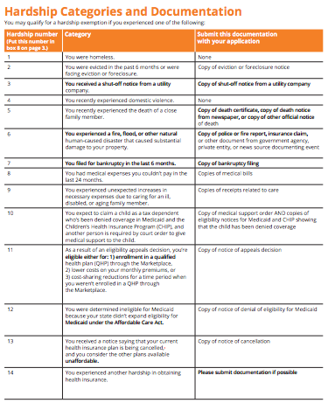
Applying for a Hardship Exemption
Most hardship exemptions require documentation of the hardship.
E.g., Hardship of utility shut-off requires a copy of the shut-off notice
Note:
The exemptions claimed on the tax return apply to both the FFM and state-run marketplaces.
For exemptions that must be approved by the Marketplace, the FFM is processing exemptions for all states except Connecticut.
Part I: Exemptions from the Marketplace

Slide 37
Types of Exemptions
Does the taxpayer already have an exemption from the Marketplace?
YES
Enter on Form 8965, Part I
NO
Does the taxpayer have income below the filing threshold?
Applies to the entire household for the entire year.
YES
Enter on Form 8965, Part II
NO
Exemptions for individuals (duration varies):
Exemptions for individuals that have a limited duration:
Exemption | IRS Code
Certain noncitizens and citizens living abroad | Code C
Health care sharing ministry | Code D
Federally-recognized Indian tribe or eligible for IHS | Code E
Limited benefit Medicaid | Code H
Incarceration | Code F
Insurance is unaffordable | Code A
Aggregate cost of insurance is unaffordable | Code G
Individuals in a state that did not expand Medicaid | Code G
Exemption | IRS Code
Short coverage gap | Code B
Coverage by May 1 or “in-line” | Code G
Non-calendar year coverage | Code H
NO
NO
Does anyone qualify for a Marketplace hardship exemption?
YES
Enter on Form 8965, Part I
apply

Slide 38
Individual Shared Responsibility Payment (ISRP)
aka Individual Responsibility Payment
aka “Penalty”

Slide 39
Individual Shared Responsibility Payment (ISRP)
Year | Full-year payment is greater of:
2014 | 1% of income above tax filing threshold (up to cap*) | $95 per adult, $47.50 per child (up to cap of $285)
2015 | 2% of income above tax filing threshold (up to cap*) | $325 per adult, $162.50 per child (up to cap of $975)
2016 | 2.5% of income above tax filing threshold (up to cap*) | $695 per adult, $347.50 per child (up to cap of $2,085)
> 2016 | Values increased by a cost-of-living adjustment
* Capped at national average premium of a bronze level plan purchased through a Marketplace. For 2014, the cap is $2,448 per individual ($204 per month per individual), with a maximum of $12,240 for a family with five or more members ($1,020 per month for a family with five or more members).
REMINDER

Slide 40
Calculating the ISRP– Partial Year Coverage
The ISRP is prorated for the number of months without coverage during the tax filing year
Uninsured and not eligible for exemption
Gets a job with employer coverage
Jan | Feb | Mar | Apr | May | Jun | Jul | Aug | Sep | Oct | Nov | Dec
Without coverage for 7 months
ISRP = 7/12 of annual calculation

Slide 41
Example: John (Single)
Income: | $17,000 (148% FPL)
Filing Status: | Single
Adults: | 1
Children: | 0
Tax Filing Threshold: | $10,150
Months Uninsured: | 12
Penalty Calculation:
1. $17,000 - $10,150 =
2. $95 x 1 adult =
$6,850
x 1%
$68.50
$95.00
ISRP for 2014

Slide 42
Calculating the ISRP - Single
= ISRP amount in 2014
$19,950
(household income)
Tax Payment (in 2014)
$10,150
(household income)
1% of income
$95
no penalty
no penalty
Household Income

Slide 43
Calculating the ISRP - Married Filing Jointly with 1 child
= ISRP amount in 2014
$43,050
(household income)
Tax Payment (in 2014)
$20,300
(household income)
1% of income
$237.50
($95 x 2 adults
+ $47.50 x 1 child)
no penalty
no penalty
Household Income

Slide 44
Example: Reyes Family (Married Filing Jointly)
Income: | $39,500 (168% FPL)
Filing Status: | Married, filing jointly
Adults: | 2 (both uninsured)
Children: | 2 (both uninsured)
Tax Filing Threshold: | $20,300
Months Uninsured: | 12
ISRP Calculation:
1. $39,500 - $20,300 =
2. $95 x 2 adults
+ $47.50 x 2 children =
$19,200
x 1%
$192.00
$285.00
ISRP for 2014

Slide 45
Example: Reyes Family (Married Filing Jointly)
Income: | $39,500 (168% FPL)
Filing Status: | Married, filing jointly
Adults:
Children:
2 (one insured)
2 (both insured)
Tax Filing Threshold: | $20,300
Months Uninsured: | 12
ISRP Calculation:
1. $39,500 - $20,300 =
2. $95 x 1 adults =
$19,200
x 1%
$192.00
$95.00
ISRP for 2014

Slide 46
Resources
Exemptions
IRS Coverage Exemption Table (with descriptions)
http://www.irs.gov/uac/ACA-Individual-Shared-Responsibility-Provision-Exemptions
Draft Form 8965
http://www.irs.gov/pub/irs-dft/f8965--dft.pdf
Draft Instructions for Form 8965
http://www.irs.gov/pub/irs-dft/i8965--dft.pdf
Marketplace exemption information and applications
https://www.healthcare.gov/fees-exemptions/fees-exemptions-overview/
Shared Responsibility
IRS – Affordable Care Act Resources
www.irs.gov/aca
IRS – Shared Responsibility Resources
http://www.irs.gov/uac/Individual-Shared-Responsibility-Provision

