Slide 1
Part I: Basic Certification Topics
Current as of October 26, 2015

Slide 2
Agenda
Basic Certification Topics
What’s New for TY 2015
VITA/TCE Scope and Intake Form for TY 2015
Minimum essential coverage (MEC)
Forms 1095-B and 1095-C
Coverage Exemptions
Shared Responsibility Payment (SRP)
Upcoming Presentations
  Nov. 2 – Advanced Certification Topic: Premium Tax Credit
  Nov. 9 – Comprehensive Examples and TaxWise Updates

Slide 3

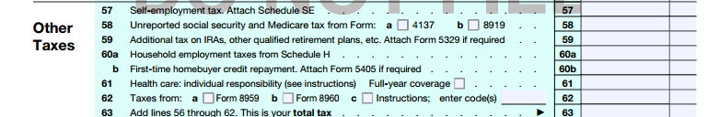

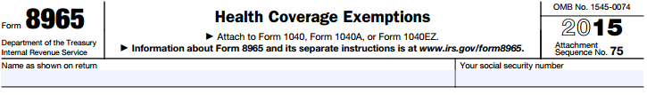

Shared Responsibility Payment - Overview
Report Health Coverage

Claim Exemption from Coverage Requirement
Make Shared Responsibility Payment
325

Slide 4
2014: VITA/TCE Tax Year in Review (Shared Responsibility)
Per TaxWise report of 3.3 million VITA/TCE returns:
Average SRP Payment of $ 131
405K total exemptions claimed (multiple/return)
Some SRP returns qualified for exemptions:
  Income below filing threshold
  Dependent Returns

Slide 5
2014: VITA/TCE Tax Year in Review (Premium Tax Credit)
Per TaxWise report of 3.3 million VITA/TCE returns:
2.74% of returns included Form 8962
2014 was the first year of APTC reconciliation:
  Additional net credit average $664
  Average excess APTC repayment $586
IRS granted administrative relief for:
  Erroneous 1095-A data
  Waiver of penalties related to repayment of excess APTC
Note: In July-August 2015, the IRS sent reminder notices to taxpayers who received Form 1095-A reminding them of the requirement to file a 2014 Form 1040/8962 to reconcile Advance Payments of the PTC . This is important to remain eligible for APTC in 2016.

Slide 6
What’s New for TY 2015

Slide 7
What’s New in TY 2015
New VITA/TCE scope
  The premium tax credit is now an advanced topic. Complex premium tax credit situations (shared policy allocations and alternative year of marriage calculation) are out of scope.
Anticipated TaxWise changes
  Revised ACA Worksheet
  New ACA affordability exemption worksheet
New Reporting Statements: Forms 1095-B and 1095-C
  Entities that issue health insurance coverage and large employers are required to provide enrollees and the IRS with tax forms that report monthly coverage information.
  New, so errors likely

Slide 8
What’s New in TY 2015
Coverage Exemptions - Updates
  2014 “Transitional” exemptions no longer in effect
    Gap in coverage before May 1
    Employer coverage with coverage year starting in 2013
    Limited-benefit Medicaid (still available for some types of Medicaid coverage but requires Marketplace application for exemption)
  New exemption
    Months not covered due to birth, adoption or death during the year
2015 Shared Responsibility Payment
  The higher of: $325/adult or 2% of income above filing threshold.*
    *Flat amount capped at $975; percentage of income capped at national average LCBP

Slide 9
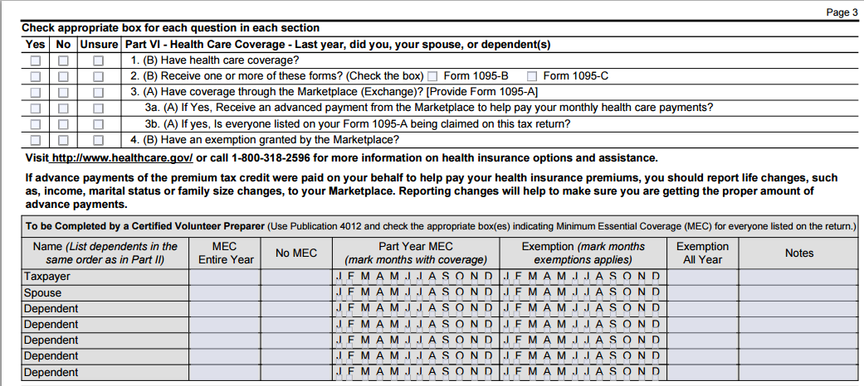
New ACA Questions on the Intake Sheet

Slide 10
Minimum Essential Coverage (MEC)

Slide 11
Minimum Essential Coverage (MEC)
QUALIFIES AS MEC
Employer sponsored coverage
  Employee coverage
  COBRA
  Retiree coverage
Individual health insurance
  Purchased from a health insurance company
  Purchased through the Marketplace
  Provided through a student health plan
Government-sponsored plans
  Medicare
  Most Medicaid
  CHIP
  Most TRICARE
  Most VA
  State high-risk insurance pools
  Peace Corps
  Refugee Medical Assistance
LIMITED BENEFITS THAT ARE NOT MEC
  Single-benefit coverage (e.g., dental-only or vision-only plans)
  Accident or disability insurance
  Workers’ compensation
  AmeriCorps/AfterCorps coverage
  Medicaid coverage that does not provide comprehensive benefits
Some people are eligible for a Marketplace exemption
Remember! Coverage for one day of the month is enough to fulfill the coverage requirement for the entire month

Slide 12
FAQs on Minimum Essential Coverage (MEC)
Who does the coverage requirement apply to?
The taxpayer, spouse and anyone who is or could be claimed on the tax return as a dependent.
How do I know if coverage is MEC?
Most coverage is MEC and reported on Form 1095 series (A,B,C)
Consult Form 8965 Instructions for detailed table
How do I verify that a person was covered?
Taxpayers may have evidence of coverage (e.g. insurance card or Form 1095).
Tax preparers are not required to see evidence of coverage to verify that each individual was insured. The interview is often sufficient.
Taxpayers are responsible for accuracy of information reported on the return (e.g. return signed under penalty of perjury).
Since 1095-B or 1095-C are new forms, they may be prone to error.

Slide 13
Forms 1095-A/B/C
Form 1095-A
Form 1095-A
Issued by the Marketplace to people who enrolled in Marketplace coverage.
Necessary to prepare Form 8962, which is required for people who received Advance Premium Tax Credits
Corrections? Call the Marketplace that issued the form
Form 1095-B
Form 1095-B
Issued by Medicaid, Medicare, insurers, and others who offer coverage.
Individuals with coverage should receive this form.
Useful in determining the months a person had coverage.
Form 1095-C
Form 1095-C
Issued only by large employers (employers with 50 or more full-time EEs)
Useful in determining the months a person had coverage or an offer of coverage and the cost of the offer of coverage. (May be helpful to calculate the affordability exemption.)
Serves a dual purpose in (1) confirming that a taxpayer had coverage and (2) helping IRS determine whether an employer owes a shared responsibility payment for failure to offer affordable coverage.

Slide 14
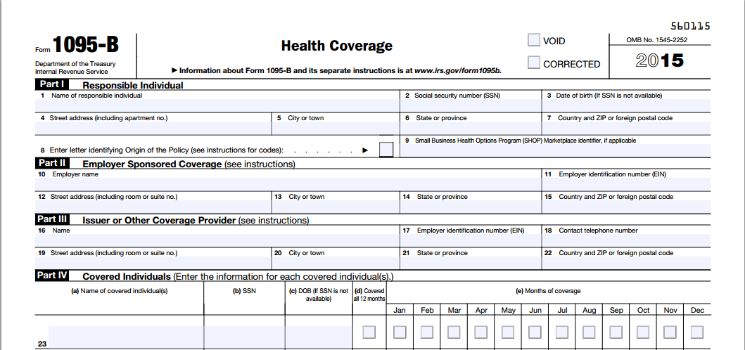
Form 1095-B
One of these sections will be completed
Each covered family member will be listed
Either the SSN or date of birth will be listed (no need to validate its accuracy)
Full year/months covered

Slide 15
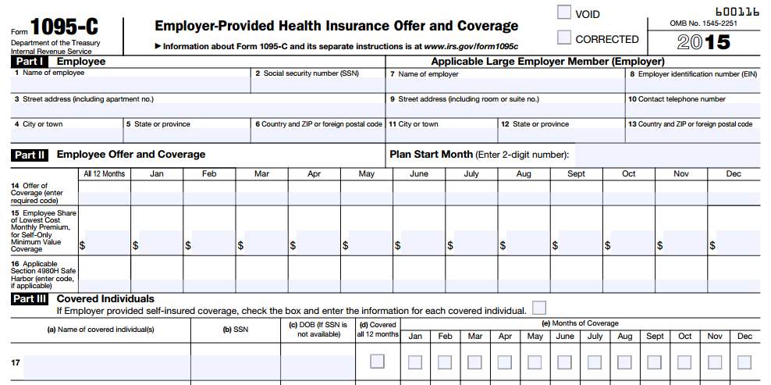
Form 1095-C
Cost of an offer of coverage – Can be used to determine whether the employee is eligible for an affordability exemption if they did not accept coverage
Each covered family member will be listed
Either the SSN or date of birth will be listed (no need to validate its accuracy)
Full year/months covered

Slide 16
Handling Missing or Incorrect 1095s
Form 1095-A
Necessary to prepare Form 8962. Taxpayers receiving APTC are required to file.
Get corrections before filing. Sometimes these are given over the phone.
Note: If the SLCSP is missing or incorrect, use the SLCSP tool on healthcare.gov to find the correct plan cost. Print out the result page for the taxpayer’s records. Enter the correct SLCSP in TaxWise.
Form 1095-B and 1095-C
If a person is insured but does not receive either 1095-B or -C, he or she should ask the insurance issuer whether one will be sent. If not, prepare the return based on client’s interview and attestation.
If a person received the form but doesn’t bring it to the tax site, prepare the return based on client’s interview and attestation. The client should be aware that the form may be needed in case of audit.
If someone received the form and it is incorrect, contact the issuer for a correction. File the return based on the client’s attestation. The client is not required to wait for a correction. The IRS plans to match data after filing, so pursuing a correction is important.

Slide 17
Entering MEC on the Intake Sheet and in TaxWise
13614-C
The TaxWise ACA Worksheet is also changing – details to follow
Note:
  Form 13614-C asks the preparer to mark months with coverage and/or months with exemption.
  Like last year, TaxWise is likely to ask for months with penalty.

Slide 18
Exemptions

Slide 19
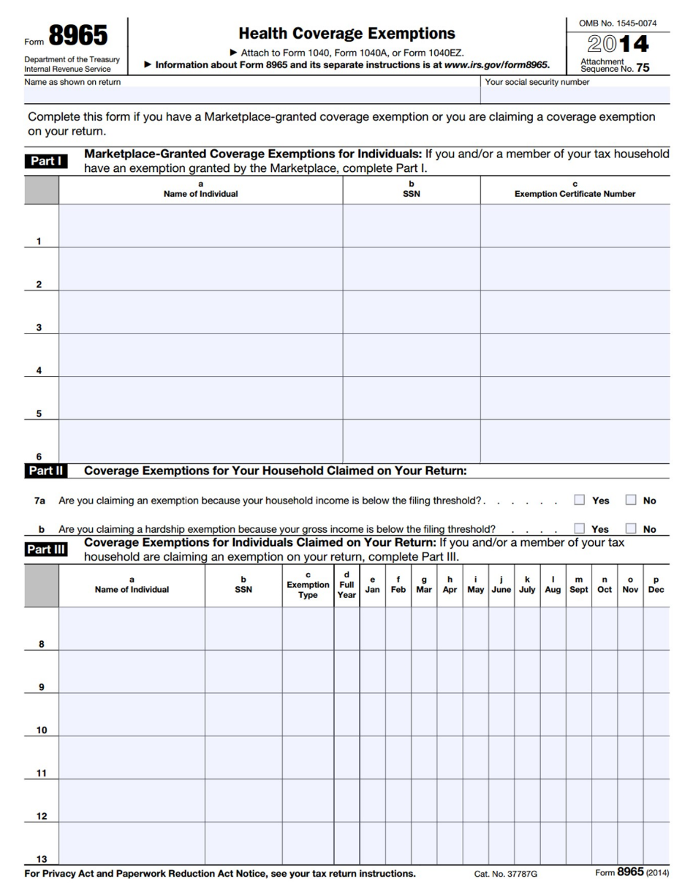
Exemptions from the Coverage Requirement
Two Types of Exemptions:
All exemptions must be claimed at tax filing on Form 8965
Exemptions Granted by the Marketplace
Part I of Form 8965 Must apply by mail for the exemption through the Marketplace Need supporting documentation Lengthy process
Exemptions Granted by the IRS
Part II and III of Form 8965 Can claim these exemptions directly on Form 8965 at tax time No supporting documentation needed Immediate

Slide 20
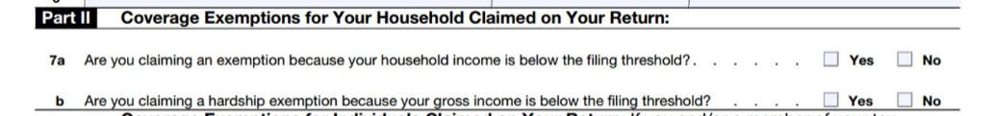
IRS Exemptions: Form 8965, Part II
Types of IRS Household Exemptions:
Household income below filing threshold
Gross income is below the filing threshold
Advantage: Checking one of these boxes can exempt everyone on the tax return for every month uninsured. (No need to also complete Part III for individual exemptions)

Slide 21
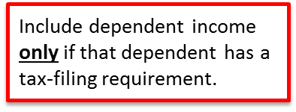
Coverage Exemptions for the Household
Household income for Line 7a (household income below filing threshold) and ISRP
Adjusted Gross Income (AGI)
Tax-Exempt
Interest
Excluded Foreign Income
Form 1040, Line 37
Form 1040, Line 8b
Form 2555, Lines 45, 50
Gross income for Line 7b (gross income below the filing threshold)
All income received in the form of money, goods, property and services that is not exempt from tax, including any income sources outside the U.S. or from the sale of your main home (even if you can exclude part or all of it)
Include only the taxable portion of Social Security benefits
Include income or gains but not expenses or losses from Schedules C, D and F
Do not include income of any dependents

Slide 22
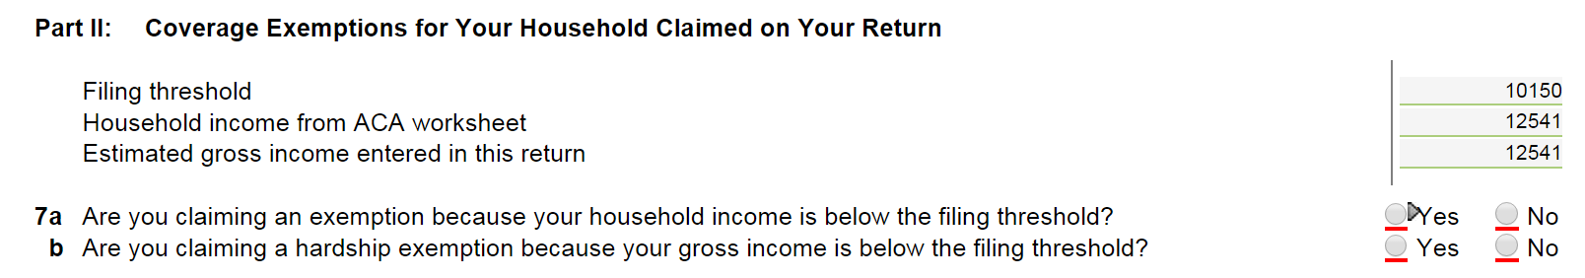
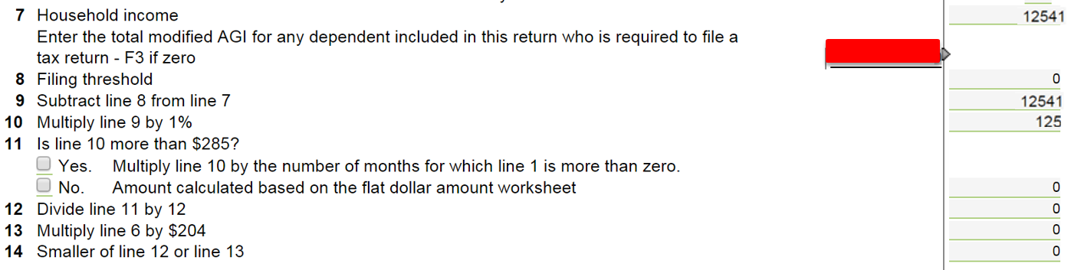
Coverage Exemptions for the Household
Form 8965
For these amount to be correct, all income must be entered and the ACA Worksheet must be completed. Make sure to enter the income of a dependent ONLY IF he or she has a filing requirement. See Pub 4012 for dependent filing requirements.

Slide 23
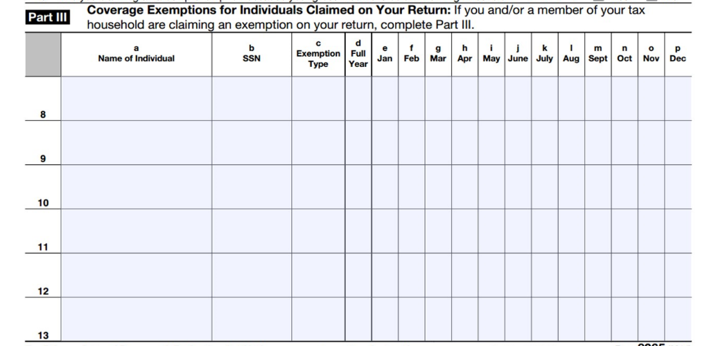
IRS Exemptions: Form 8965, Part III
IRS Individual Exemptions:
Use Part III to claim exemptions for individual household members
Can be claimed for monthly or for entire year
A person can be eligible for multiple exemptions during the year, but only report one exemption per month.
Note: Enter an exemption type (A-F) if eligible for IRS exemption

Slide 24
IRS Exemptions: Form 8965, Part III
Insurance is considered unaffordable – Minimum premium would have cost more than 8.05% of household income
A
Short coverage gap – Uninsured for less than 3 consecutive months
B
Citizens living abroad and certain noncitizens – Includes people who are not lawfully present
C
Members of a health care sharing ministry
D
Members of an Indian tribe or eligible for services through an Indian health care provider or the Indian Health Service
E
Incarceration
F
Aggregate self-only coverage is considered unaffordable – Total cost of two or more family members’ aggregate self-only coverage is more than 8.05% of household income
G
Resident of a state that did not expand Medicaid
G
Member of the tax household born, adopted or died
H

Slide 25
IRS Exemptions: Medicaid Coverage Gap
Resident of a state that did not expand Medicaid
G
Individuals who resided at any time during 2015 in a state that did not expand Medicaid, and
Had household income below 138% FPL
Adjusted Gross Income (AGI)
Non-Taxable Social Security Benefits
Tax-Exempt
Interest
Excluded Foreign Income
Form 1040, Line 37
Form 1040, Line 20a minus 20b
Form 1040, Line 8b
Form 2555, Lines 45, 50
Family Size | 138% FPL
1 | $16,105
2 | $21,707
3 | $27,310
4 | $32,913
Applies to people who lived at any time in 2015 in one of the following states:
Alabama
Alaska
Florida
Georgia
Idaho
Indiana
Kansas
Louisiana
Maine
Mississippi
Missouri
Montana
Nebraska
North Carolina
Oklahoma
South Carolina
South Dakota
Tennessee
Texas
Utah
Virginia
Wisconsin
Wyoming

Slide 26

Example: Medicaid Coverage Gap Exemption
Rashid, Miriam and Leila
Rashid was uninsured for all of 2015
His wife, Miriam, had insurance all year through her employer
Leila was born in November and was covered by CHIP
Household income for 2015: $25,000 (129% FPL)
They live in Virginia (a state that did not expand Medicaid)
Does Rashid qualify for an exemption?
YES, Rashid’s household income is below 138% FPL and in 2015, he lived in a non-expansion state
Rashid qualifies for this exemption for the entire year even if he had other insurance options, such as coverage through his wife’s employer or insurance in the Marketplace with PTCs
Rashid also qualifies for the entire year, even if he only lived in VA for one month before moving to Maryland (a state that did expand Medicaid)

Slide 27
IRS Exemptions: Short Coverage Gap
Short coverage gap
B
A coverage gap of less than 3 months (so, 1 or 2 months). If the coverage gap is 3 months or longer, none of the months in the gap qualify for exemption.
  Example: If Bob is uninsured January 1 to March 31, the exemption does not apply to any of those months because the gap is not less than 3 months.
But remember that a person is considered to have coverage for the entire month if they have coverage for one day in the month.
  Example 2: If Bob is uninsured January 20 to April 15, the exemption does apply. He is considered insured in January and April so there are only 2 months in the gap.
There is a look-back but no look-forward. Consecutive uninsured months at the end of 2014 count toward a gap at the start of 2015; uninsured months in 2016 do not.
  Example 3: If Bob is uninsured Dec 2014, Jan 2015 and Feb 2015, he doesn’t qualify for this exemption because the gap is not less than 3 months.
  Tip! If someone was uninsured in January 2015, and appears eligible for this exemption, ask whether they had coverage in December 2014.
  Example 4: If Bob is uninsured starting in December 2015 and is still uninsured when you prepare his taxes in March 2016, he can claim this exemption for Dec.

Slide 28
IRS Exemptions: Affordability Exemption
Insurance is considered unaffordable – Lowest-cost premium would have cost more than 8.05% of household income
A
Start by determining household income
Then determine the lowest-cost premium available to each person
If the person is eligible for employer-sponsored insurance, use that cost (only).
Adjusted Gross Income (AGI)
Tax-Exempt
Interest
Excluded Foreign Income
Any pre-tax deduction for ESI premiums
Household Income (MAGI)
Line 37
IRS Form 1040
Line 8b
IRS Form 1040
Lines 45 and 50
IRS Form 2555
If eligible for employer-sponsored insurance:
As an employee: the lowest-cost self-only plan costs more than 8.05% of household income (Code A) As a member of the employee’s family: the lowest-cost family plan costs more than 8.05% of household income (Code A)
If not eligible for an offer of employer-sponsored insurance:
Lowest cost bronze plan (after PTCs) for all non-exempt members of the taxpayer’s family costs more than 8.05% of household income (Code A)

Slide 29
For a Person Eligible for Employer-Sponsored Insurance
It’s often difficult to find the cost of the applicable employer plan
If the taxpayer has a 1095-C, line 15 will contain the lowest cost plan for the employee. The form will not state the lowest-cost family plan.
If there is no 1095-C, the employee may have to ask his or her Human Resources Dept for the correct 2015 plan cost

Slide 30
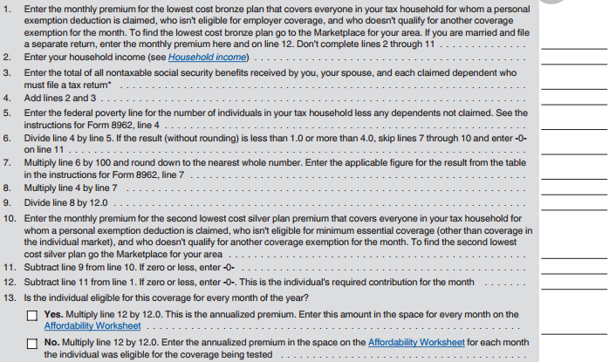
IRS Exemptions: Affordability Exemption
The worksheet requires careful reading!
Line 1 requires the preparer to use an online tool to find the cost of the lowest-cost bronze plan (LCBP) available to members of the household.
Find the LCBP that includes everyone claimed on the tax return that is NOT:
Eligible for employer-sponsored coverage, OR
Eligible for exemption
Note: This means that you will include household members that have Medicaid or Medicare coverage!
Federal marketplace LCBP tool https://www.healthcare.gov/taxes/tools/bronze/
IRS Draft Instructions, Form 8965, page 10

Slide 31
IRS Exemptions: Affordability Exemption
The worksheet requires careful reading!
Line 10 requires the preparer find the cost of the second lowest-cost silver plan (SLCSP) available to members of the household.
Find the SLCSP that includes everyone claimed on the tax return that is NOT:
Eligible for other MEC (including Medicaid, Medicare or employer-sponsored coverage), OR
Eligible for exemption
Federal marketplace SLCSP tool https://www.healthcare.gov/taxes/tools/silver/
IRS Draft Instructions, Form 8965, page 10

Slide 32
IRS Exemptions: Affordability Exemption
The worksheet requires careful reading!
TIP!
Everything after Line 1 is designed to calculate the premium tax credit the individual may have been eligible for, i.e., to reduce the cost of coverage.
If the LCBP is already less than 8.05% of household income, STOP. The taxpayer is not eligible for this exemption.
Federal marketplace LCBP tool https://www.healthcare.gov/taxes/tools/bronze/
IRS Draft Instructions, Form 8965, page 10

Slide 33
IRS Exemptions: Affordability Exemption
Example: Household income for a taxpayer is $25,000. He has no offer of employer-sponsored coverage and is seeking a Marketplace exemption. He can only claim the exemption for unaffordability if the cost of coverage is greater than 8.05% of his income.
$25,000 x 0.0805 = $2,013
On Line 1 of the worksheet, he calculates a LCBP cost of $100 per month, or $1,200 per year.
STOP – he cannot claim this exemption because his plan cost is already less than 8.05% of income, even before accounting for the additional discount he may get from the premium tax credit.
TIP!
Everything after Line 1 is designed to calculate the premium tax credit the individual may have been eligible for, i.e., to reduce the cost of coverage.
If the LCBP is already less than 8.05% of household income, STOP. The taxpayer is not eligible for this exemption.
Federal marketplace LCBP tool https://www.healthcare.gov/taxes/tools/bronze/
IRS Draft Instructions, Form 8965, page 10

Slide 34

IRS Exemptions: Affordability Exemption
Aggregate self-only coverage is considered unaffordable – Total cost of two or more family members’ aggregate self-only coverage is more than 8.05% of household income
G
Household Income: $45,000
Premium cost for Joan only:
$2,100/year
(No offer of family coverage)
4.6% of income
Premium cost for Bob only:
$2,400/year
(Offer of family coverage that exceeds 8.05% of income)
5.3% of income
Aggregate cost: $2,100 + $2,400 = $4,500
10% of income
Therefore, Joan and Bob are eligible for a Code G exemption for the year.

Slide 35
IRS Exemptions: Certain Noncitizens
Citizens living abroad and certain noncitizens
C
This exemption applies to:
Individuals who are not U.S. citizens, nationals or lawfully present (i.e., undocumented immigrants)
Some other citizens living outside of the U.S., residents of territories, and 1040NR (or 1040NR-EZ) filers.
How do I identify someone who is eligible for this exemption?
A person is eligible for PTC (and therefore NOT eligible for this exemption) if the person has an immigration status listed here: https://www.healthcare.gov/immigrants/immigration-status/
If the person has an immigration status that is not listed, they are eligible for this exemption.
For the most part, a person with an ITIN is eligible for this exemption. But there are exceptions:
  A person is NOT eligible for this exemption if they have an ITIN and a status that allows them to purchase coverage in the Marketplace, such as the spouse of a student visa holder.
  A person IS eligible for this exemption if they have a lawful social security number but not an eligible immigration status. So, a person who is a Deferred Action for Childhood Arrivals (DACA) grantee (“Dreamer”) can claim the exemption, despite having an SSN.

Slide 36

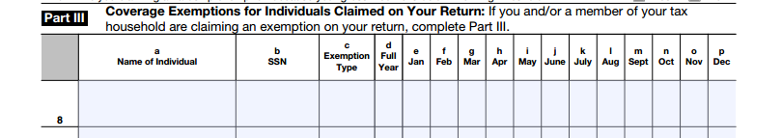
Example: Certain Noncitizens
Example
Fatima has an ITIN and files taxes but she is not lawfully present in the U.S. Her husband and daughter are U.S. citizens
Fatima Diallo
990-71-1111
C
X
Alternatively, Fatima could claim the exemption if:
Fatima is a nonresident living abroad but elects to be treated as a U.S. resident for the purpose of joint filing.
Fatima has a social security number but is a Deferred Action for Childhood Arrivals (DACA) grantee (“Dreamer”).

Slide 37
IRS Exemptions: Born, Adopted or Died
Member of the tax household born, adopted or died
H
The coverage requirement applies for full months alive or adopted. This exemption covers the other months of the year, when coverage is not required (e.g. before birth or after death).
  Example 1: A child is born May 14. Coverage is required June - December. The exemption can be used January – May.
  Example 2: A person dies May 14. Coverage is required January – April. The exemption can be used May – December.
Tip: If the entire tax family had coverage all year, you can still consider the born, died or adopted person to have full-year coverage. In examples 1 and 2 above, if everyone else on the return had coverage all year, you can still check the box on Line 61.
If you can’t check the box, and need to indicate exemption or penalty by individual, use this exemption.

Slide 38
Example: Born, Adopted or Died
Rashid, Miriam and Leila
Rashid and Miriam had insurance for all of 2015 through Miriam’s employer.
Leila was born in November and was added to the coverage.
Rashid and Miriam can check the box on Line 61 for full-year coverage, even though Leila only had coverage in November and December.
Alternatively:
Rashid and Miriam were uninsured for all of 2015.
Leila was born in November and was also uninsured.
Assuming no household exemption applies, use Code H for Leila for January through November. Use the short coverage gap exemption code “B” for December.

Slide 39
The Last Resort…Marketplace Exemptions
If no other IRS exemption applies, consider helping a client apply for a Marketplace exemption
Application must be mailed and takes time for processing
If the application has been mailed but not processed, write “pending” in Part 1 of Form 8965.
Useful for:
  Religious conscience exemption (available only through the Marketplace)
  Hardship exemptions
Should I Make a Referral to Complete a Hardship Application?
A referral to a health care assister is one option but it causes additional delay
Consider helping the client complete the hardship application at your tax site
No special health care knowledge is needed. Application requires:
  Name and contact info
  Dependents
  Documentation of exemption
  Taxpayer’s signature

Slide 40
Marketplace Exemptions: Hardship
Hardship Exemptions Granted by Marketplace | Duration
Financial or domestic circumstances Homelessness Eviction in the last 6 months or facing eviction or foreclosure Utility shut-off notice Domestic violence Recent death of a close family member Disaster that resulted in significant property damage Bankruptcy in the last 6 months Debt from medical expenses in the last 24 months High expenses caring for ill, disabled or aging relative Failure of another party to comply with a medical support order for a dependent child who is determined ineligible for Medicaid or CHIP Through an appeals process, determined eligible for a Marketplace plan or lower costs, but was not enrolled Determined ineligible for Medicaid because the state did not expand Individual health insurance plan was cancelled and you believe Marketplace plans are unaffordable Other hardship in obtaining coverage (including for people with limited Medicaid coverage)
At least one month before and after hardship
When to Apply
Up to 3 years after the month of the hardship (but documentation is required in most circumstances so earlier is better)

Slide 41
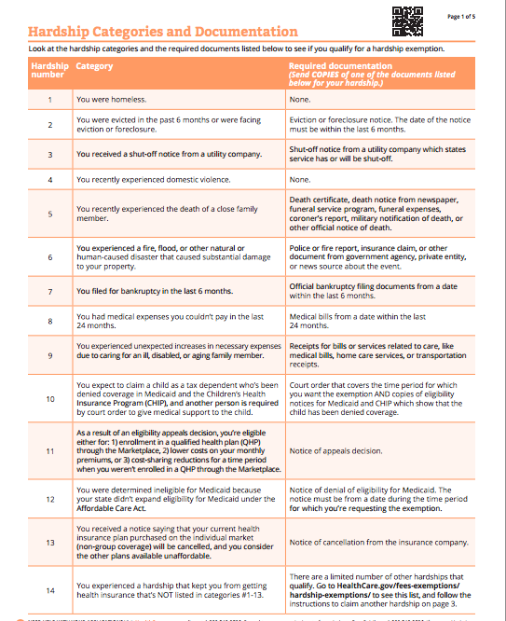
Applying for a Hardship Exemption
For exemptions that must be approved by the Marketplace, the FFM is processing exemptions for all states except Connecticut.
Hardship application
https://marketplace.cms.gov/applications-and-forms/hardship-exemption.pdf

Slide 42
Shared Responsibility Payment

Slide 43
Shared Responsibility Payment
Calculate Shared Responsibility Payment for a taxpayer, spouse or dependent is uninsured and is not eligible for an exemption (e.g. income below the filing threshold).
Shared Responsibility Payment† Year If income is above filing threshold, the payment is the greater of...
2014 | NO PENALTY if income is less than filing threshold In 2015: Single $10,300 MFJ $20,600 | $95 per adult, $47.50 per child (up to $285) | or | 1% of income above the tax filing threshold*
2015 |  | $325 per adult, $162.50 per child (up to $975) | or | 2% of income above the tax filing threshold*
2016 |  | $695 per adult, $347.50 per child (up to $2,085) | or | 2.5% of income above the tax filing threshold*
2017 |  | Values are increased by a cost of living adjustment
† The payment calculation is for a person who is uninsured all year. If a person is uninsured for only some months, prorate the payment. *Capped at the national average premium of a bronze level plan purchased through a Marketplace.

Slide 44

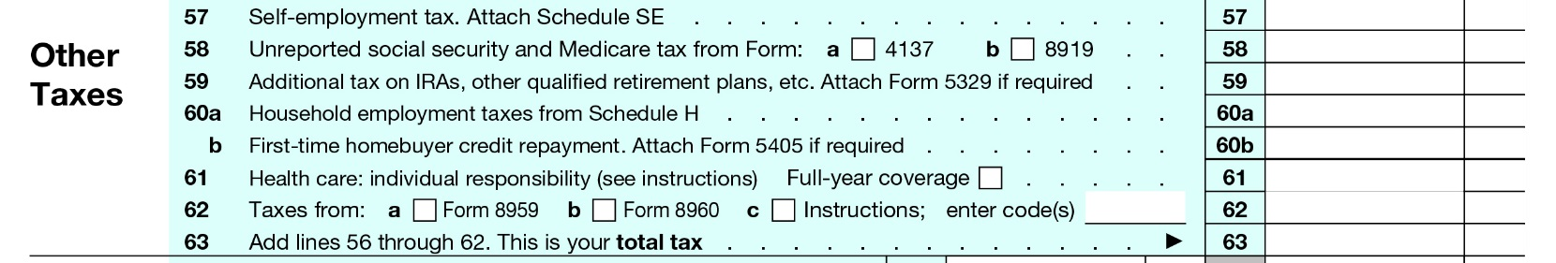
Example: Joe (Single)
Income: | $17,000
Filing Status: | Single
Adults: | 1
Children: | 0
2015 Tax Filing Threshold: | $10,300
Months Uninsured: | 12
Payment Calculation:
1. $17,000 - $10,300 =
2. $325 x 1 adult =
$6,700
x 2%
$ 134
$325
Note: In tax year 2014, Joe would have paid only $95. If everything remains the same, in 2016 he would pay $695.
vs.
Report on F1040, Line 61
Form 1040
$325

Slide 45

Example: Ruiz Family
Income: | $39,500
Filing Status: | MFJ
Adults: | 2 (both uninsured)
Children: | 2 (both uninsured)
2015 Tax Filing Threshold: | $20,600
1. $39,500 - $20,600 =
2. $325 x 2 adult + $162.50 x 2 children =
$18,900 x 2% = $378
vs.
$975
Ruiz family’s 2015 payment
Form 1040
$975

Slide 46
Example: Ruiz Family
Income: | $39,500
Filing Status: | MFJ
Adults: | 2 (1 uninsured)
Children: | 2 (both insured)
2015 Tax Filing Threshold: | $20,600
1. $39,500 - $20,600 =
2. $325 x 1 adult =
$18,900 x 2% = $378
Ruiz family’s 2015 payment
vs.
$325
Form 1040
$378

Slide 47
What do I tell a client that pays the SRP?
Make the taxpayer aware of the payment. It was easy to miss in TY 2014 but it increases substantially this year and next.
Refer to a health care assister, healthcare.gov or your state-based Marketplace. If the taxpayer gets health care at a free clinic, clinic staff can likely help with enrollment.
  Medicaid and CHIP are always open for enrollment
  Marketplace open enrollment for 2016 coverage is November 1, 2015 – January 31, 2016
  After January 31, a person can only purchase private health insurance in certain circumstances, such as:
  Getting married
  Having a baby
  Losing other insurance coverage
  Moving

Slide 48
Resources
General
IRS – ACA Landing Page www.irs.gov/aca
Publication 4491 https://www.irs.gov/pub/irs-pdf/p4491.pdf
Healthcare.gov www.healthcare.gov
MEC & Exemptions
Draft Form 8965 http://www.irs.gov/pub/irs-dft/f8965--dft.pdf
Draft Instructions for Form 8965 http://www.irs.gov/pub/irs-dft/i8965--dft.pdf
Marketplace exemption information and applications
https://www.healthcare.gov/fees-exemptions/exemptions-from-the-fee/
Shared Responsibility
  IRS – Shared Responsibility Resources
  http://www.irs.gov/uac/Individual-Shared-Responsibility-Provision
Taxpayer Advocate Service – Shared Responsibility Payment Tool
  http://www.taxpayeradvocate.irs.gov/get-help/aca-isrp?taxissue=112

