Slide 1
VITA/TCE Basic Topic:
Exemptions
Current as of November 16, 2016

Slide 2
Agenda
Webinar #1 -- Health Insurance Coverage, Including PTC
Best practices for intake
Using TaxSlayer to report coverage and PTC
Complex 1095-A issues
Review tips for PTC
Webinar #2 – Exemptions & Shared Responsibility Payment
Exemption rules
Using TaxSlayer to report exemptions
Exemption examples (focusing on affordability)

Slide 3
Exemption & SRP Refresher

Slide 4
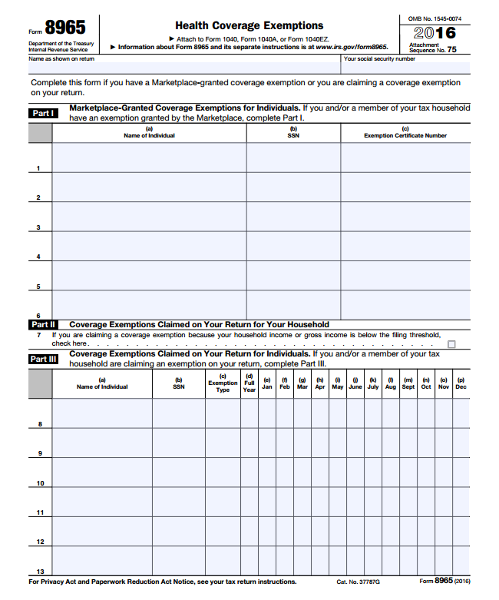
Exemptions from the Coverage Requirement
Two Types of Exemptions:
All exemptions must be claimed at tax filing on Form 8965
Exemptions Granted by the Marketplace
Part I of Form 8965 Must apply by mail for the exemption through the Marketplace Need supporting documentation Lengthy process
Exemptions Granted by the IRS
Part II and III of Form 8965 Can claim these exemptions directly on Form 8965 at tax time No supporting documentation needed Immediate

Slide 5
IRS Exemptions: Form 8965, Part II
Types of IRS Household Exemptions:
Household and gross income below filing threshold are combined into one exemption
Advantage: Checking Line 7 exempts everyone on the tax return for every month uninsured. (No need to also complete Part III for individual exemptions.)

Slide 6
Income Below Filing Threshold
Household income for Line 7 and SRP
Adjusted Gross Income (AGI)
Tax-Exempt
Interest
Excluded Foreign Income
Dependent Income
Form 1040, Line 37
Form 1040, Line 8b
Form 2555, Lines 45, 50
Only if the dependent has a filing requirement
Gross income for Line 7
All income received in the form of money, goods, property and services that is not exempt from tax, including any income sources outside the U.S. or from the sale of your main home (even if you can exclude part or all of it)
Include only the taxable portion of Social Security benefits
Include income or gains but not expenses or losses from Schedules C, D and F
Do not include income of any dependents

Slide 7
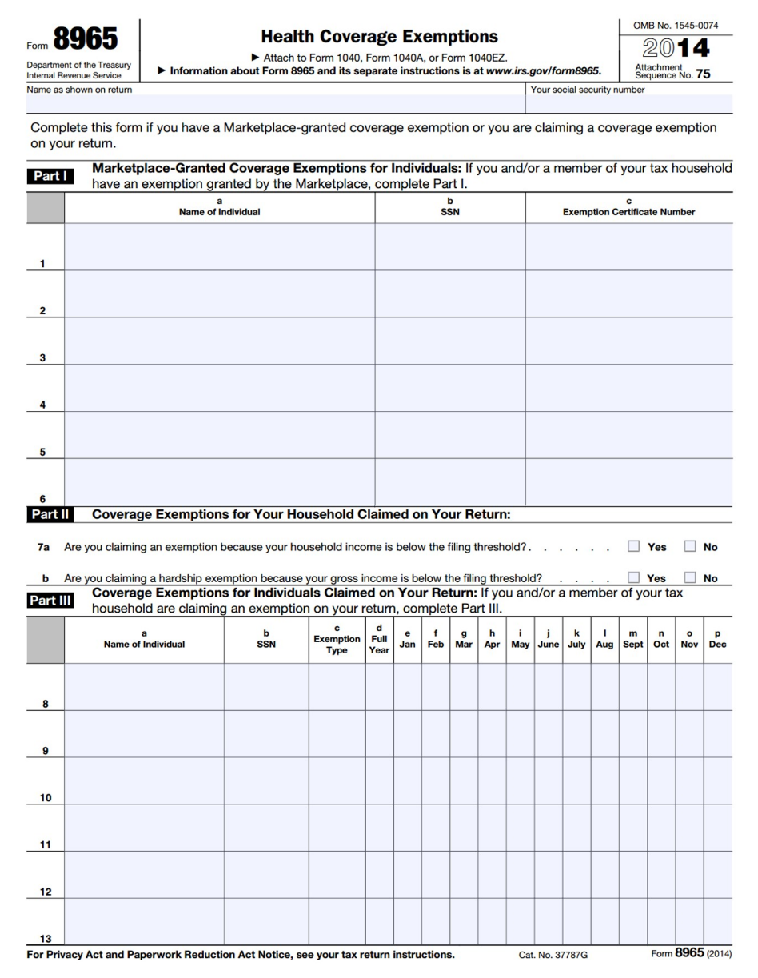
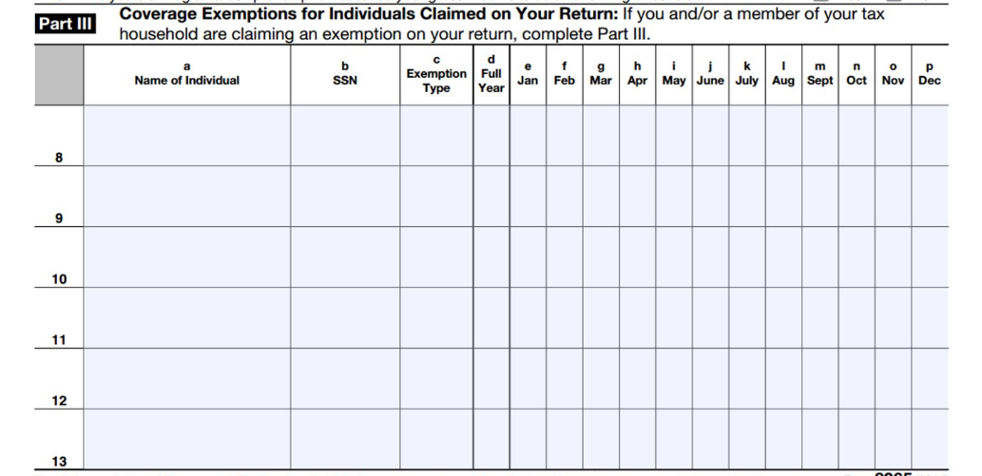
IRS Exemptions: Form 8965, Part III
IRS Individual Exemptions:
Use Part III to claim exemptions for individual household members
Can be claimed monthly or for entire year
A person can be eligible for multiple exemptions during the year, but only report one exemption per month.
If a person is eligible for exemption for one day of the month, they can claim it for the entire month.
Note: Enter an exemption type (A-H) if eligible for IRS exemption

Slide 8
IRS Exemptions: Form 8965, Part III
Insurance is considered unaffordable – Lowest premium would have cost more than 8.13% of household income
A
Short coverage gap – Uninsured for less than 3 consecutive months
B
Citizens living abroad and certain noncitizens – Includes people who are not lawfully present
C
Members of a health care sharing ministry
D
Members of an Indian tribe or eligible for services through an Indian health care provider or the Indian Health Service
E
Incarceration
F
Aggregate self-only coverage is considered unaffordable – Total cost of two or more family members’ aggregate self-only coverage is more than 8.13% of household income
G
Resident of a state that did not expand Medicaid
G
Eligible for the Health Care Tax Credit (HCTC)
G
Member of the tax household born or adopted
H
Member of the tax household died
H

Slide 9
IRS Exemptions: Affordability Exemption
Insurance is considered unaffordable
Lowest-cost premium would have cost more than 8.13% of household income
A
Start by determining household income
Then determine the lowest-cost premium available to each person
Adjusted Gross Income (AGI)
Tax-Exempt
Interest
Excluded Foreign Income
Dependent Income
Any pre-tax deduction for ESI premiums
Household Income
Line 37
IRS Form 1040
Line 8b
IRS Form 1040
Lines 45 and 50
IRS Form 2555
Only if the dependent has a filing requirement
If eligible for employer-sponsored insurance:
As an employee: the lowest-cost self-only plan costs more than 8.13% of household income (Code A) As a member of the employee’s family: the lowest-cost family plan costs more than 8.13% of household income (Code A)
If not eligible for an offer of employer-sponsored insurance:
Lowest cost bronze plan (after PTCs) for all non-exempt members of the taxpayer’s family costs more than 8.13% of household income (Code A)

Slide 10
IRS Exemptions: Short Coverage Gap
Short coverage gap
B
A coverage gap of less than 3 months (so, 1 or 2 months). If the coverage gap is 3 months or longer, none of the months in the gap qualify for exemption.
Example: If Bob is uninsured January 1 to March 31, the exemption does not apply to any of those months because the gap is not less than 3 months.
Months covered by another exemption don’t count as uninsured months.
Example: Bob has coverage January to March, is uninsured in April and May, and is eligible for the affordability exemption June to December. Even though Bob was uninsured April to December, he is eligible for a short gap exemption for April and May.
A person is considered to have coverage for the entire month if they have coverage for one day in the month.
Example: If Bob is uninsured January 5 to April 28, the exemption does apply. He is considered insured in January and April so there are only 2 months in the gap.
There is a look-back but no look-forward. Consecutive uninsured months at the end of 2015 count toward a gap at the start of 2016; uninsured months in 2017 do not.
Example: If Bob is uninsured (and not exempt) Dec 2015, Jan 2016 and Feb 2016, he doesn’t qualify for this exemption because the gap is not less than 3 months.

Slide 11
IRS Exemptions: Certain Noncitizens
Citizens living abroad and certain noncitizens
C
This exemption applies to:
Individuals who are not U.S. citizens, nationals or lawfully present (i.e., undocumented immigrants)
Some other citizens living outside of the U.S., residents of territories, and 1040NR (or 1040NR-EZ) filers.
How do I identify someone who is eligible for this exemption?
Consult the list of immigration statuses that qualify a person for help with health costs. If the person’s status is not on this list, they are eligible for this exemption.
https://www.healthcare.gov/immigrants/immigration-status/
Does everyone with an ITIN get this exemption?
Many people with ITINs will be eligible for this exemption.
Some people with SSNs are eligible, too.
Example: A lawful social security number but not an eligible immigration status. E.g., a person who is a Deferred Action for Childhood Arrivals (DACA) grantee (“Dreamer”) can claim the exemption, despite having an SSN.

Slide 12
IRS Exemptions
Members of a health care sharing ministry
D
Members of an Indian tribe or eligible for services through an Indian health care provider or the Indian Health Service
E
Incarceration
F
As of September 1, 2016, these exemptions will not be available from the marketplace.
“Evergreen” exemptions can still be used.
If someone already has an Exemption Certificate Number, use it.

Slide 13
IRS Exemptions: Affordability Exemption
Aggregate self-only coverage is considered unaffordable
Total cost of two or more family members’ aggregate self-only coverage is more than 8.13% of HHI
G
Household Income: $45,000
Premium cost for Joan only:
$2,100/year
No offer of family coverage
4.6% of income
Premium cost for Bob only:
$2,400/year
Family coverage is offered but is unaffordable (exceeds 8.13% of income)
5.3% of income
Aggregate cost: $2,100 + $2,400 = $4,500
10% of income
Therefore, Joan and Bob are eligible for a Code G exemption for the year.

Slide 14
IRS Exemptions: Medicaid Coverage Gap
Resident of a state that did not expand Medicaid
G
Individuals who resided at any time during 2016 in a state that did not expand Medicaid, and
Had household income below 138% FPL
Adjusted Gross Income (AGI)
Non-Taxable Social Security Benefits
Tax-Exempt
Interest
Excluded Foreign Income
Dependent Income
Form 1040, Line 37
Form 1040, Line 20a minus 20b
Form 1040, Line 8b
Form 2555, Lines 45, 50
Only if the dependent has a filing requirement
Family Size | 138% FPL
1 | $16,243
2 | $21,984
3 | $27,725
4 | $33,465
Applies to people who lived at any time in 2016 in one of the following states:
Alabama
Florida
Georgia
Idaho
Kansas
Louisiana
Maine
Mississippi
Missouri
Nebraska
North Carolina
Oklahoma
South Carolina
South Dakota
Tennessee
Texas
Utah
Virginia
Wisconsin
Wyoming

Slide 15
Example: Medicaid Coverage Gap Exemption
Rashid, Miriam and Leila
Rashid was uninsured for all of 2016
His wife, Miriam, had insurance all year through her employer
Leila was born in November and was covered by CHIP
Household income for 2016: $25,000 (~124% FPL)
They live in South Carolina (a state that did not expand Medicaid)
Does Rashid qualify for an exemption?
YES, Rashid’s household income is below 138% FPL and in 2016, he lived in a non-expansion state
Rashid qualifies for this exemption for the entire year even if he had other insurance options, such as coverage through his wife’s employer or insurance in the Marketplace with PTCs
Rashid also qualifies for the entire year, even if he only lived in SC for one month before moving to Maryland (a state that did expand Medicaid)

Slide 16
IRS Exemptions: Born, Adopted or Died
Member of the tax household born, adopted, or died
H
The coverage requirement applies for full months alive or adopted. This exemption covers the other months of the year, when coverage is not required (e.g. before birth or after death).
Example 1: A child is born May 14. Coverage is required June - December. The exemption can be used January – May.
Example 2: A person dies May 14. Coverage is required January – April. The exemption can be used May – December.
Tip: If the entire tax family had coverage all year, you can still consider the born, died or adopted person to have full-year coverage. In examples 1 and 2 above, if everyone else on the return had coverage all year, you can still check the box on Line 61.

Slide 17
The Last Resort…Marketplace Exemptions
If no other IRS exemption applies, consider helping a client apply for a Marketplace exemption
Application must be mailed and takes time for processing
Write “Pending” if approval has not yet been received.
Useful for:
Religious conscience exemption (available only through the Marketplace)
Hardship exemptions
For exemptions that must be approved by the Marketplace, the FFM is processing exemptions for all states except Connecticut.
Should I Make a Referral to Complete a Hardship Application?
A referral to a health care assister is one option but it causes additional delay
Consider helping the client complete the hardship application at your tax site
No special health care knowledge is needed. Application requires:
Name and contact info
Dependents
Documentation of exemption
Taxpayer’s signature
Hardship application @
https://www.healthcare.gov/exemption-form-instructions/

Slide 18
Marketplace Exemptions: Hardship
Hardship Exemptions Granted by Marketplace | Duration
Financial or domestic circumstances Homelessness Eviction in the last 6 months or facing eviction or foreclosure Utility shut-off notice Domestic violence Recent death of a close family member Disaster that resulted in significant property damage Bankruptcy in the last 6 months Debt from medical expenses in the last 24 months High expenses caring for ill, disabled or aging relative Failure of another party to comply with a medical support order for a dependent child who is determined ineligible for Medicaid or CHIP Through an appeals process, determined eligible for a Marketplace plan or lower costs, but was not enrolled Determined ineligible for Medicaid because the state did not expand Individual health insurance plan was cancelled and you believe Marketplace plans are unaffordable Other hardship in obtaining coverage (including for people with limited Medicaid coverage)
At least one month before and after hardship
When to Apply
Up to 3 years after the month of the hardship (but documentation is required in most circumstances so earlier is better)

Slide 19
Shared Responsibility Payment
Calculate Shared Responsibility Payment for a taxpayer, spouse or dependent is uninsured and is not eligible for an exemption (e.g. income below the filing threshold).
Shared Responsibility Payment† Year If income is above filing threshold, the payment is the greater of...
2014 | NO PENALTY if income is less than filing threshold In 2016: Single $10,350 MFJ $20,700 | $95 per adult, $47.50 per child (up to $285) | or | 1% of income above the tax filing threshold*
2015 |  | $325 per adult, $162.50 per child (up to $975) | or | 2% of income above the tax filing threshold*
2016 |  | $695 per adult, $347.50 per child (up to $2,085) | or | 2.5% of income above the tax filing threshold*
2017 |  | Values are increased by a cost of living adjustment
† The payment calculation is for a person who is uninsured all year. If a person is uninsured for only some months, prorate the payment. *Capped at the national average premium of a bronze level plan purchased through a Marketplace.

Slide 20
Shared Responsibility Payment – Single Filer (2015)
penalty amount in 2015
$10,300
(tax filing threshold, filing single)
$26,550
2% of income
$325
($325 x 1 adult)
no penalty

Slide 21
Shared Responsibility Payment – Single Filer (2016)
penalty amount in 2016
$38,250
$10,350
(tax filing threshold, filing single)
2.5% of income
$695
($695 x 1 adult)
no penalty

Slide 22
What do I tell a client that pays the SRP?
Make the taxpayer aware of the payment.
Refer to a health care assister, healthcare.gov or your state-based Marketplace. If the taxpayer gets health care at a free clinic, clinic staff can likely help with enrollment.
Medicaid and CHIP are always open for enrollment
Marketplace open enrollment for 2017 coverage is November 1, 2016 – January 31, 2017
After January 31, a person can only purchase private health insurance in certain circumstances, such as:
Getting married
Having a baby
Losing other insurance coverage

Slide 23
Exemptions & SRP in TaxSlayer

Slide 24
TaxSlayer – Insurance Status

Slide 25
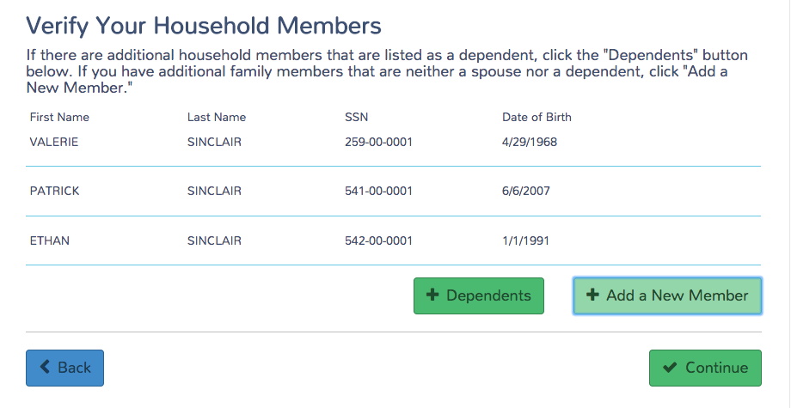
TaxSlayer – Insurance Status
This box will add a dependent to the tax return.
This box will add a person to the tax return for ACA exemption and penalty purposes.
Rule: The TP is responsible for the health insurance of any person they claim or could claim as a dependent. But this is extremely rare, and there is no way to indicate to the IRS about whom the exemption or penalty applies.

Slide 26
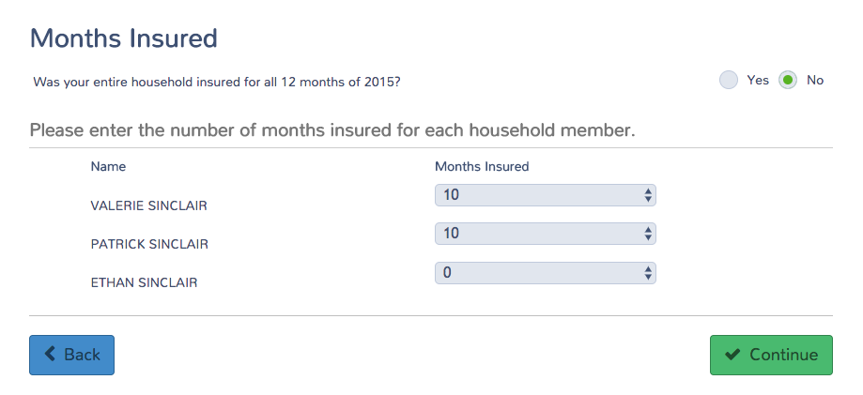
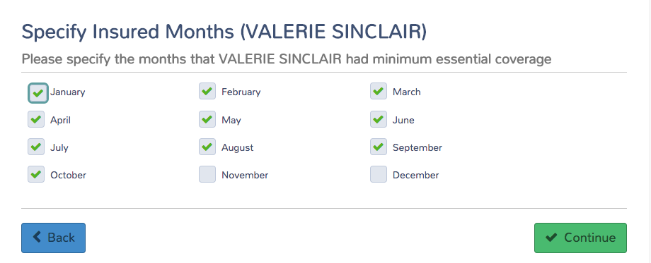
TaxSlayer – Insurance Status

Slide 27
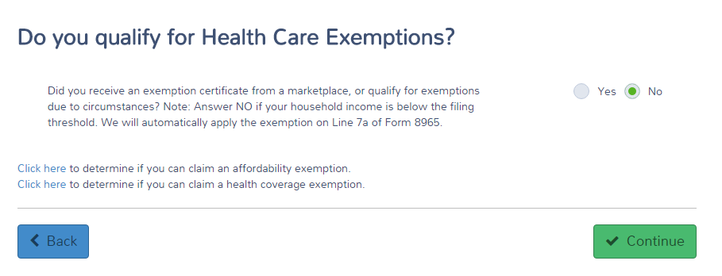
TaxSlayer – Exemptions
TaxSlayer is designed to automatically calculate household income below filing requirement.
Currently, the calculation isn’t accurate because it doesn’t include income of dependents with a filing requirement.
Links go to Marketplace tools

Slide 28
TaxSlayer – Exemptions
Only check this if the gross income exemption – and not the household income exemption -- applies
[Currently, if you check this box, you will still be required to enter an exemption on the next screen.]
Gross income for Line 7
All income received in the form of money, goods, property and services that is not exempt from tax, including any income sources outside the U.S. or from the sale of your main home (even if you can exclude part or all of it)
Include only the taxable portion of Social Security benefits
Include income or gains but not expenses or losses from Schedules C, D and F
Do not include income of any dependents

Slide 29
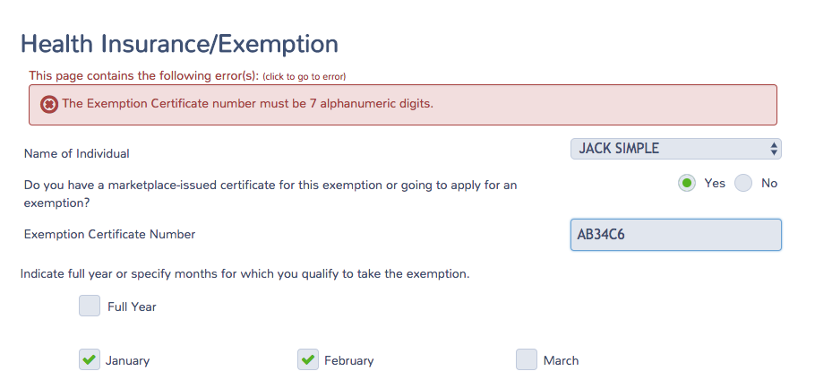
TaxSlayer – Exemptions
For Marketplace exemptions, a seven-digit alphanumeric code is required. If the exemption is 6 digits, add a zero at the beginning or end.
Or PENDING, if the exemption application has not yet been approved.

Slide 30
TaxSlayer – Exemptions
Note: These exemptions aren’t correct.
Careful: Know the exemption rules. TaxSlayer doesn’t stop you from making errors.
Ex. Short coverage gap can be claimed for an unlimited number of months.

Slide 31
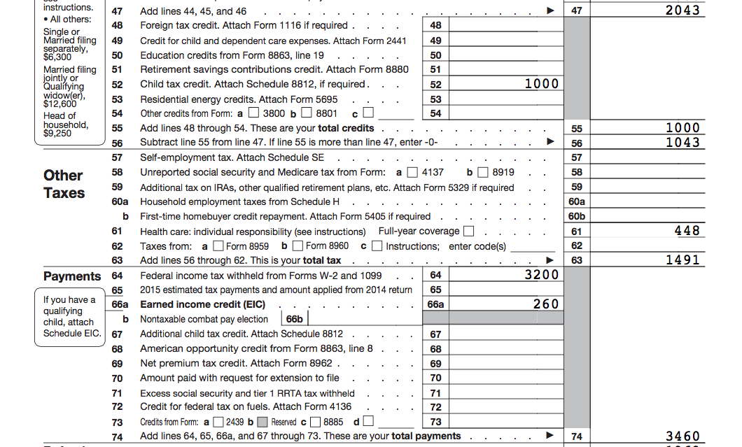
TaxSlayer – Shared Responsibility Payment

Slide 32
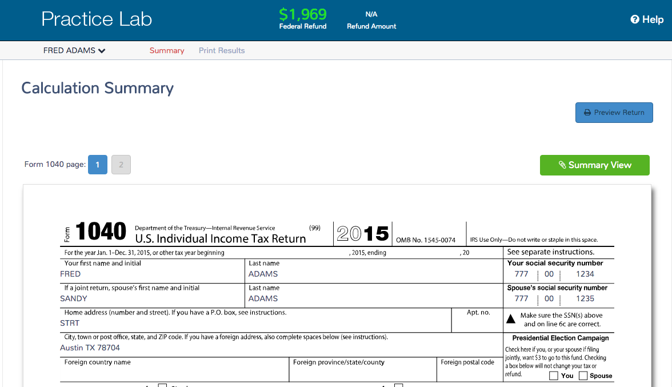
Always Preview the Return!

Slide 33
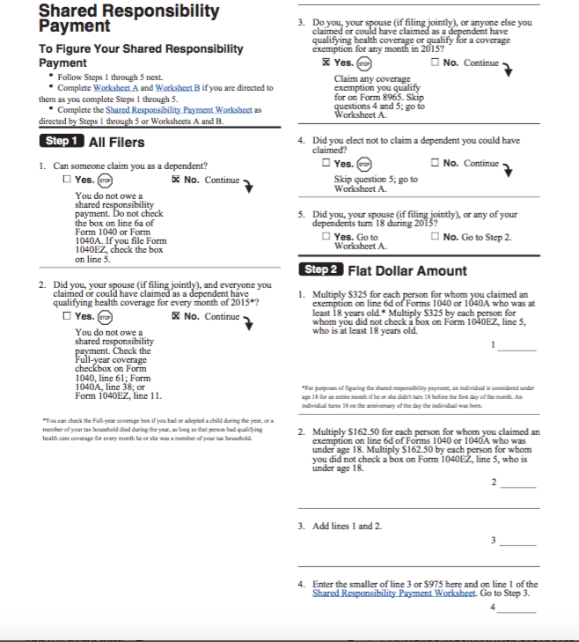
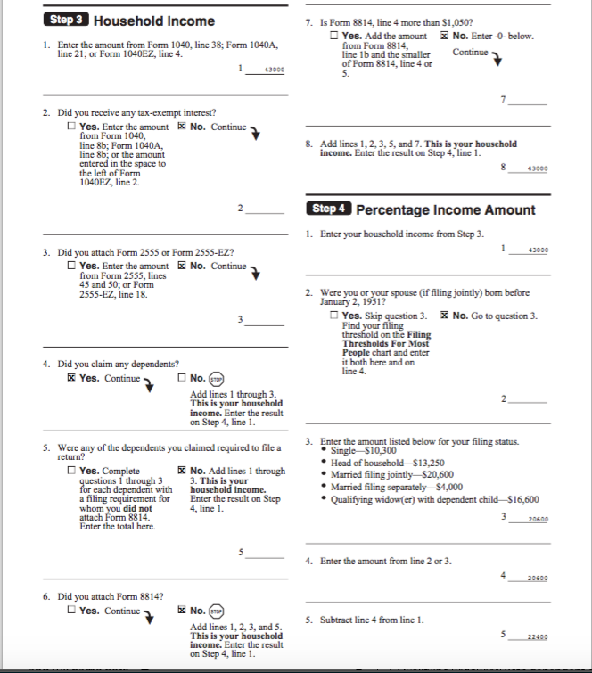
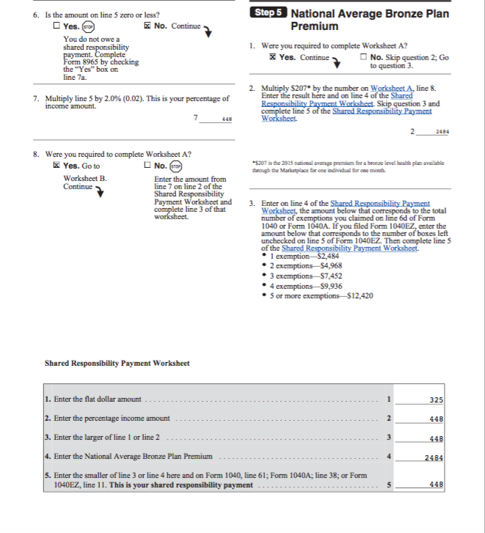
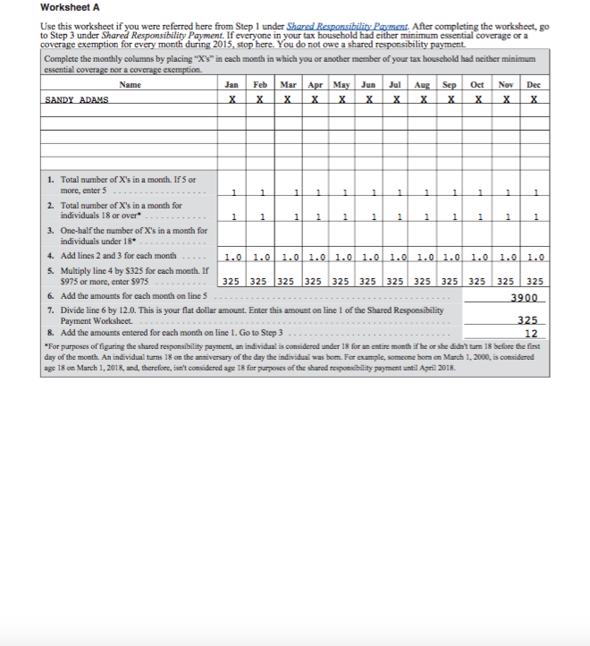
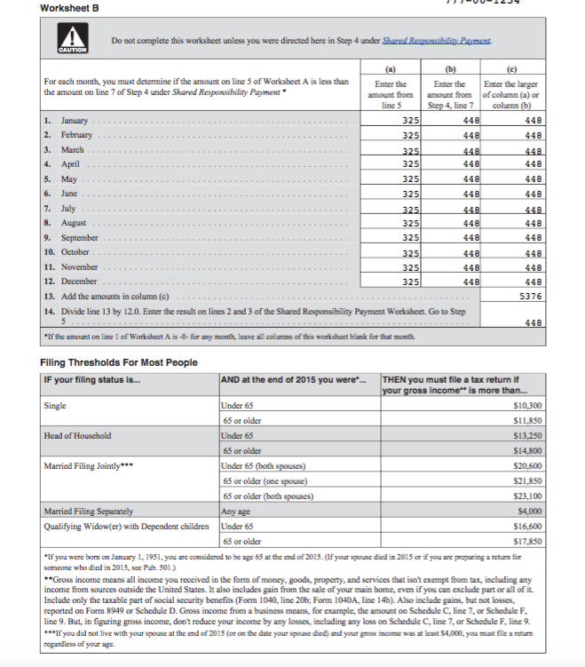
TaxSlayer – Shared Responsibility Payment
1
2
3
4
5

Slide 34
TaxSlayer – Shared Responsibility Payment
Page 4 of the SRP preview tells who the payment is calculated for
4

Slide 35
Deep Dive: Affordability Exemption

Slide 36
Example 1: Affordability of ESI
Gregory and Alice are MFJ.
They lived in Oklahoma City, OK in 2016 (Zip: 73111)
Both uninsured all year; no other exemption applies
Gregory
W-2: Box 1 - $18,000, Box 2 - $1,500
Self-only insurance offer: $84/mo
Family insurance offer: $392/mo
Alice
W-2: Box 1 - $24,000, Box 2 - $1,900
No insurance offered
How is affordability measured? (Use the first that applies for each family member)
Lowest cost self-only plan offered to each family member by his or her employer
Lowest cost family plan offered by the taxpayer or spouse’s employer
If it covers everyone on your tax return, who isn’t eligible for coverage through their own employer, and doesn’t qualify for another exemption.
Lowest-cost bronze plan in the marketplace, after accounting for PTC.

Slide 37
Example 1: Affordability of ESI
Gregory and Alice are MFJ.
They lived in Oklahoma City, OK in 2016 (Zip: 73111)
Both uninsured all year; no other exemption applies
Gregory
W-2: Box 1 - $18,000, Box 2 - $1,500
Self-only insurance offer: $84/mo
Family insurance offer: $392/mo
Alice
W-2: Box 1 - $24,000, Box 2 - $1,900
No insurance offered
Gregory
His lowest-cost self only employer plan is $84/mo
Annualized cost is $1,008
Compared to annual income of $42,000
$1,008 / $42,000 = 2.4% of household income
Gregory is not eligible for the affordability exemption because his plan costs less than 8.13% of household income.

Slide 38
Example 1: Affordability of ESI
Gregory and Alice are MFJ.
They lived in Oklahoma City, OK in 2016 (Zip: 73111)
Both uninsured all year; no other exemption applies
Gregory
W-2: Box 1 - $18,000, Box 2 - $1,500
Self-only insurance offer: $84/mo
Family insurance offer: $392/mo
Alice
W-2: Box 1 - $24,000, Box 2 - $1,900
No insurance offered
Alice
Her lowest-cost family plan through Gregory’s employer is $392/mo
Annualized cost is $4,704
Compared to annual income of $42,000
$4,704 / $42,000 = 11.2% of household income
Alice is eligible for the affordability exemption because her offer of coverage costs more than 8.13% of income.

Slide 39
Example 1: Affordability of ESI
$3,415
Gregory
Alice
Gregory is not eligible for an affordability exemption because
$1,008 < $3,415 (8.13% of income).
$1,008
$1,008
$1,008
$1,008
$1,008
$1,008
$1,008
$1,008
$1,008
$1,008
$1,008
$1,008
$4,704
$4,704
$4,704
$4,704
$4,704
$4,704
$4,704
$4,704
$4,704
$4,704
$4,704
$4,704
Alice is eligible for an affordability exemption because
$4,704 > $3,415 (8.13% of income).

Slide 40
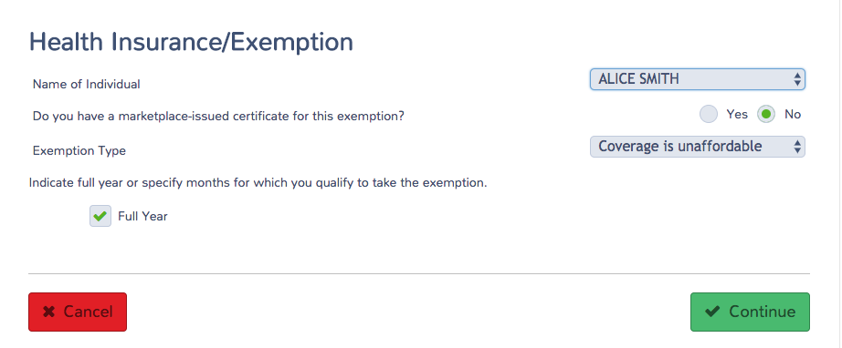
Example 1: Affordability of ESI
Form 8965

Slide 41
Example 1: Affordability of ESI

Slide 42
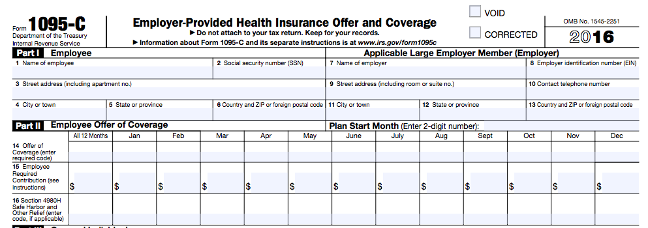
For a Person Eligible for Employer-Sponsored Insurance
It’s often difficult to find the cost of the applicable employer plan
If the taxpayer has a 1095-C, line 15 will contain the lowest cost plan for the employee. The form will not state the lowest-cost family plan.
If there is no 1095-C, the employee may have to ask his or her Human Resources Dept for the correct 2016 plan cost

Slide 43
Affordability: Marketplace Coverage
If there is no employer coverage offer, consider the affordability of marketplace coverage.
You’ll need to determine:
The lowest-cost bronze plan (LCBP)
The second-lowest cost silver plan (SLCSP) only if eligible for PTC
Find these values at:
For federal marketplace states: https://www.healthcare.gov/tax-tool/
For other states: State-based marketplaces
Enter these amounts on the Marketplace Affordability Worksheet

Slide 44
Affordability: Marketplace Coverage
LCBP (Line 1)
Include:
Everyone claimed on the tax return, and
Who is not eligible for employer-sponsored coverage, and
Who is not eligible for another exemption.
Note: This means that you will include household members that have Medicaid or Medicare coverage!
SLCSP (Line 10)
Include:
Everyone claimed on the tax return, and
Who is not eligible for any other MEC (other than individual market), and
Who is not eligible for another exemption.
TIP! If the LCBP is already lower than 8.13% of household income, STOP. The taxpayer is not eligible for this exemption. (The rest of the worksheet will only further reduce the cost.)

Slide 45
Example 2: Marketplace Affordability
Max is single with no dependents.
He was uninsured January to late-April, before getting a job with coverage starting April 21.
Residence: 15905, Cambria County, PA; DOB: 7/21/84
W-2: Box 1 - $17,500, Box 2 - $800
Where do we start?
Max is insured April – December. Does any exemption apply January – March?
Medicaid coverage gap?
No, he lives in Pennsylvania, which is a state that expanded Medicaid
No other exemption applies. Consider affordability.
In January through March, was Max eligible for employer-sponsored coverage?
No, so consider marketplace affordability

Slide 46
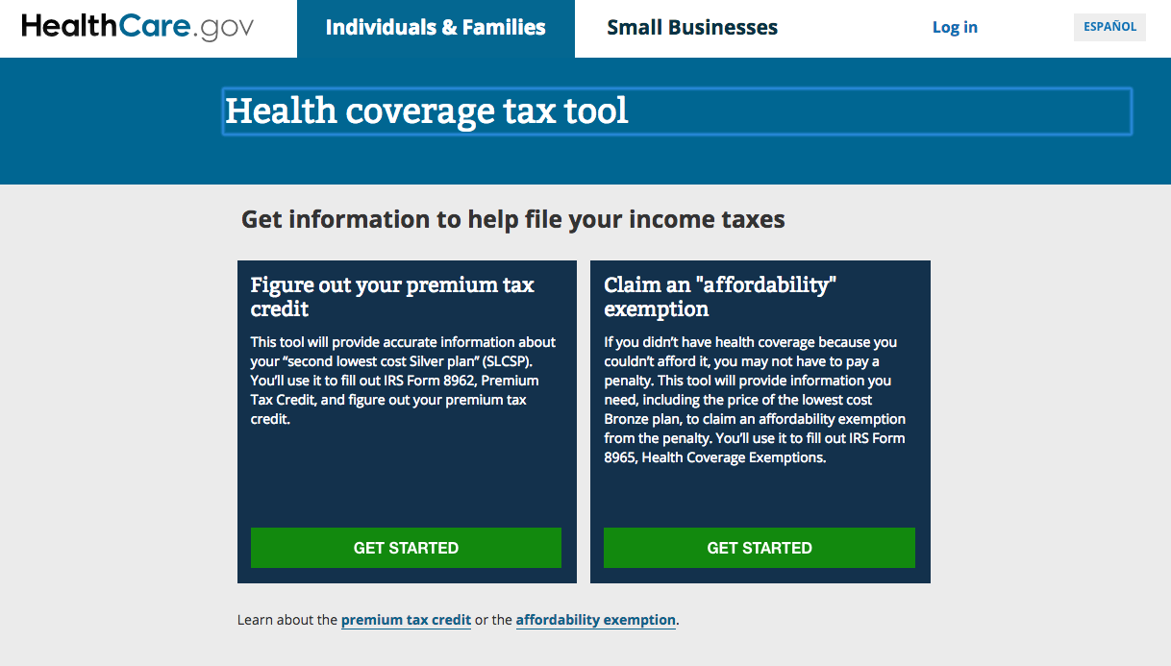
Example 2: Marketplace Affordability
Max is single with no dependents.
He was unemployed and uninsured January to late-April, before getting a job with coverage starting April 21.
Residence: 15905, Cambria County, PA; DOB: 7/21/84
W-2: Box 1 - $17,500, Box 2 - $800 (no other income)
Note: LCBP and SLCSP are for 2015

Slide 47
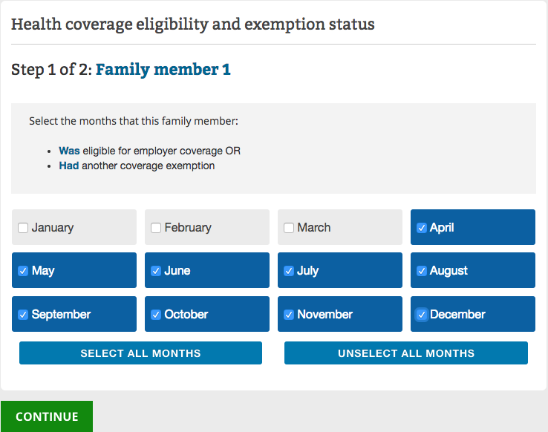
Example 2: Marketplace Affordability
This is asking about the household for Line 1.
Note: LCBP and SLCSP are for 2015

Slide 48
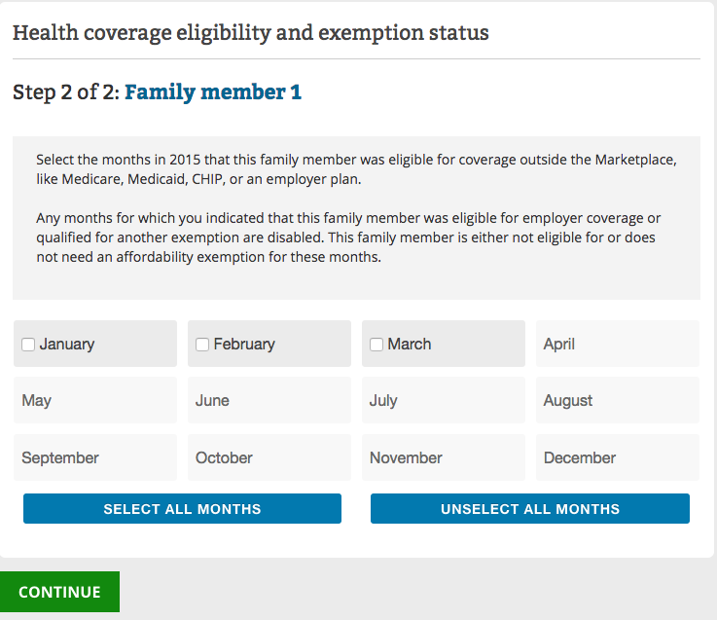
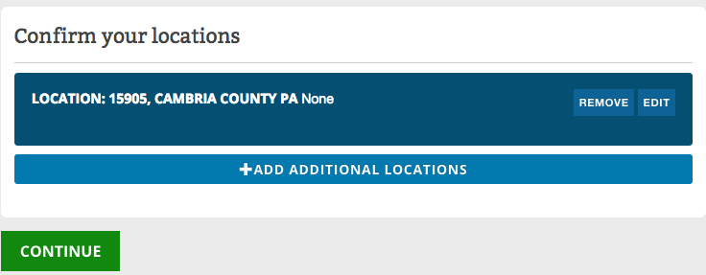
Example 2: Marketplace Affordability
This is asking about the household for Line 10.
Note: LCBP and SLCSP are for 2015

Slide 49
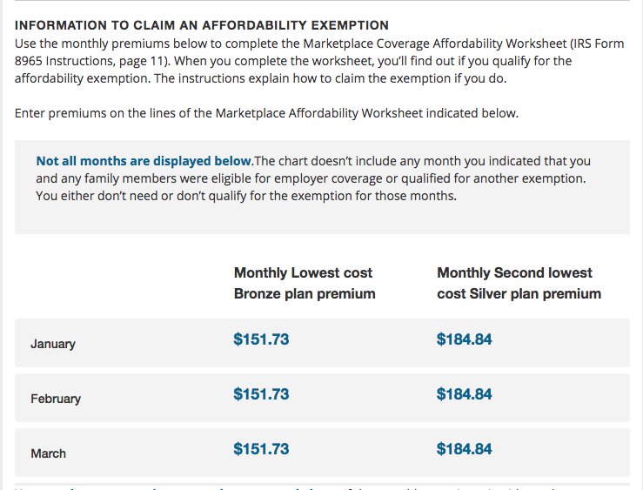
Example 2: Marketplace Affordability
Use these figures in the Marketplace Affordability Worksheet or other calculator tool.
This results in a monthly contribution of $25.
The annualized amount is $300, which is less than 8.13% of his income.
Insurance is affordable and he does not qualify for exemption.
Note: LCBP and SLCSP are for 2015

Slide 50
Example 3: Marketplace Affordability
Summer is single with no dependents.
She lived in Los Angeles, CA (90017) all year.
Uninsured all year. No offer of employer-sponsored coverage.
W-2: Box 1 - $13,000, Box 2 - $400.
Summer’s LCBP is $166
Does Summer qualify for an exemption?
With an income of $13,000 in a Medicaid expansion state, Summer was eligible for Medicaid, but she didn’t enroll.
Therefore, determine if the (annualized) LCBP is less than 8.13% of her income.
$166 x 12 = $1,992
$1,992 /$13,000 = 15.3% of income
15.3% of income > 8.13%
Insurance is unaffordable. Claim Code A exemption.
Note: LCBP and SLCSP are for 2015

Slide 51
In general…
A person is likely to qualify for exemption if:
Eligible for Medicaid but not enrolled (under 138% FPL in expansion state; under 100% FPL elsewhere). Confirm that the annualized LCBP is greater than 8.13% of income.
Otherwise ineligible for PTC (e.g., married filing separately). Confirm that the annualized LCBP is greater than 8.13% of income.
Eligible for PTC with income at 249% FPL or higher.
A person will not qualify for exemption if:
Eligible for PTC with income between Medicaid-eligibility level (100/138% FPL) and 248% FPL.
Why? The premium tax credit is determined by income. Below 249% FPL, the formula requires premium payment of no more than 8.13% of income.
The result may be different for tobacco-users, depending on the state, because the SLCSP does not account for the higher premiums some tobacco users have.
Always do the calculation! Don’t assume eligibility or ineligibility for a Code A exemption.

