Slide 1
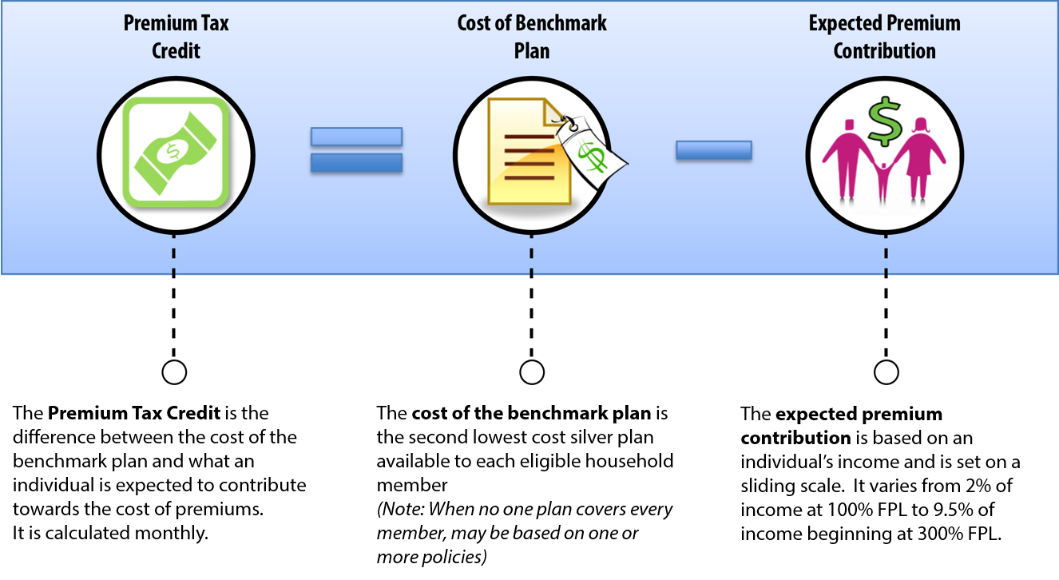
How to Calculate the Premium Tax Credit

