Slide 1
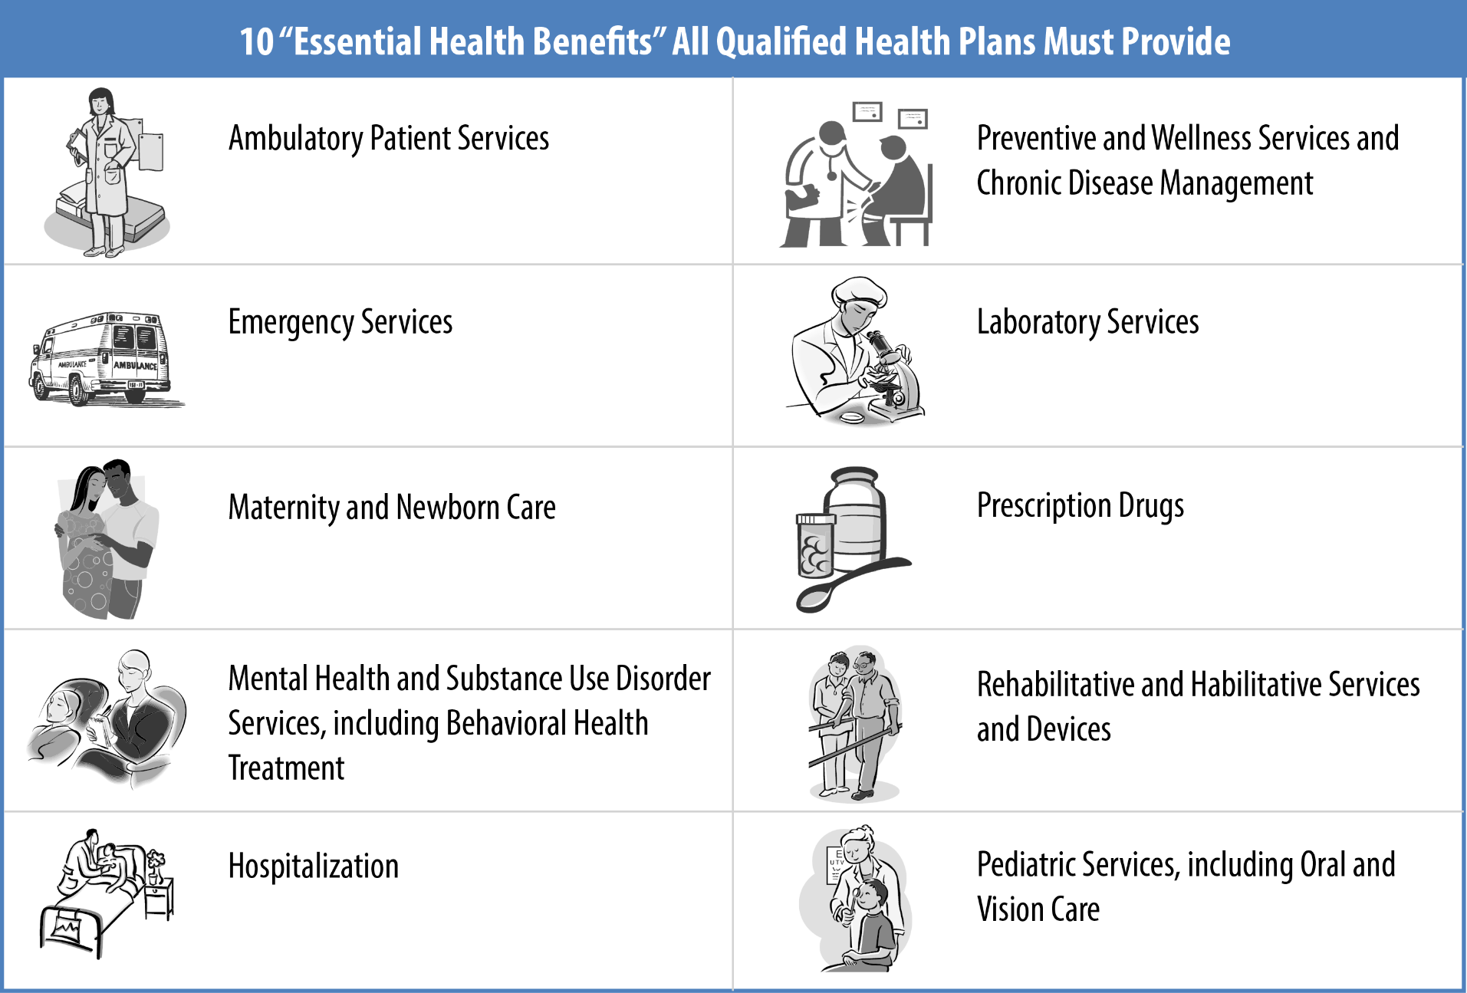
Ten Essential Health Benefits (EHBs)

