Slide 1
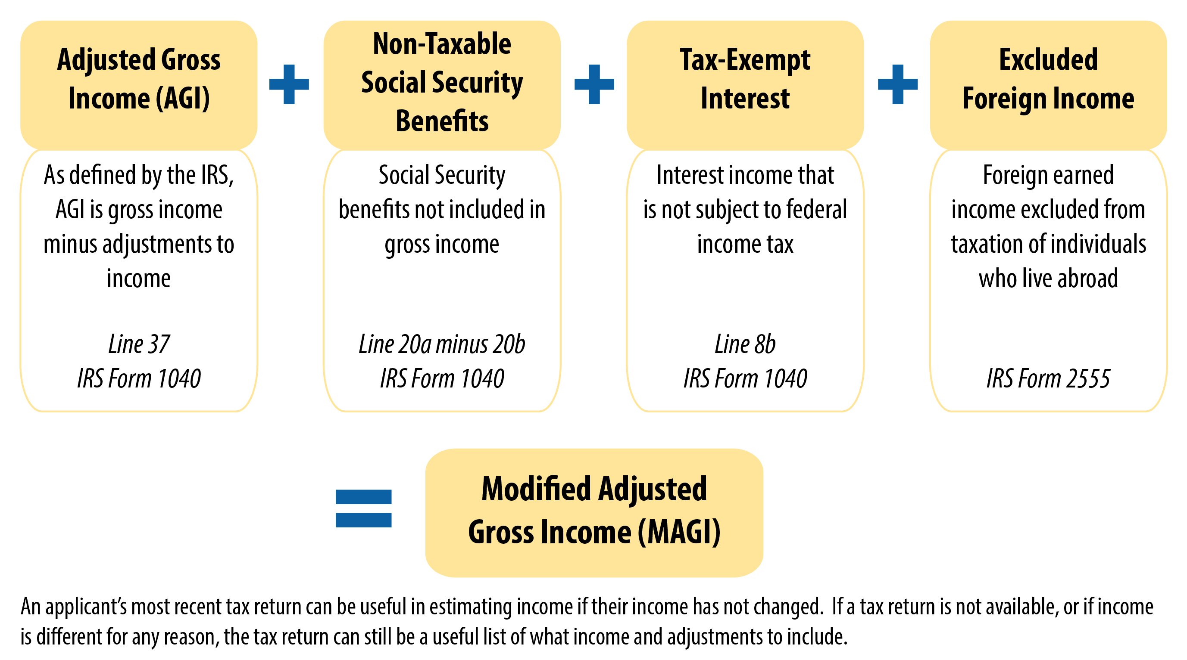
Calculating Modified Adjusted Gross Income (MAGI)
*

