Slide 1
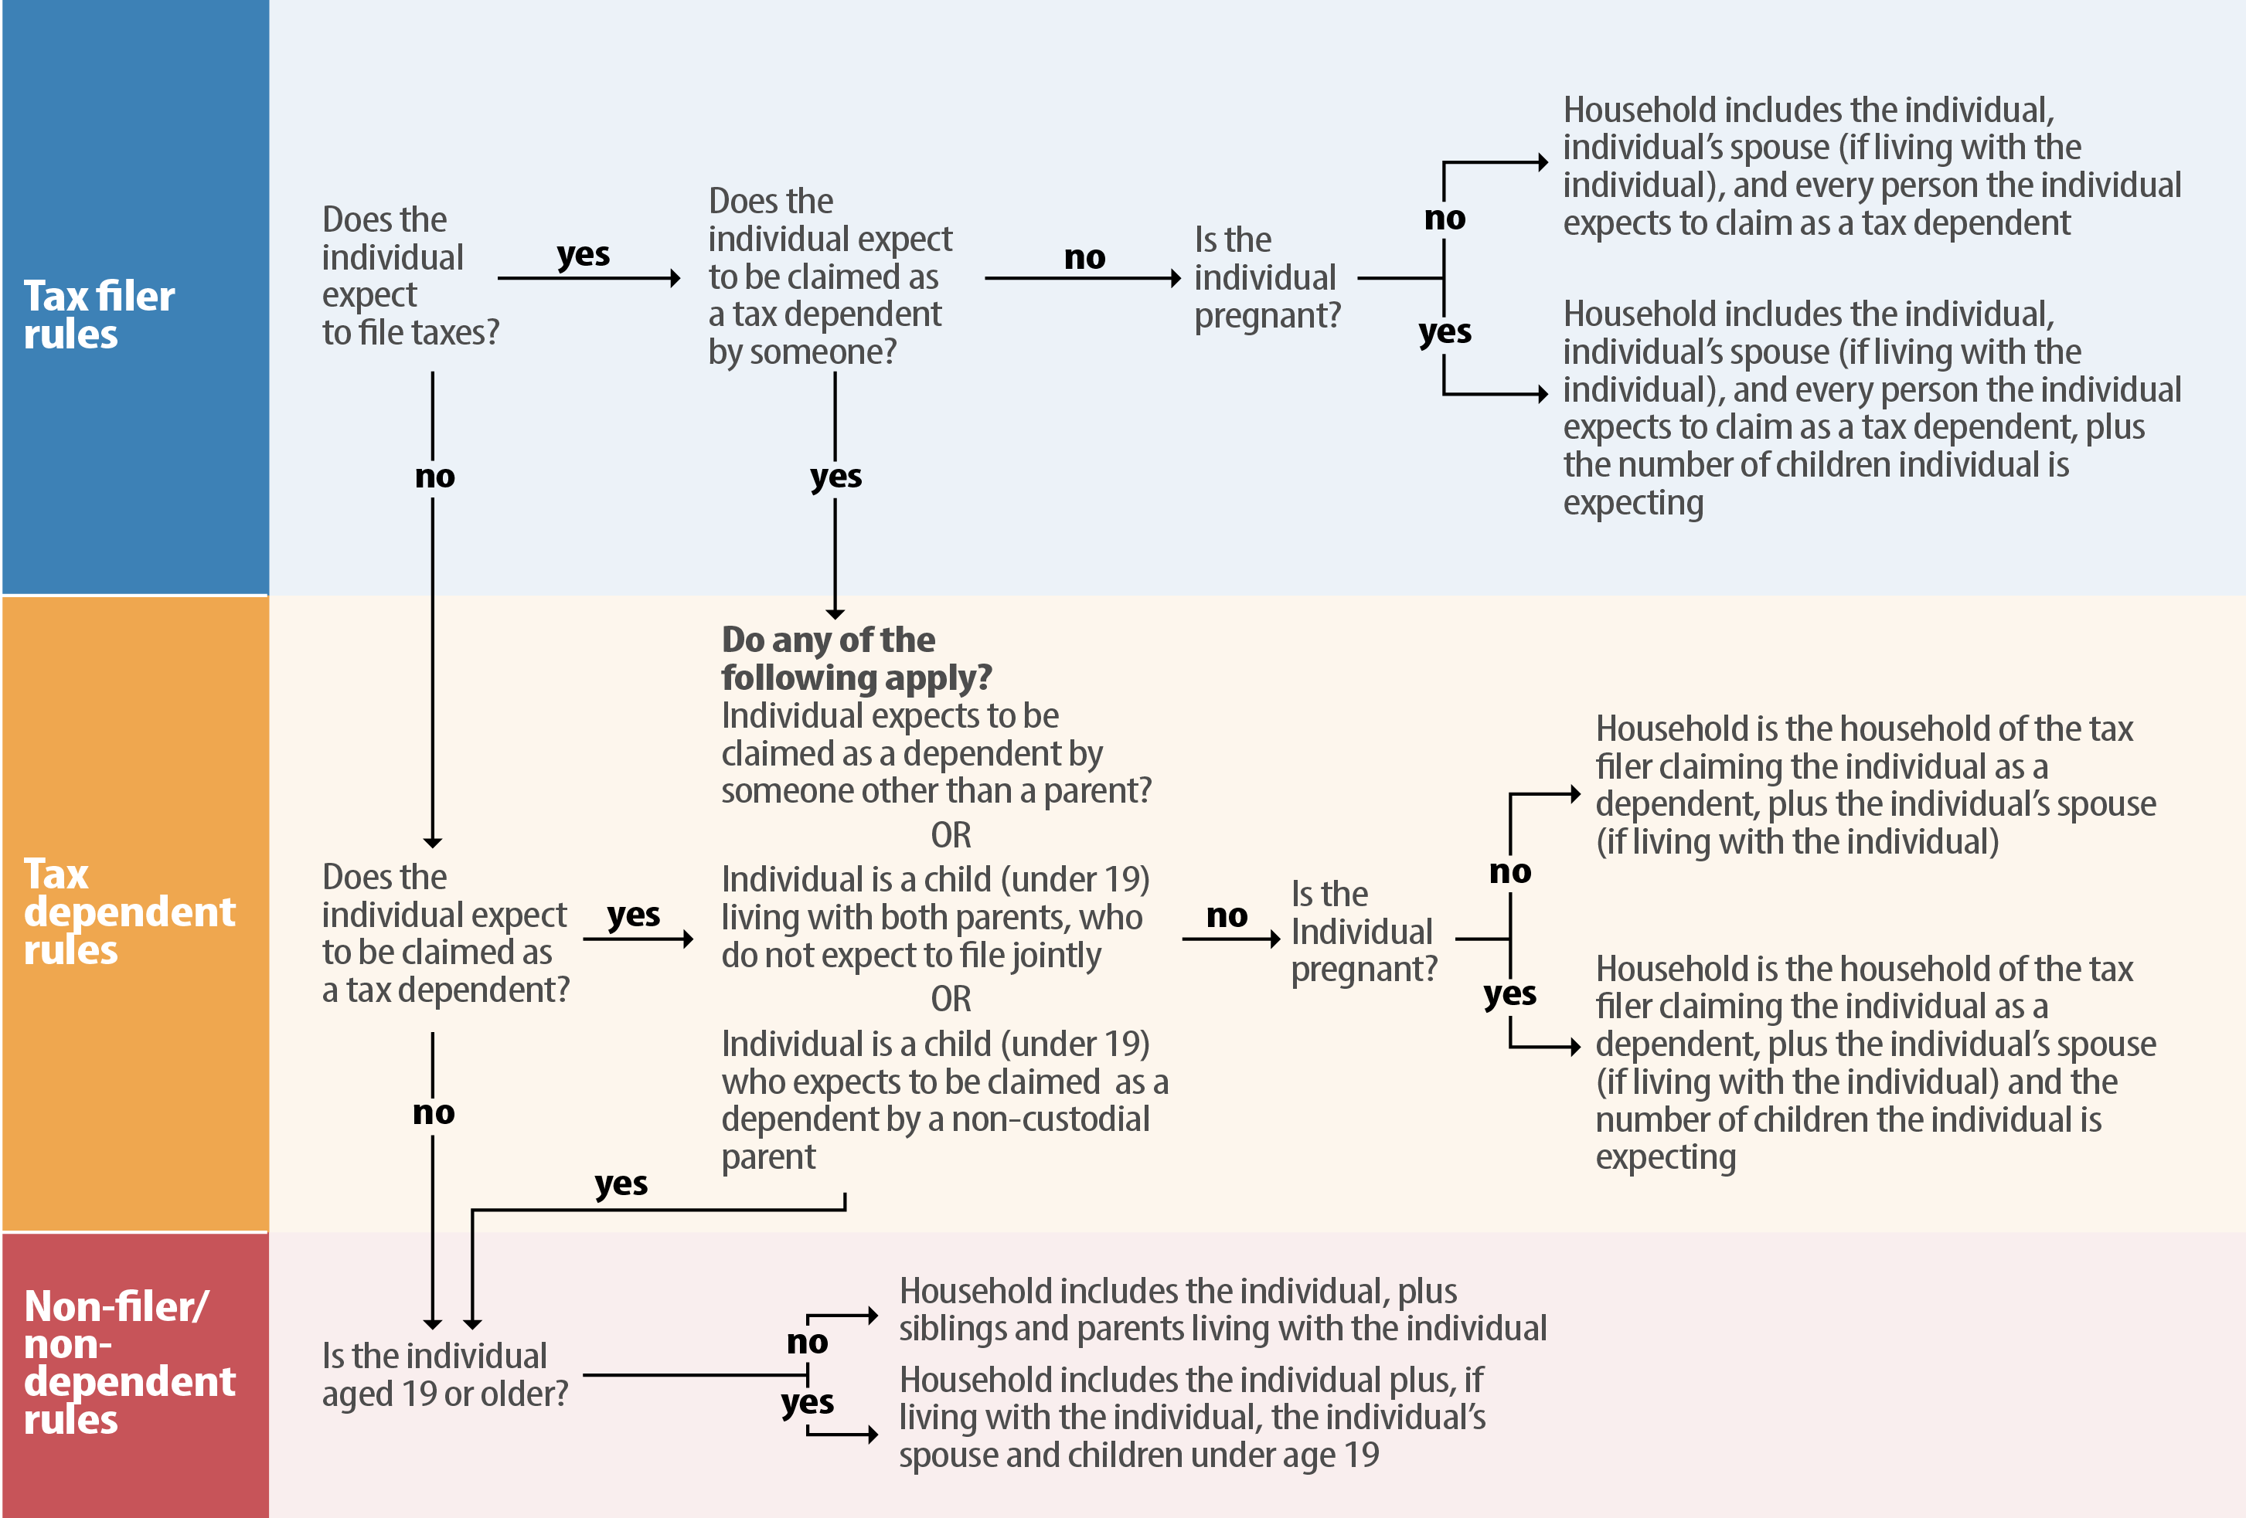
How to Determine An Individual’s Medicaid Household

