Slide 1
Part I: Introduction to the ACA
Minimum Essential Coverage
Current as of October 30, 2014

Slide 2
Welcome to the ACA

Slide 3
What is the Affordable Care Act?
The Patient Protection and Affordable Care Act (ACA) is a federal law signed by the President on March 23, 2010.
  The law expands access to health insurance and creates a requirement to have coverage.
  For the first time, taxpayers will:
    Report health coverage (and lack of coverage)
    Claim an exemption from the coverage requirement
    Calculate a payment for any months without coverage or exemption
    Reconcile advance payments or claim premium tax credits
  Tax year 2014 is the first year that the individual shared responsibility payment, exemptions and premium tax credit affect tax returns.
  All of these ACA-related tax items are in scope for Basic VITA volunteers.

Slide 4
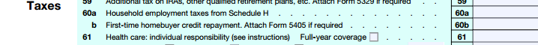
Steps in the tax return related to the ACA
There is a requirement to have health insurance coverage starting Jan. 1, 2014. People without coverage or an exemption may pay a penalty.
 | Did everyone on the return have minimum essential coverage for every month?
Step 1
YES
NO
See Step 2.
 | Is anyone on the tax return eligible for an exemption from the coverage requirement for any month during the year?
Step 2
Can this exemption be granted by the IRS on the tax return?
OR
Does this exemption require approval from the Marketplace?
 | If no coverage and no exemption, calculate Individual Shared Responsibility Payment using tax worksheet.
Step 3
 | If someone on the tax return purchased coverage in the Marketplace and qualifies for a premium tax credit, complete Form 8962.
Step 4

Slide 5
How Does the ACA Work?

Slide 6
Shared Responsibility
Individuals
- Report coverage,
- Claim an exemption from the coverage requirement, or
- Make a shared responsibility payment
Employers
- Large employers: Provide coverage, and
- Small employers: Incentives to provide coverage
Government
- Expand Medicaid (at state option),
- Make available premium tax credits,
- Build Marketplace(s)

Slide 7


Two New Coverage Options
Premium tax credits for families with income 100–400% FPL
28.6 million eligible
8 million enrolled (28%)
85% had financial assistance
Average exchange subsidy will be $7,900 by 2023
Medicaid expansion to individuals and families with income up to 138% FPL
States decide whether to expand

Slide 8
What Are Premium Tax Credits (PTC)?
Assistance with the cost of health coverage for people purchasing coverage in a Health Insurance Marketplace
  Some states use the Federally Facilitated Marketplace (FFM) at www.healthcare.gov. Other states have their own Marketplace. The same rules apply to both.
  Insurance can be purchased only during open enrollment or if a person has cause for a special enrollment period.
Administered by CCIIO (Center for Consumer Information and Insurance Oversight)

Slide 9
What Are Premium Tax Credits (PTC)?
Eligibility Criteria for PTC
To receive a premium tax credit, a person must:
  Be enrolled in a Marketplace plan
  Have income between 100 and 400 percent of the federal poverty line (FPL)
    Individual: $11,690 - $46,760
    Family of four: $23,850 - $95,400
    Exception: Lawfully present immigrants with income under the poverty line are eligible for PTCs if they are ineligible for Medicaid because of their immigration status
  Have an eligible filing and dependent status
    Cannot be married filing separately (exceptions for abandoned and abused spouses )
    Cannot be a dependent
  Be ineligible for minimum essential coverage (MEC), which includes most public and employer-sponsored coverage

Slide 10



What Are Premium Tax Credits (PTC)?
Advanced payment of the PTC can be made based on a determination by the Marketplace during the application process. The actual PTC is claimed on the tax return.
The PTC can be taken:
In advance
  Forwarded to the insurer
  monthly to reduce premiums; reconciled on tax return
or
At tax time
  Claimed on the tax return
Reconciliation

Slide 11
Premium Tax Credits
The PTC is refundable.
Receipt of advance payments of PTC creates a tax filing requirement.
If no advance payments of PTC are made during the year, or if only part of the PTC is received during the year, the remainder may be claimed on the tax return.
If a taxpayer receives excess PTC, it must be paid back.
REPAYMENT LIMITS ON APTC
Income (as % of federal poverty line) | SINGLE taxpayers will pay back no more than … | OTHER taxpayers will pay back no more than….
Under 200% | $300 | $600
At least 200% but less than 300% | $750 | $1,500
At least 300% but less than 400% | $1,250 | $2,500
400% and above | Full reconciliation | Full reconciliation

Slide 12
Why should you care about Marketplace enrollment and PTC?
Marketplace enrollment is minimum essential coverage
People who receive advance payments of PTC must file a tax return, even if they otherwise have no tax filing requirement.
  Also must file if a dependent received advance payments of PTC, or
  If no PTC was received in advance but a taxpayer (or dependent) purchased coverage in the Marketplace and now wants to claim the credit
Advance payments of PTC are reconciled against the amount of PTC that is allowed based on the taxpayer’s year-end household and income (Form 8962)

Slide 13
Medicaid Expansion
Who is newly eligible?
  Mainly adults, including parents (whether or not they work) and adults without dependent children
At what income?
  138% of federal poverty level (FPL)
  Depends on family size
Administered by CMS (Centers for Medicare and Medicaid Services) at the federal level and your state Medicaid agency
Family Size | 138% FPL (in 2014 dollars)
1 | $16,105
2 | $21,707
3 | $27,310
4 | $32,913

Slide 14
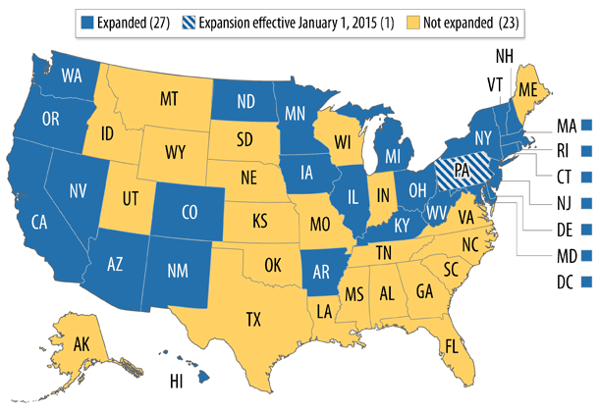
Status of State Medicaid Expansions

Slide 15
Why should you care about Medicaid coverage?
In Medicaid expansion states, more low-income people will have minimum essential coverage
  Likely to have an easier tax return: More likely to check a box on the tax return for MEC instead of determining exemption eligibility or calculating shared responsibility payment.
  Referral for coverage: Eligible people can enroll in Medicaid at any time. Enrollment in Marketplace coverage is limited to open and special enrollment periods.
In non-expansion states, low-income adults may be in a coverage gap: not eligible for help until PTC begins at 100% FPL
  Less likely to have coverage: More will need to qualify for an exemption or make a shared responsibility payment.
  Referral for coverage: Enrollment in Marketplace coverage is limited to open and special enrollment periods. However, a person may be eligible for Medicaid under existing rules (even without expansion) so it’s helpful to check.
TIP
  There is an exemption for people who are in the coverage gap in states that did not expand Medicaid.

Slide 16
Minimum Essential Coverage

Slide 17
What is minimum essential coverage (MEC)?
Starting in 2014, most people are required to have health insurance that qualifies as minimum essential coverage and to report it on their tax return.
Most types of coverage count as minimum essential coverage
Coverage for one day = coverage for the month

Slide 18
Minimum Essential Coverage (MEC)
QUALIFIES AS MEC
Employer sponsored coverage
  Employee coverage
  COBRA
  Retiree coverage
Individual health insurance
  Purchased from a health insurance company
  Purchased through the Marketplace
  Provided through a student health plan
Government-sponsored plans
  Medicare
  Most Medicaid
  CHIP
  Most TRICARE
  Most VA
  State high-risk insurance pools
  Peace Corps
  Refugee Medical Assistance
LIMITED BENEFITS THAT ARE NOT MEC
  Single-benefit coverage (e.g., dental-only or vision-only plans)
  Accident or disability insurance
  Workers’ compensation
  AmeriCorps/AfterCorps coverage
  Limited-benefit Medicaid
    Family planning services
    Tuberculous treatment
    Pregnancy-related
    Emergency medical condition
    1115 demonstrations
    Medically needy
  Limited-benefit TRICARE
    Space-available care
    Line-of-duty care
Exemption available for 2014 – no penalty

Slide 19
Verification of MEC
Many people will have no tax document that verifies MEC in 2014
  Coverage reporting by employers and insurers is voluntary for 2014; will be mandatory starting in Tax Year 2015.
Tax preparers do not need to see specific documentation of insurance.
Instead, tax preparers will use due diligence to determine whether a client has coverage. This includes:
  A comprehensive interview that includes questions about insurance coverage
  A W-2 with code DD in box 12, which indicates some type of health coverage through the employer for some number of months (individual or family coverage)
  Form 1095-A, for people who purchased coverage in the Marketplace
  Forms 1095-B or 1095-C, but since these forms are optional, failure to get one does not indicate lack of coverage. Many insured people will not receive these forms for 2014.
Reminder: Tax return is signed under penalty of perjury

Slide 20
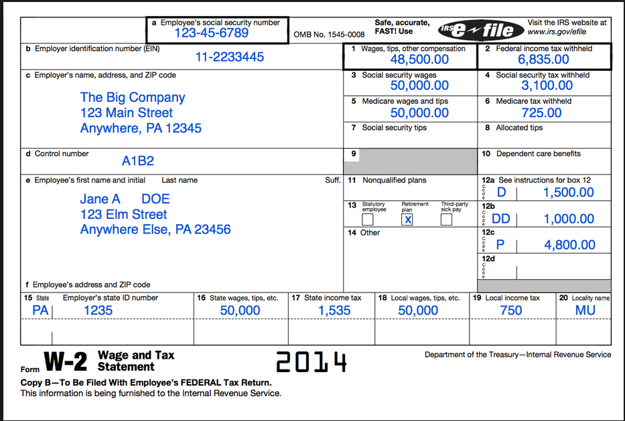
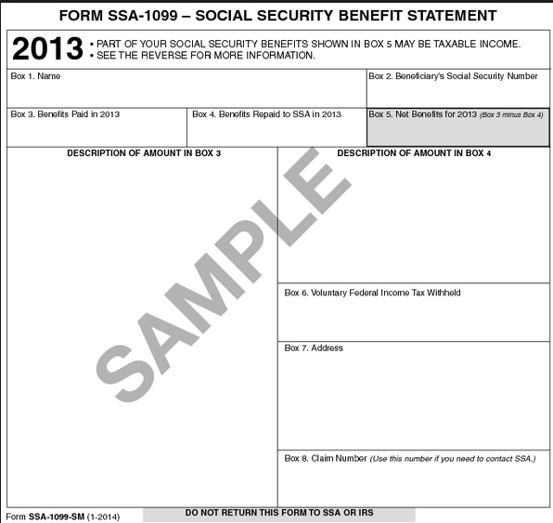
Tax forms that show evidence of coverage
Cost of employer-sponsored coverage
Medicare premiums deducted from benefits

Slide 21
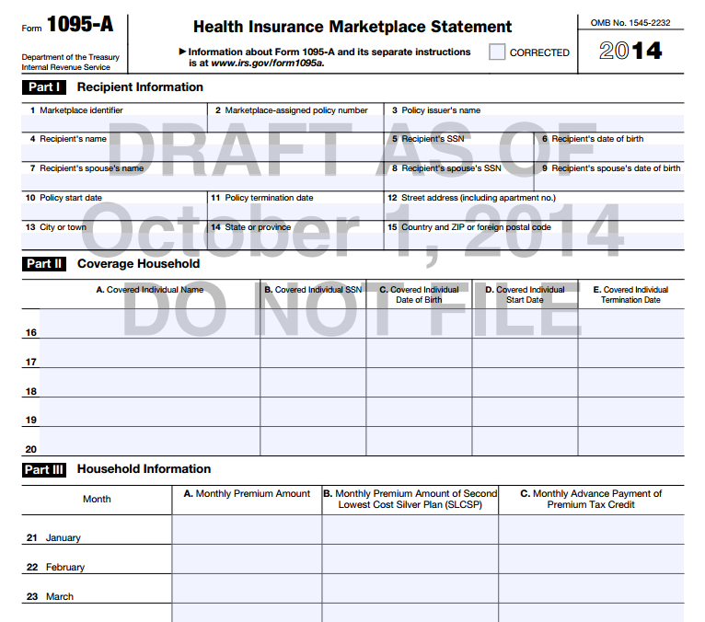
Tax forms that show evidence of coverage
Form 1095-A
Everyone who purchased 2014 insurance in the Marketplace will receive a 1095-A by January 31, 2015.

Slide 22
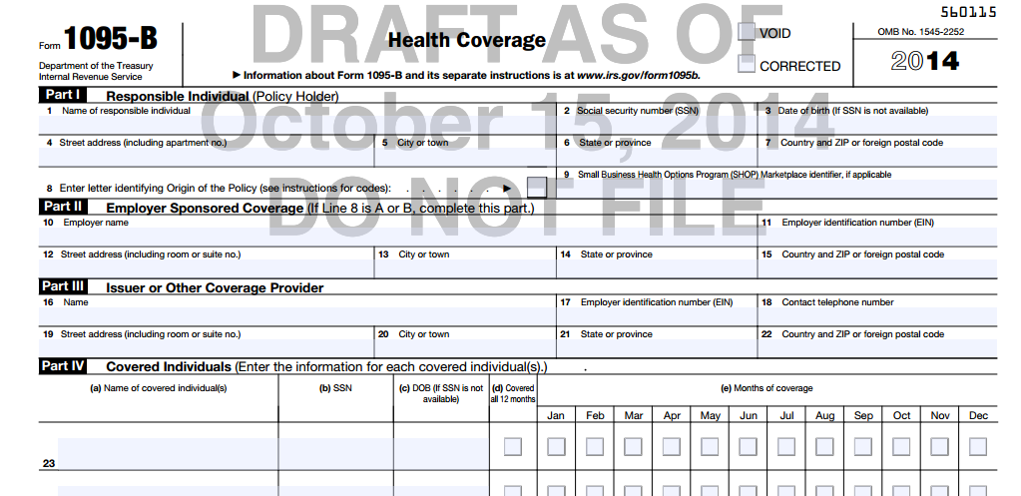
Tax forms that show evidence of coverage
Form 1095-B
Will be sent to taxpayers, mainly by health insurance issuers
Filing this form is optional for issuers for tax year 2014

Slide 23
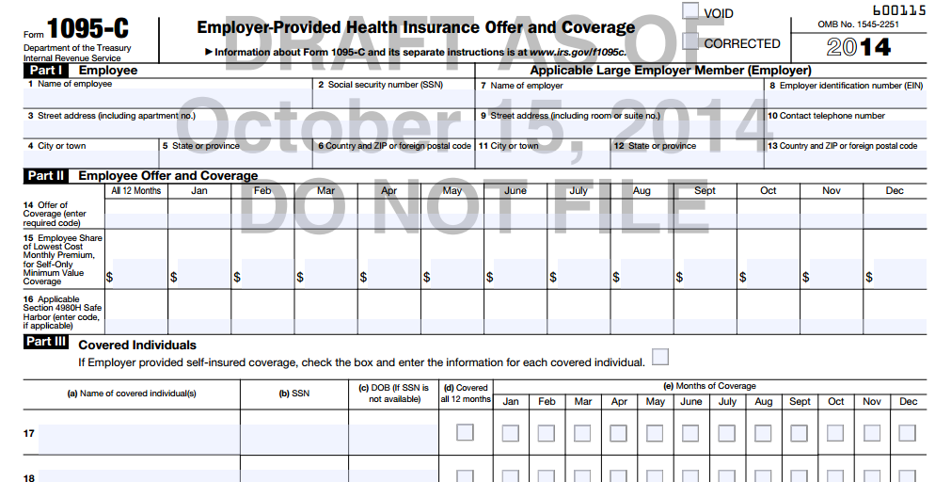
Tax forms that show evidence of coverage
Form 1095-C
Will be sent to taxpayers, mainly by large employers that are subject to the employer shared responsibility requirement
Filing this form is optional for employers in tax year 2014

Slide 24
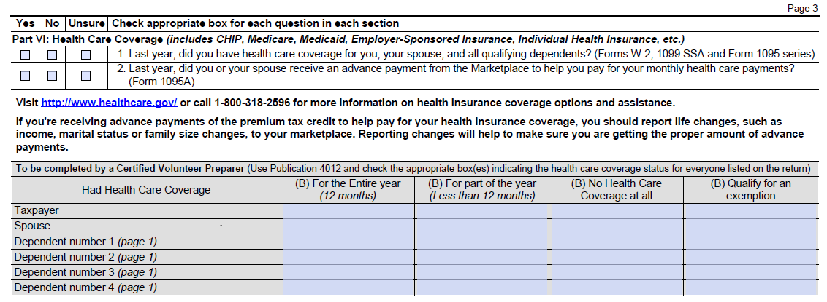
What information will I get from clients at intake?
IRS Form 13614-C
Minimum essential coverage

Slide 25

Example: Reyes Family
Did you have insurance in 2014?
Sonya Reyes lost her health coverage in June 2014
Gilberto Reyes received reimbursement for some medical costs through workers compensation after he was injured at work.
Kids, Gaby and Marco, were enrolled in CHIP all year.
Sonya
Gilberto
Gaby
Marco

Slide 26
Example: Reyes Family
Did you have insurance in 2014?
Next steps:
  No more questions about Gaby and Marco – they’re covered
  Figure out if Sonya and Gilberto are eligible for exemptions for their months without coverage
  If they qualify, correct the intake sheet to note the exemption
Sonya
Gilberto
Gaby
Marco

Slide 27
Common Questions

Slide 28
What happened during the first open enrollment?
Successes
  8 million people enrolled in Marketplace
    85% received financial assistance
    Nearly half (46%) of individuals selecting plans with tax credits in the FFM were able to get covered for $50 per month or less.
  8 million people enrolled in Medicaid
Challenges
  Technology problems deterred enrollment
  Many people didn’t know PTC were available
  Health assisters not trained in tax definitions
More people will be uninsured. They’ll need exemptions or will make payment.
People who received PTC may have gotten too much or too little.

Slide 29
What can we tell a client who is uninsured?
If low-income:
  Apply for Medicaid. The person may be eligible. If not, their Medicaid denial may qualify them for an exemption from the individual responsibility payment for the 2015 tax year.
If income in PTC range:
  Problem: Open enrollment is Nov. 15, 2014 – Feb. 15, 2015
    They may miss the enrollment window for 2015
Direct family to a health care assister anyway. Certain life circumstances (a move, a marriage, job loss, etc) can qualify them for a special enrollment period.
More people will be uninsured. They’ll need exemptions or will make payment.

Slide 30
Outreach Before the Tax Season
Incorporate a health care message on posters, postcards or other mailers. Include:
  Dates of open enrollment (Nov. 15, 2014 – Feb. 15, 2015)
  Where to get insurance
  The consequences of not having insurance
Example:
  Are You Covered? New Tax Credit Can Help with Health Insurance
  If you don’t have insurance, a new credit could cover most of the cost of a new plan. Enroll for 2015 between Nov. 15, 2014 – Feb. 15, 2015. Some people without insurance may face a penalty. Get more information at 1-800-318-2596 or www.healthcare.gov.
This contact information is for the FFM. If your state runs its own Marketplace, use that contact information.

Slide 31
Outreach During the Tax Season
Beginning of season to February 15
  Open enrollment ends soon! Do you have coverage?
  Navigators and other in-person assisters
    How do I find an in-person assister? https://localhelp.healthcare.gov/
    https://www.getcoveredamerica.org/locator/
February 15 to end of tax season
  After February 15, a person who learns about new coverage options may be frustrated to find out that they need to wait until 2016
  They should talk to a Navigator or other in-person assister to find out if they qualify for Medicaid or a special enrollment period.

Slide 32
How do I work with an in-person assister?
Bring health enrollment and tax assistance together
  Co-location
  “Super-Site” days
  Warm referral: Facilitate setting up an appointment
  Cold referral: Provide hours, locations, directions
Find someone who can answer your FAQs (and vice versa)
  Tax to health: Does x count as MEC?
  Health to tax: Is x income taxable?

Slide 33
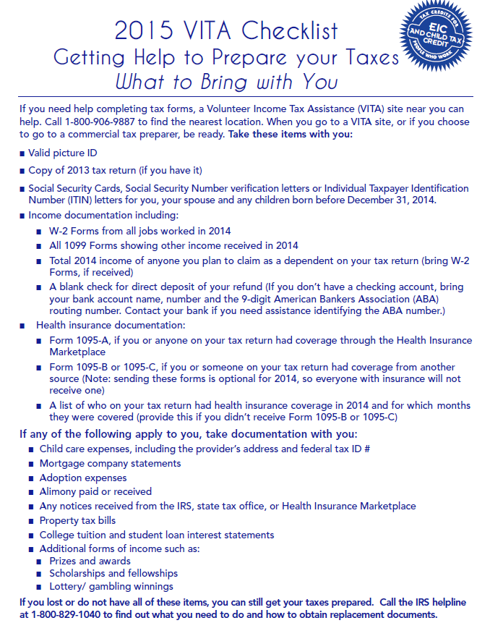
What Should Clients Bring to the Site?
Coming soon to eitcoutreach.org!

Slide 34
EITC Outreach

Slide 35

CBPP's National Tax Credit Outreach Campaign
The Campaign provides:
  Trainings
  Technical assistance and support
  Connection to a network of outreach organizations
  Tax Credit Outreach Kit
  Online resources at www.eitcoutreach.org

Slide 36
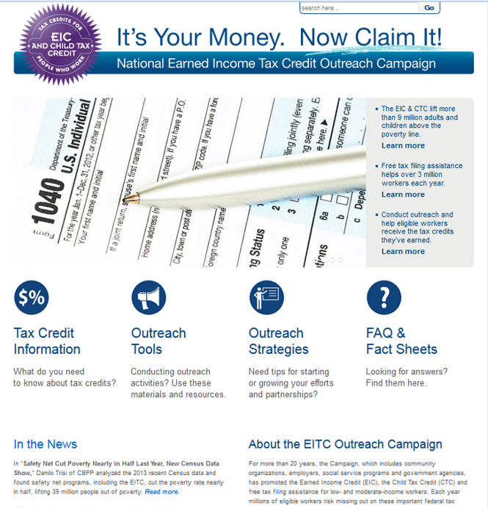
EITCoutreach.org: Online Resources
Outreach materials: EIC/CTC Flyers in 21 Languages, Envelope Stuffers, VITA Site Checklist
EIC Estimator
Searchable Outreach Strategies Database
Video Library
State EICs
Infographics
In the News

