Slide 1
Part III – ACA Examples
Presented on November 23, 2015

Slide 2
Agenda
What’s New in TaxWise (Practice Lab)
Examples
Draft forms and instructions:
Form 8962, Premium Tax Credit https://www.irs.gov/pub/irs-dft/f8962--dft.pdf
Form 8962 Instructions https://www.irs.gov/pub/irs-dft/i8962--dft.pdf
Publication 4012 https://www.irs.gov/pub/irs-pdf/p4012.pdf

Slide 3
ACA in TaxWise
As of 11/16/2015

Slide 4
New ACA Worksheet: Household Questions
ACA Page 1: Asks questions about the insurance/exemption status of the household and of individuals
ACA Page 2: Calculates the individual shared responsibility payment (ISRP)
Two new household questions at the top:
Did someone purchase Marketplace coverage?
If yes, Form 8962 will be added and required
Will someone claim any exemption?
If yes, Form 8965 will be added and required

Slide 5
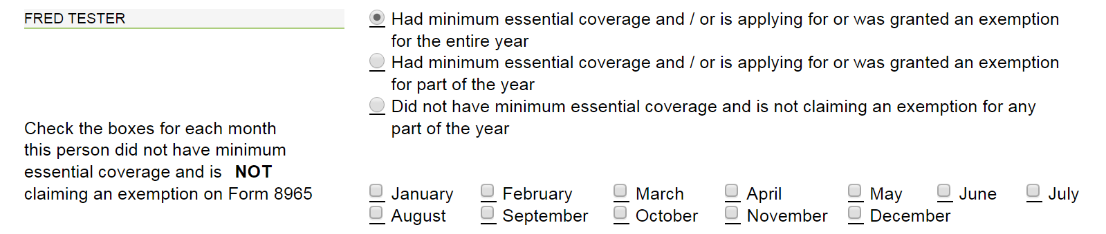
New ACA Worksheet: Full-Year Coverage or Exemption
To check the box on Line 61, must:
Indicate in the Household Questions that there is no exemption, and
Check the first box indicating full-year MEC (or exemption) for each individual on the tax return

Slide 6
New ACA Worksheet: Part-Year Shared Responsibility Payment
Check this box for some months with a shared responsibility payment and some months without
Checking this middle box will make the month boxes red and require responses. Check the months with no coverage and no exemption (i.e., penalty months)

Slide 7
New ACA Worksheet: Full-Year Shared Responsibility Payment
Check this box if the person has no coverage and no exemption and will make a payment for the entire year
No month boxes are highlighted. Checking/unchecking boxes will not change the ISRP calculation on ACA Page 2.
Quality Review Tips:
Look carefully at whether the second or third options are checked. Do not check the third option (full-year ISRP) and month boxes.
Review ACA Page 2

Slide 8
New ACA Worksheet – Page 2
Line 7 is a required field if at least one dependent is listed on the return
Remember: ONLY enter the dependent’s modified AGI (MAGI) if the dependent has a tax filing requirement (Pub. 4012, A-2)
Otherwise, hit F3

Slide 9
New ACA Worksheet – Page 2
After completing the return, ask: Does the result make sense?
Review Form 1040, Line 61
Should the taxpayer owe any ISRP at all? If not, Line 61 should be blank.
If the taxpayer does owe ISRP, is it based on a flat-dollar amount (relatively lower income person) or a percentage of income (relatively higher income person)?
Is the penalty amount prorated or owed for the full year?

Slide 10
Sequence – In what order do I complete the ACA elements?
During intake:
Have a detailed conversation about coverage months to complete or partially complete the Intake Form
Preparing the return:
If everyone had coverage all year, complete the ACA Wkt first
For months without coverage, prepare the rest of the tax return, consider exemptions, and complete the ACA Wkt last
Start with household exemptions (Form 8965, Lines 7a & 7b)
Then consider individual exemptions (annual/monthly)
Complete Form 8965 if any exemption applies
Complete ACA Wkt, Pages 1 & 2. Check Line 61.
Complete Intake Form

Slide 11
Basic-Level Examples

Slide 12
Example 1
Fred and Sandy are MFJ.
They have two tax dependents: 27-year-old daughter, Janey, and Janey’s infant daughter, Ava.
Janey briefly worked part-time but earned less than $4,000. She is a dependent with no filing requirement.
They live in Texas, a Medicaid non-expansion state.

Slide 13
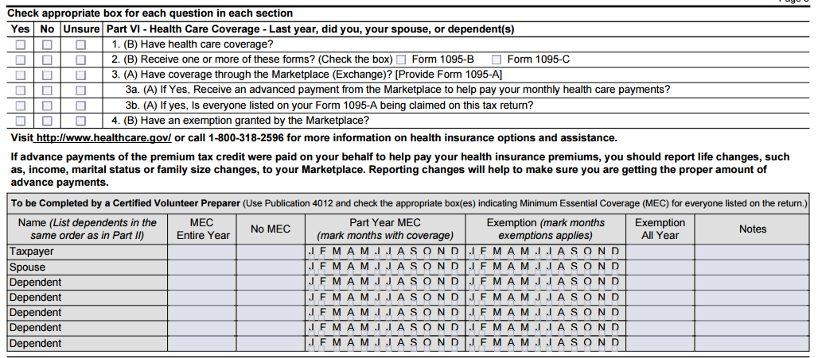
Example 1
Fred and Sandy had coverage through Sandy’s employer all year.
Janey had coverage through her own employer from January to March and then enrolled in Medicaid when she found out she was pregnant. She had Medicaid coverage the rest of the year.
Ava was enrolled in Medicaid at birth in September.
x
x
x
x
x
x
Janey
x
Ava

Slide 14
Example 1
Everyone but Ava had coverage in every month
What is Ava’s coverage requirement?
Remember: The coverage requirement applies to FULL months alive.
Ava is considered covered in months prior to and including the month of birth. She only needs coverage Oct – Dec. (But here, she actually had coverage Sept – Dec.)
How do we report Ava’s coverage?
Since everyone else on the return had coverage, check the first box for coverage/exemption all year.

Slide 15
Example 1: Variation
Fred and Sandy had coverage through Sandy’s employer all year.
Janey was uninsured until April, when she found out she was pregnant and enrolled in Medicaid. She had Medicaid coverage the rest of the year.
Ava was enrolled in Medicaid at birth in September.
What are the gaps in coverage?
Ava: Jan – Aug
Janey: Jan – Mar
x
Employer
x
Employer
Janey
Medicaid: Apr-Dec
Ava
Medicaid: Sept-Dec

Slide 16
Example 1: Variation
No household exemptions apply
Do any individual exemptions apply?
Ava is required to have coverage October to December, but the way we report it changes because we can’t otherwise “check the box.”
Ava is eligible for exemption Code H for months prior to and including month of birth.
Complete the Form 8965 for Ava. Then complete the ACA Wkt and the Intake Form.
Form 8965
ACA Page 1

Slide 17
Example 1 Variation
Do any individual exemptions apply for Janey?
Janey had coverage April through Dec
You determine she is ineligible for an exemption for Jan, Feb or March
ACA Page 1
To correctly calculate the ISRP, did Janey earn enough to require filing a tax return?
ACA Page 2

Slide 18
Example 1: Variation
x
x
x
x
x
Employer
x
Employer
Janey
Medicaid: Apr-Dec
Ava
Medicaid: Sept-Dec
Code H – Jan-Aug

Slide 19
Example 2
Jonah’s only income was from his job as a concession worker at the local stadium.
His Box 1 wages were $8,500 and his federal withholding in Box 2 was $137.
He was uninsured all year.

Slide 20
Example 2
Jonah isn’t required to file a tax return. But if he does (e.g., to get his withholding or claim EITC), he can claim an exemption for having income below the filing requirement.
ACA Page 1
Enter all income. TaxWise will check Yes automatically on Line 7a if this exemption applies. (It will not determine whether the 7b exemption applies.)
Form 8965
ACA Page 1

Slide 21
Example 3
You are preparing Anna’s return.
She divorced Mark in 2013 and has not remarried.
Anna claims their daughter, Cindy Lou, as a dependent.

Slide 22
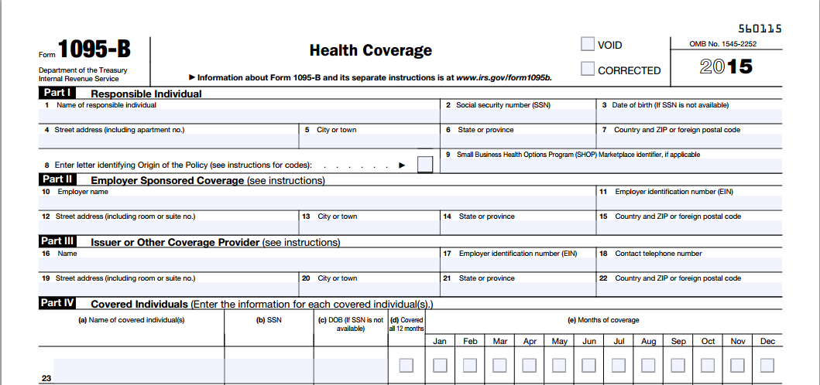
Example 3
Anna had coverage all year through her job. Mark added Cindy Lou to his job-based coverage.
Anna has one Form 1095-B from her employer. It does not include Cindy Lou.
Anna Tester
XXX-XX-XXXX
110 Broadway St
San Antonio
TX
78205
B
Big Ins Co
XX-XXXXXX
XXX-XXX-XXXX
101 Main St
Lexington
KY
40512
Anna Tester
xxx-xx-xxxx
X

Slide 23
Example 3
Anna is sure Cindy Lou is covered on her dad’s plan.
Anna didn’t provide Cindy Lou’s coverage. Does that matter?
No, it doesn’t matter who enrolled or paid for Cindy Lou’s coverage, as long as she has MEC.
Do you need to see Mark’s 1095-B or –C to confirm Cindy Lou’s coverage?
No, if you determine Cindy Lou had MEC from the interview, it’s not necessary.
ACA Page 1
Form 1040

Slide 24
Example 4
Gregory and Alice are MFJ.
Alice earns $24,000 and is not offered coverage through her job.
Gregory earns $18,000 and enrolls in job-based insurance for himself for $84/month. Gregory is insured for the entire year.
Gregory’s employer offers family coverage for $98/week but they decide it’s too expensive. Alice is uninsured all year.

Slide 25
Example 4
You determine that no other household or individual exemption applies for Alice, and you approach the Affordability Exemption.
Start by adding the ACA Affordability Worksheet.

Slide 26
Example 4
Line 2: Gregory’s cost of coverage
How will Gregory know the exact cost of his insurance?
Last pay stub
Difference between Box 1 and Box 3 of the W-2 (if no other payroll deductions)
Box 12, DD. Caution: The amount in Code DD should be the full cost of the employer-sponsored coverage, not just his share of the cost. So the amount in DD may not be applicable here.
Line 4: This is 8.05% of household income. We will compare Alice’s insurance cost to this amount.

Slide 27
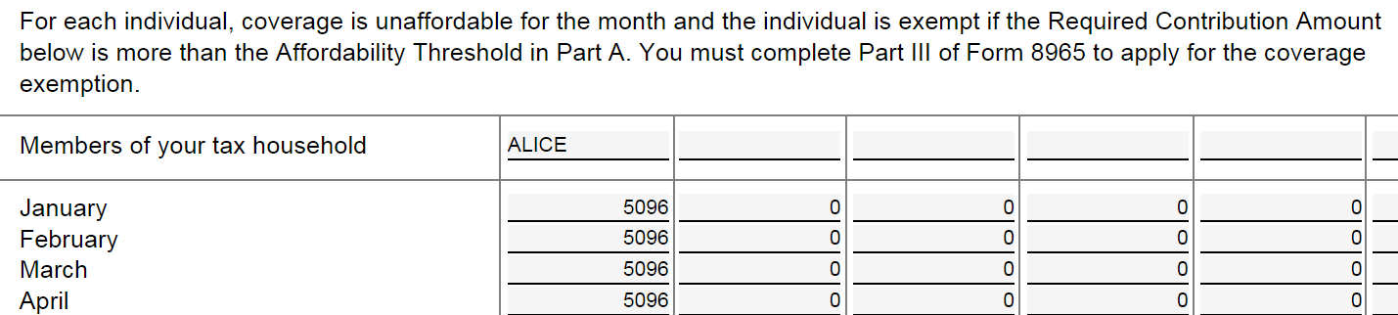
Example 4
We’re comparing annual income to annualized premium
Affordability Threshold = $3,462 (8.05% of household income, from Part A, Line 4)
Required Contribution Amount:
Alice’s annualized premium of $5,096 ($98/wk x 52)
Code A exemption applies because the annualized premium cost of $5,096 is greater than the Affordability Threshold of $3,462.
Complete Form 8965 (enter Code A for the entire year), the ACA Worksheet indicating exemption all year, and the Intake Sheet

Slide 28
Example 4: Variation
Everything is the same, except Alice was offered self-only coverage through her employer at a cost of $150 per month from January to July. Then she switched to a job with no offer of coverage. She also had the offer through her husband’s employer at $98/wk for the entire year. She didn’t enroll in any coverage.
Which plan’s affordability do we measure? Or do we measure both? Go to the ACA Worksheet and review the bullets
Use her self-only offer for Jan – July.
Use her offer through her husband’s employer for the remaining months.

Slide 29
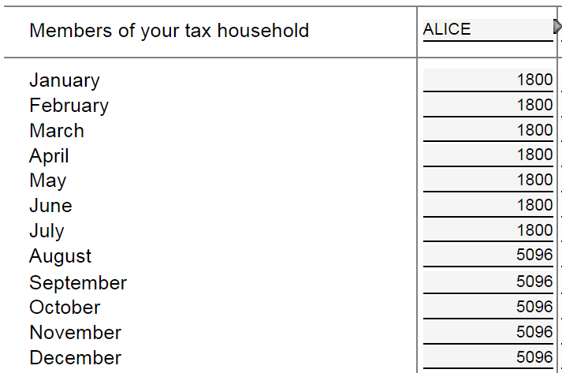
Example 4 Variation
Compare the dollar amount in each month to the Affordability Threshold above:
January – July are less than the Affordability Threshold. The insurance was affordable. No exemption applies.
August – December is greater than the Affordability Threshold. The insurance was not affordable. Exemption Code A applies August – December.
January – July reflect the annualized cost of the coverage Alice was offered through her job ($150 x 12 mo)
August – December reflect the annualized cost of the coverage Alice was offered through her husband’s employer ($98 x 52 wk)

Slide 30
Example 5
Max is 31 years old and lives in Pennsylvania, a Medicaid expansion state.
At the beginning of 2015, he was unemployed.
He had no income and no insurance until April, when he got work as an electrician.
He was not offered health insurance through this work.
He ended the year with an AGI of $17,500.
He was uninsured all year.

Slide 31
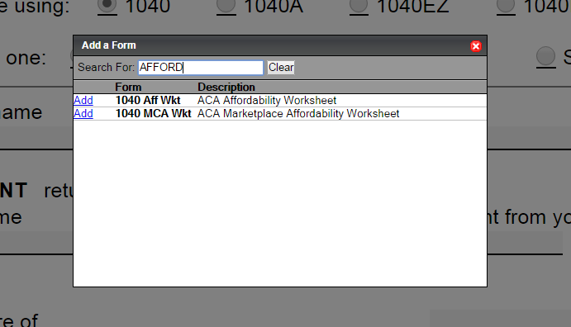
Example 5
Max doesn’t qualify for the Household or Medicaid coverage gap exemption. No other exemption seems to apply. You consider the affordability exemption.
Start by adding 1040 Aff Wkt - ACA Affordability Worksheet

Slide 32
Example 5
Max’s Affordability Threshold (8.05% of household income) is $1,409. If the annualized premium costs more than that amount, the Code A exemption applies.
What cost are we measuring to test affordability?
Go back to Add Forms. Add 1040 MCA Wkt – ACA Marketplace Affordability Worksheet

Slide 33
Example 5
TaxWise will direct you to the online Marketplace tool
If you have a state-based marketplace, you can go its tool directly, or if you’re not sure where to go, start with the link above, enter the taxpayer’s zip code and you will be redirected to the right website.
Note: The Marketplace Affordability Tools for 2015 are not yet available. We’ll use 2014.

Slide 34
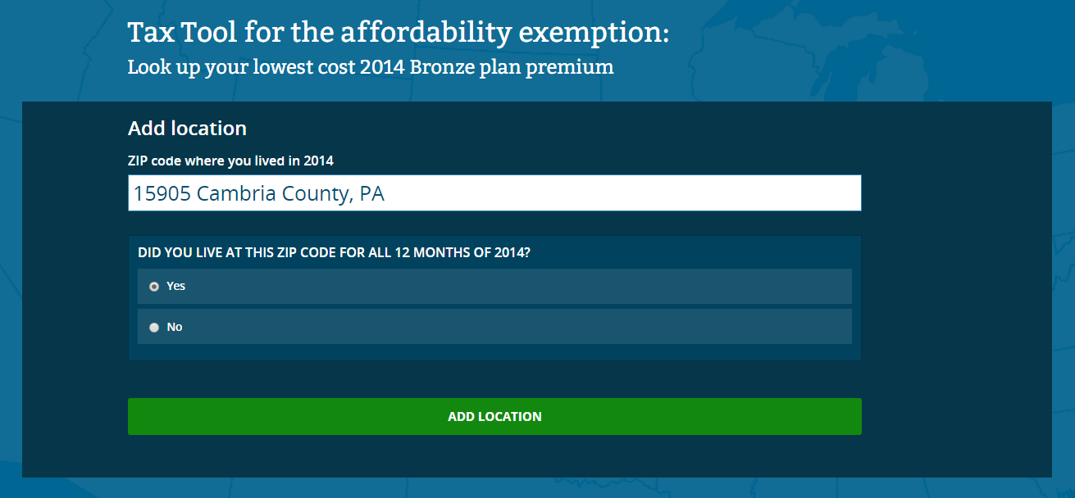
Example 5
Enter the taxpayer’s zip code

Slide 35
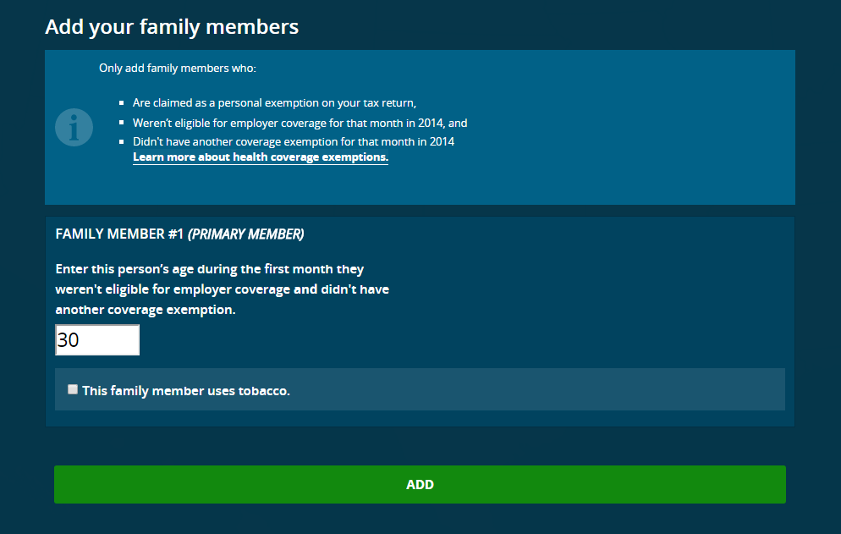
Example 5
TIP: Here, it’s easy because there is only one family member. But keep these instructions in mind.
What is tobacco use? Use of a tobacco product 4 or more times per week within no longer than the past 6 months by legal users of tobacco products (generally those 18 years and older). Includes all tobacco products.
TIP: Premiums may be higher if the person used tobacco. That will make them more likely to qualify for this exemption.

Slide 36
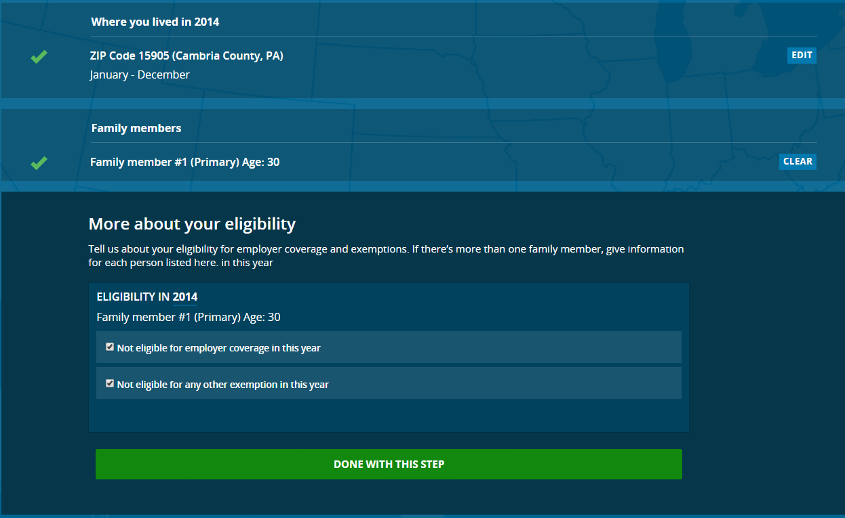
Example 5
TIP: Confirm that each person is not eligible for employer-sponsored coverage and not eligible for any other exemption.
Check both boxes or the next page may be blank.

Slide 37
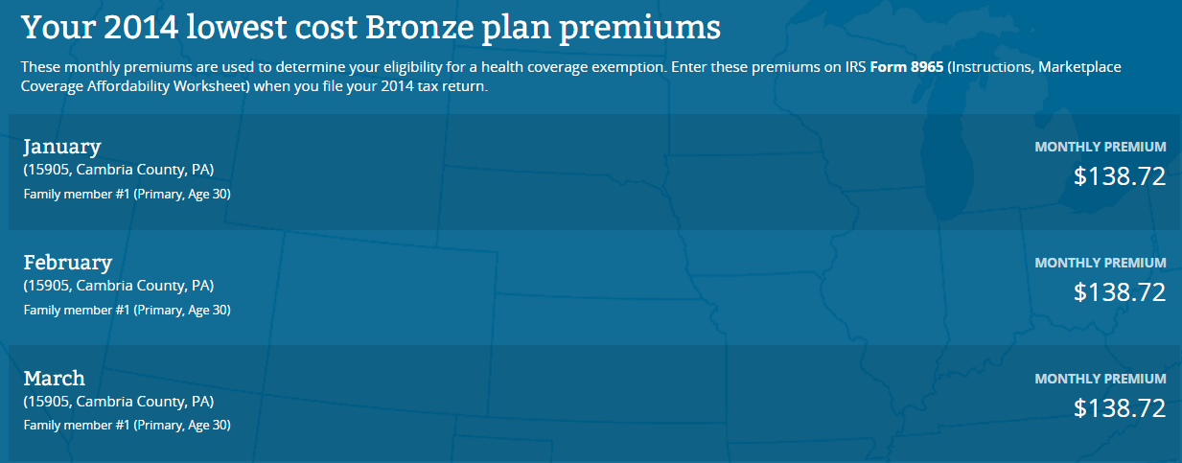
Example 5
Results for lowest cost bronze plan premiums for each month in the tax year

Slide 38
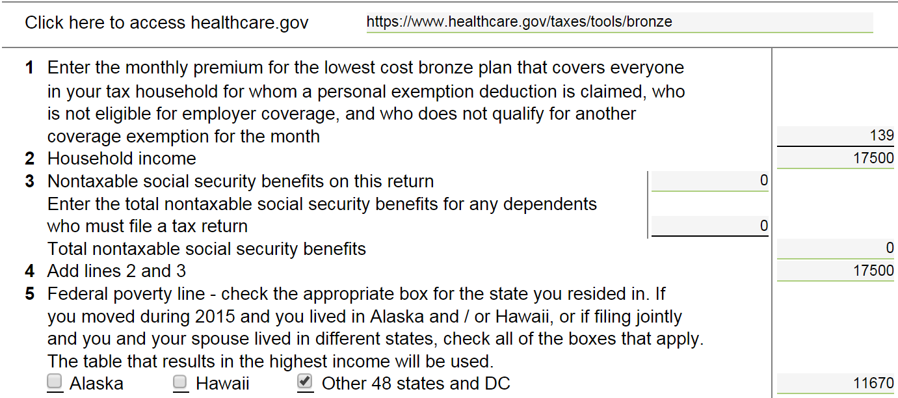
Example 5
LINE 1: Enter amount from HC.gov LCBP tool
LINE 3: Nontaxable social security benefits will carry over from 1040. Enter dependents’ social security benefits only if they are required to file a tax return.
LINE 5: Check box for Alaska, Hawaii, or other 48 states

Slide 39
Example 5
LINE 10: Go to Healthcare.gov SLCSP lookup tool: www.healthcare.gov/taxes/tools/silver

Slide 40
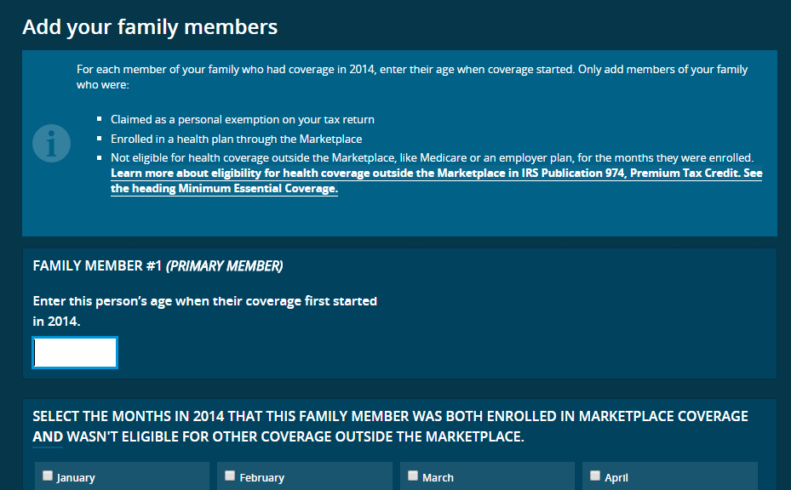
Example 5
Start by entering zip code (Note: the instructions assume that the person was enrolled in coverage – ignore that part.)
TIP: Ignore references to Marketplace enrollment.

Slide 41
Example 5
Click through a few confirmation screens and get the SLCSP.
Enter this on Line 10 of the worksheet
LINE 13: This is the annualized monthly premium. This amount will transfer to the ACA Affordability Worksheet. (Part B, Line 3)

Slide 42
Example 5
Transfers from Mkt Afford Wkt
The amount from Part B, Line 3 gets entered on the month boxes for Max for every month he did not have an employer coverage offer. Here, enter $84 every month.
The amount for each month is less than $1,087—his affordability threshold—so the Marketplace coverage was affordable. The exemption does not apply.

Slide 43
Example 5
Why is Max entitled to no exemption when he didn’t have any income in the first 3 months of the year?
The affordability exemption available on the tax return uses annualized income. It doesn’t matter that his income for some months was zero.
In a Medicaid expansion state, Max would have qualified for Medicaid at the beginning of the year, had he applied, since he had no income.
In a state that did not expand Medicaid, Max would have qualified for the Code G coverage gap exemption for the entire year (regardless of change in income) had he applied.
In either cases, based on annualized income, the exemption no longer applies.

Slide 44
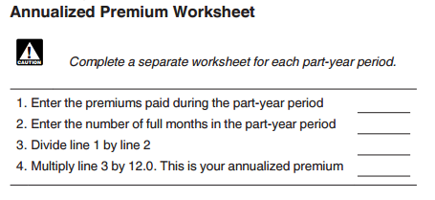
Example 5: Variation
What if Max was offered insurance at his new job but did not take it?
Jan–Mar: Uninsured and unemployed
April–Dec: Uninsured and employed, with an offer of coverage for $85 per pay period (every two weeks) beginning on April 28.
18 pay periods x $85 = $1,530
1530
8
191
2292

Slide 45
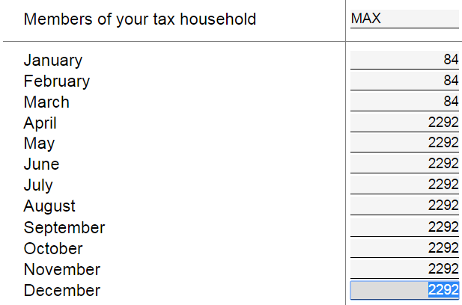
Example 5: Variation
Months with no employer offer. Measure affordability of Mkt coverage.
Code A exemption does not apply.
Months with employer offer. Measure affordability of employer offer, using annualized premium.
Code A exemption apples for these months.

Slide 46
Advanced-Level Examples

Slide 47
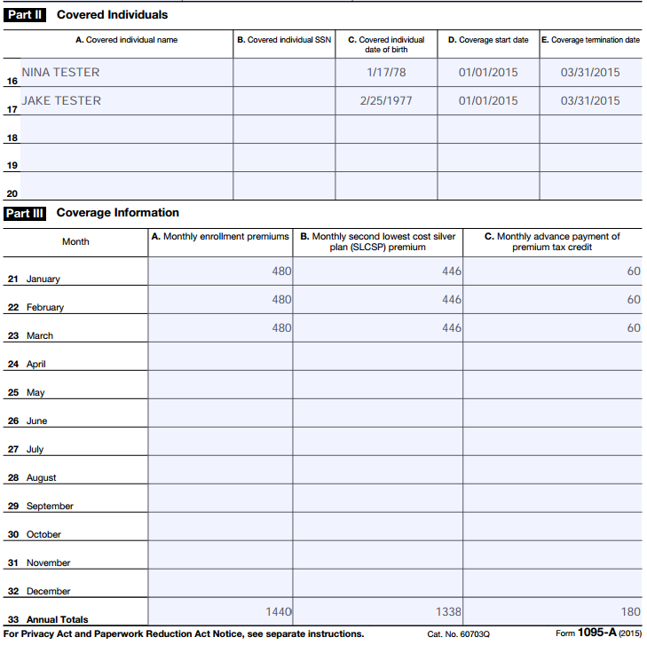
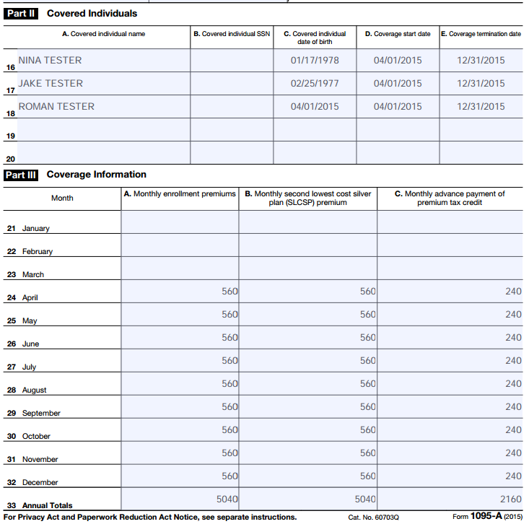
Example 7
Jake and Nina had insurance through the Marketplace. On April 1 they welcomed a baby, Roman, and he joined their health plan as of that day.
They received two Forms 1095-A.

Slide 48
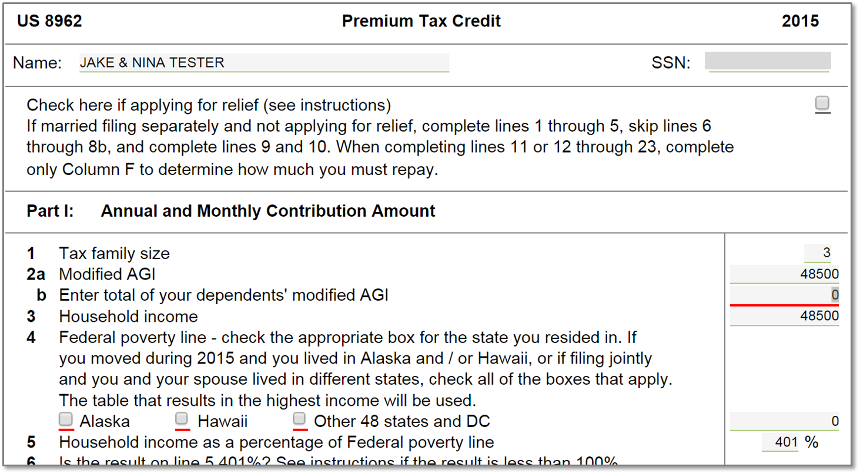
Example 7
Note that even though the number of people in the household changed during the year, the year-end tax family size is used.

Slide 49
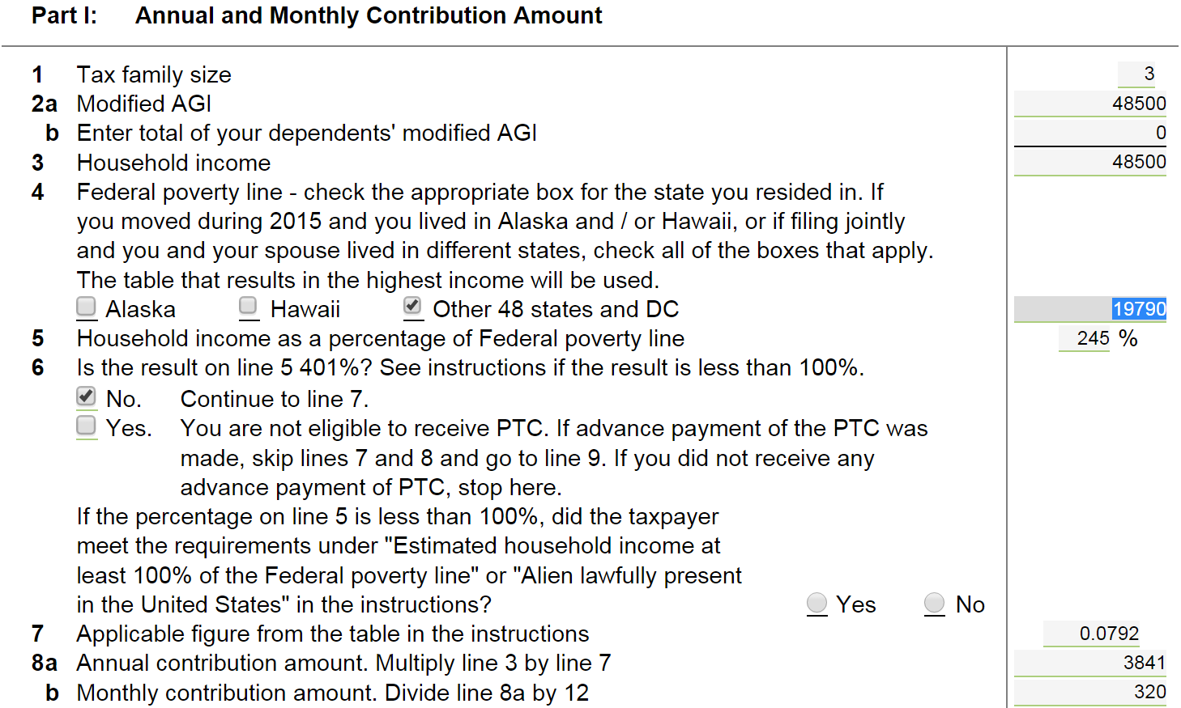
Example 7

Slide 50
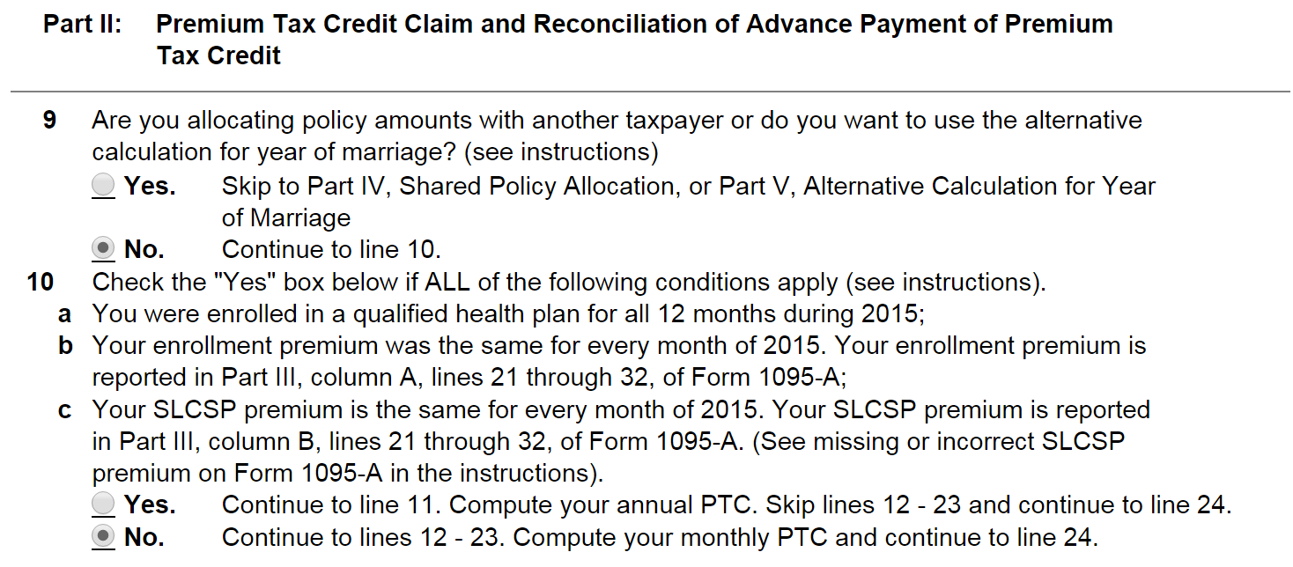
Example 7
Line 10 is expanded to help make a determination about whether to compute annual PTC in Line 11 or monthly PTC in Lines 12-23.

Slide 51
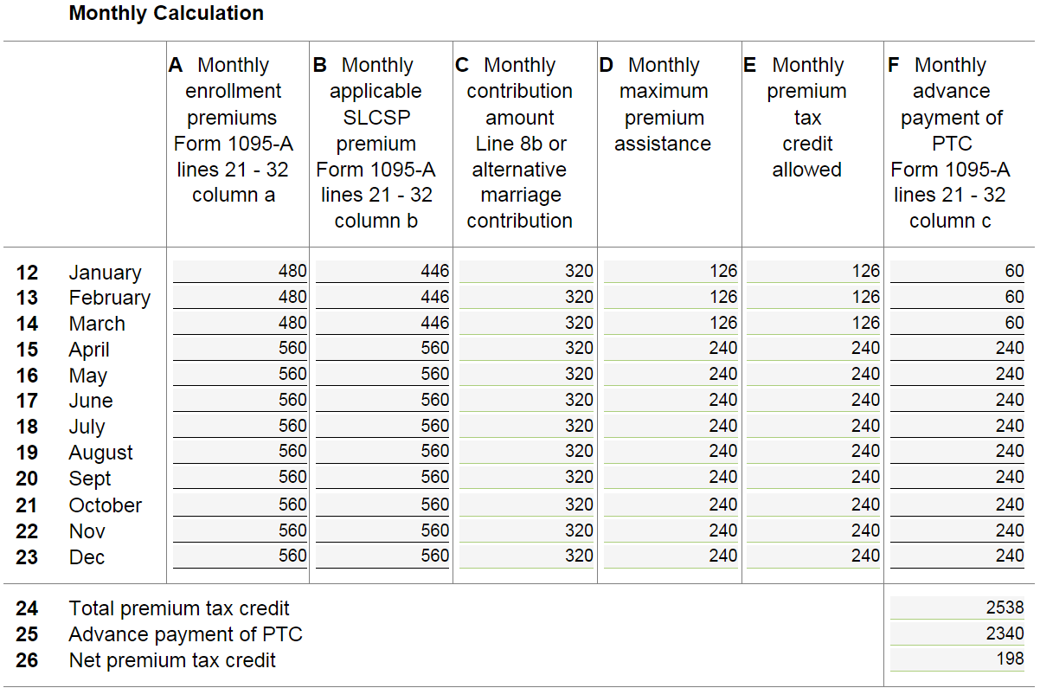
Example 7

