Slide 1
VITA/TCE Advanced Topic:
Premium Tax Credits
Current as of November 21, 2017

Slide 2
Agenda
Webinar #1 – Basic Certification Topics
Minimum essential coverage
Shared responsibility payment
Exemptions
Webinar #2 – Advanced Certification Topics
Reconciling the premium tax credit
Complex 1095-A issues
Review tips

Slide 3
Clean Up
If a taxpayer used the short coverage gap exemption in December 2016, can he use it again in January 2017?
Maybe.
If he was uninsured in December 2016 and January 2017 only, January qualifies as a short coverage gap month because the total gap is less than 3 months.
If he was uninsured in November and December 2016 and January 2017, January does not qualify as a short gap month because the total period is 3 months or more.
If he had received a different type of exemption in November and December 2016, the 2016 exemption period would be treated as ‘coverage’ and the short gap may apply for January.

Slide 4
Clean Up
If you’re measuring the affordability of employer-sponsored coverage to determine eligibility for Code A, does an offer of COBRA or retiree coverage count?
No. COBRA or retiree coverage does not count as an employee offer for this purpose, unless the eligible person or family member actually enrolled in the coverage.
For example:
A person is offered COBRA and does not enroll. He was uninsured.
In testing eligibility for the affordability exemption, he wouldn’t be considered eligible for an employer offer. (And he was not eligible for coverage under another family member’s employer coverage.)
His exemption eligibility will be determined by the affordability of marketplace coverage, after taking into account the PTC.

Slide 5
PTC Refresher

Slide 6
Eligibility Criteria for the Premium Tax Credit (PTC)
To receive a premium tax credit, a person must:
Enroll in a Marketplace plan
Have income between 100 and 400 percent of the federal poverty line (FPL)
Individual: $11,770 - $47,080 Family of four: $24,250 - $97,000
*Exception for people with income below 100% FPL can claim PTC if they received APTC under the belief that they would be income-eligible for the credit.
Have an eligible filing status
PTC cannot be claimed by a person who is Married Filing Separately *Exceptions for abused or abandoned spouses
PTC cannot be claimed on a dependent return (whoever claims an individual’s personal exemption can claim their PTC)
Not eligible for (or enrolled in) other minimum essential coverage (MEC)
Not eligible for Medicare or most Medicaid/CHIP or affordable employer-sponsored coverage (regardless of whether the person is actually enrolled) *Many exceptions allow a person who received APTC to claim the credit despite eligibility for other coverage

Slide 7
Who Must File Form 8962
If a person received any advance payments of PTC, they must file a tax return!
File Form 8962 if:
Any member of the tax family received PTC in advance, or
A member of the tax family purchased insurance in the Marketplace and did not receive PTC in advance but wishes to claim it now, or
The taxpayer received advanced payment of PTC for someone they thought would be claimed as a dependent but is not claimed and no one else claims that individual’s personal exemption.
Example: Diane enrolls her 19-year-old son, Danny, in marketplace coverage, assuming she will claim him as a dependent. At the end of the year, Danny cannot be claimed as a dependent. Danny can file taxes, including Form 8962. But if he doesn’t file and no one claims his personal exemption, Diane must reconcile the PTC.

Slide 8
Reconciliation
If no PTC is taken in advance, or if only a portion of the PTC is claimed in advance, the remainder is refundable and may be claimed on the tax return.
If a taxpayer receives excess advance payments of the PTC, some or all of it must be paid back.
REPAYMENT LIMITS (2017)
Income (as % of FPL) | SINGLE taxpayers will pay back no more than … | OTHER taxpayers will pay back no more than….
Under 200% | $300 | $600
At least 200% but less than 300% | $750 | $1,500
At least 300% but less than 400% | $1,275 | $2,550
400% and above | None: Full repayment | None: Full repayment

Slide 9
Form 1095-A
This includes the actual premium paid plus the APTC (minus certain “extra” benefits, such as adult dental)
This is the benchmark plan that helps establish the PTC amount. It may be incorrect if:
(1) no APTC was paid, or (2) a change in circumstance was not reported.
Advance payment of PTC

Slide 10
Form 1095-A Corrections
What if the 1095-A is wrong?
The taxpayer should call the Marketplace for an amended form
Requests for amended forms don’t always require filing delays
If an error doesn’t affect the PTC calculation (e.g., incorrect address, social security number or birth date), seek a correction, but the consumer should file anyway. Don’t wait.
If an error does affect the PTC calculation, get corrected information before filing. The consumer may be able to get the information over the phone.
Note: An incorrect second lowest cost silver plan (SLCSP) will not be amended.
If the SLCSP is wrong, use the look-up tool to find the correct one to use on Form 8962 (FFM tool: www.healthcare.gov/tax-tool/)

Slide 11
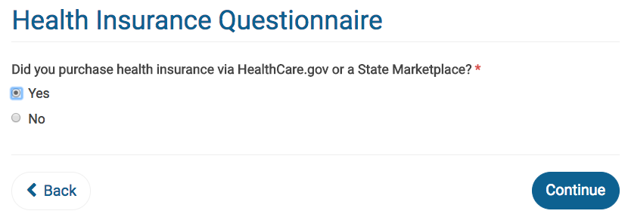
Enter Insurance Status

Slide 12
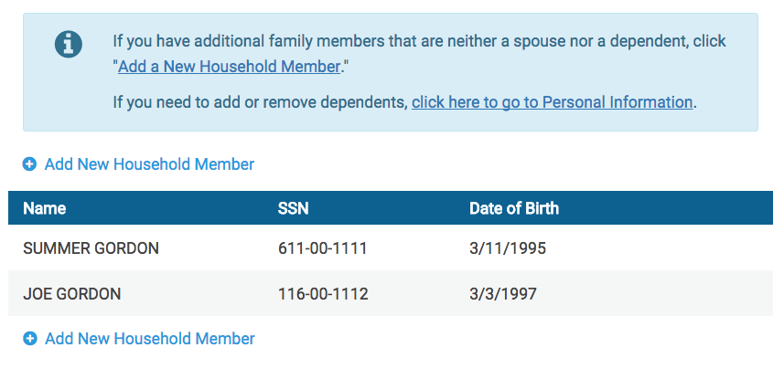
Verify Household
“Add New Household Member” will add a person to the tax return for ACA coverage and penalty purposes.
Warning: Do not add a person who is on Form 1095-A but not on the tax return (shared policy). That’s not an accurate way to reconcile APTC.

Slide 13
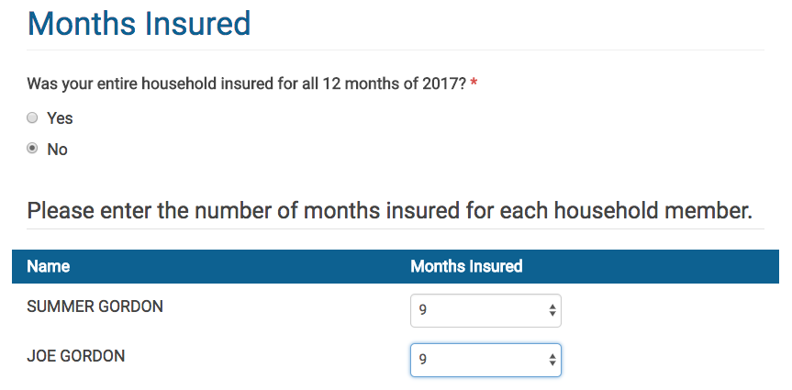
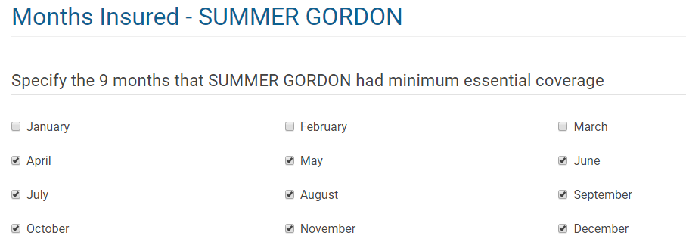
Enter Insured Months

Slide 14
Entering Form 1095-A

Slide 15
Requirement to Repay All APTC
Who needs to repay ALL APTC? (Answer Yes)
People who are not lawfully present and received a credit only for themselves (if a citizen also received the credit, it’s out of scope)
People who received APTC and also receive Health Care Tax Credit payments
People with income at 401% FPL or above
Who does NOT need to repay all APTC? (Answer No)
People who are eligible to claim the credit
People who are NOT eligible to claim the credit, such as people who are married filing separately or who have other health insurance coverage.

Slide 16
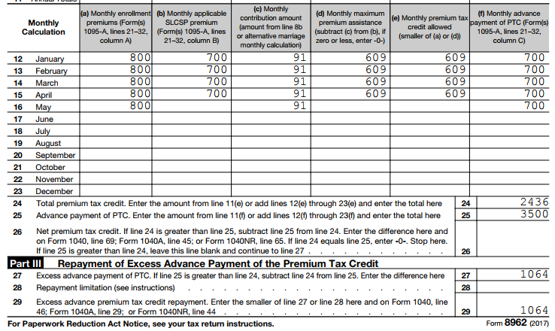
Requirement to Repay All APTC
Line 28 should always show the repayment cap, even if the repayment cap is higher than the amount owed.
If it doesn’t show a repayment cap, and income is under 400% FPL, check this question.

Slide 17
Income Below 100% FPL
Rule: A person with income under 100% FPL can claim the PTC if they were enrolled in marketplace coverage and received APTC.
TaxSlayer defaults to No. Consequences of answering No:
For someone with income 100-400% FPL, answering No is fine. (In most cases, the program will skip this question.)
For someone with income below 100% FPL, answering No will trigger repayment.
Answer Yes: If a taxpayer has income below 100% FPL but is eligible to claim the credit.

Slide 18
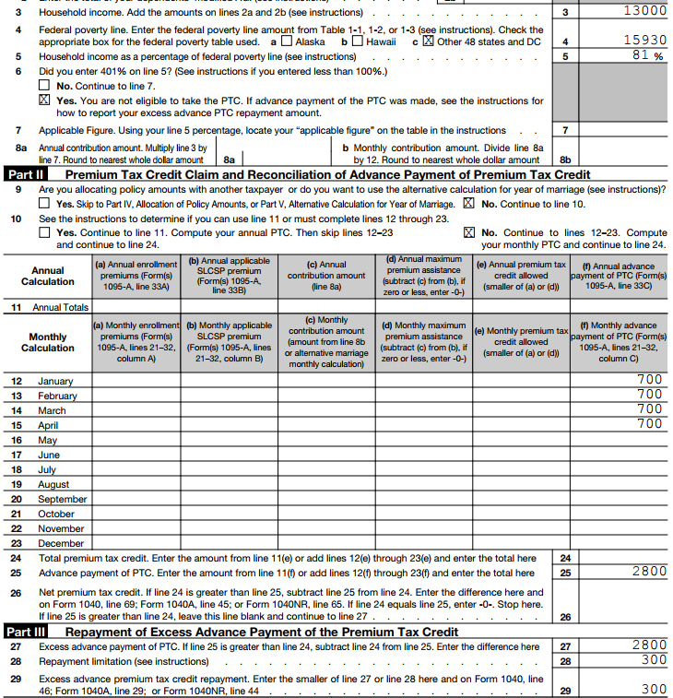
Income Below 100% FPL
In some cases, you may not even be asked the question about whether you can claim PTC with income under 100% FPL.

Slide 19
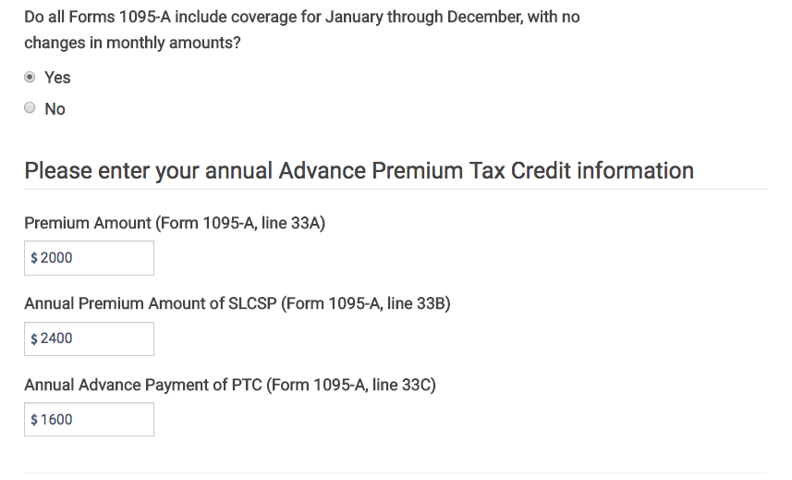
Entering Form 1095-A

Slide 20
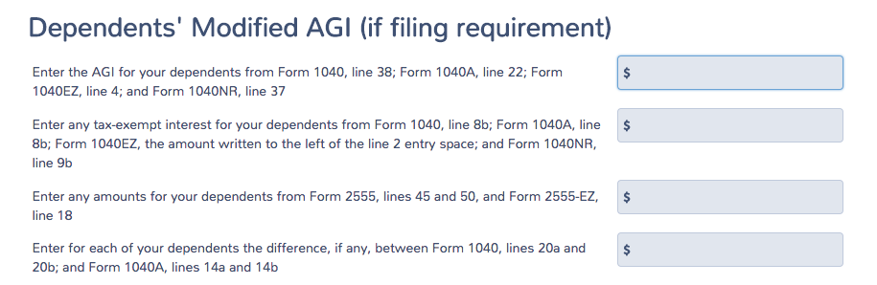
Dependent MAGI
Dependent income is rarely needed because few dependents are required to file taxes.
The income of a dependent with a tax filing requirement is included in the calculation of household income for:
PTC
Income-based exemptions: income below filing threshold, Medicaid coverage gap, and affordability (but not gross income below filing threshold)
Shared responsibility payment

Slide 21
Complex 1095-A Issues

Slide 22
Issue: I thought I would file jointly, but I’m MFS
In general, a taxpayer cannot claim PTC if Married Filing Separately.
Two exceptions:
Domestic abuse: The taxpayer lives apart from the spouse and is unable to file a joint return because of domestic abuse
Abandoned spouse: The taxpayer lives apart from the spouse and is unable to locate spouse after using due diligence.
Note: Each exception can be used for a maximum of three consecutive years
The taxpayer does not have to produce proof to the tax preparer, but, as with other claims on a tax return, the IRS could ask for verifying documents later.

Slide 23
Example: MFS with APTC
Alma hasn’t seen her husband in over a year. When she applied for health coverage, she said she was single. She was awarded APTC.
At tax filing, you inform Alma that her filing status is married filing separately.
Explain that a person cannot claim PTC if MFS, and ask if the domestic violence or abandonment exceptions apply
Abandonment might apply. Has she used due diligence to locate him?
Alma: He lives with his new girlfriend in Arlington. I could call him on his cell phone. But I don’t have any interest in filing taxes with him.
Exception does not apply. Enter 1095-A as it appears. TaxSlayer will trigger payback of the APTC received (up to the repayment cap).
Form 8962

Slide 24
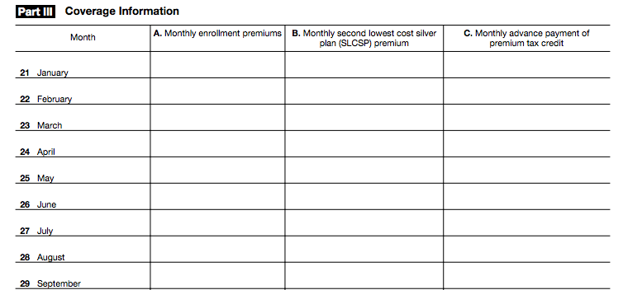
Issue: Multiple Forms 1095-A
Many people have multiple 1095-As.
Sometimes it’s because of an actual change in plan selection. Other changes, like a change in income, also triggered a new “policy” in the enrollment system in the past.
Form 1095-A
Add the premiums together
If same state, SLCSP should be the same.
If different states, add them.
Or use tool.
Add the APTC together
See Form 8962 Instructions for details.

Slide 25
Example: Multiple Forms 1095-A
Felicia and Murphy claim their 27-year-old daughter, Gwen, as a dependent. They enroll together as a household in the same plan but cannot be in the same “policy.” They get separate Forms 1095-A.
Form 1095-A for Felicia and Murphy
$12,000
$10,800
$4,800
Form 1095-A for Gwen
$3,600
$10,800
$1,200
15,600
$12,000 + $3,600
10,800
6,000
$4,800 + $1,200

Slide 26
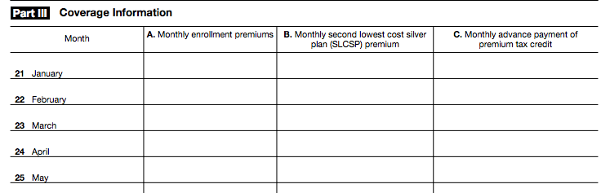
Issue: Failure to Pay Premiums
Form 1095-A
$400
$300
$200
$400
$300
$200
$400
$300
$200
$400
$300
$200
$300
$200
There is a 3-month grace period for nonpayment. If the taxpayer doesn’t catch up on all missed premiums, coverage is terminated retroactively as of the end of the first month of nonpayment.
Taxpayer will owe back the APTC for that month of nonpayment OR the taxpayer can pay the premium for the month prior to the tax deadline.
If there are multiple months of APTC without a premium in column A, this is an error.

Slide 27
Example: Failure to Pay Premiums
Greg had an unexpected car repair in April and could not afford to make his $200 May premium for his marketplace insurance. He made no other payments and his coverage was canceled, retroactive to the end of May.
Enter this into TaxSlayer and the program will trigger a repayment of the $200 in APTC received in May.
Even though Greg didn’t pay his premium for May, he is still considered covered for that month.
Alternative to repayment: Greg can pay his portion of the May premium ($200), request a new 1095-A, and avoid APTC repayment for that month.

Slide 28
Issue: Only Column A of Form 1095-A is Completed
Form 1095-A
$300
$300
$200
$300
$300
$200
$300
$300
$200
$300
$300
Warning! If you enter the Form 1095-A exactly as written, no PTC will be awarded for April and May.
Instead:
Determine eligibility for the credit for the months a premium was paid.
If she is eligible for the PTC, use the Tax Tool to look up the SLCSP for Column B (or call your state marketplace)

Slide 29
Example: Only Column A of Form 1095-A is Completed
Carolina failed to reconcile her APTC for 2015 and had her 2017 APTC canceled. She filed her 2015 tax return and APTC was reinstated starting in March.
Form 1095-A
X
$300
$300
$300
$300
$200
$300
$300
$200
$300
$300
$200
Even though she didn’t receive APTC in January and February, she meets all of the eligibility criteria for PTC.
In TaxSlayer, enter the SLCSP for January and February. (If you’re not sure of the SLCSP, look it up.)
Leave the APTC column BLANK for January and February

Slide 30
Forms 1095-A, B, and C
Form 1095-A
Form 1095-A
Issued by the Marketplace to people who enrolled in Marketplace coverage.
Necessary to prepare Form 8962, which is required for people who received Advance Premium Tax Credits
Corrections? Call the Marketplace that issued the form
Form 1095-B
Form 1095-B
Issued by Medicaid, Medicare, insurers, and others who offer coverage.
Useful in determining the months a person had coverage.
Form 1095-C
Form 1095-C
Issued only by large employers (employers with 50 or more full-time EEs)
Useful in determining the months a person had coverage or an offer of coverage and the cost of the offer of individual coverage. (May be helpful to calculate the affordability exemption.)

Slide 31
Overlapping Coverage
In general, to be eligible for PTC, the taxpayer must not be eligible for (or enrolled in) other minimum essential coverage (MEC).
Many exceptions!
For any coverage conflict:
People who are eligible for PTC on the first day of the month are considered eligible for the full month (even if they become eligible for other coverage later that month, for instance.)
If a person is enrolled in APTC but later determined eligible Medicaid:
PTC is allowed for months of retroactive Medicaid coverage
The person is generally eligible for PTC for the entire calendar year even if also enrolled in Medicaid for some of those months.
https://www.irs.gov/pub/irs-utl/best_practices_resolving_1095_conflicts.pdf.pdf

Slide 32
Overlapping Coverage
More exceptions!
Eligibility for Medicare: A person loses eligibility for PTC when they become Medicare-eligible, even if they fail to enroll in Medicare. But the loss of eligibility doesn’t occur until the first day of the fourth full month after the person became eligible for Medicare.
Example: Freddie is enrolled in Marketplace coverage with APTC. His 65th birthday is May 17 and he becomes eligible to enroll in Medicare.
If he continues in the marketplace the APTC all year:
He’ll owe back APTC for Sept–Dec.
And when he enrolls in Medicare Part B, he’ll pay a higher premium.
May
Jun
Jul
Aug
Sep
Eligible for Medicare
Three full months
NOT eligible for PTC
https://www.irs.gov/pub/irs-utl/best_practices_resolving_1095_conflicts.pdf.pdf

Slide 33
Overlapping Coverage
Eligibility for Employer-Sponsored Coverage: In general, a person is not eligible for PTC if they have an affordable, minimum value offer of coverage from an employer. If the employer is large, the coverage offer will be indicated on Form 1095-C. (There is no similar record for small employers.)
It’s an affordable offer if:
Line 14 says 1A, or
Line 14 says 1B, 1C, 1D, or 1E and the cost on line 15 is less 9.69% of income
This only tells you the cost of self-only coverage; family coverage may still be unaffordable.
https://www.irs.gov/pub/irs-utl/best_practices_resolving_1095_conflicts.pdf.pdf

Slide 34
Overlapping Coverage
More exceptions!
SAFE HARBOR: If the taxpayer informed the marketplace of the cost of employer-sponsored coverage and they awarded APTC anyway, the taxpayer can claim PTC.
Ask: Did you provide accurate information about the cost of employer-sponsored coverage? If so, and the person received APTC, disregard the offer of coverage – they are eligible for PTC (if all other requirements are met).
https://www.irs.gov/pub/irs-utl/best_practices_resolving_1095_conflicts.pdf.pdf

Slide 35
Review Tips

Slide 36
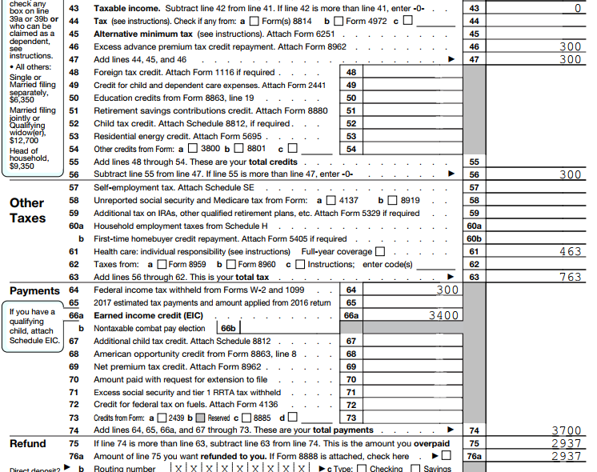
Review the Return Carefully

Slide 37
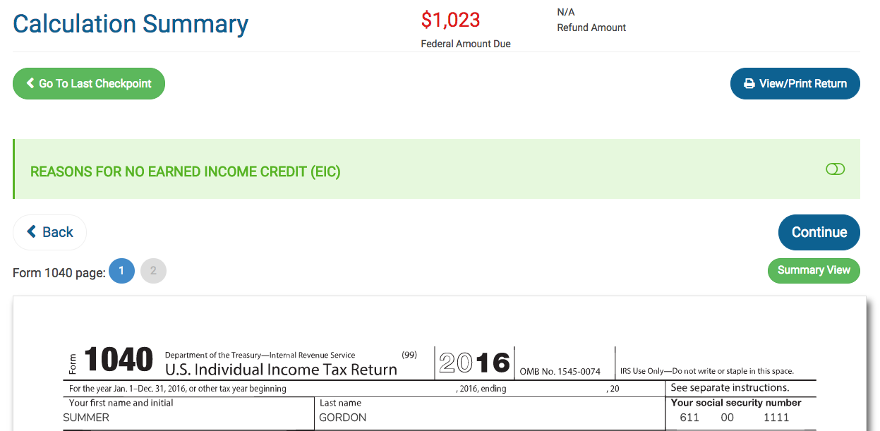
Always Preview the Return!

Slide 38
Form 8962 Review
If MFS, PTC is disallowed and all APTC is repaid. Does this taxpayer qualify for an exception?
Spousal abandonment
Domestic abuse

Slide 39
Form 8962 Review
Did I enter dependent income inappropriately?
Only enter if dependent has a filing requirement

Slide 40
Form 8962 Review
Line 6: If YES is checked, it’s probably wrong. A taxpayer can claim the PTC with income below 100% FPL if they received APTC or are a lawfully present alien who is not eligible for Medicaid.
If income is 401% FPL, the taxpayer must repay all APTC.
Did you consider:
Married filing separately?
Adjustments such as making a deductible IRA contribution, contributing to a health savings account, taking the tuition and fees deduction instead of an education credit?

Slide 41
Form 8962 Review
Line 9: TaxSlayer assumes that there is no out-of-scope issue.
Double check that everyone on Form 1095-A is on the tax return (no shared policy allocation)
If the taxpayer must repay PTC, did he or she get married in 2017? If so, the person may qualify to use the alternative marriage calculation.

Slide 42
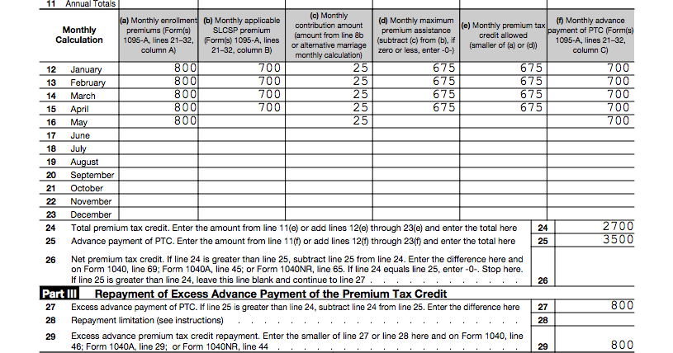
Form 8962 Review
Form 8962
If a credit was not allowed in a month, do I understand why? Can the taxpayer take steps to avoid repayment?

Slide 43
What Can a Tax Preparer Tell a Person with a Repayment?
Try to determine why the taxpayer’s advance payment was too high:
Do you suspect the Form 1095-A is incorrect?
Did they make an error in estimating their income or their dependent’s income?
Was there an error in calculating family size?
Has their filing status changed?
Has a dependent joined or left the family?
Encourage taxpayers to take less than the maximum APTC in future years.
Remind taxpayers to promptly report changes in income and family size to the Marketplace.
If the taxpayer has Marketplace coverage for 2018, encourage them to report their most recent income/dependent information to improve the accuracy of the 2018 income and household projection.

Slide 44
Failure to Reconcile
Delays in Return Processing
Many taxpayers received Letter 12C to request more information
Generally, 1095-A, Form 8962, page 2 of 1040
If someone did not respond, their return may have been sent to exams for review and assessment
Consider amending the tax return if the result of the exam seems inaccurate
Failure to File and Reconcile APTC for TY2016
People who did not file for 2016 may lose their APTC for 2018
Consider preparing the prior-year return early in the season, even if those returns would normally be delayed until a less-busy time. It may affect a person’s ability to get or keep health insurance.

