Slide 1
VITA/TCE Basic Certification Topics on Affordable Care Act
Current as of November 20, 2017

Slide 2
Agenda
Webinar #1 – Basic Certification Topics
Minimum essential coverage
Shared responsibility payment
Exemptions
Webinar #2 – Advanced Certification Topics
Reconciling the premium tax credit
Complex 1095-A issues
Review tips

Slide 3
MEC & SRP Refresher

Slide 4
What does the ACA require?
or
or
Coverage
Exemption
SRP

Slide 5
Minimum Essential Coverage (MEC)
Minimum Essential Coverage
**One day of coverage = a covered month**
Employer-Sponsored Coverage Group coverage COBRA coverage Retiree coverage Individual Market Coverage Purchased through the Marketplace, an insurance company, or as a student health plan Government-Sponsored Programs Medicare Most Medicaid CHIP Most TRICARE DoD Nonappropriated Fund Health Benefits Program Peace Corps coverage Certain Other Coverage
Pub 1040, Tab H-5

Slide 6
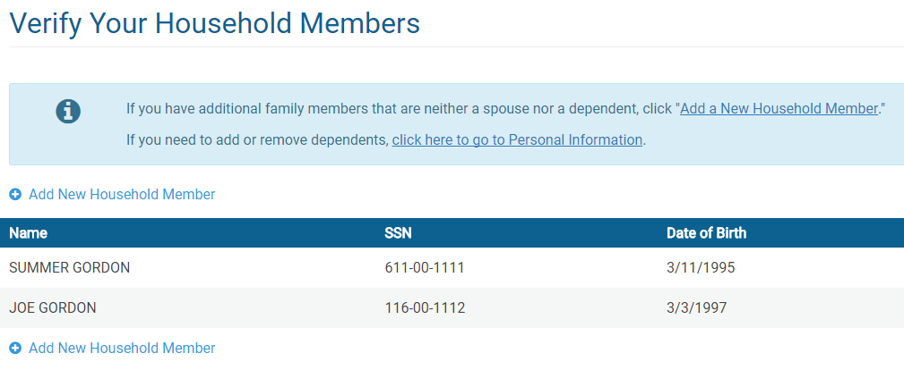
TaxSlayer Screens

Slide 7
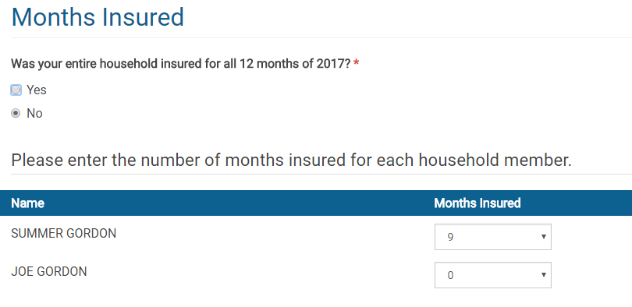
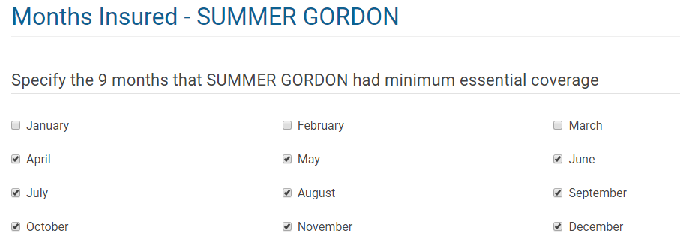
TaxSlayer Screens

Slide 8
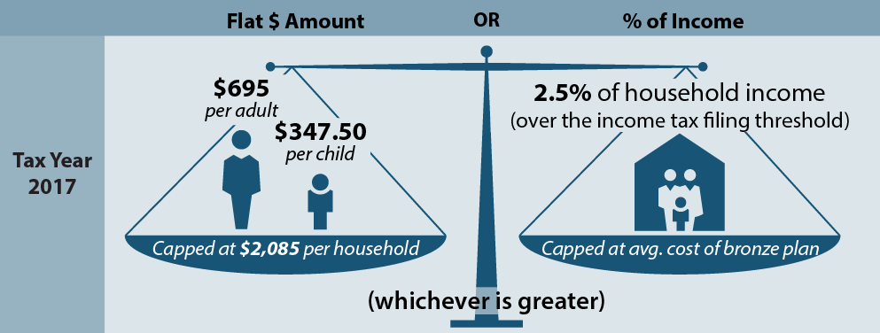
Shared Responsibility Payment (SRP)
Everyone in a household must have minimum essential coverage or an exemption from the coverage requirement
If they do not, they owe an individual shared responsibility payment, or penalty, for every month they are uninsured
The flat amount increases each year by a cost-of-living adjustment
*New: IRS will not accept electronic returns that omit health coverage information.

Slide 9
Calculating the SRP: Filing Single (2017)
penalty amount in 2017
$38,200
$10,400
(tax filing threshold, filing single)
2.5% of income
$695
($695 x 1 adult)
no penalty

Slide 10
Example: John
Calculating the Penalty
Income: $17,000
Filing Status: Single
Adults: 1
Children: 0
Months uninsured: 7
Tax filing threshold in 2017: $10,400
1. $17,000 - $10,350 =
2. $695 x 1 adult =
$6,600
x 2.5%
$165
$695
/12 = $14
/12 = $58
$58
x 7
$406
John’s penalty for 2017

Slide 11
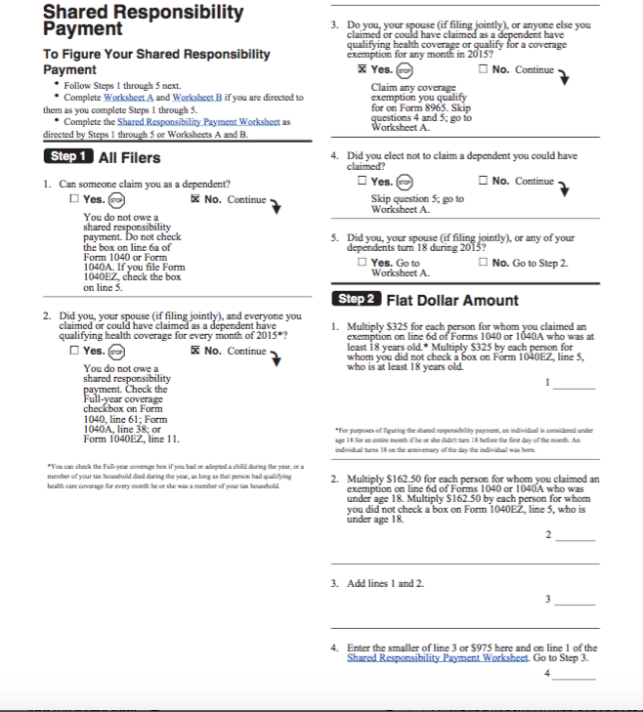
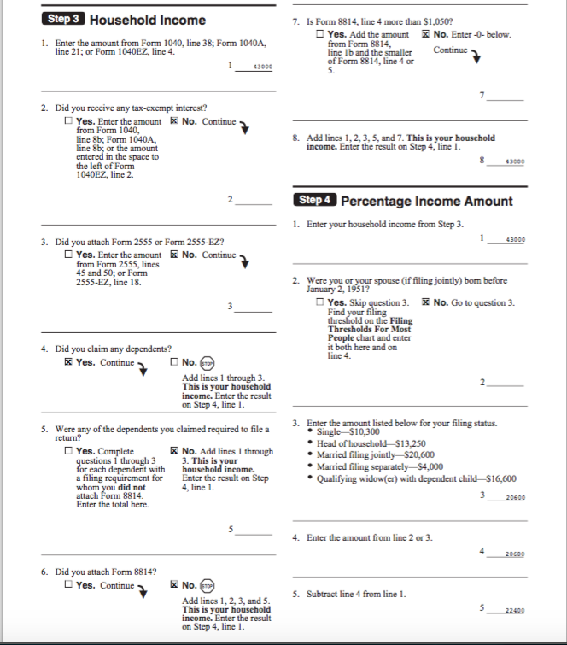
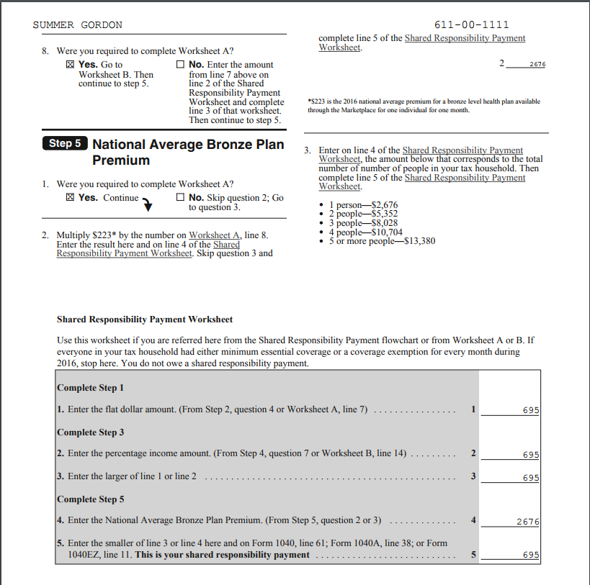
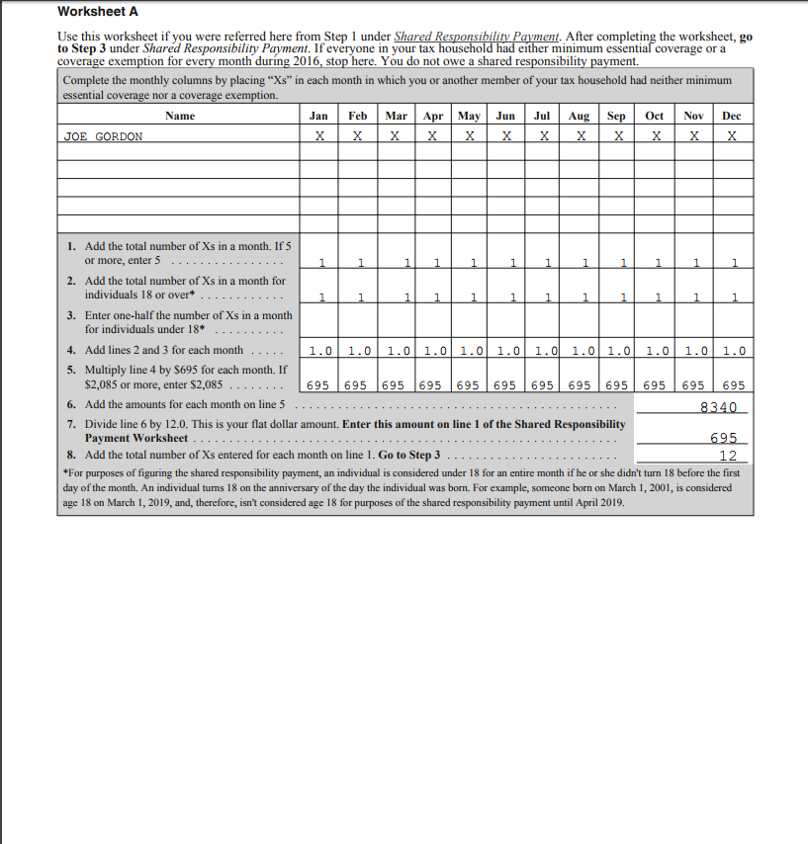
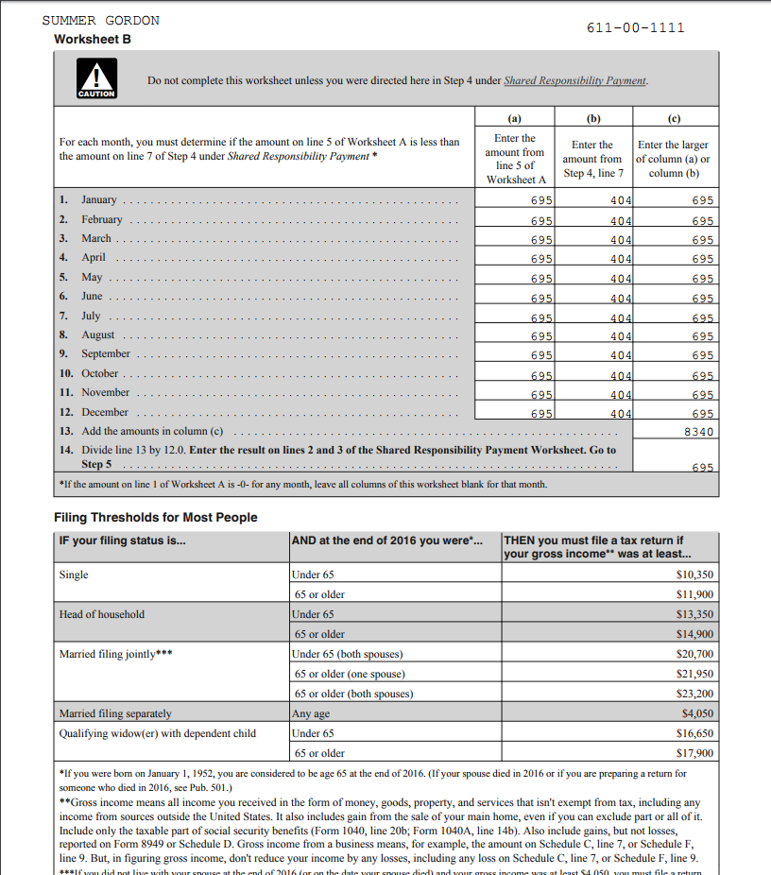
TaxSlayer – Shared Responsibility Payment
1
2
3
4
5

Slide 12
TaxSlayer – Shared Responsibility Payment
Page 4 of the SRP worksheet tells who the payment is calculated for
4

Slide 13
TaxSlayer – Shared Responsibility Payment
Page 5 of the SRP worksheet tells which method was used to calculated the payment (flat fee or percentage of income)
5

Slide 14
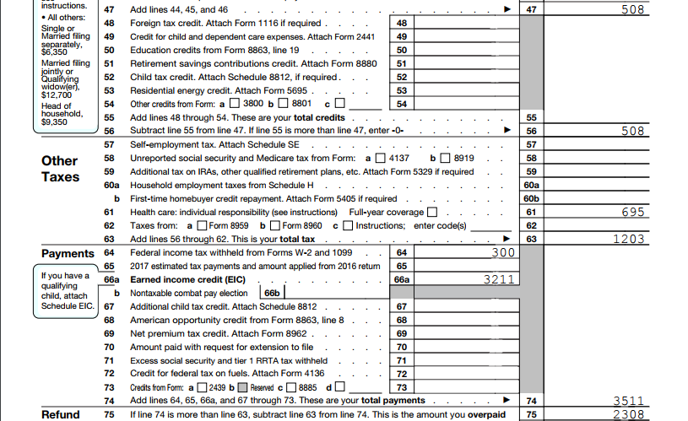
TaxSlayer – Shared Responsibility Payment

Slide 15
Exemptions

Slide 16
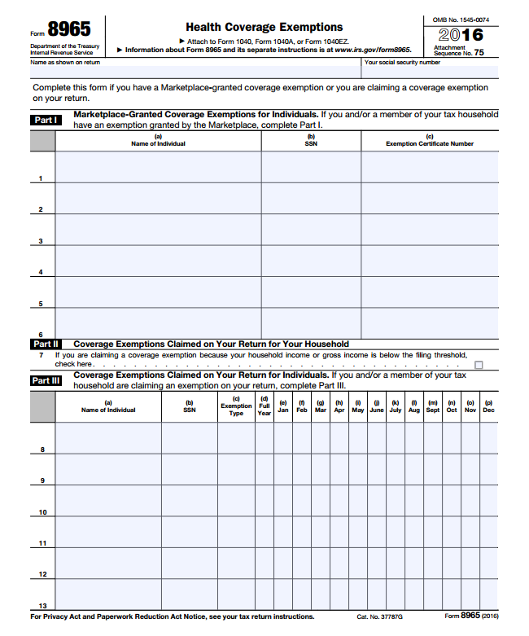
Exemptions from the Coverage Requirement
Three Types of Exemptions:
All exemptions must be claimed at tax filing on Form 8965
Marketplace-Granted Exemptions:
Must be applied for by mail, often with supporting documentation.
Approved exemptions get an Exemption Certificate Number (ECN) for the tax return.
If a taxpayer appears eligible and applies for an exemption, but it hasn’t yet been approved, write “pending” in place of ECN.
Household Exemption on the Tax Return:
If household or gross income is below filing threshold.
Individual Exemptions on the Tax Return:
Claimed directly on the tax form with no supporting documentation.

Slide 17
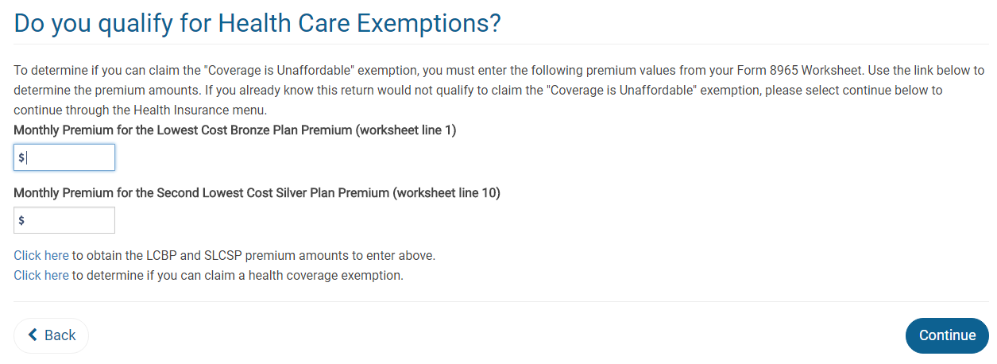
Exemption Speedbump

Slide 18
Income Below Filing Threshold
Household income for Line 7 and SRP
Adjusted Gross Income (AGI)
Tax-Exempt
Interest
Excluded Foreign Income
Dependent Income
Form 1040, Line 37
Form 1040, Line 8b
Form 2555, Lines 45, 50
Only if the dependent has a filing requirement
Gross income for Line 7
All income received in the form of money, goods, property and services that is not exempt from tax, including any income sources outside the U.S. or from the sale of your main home (even if you can exclude part or all of it)
Include only the taxable portion of Social Security benefits
Include income or gains but not expenses or losses from Schedules C, D and F
Do not include income of any dependents

Slide 19
In TaxSlayer
TaxSlayer will determine eligibility for the household and gross income exemption.
The exemption will appear on Form 8965, whether or not you answered Yes to the question “Did you qualify for an exemption…?”

Slide 20
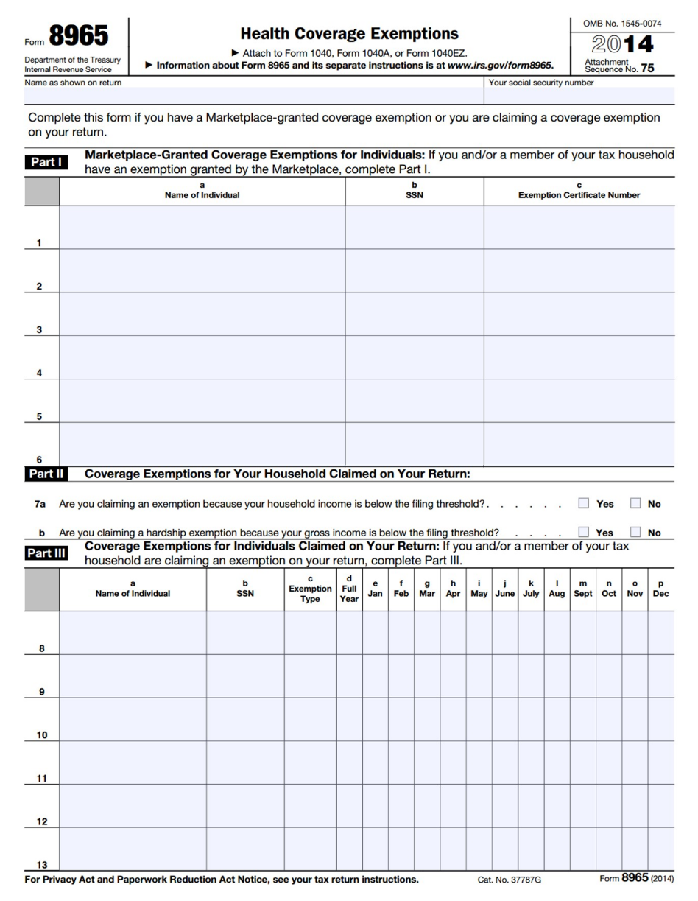
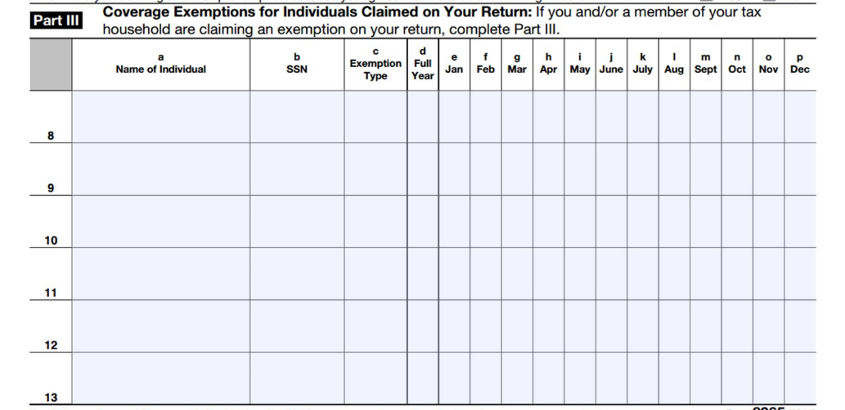
IRS Exemptions: Form 8965, Part III
IRS Individual Exemptions:
Use Part III to claim exemptions for individual household members
Can be claimed monthly or for entire year
A person can be eligible for multiple exemptions during the year, but only report one exemption per month.
If a person is eligible for exemption for one day of the month, they can claim it for the entire month.

Slide 21
IRS Exemptions: Form 8965, Part III
Coverage Exemption | Code
Insurance is considered unaffordable – Lowest premium would have cost more than 8.16% of household income | A
Short coverage gap – Uninsured for less than 3 consecutive months | B
Citizens living abroad and certain noncitizens – Includes people who are not lawfully present | C
Members of a health care sharing ministry | D
Members of an Indian tribe or eligible for services through an Indian health care provider or the Indian Health Service | E
Incarceration | F
Aggregate self-only coverage is considered unaffordable – Total cost of two or more family members’ aggregate self-only coverage is more than 8.16% of household income | G
Resident of a state that did not expand Medicaid | G
Member of the tax household born or adopted or died during the year | H

Slide 22
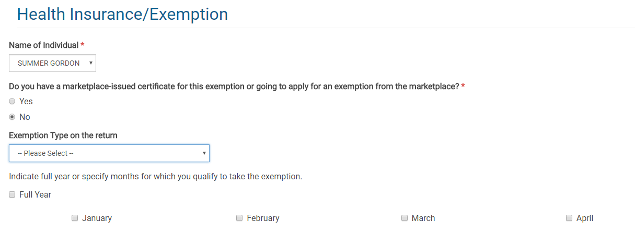
In TaxSlayer

Slide 23
IRS Exemptions: Short Coverage Gap
Short coverage gap – Uninsured for less than 3 consecutive months | B
A coverage gap of less than 3 months (so, 1 or 2 months). If the coverage gap is 3 months or longer, none of the months in the gap qualify for exemption. Apply to the first gap in coverage.
Example: If Bob is uninsured January 1 to March 31, the exemption does not apply to any of those months because the gap is not less than 3 months.
A person is considered to have coverage for the entire month if they have coverage for one day in the month.
Example: If Bob is uninsured January 5 to April 28, the exemption does apply for February and March. He is considered insured in January and April so there are only 2 months in the gap.
Months covered by another exemption are treated like months with coverage.
Example: Bob has coverage January to March, is uninsured in April and May, and is eligible for the affordability exemption June to December. Even though Bob was uninsured April to December, he is eligible for a short gap exemption for April and May.
There is a look-back but no look-forward. Consecutive uninsured months at the end of 2016 count toward a gap at the start of 2017; uninsured months in 2018 do not.
Example: If Bob is uninsured Dec 2016, Jan and Feb 2017, he doesn’t qualify for this exemption in 2017 because the gap is not less than 3 months.

Slide 24
IRS Exemptions: Certain Noncitizens
Citizens living abroad and certain noncitizens – Includes people who are not lawfully present | C
This exemption applies to:
Individuals who are not U.S. citizens, nationals or lawfully present (i.e., undocumented immigrants)
Some other citizens living outside of the U.S., residents of territories, and 1040NR (or 1040NR-EZ) filers.
How do I identify someone who is eligible for this exemption?
Consult the list of immigration statuses that qualify a person for help with health costs. If the person’s status is not on this list, they are eligible for this exemption.
https://www.healthcare.gov/immigrants/immigration-status/
Does everyone with an ITIN get this exemption?
Many people with ITINs will be eligible for this exemption.
Some people with SSNs are eligible, too.
Example: A lawful social security number but not an eligible immigration status. E.g., a person who is a Deferred Action for Childhood Arrivals (DACA) grantee (“Dreamer”) can claim the exemption, despite having an SSN.

Slide 25
IRS Exemptions: Medicaid Coverage Gap
Resident of a state that did not expand Medicaid | G
Had household income below 138% FPL, and
Resided at any time during 2017 in a state that did not expand Medicaid
Adjusted Gross Income (AGI)
Non-Taxable Social Security Benefits
Tax-Exempt
Interest
Excluded Foreign Income
Dependent Income
Form 1040, Line 37
Form 1040, Line 20a minus 20b
Form 1040, Line 8b
Form 2555, Lines 45, 50
Only if the dependent has a filing requirement
Family Size | 138% FPL (2017 coverage year)
1 | $16,394
2 | $22,108
3 | $27,821
4 | $33,534
Applies to people who lived at any time in 2017 in one of the following states:
Alabama
Florida
Georgia
Idaho
Kansas
Louisiana
Maine
Mississippi
Missouri
Nebraska
North Carolina
Oklahoma
South Carolina
South Dakota
Tennessee
Texas
Utah
Virginia
Wisconsin
Wyoming

Slide 26
Example: Medicaid Coverage Gap Exemption
Rashid, Miriam and Leila
Rashid was uninsured for all of 2017
His wife, Miriam, had insurance all year through her employer
Leila was born in November and was covered by Medicaid
Household income for 2017: $25,000 (~124% FPL)
They live in South Carolina (a state that did not expand Medicaid)
Does Rashid qualify for an exemption?
YES, Rashid’s household income is below 138% FPL and in 2017, he lived in a non-expansion state
Rashid qualifies for this exemption for the entire year even if he had other insurance options, such as coverage through his wife’s employer or insurance in the Marketplace with PTCs
Rashid also qualifies for the entire year, even if he only lived in SC for one month before moving to Maryland (a state that did expand Medicaid)

Slide 27
IRS Exemptions: Born, Adopted or Died
Member of the tax household born or adopted or died during the year | H
The coverage requirement applies for full months alive or post-adoption. This exemption covers the other months of the year, when coverage is not required (e.g. before birth/adoption or after death).
Example: A person dies May 14. Coverage is required January – April. The exemption can be used May – December.
Tip: If the entire tax family had coverage all year, you can still consider the born, died or adopted person to have full-year coverage. In the example above, if everyone else on the return had coverage all year, you can still check the box on Line 61.
Rashid claims exemption Code G.
Leila was born in November and was covered by Medicaid retroactive to the date of birth.
Claim Code H for Leila January–October.

Slide 28
Deep Dive: Affordability Exemption

Slide 29
IRS Exemptions: Affordability Exemption
Insurance is considered unaffordable – Lowest premium would have cost more than 8.16% of household income | A
Start by determining household income
Then determine the lowest-cost premium available to each person
Adjusted Gross Income (AGI)
Tax-Exempt
Interest
Excluded Foreign Income
Dependent Income
Any pre-tax deduction for ESI premiums
Household Income
Line 37
IRS Form 1040
Line 8b
IRS Form 1040
Lines 45 and 50
IRS Form 2555
Only if the dependent has a filing requirement
If eligible for employer-sponsored insurance:
As an employee: the lowest-cost self-only plan costs more than 8.16% of household income As a member of the employee’s family: the lowest-cost family plan costs more than 8.16% of household income
If not eligible for an offer of employer-sponsored insurance:
Lowest cost bronze plan (after PTCs) for all non-exempt members of the taxpayer’s family costs more than 8.16% of household income

Slide 30
Example 1: Affordability of ESI
Gregory and Alice are MFJ.
They lived in Oklahoma City, OK in 2017 (Zip: 73111)
Both uninsured all year; no other exemption applies
Gregory
W-2, Box 1: $20,000
Self-only insurance offer: $50/mo
Family insurance offer: $350/mo
Alice
W-2, Box 1: $25,000
No insurance offered
How is affordability measured? (Use the first that applies for each family member)
Lowest-cost self-only plan offered to each family member by his or her employer
Lowest-cost family plan offered by the taxpayer or spouse’s employer
Lowest-cost bronze plan in the marketplace, after accounting for PTC

Slide 31
Example 1: Affordability of ESI
Gregory and Alice are MFJ.
They lived in Oklahoma City, OK in 2016 (Zip: 73111)
Both uninsured all year; no other exemption applies
Gregory
W-2, Box 1: $20,000
Self-only insurance offer: $50/mo
Family insurance offer: $350/mo
Alice
W-2, Box 1: $25,000
No insurance offered
Gregory
His lowest-cost self-only employer plan is $50/mo
Annualized cost is $600
Compared to annual income of $45,000
$600 / $45,000 = 1.3% of household income
Gregory is not eligible for the affordability exemption because his plan costs less than 8.16% of household income.

Slide 32
Example 1: Affordability of ESI
Gregory and Alice are MFJ.
They lived in Oklahoma City, OK in 2016 (Zip: 73111)
Both uninsured all year; no other exemption applies
Gregory
W-2, Box 1: $20,000
Self-only insurance offer: $50/mo
Family insurance offer: $350/mo
Alice
W-2, Box 1: $25,000
No insurance offered
Alice
No offer of coverage through her own employer
Her lowest-cost family plan through Gregory’s employer is $350/mo
Annualized cost is $4,200
Compared to annual income of $45,000
$4,200 / $45,000 = 9.33% of household income
Alice is eligible for the affordability exemption because her offer of coverage costs more than 8.16% of income.

Slide 33
Example 1: Affordability of ESI
Gregory and Alice are MFJ.
They lived in Oklahoma City, OK in 2016 (Zip: 73111)
Both uninsured all year; no other exemption applies
Gregory
W-2, Box 1: $20,000
Self-only insurance offer: $50/mo
Family insurance offer: $350/mo
Alice
W-2, Box 1: $25,000
Jan-June: No insurance offered
July-Dec: Alice enrolls in coverage at work
What if Alice is uninsured only part of the year?
No offer of coverage through her own employer for Jan-June.
Her lowest-cost family plan through Gregory’s employer is $350/mo ($4,200 annually)
$4,200 / $45,000 = 9.33% of household income
Look at the annual cost of coverage, even if you’re just determining eligibility for a month.
Alice is eligible for the affordability exemption January through June because her offer of coverage costs more than 8.16% of income.

Slide 34
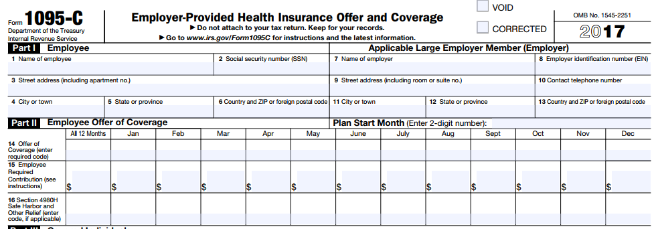
For a Person Eligible for Employer-Sponsored Insurance
It’s often difficult to find the cost of the applicable employer plan
If the taxpayer has a 1095-C, line 15 will list the employee’s share of the lowest-cost plan for the employee. The form will not state the lowest-cost family plan.
If there is no 1095-C, the employee may have to ask his or her Human Resources Dept for the correct 2017 plan cost

Slide 35
NOW you can use this screen…
If there is no employer coverage offer, consider the affordability of marketplace coverage.
You’ll need to determine:
The lowest-cost bronze plan (LCBP)
The second-lowest cost silver plan (SLCSP) only if eligible for PTC
Find these values at:
For federal marketplace states: https://www.healthcare.gov/tax-tool/
For other states: State-based marketplaces

Slide 36
Affordability: Marketplace Coverage
LCBP (Line 1 of Marketplace Coverage Affordability Worksheet)
Include:
Everyone claimed on the tax return, and
Who is not eligible for employer-sponsored coverage, and
Who is not eligible for another exemption.
Note: This means that you will include household members that have Medicaid or Medicare coverage!
SLCSP (Line 10)
Include:
Everyone claimed on the tax return, and
Who is not eligible for any other MEC (other than individual market), and
Who is not eligible for another exemption.
Marketplace Coverage Affordability Worksheet, Form 8965, page 11

Slide 37
Example 2: Marketplace Affordability
Max is single with no dependents.
He was uninsured before getting a job with coverage starting April 21. (Employer paid entire cost – no pre-tax deduction.)
Residence: 22204, Arlington, VA; DOB: 7/21/84
W-2, Box 1 - $17,500
Step 1. Figure out coverage vs exemption months.
Covered: April-Dec
Needs exemption: Jan-Mar
Step 2. Does an easy exemption apply?
Short coverage gap?
Income below filing threshold?
Medicaid coverage gap?
No other exemption applies
Step 3. Consider the affordability exemption.
First, did Max have an offer of employer-sponsored coverage? No
Then, consider marketplace affordability exemption.

Slide 38
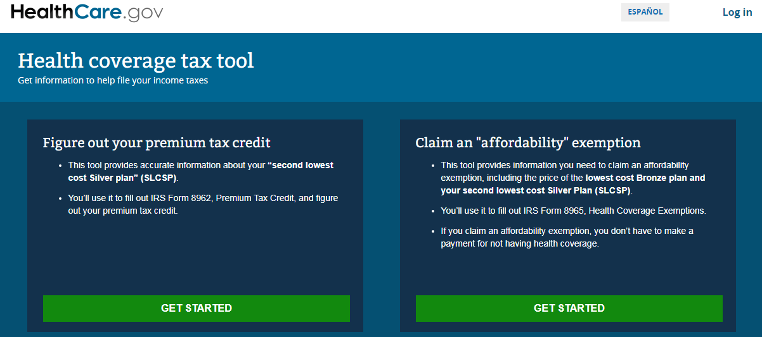
Example 2: Marketplace Affordability
Max is single with no dependents.
He was uninsured before getting a job with coverage starting April 21.
Residence: 22204, Arlington, VA; DOB: 7/21/84
W-2, Box 1 - $17,500
Note: LCBP and SLCSP are for 2016

Slide 39
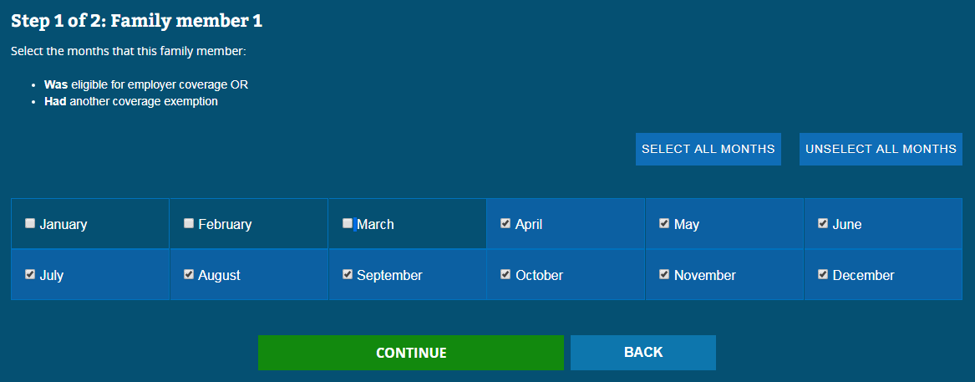
Example 2: Marketplace Affordability
Step 1 of the tool solicits information about the household for Line 1 of the marketplace affordability worksheet.
Note: LCBP and SLCSP are for 2016

Slide 40
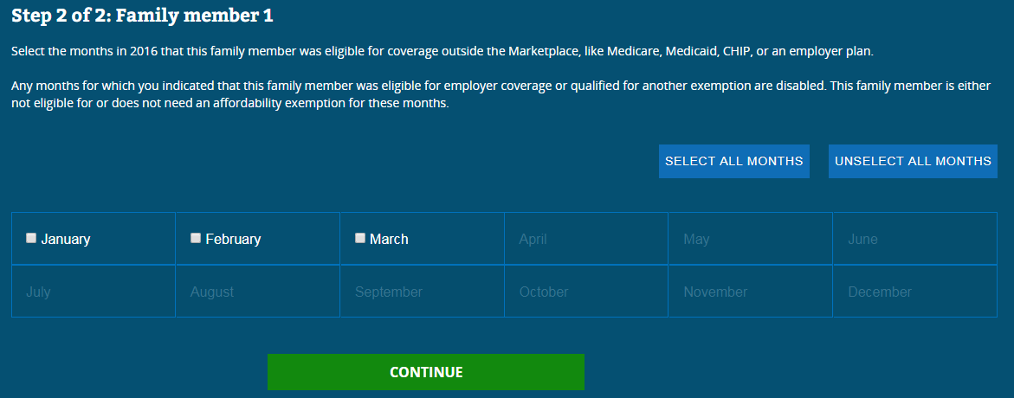
Example 2: Marketplace Affordability
Step 2 of the tool solicits information about the household for Line 10 of the marketplace affordability worksheet.
Then, enter the zip code.
Note: LCBP and SLCSP are for 2016

Slide 41
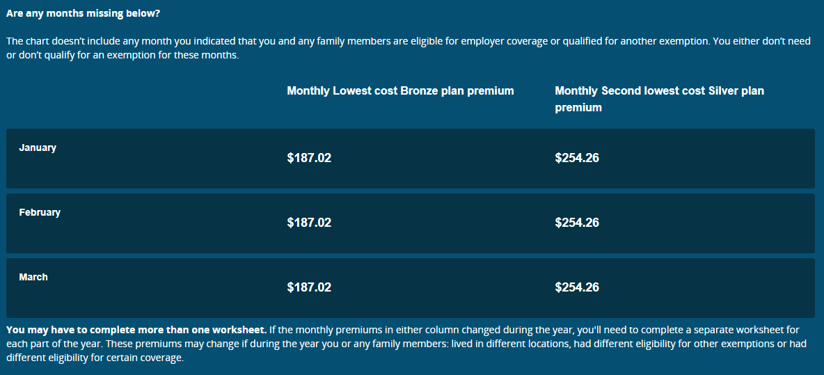
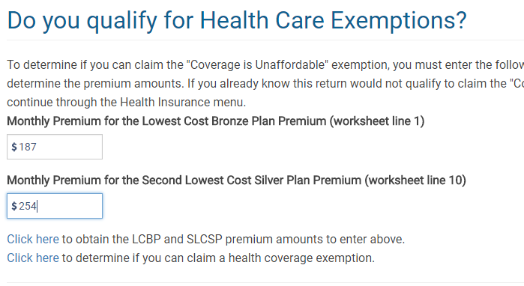
Example 2: Marketplace Affordability
Note: LCBP and SLCSP are for 2016

Slide 42
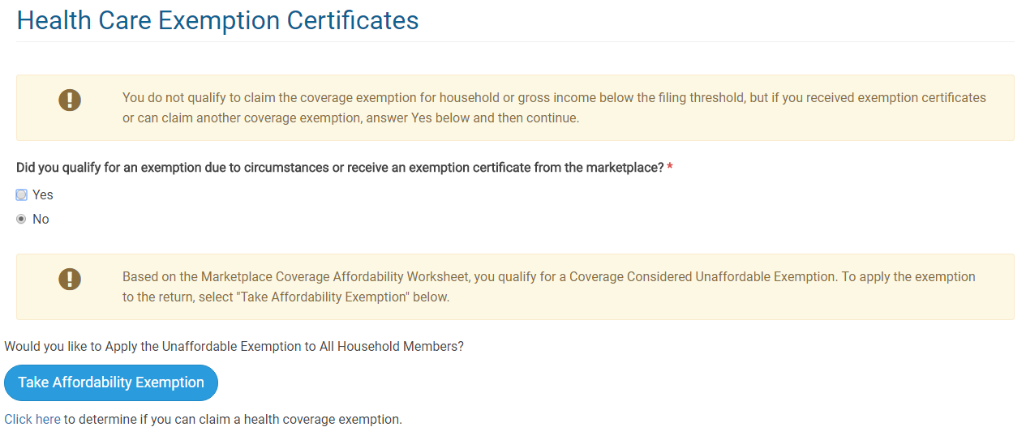
Example 2: Marketplace Affordability
Note: LCBP and SLCSP are for 2016

Slide 43
Example 2: Marketplace Affordability
187
17500
17500
11770
148
0.0396
693
57.8
254
196.3
0
The result of the Marketplace Affordability Worksheet is the annualized cost of coverage after tax credit. Compare to 8.16% of income. Insurance is affordable. No exemption.
0
See Form 8965 Instructions, page 11, Marketplace Coverage Affordability Worksheet
Note: LCBP and SLCSP are for 2016

Slide 44
Comparing Annualized Amounts
Let’s imagine the annualized premium cost on the affordability worksheet was $700.
58.3
700
$17,500 x 0.816 = $1,428
This is 8.16% of income. To qualify for Code A, the cost of marketplace coverage must be less than $1,428.
 | Annualized Cost of Marketplace Coverage | Annualized Affordability Threshold
January | $700 | $1,428
February | $700 | $1,428
March | $700 | $1,428
Code A does not apply because the annualized cost of coverage is less than 8.16% of income.
See Form 8965 Instructions, page 10, Affordability Worksheet
Note: LCBP and SLCSP are for 2016

Slide 45
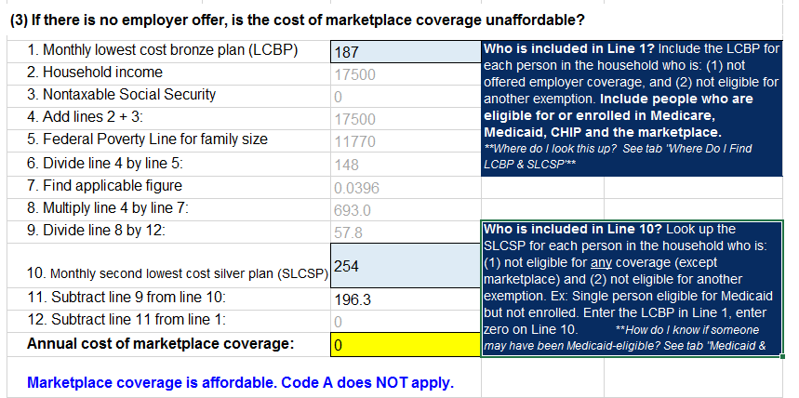
Example 2: Marketplace Affordability
http://www.healthreformbeyondthebasics.org/aca-exemptions-income-tool/
Note: LCBP and SLCSP are for 2016

Slide 46
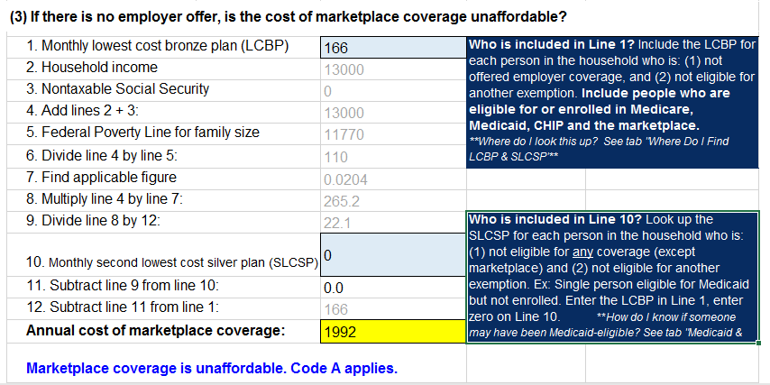
Example 3: Marketplace Affordability
Summer is single with no dependents.
She lived in Los Angeles, CA (90017) all year.
Uninsured all year. No offer of employer-sponsored coverage.
W-2, Box 1 - $13,000
Summer’s LCBP is $166
Does Summer qualify for an exemption?

Slide 47
Example 3: Marketplace Affordability
Summer is single with no dependents.
She lived in Los Angeles, CA (90017) all year.
Uninsured all year. No offer of employer-sponsored coverage.
W-2: Box 1 - $13,000
Summer’s LCBP is $166
Does Summer qualify for an exemption?
With an income of $13,000 in a Medicaid expansion state, Summer was eligible for Medicaid. She didn’t enroll.
People who are Medicaid-eligible often qualify for Code A because they are ineligible for the premium tax credit.
Short cut: Determine if the (annualized) LCBP is less than 8.16% of her (annualized) income.
$166 x 12 = $1,992
$1,992 /$13,000 = 15.3% of income
15.3% of income > 8.16% of income
Insurance is unaffordable. Claim Code A exemption.

Slide 48
In general…
A person is most likely to qualify for the affordability exemption if:
Eligible for Medicaid but not enrolled (under 138% FPL in expansion state; under 100% FPL elsewhere).
Ineligible for PTC for other reasons (e.g., married filing separately).
A person often won’t qualify for exemption if:
Eligible for PTC with income above Medicaid-eligibility level (100/138% FPL)
Why? The premium tax credit is most generous in that income range. It’s hard to make insurance unaffordable, mathematically.
The result may be different for tobacco-users, depending on the state, because they often have higher premiums.
Bottom line: Do the math.

Slide 49
The Last Resort…Marketplace Exemptions
If no other IRS exemption applies, consider helping a client apply for a Marketplace exemption
Application must be mailed and takes time for processing
Write “Pending” if approval has not yet been received.
Useful for:
Religious conscience exemption (available only through the Marketplace)
Hardship exemptions
For exemptions that must be approved by the Marketplace, the FFM is processing exemptions for all states except Connecticut.
Should I Make a Referral to Complete a Hardship Application?
A referral to a health care assister is one option but it causes additional delay
Consider helping the client complete the hardship application at your tax site
No special health care knowledge is needed. Application requires:
Name and contact info
Dependents
Documentation of exemption
Taxpayer’s signature
Hardship application @
https://www.healthcare.gov/exemption-form-instructions/

Slide 50
Marketplace Exemptions: Hardship
Hardship Exemptions Granted by Marketplace | Duration
Financial or domestic circumstances Homelessness Eviction in the last 6 months or facing eviction or foreclosure Utility shut-off notice Domestic violence Recent death of a close family member Disaster that resulted in significant property damage Bankruptcy in the last 6 months Debt from medical expenses in the last 24 months High expenses caring for ill, disabled or aging relative Failure of another party to comply with a medical support order for a dependent child who is determined ineligible for Medicaid or CHIP Through an appeals process, determined eligible for a Marketplace plan or lower costs, but was not enrolled Determined ineligible for Medicaid because the state did not expand Individual health insurance plan was cancelled and you believe Marketplace plans are unaffordable Other hardship in obtaining coverage (including for people with limited Medicaid coverage)
At least one month before and after hardship
When to Apply
Up to 3 years after the month of the hardship (but documentation is required in most circumstances so earlier is better)

Slide 51
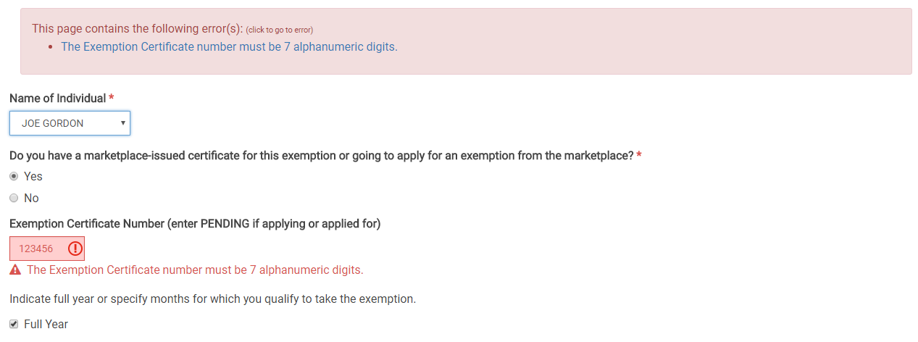
TaxSlayer – Exemptions
For Marketplace exemptions, a seven-digit alphanumeric code is required. If the exemption is 6 digits, add a zero at the beginning or end.
Type PENDING if the exemption application has not yet been approved.

Slide 52
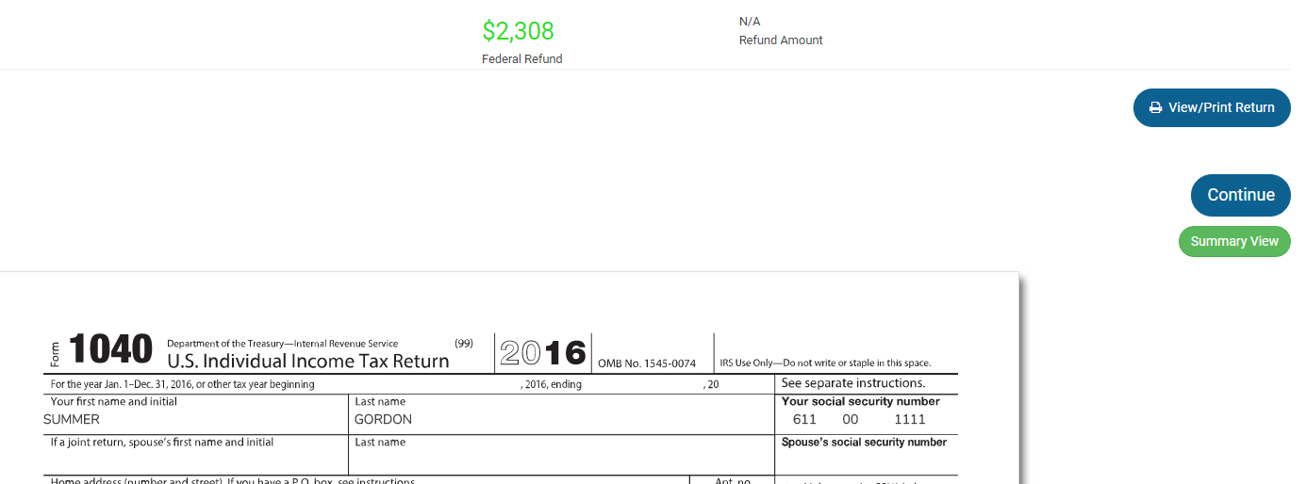
Parting Advice: Always Preview the Return!

