Slide 1
VITA/TCE Basic Certification Topics on Affordable Care Act
Current as of November 15, 2018

Slide 2
Agenda
The Individual Mandate Penalty Was Repealed
Everyone is Exempt
Not Quite

Slide 3
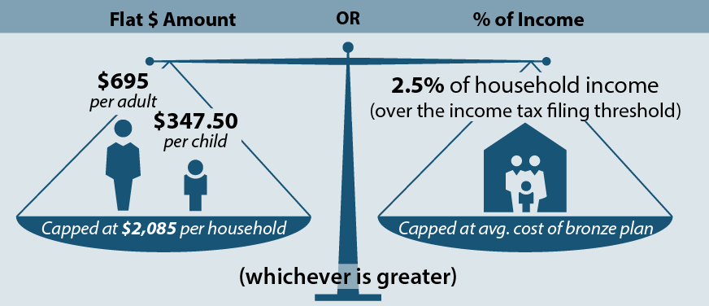
Shared Responsibility Payment (SRP)
For 2018, everyone in a household must:
Have minimum essential coverage, or
Claim an exemption from the coverage requirement, or
Make a shared responsibility payment (penalty)
IRS will not accept electronic returns that omit health coverage information.

Slide 4
ACA: Where are we now?
What’s the same?
Still a requirement to have coverage or an exemption or pay a penalty (for tax year 2018) Penalty amount is the same as last year Exemptions are (mostly) the same Premium tax credit is still available
What’s new?
The coverage question is expanded to ‘covered or exempt’ and is now on Form 1040, page 1 Fewer people are required to file Form 8965 Taxpayers can claim hardship exemptions on the tax return instead of applying to the marketplace A few general hardships have been added

Slide 5
Most people will check a box on Form 1040, page 1
The check box for full-year coverage is now on page 1.
It’s now also used to indicate full-year exemption eligibility
Check the box on 1040, page 1 if:
Everyone on the return is covered, or
Everyone on the return is exempt using one or more exemptions, or
Any combination of covered/exempt for everyone on the return
Only complete Form 8965 if:
There is a mixture of exemption and uninsured (penalty) months

Slide 6
New General Hardship Exemptions* (Code G)
Did any of the following hardships prevent you from obtaining coverage?
Financial Hardship You were homeless You were evicted or face eviction or foreclosure You received a utility shut-off notice You filed for bankruptcy You had medical debt in the last 24 months You had unexpected increases in expenses caring for ill, disabled or aging relative You were determined ineligible for Medicaid in a state that did not expand Medicaid coverage You were without coverage while awaiting a decision on a marketplace appeal Plan Choice Hardship You lived in a county with only one issuer offering coverage and can show that the lack of choice precluded enrollment** | All affordable plans provide abortion coverage contrary to your beliefs** You experienced a personal circumstance that created a hardship, such as when no affordable plans provide access to needed specialty care** Personal Hardship You experienced a disaster that resulted in significant property damage You experienced domestic violence A close family member died Your child was denied Medicaid or CHIP and another person is required by court order to provide coverage for the child You experienced another hardship that prevented you from obtaining coverage
*Most of these exemptions were formerly claimed by submitting a marketplace application. The exemption is valid for the month(s) of the hardship and the month before and after. **New hardships

Slide 7
Coverage & Exemptions

Slide 8
What is “Health Care Coverage”?
Minimum Essential Coverage
**One day of coverage = a covered month**
Employer-Sponsored Coverage Group coverage COBRA coverage Retiree coverage Individual Market Coverage Purchased through the Marketplace, an insurance company, or as a student health plan Government-Sponsored Programs Medicare Most Medicaid CHIP Most TRICARE DoD Nonappropriated Fund Health Benefits Program Peace Corps coverage Certain Other Coverage
Pub 1040, Tab H-5

Slide 9
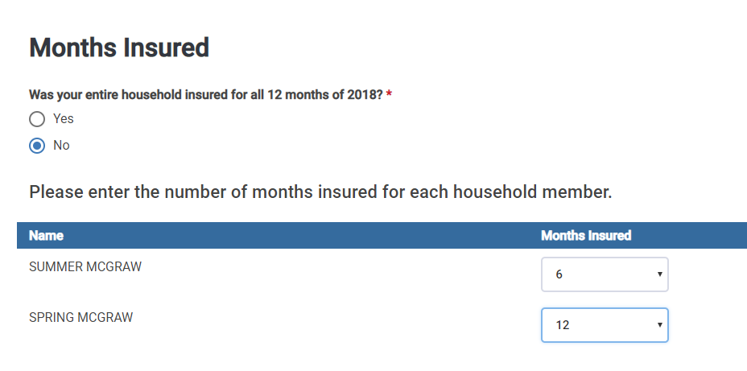
Months Insured are Reported in TaxSlayer

Slide 10
Income Below Filing Threshold
TaxSlayer will automatically calculate this exemption
Since this exemption covers the whole household, it will appear on the first page of Form 1040 and there will be no Form 8965.
Household income for Filing Threshold Exemption and SRP
Adjusted Gross Income (AGI)
Tax-Exempt
Interest
Excluded Foreign Income
Dependent Income
Form 1040, Line 7
Form 1040, Line 2a
Form 2555, Lines 45, 50
Only if the dependent has a filing requirement
Gross income for Filing Threshold Exemption
All income received in the form of money, goods, property and services that is not exempt from tax, including any income sources outside the U.S. or from the sale of your main home (even if you can exclude part or all of it)
Include only the taxable portion of Social Security benefits
Include income or gains but not expenses or losses from Schedules C, D and F
Do not include income of any dependents

Slide 11
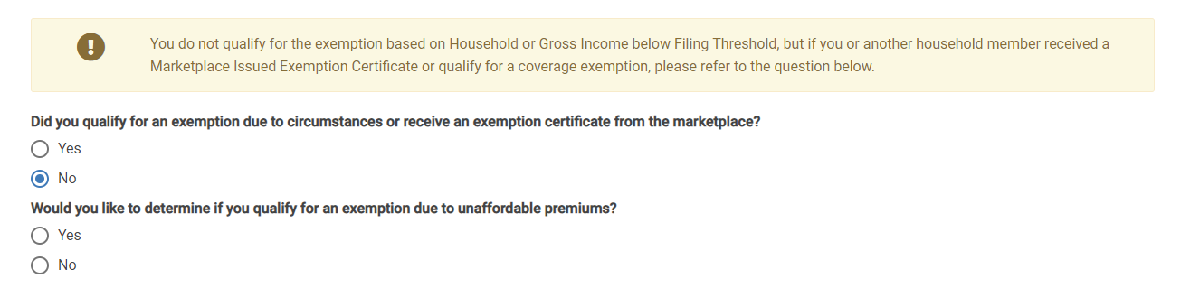
TaxSlayer Calculates the Filing Threshold Exemption
If the household doesn’t qualify for the exemption, you’ll be asked whether the household qualifies for an exemption “due to circumstances.”
Answer Yes to enter any exemption (including affordability)
Answer No to get the affordability exemption question

Slide 12
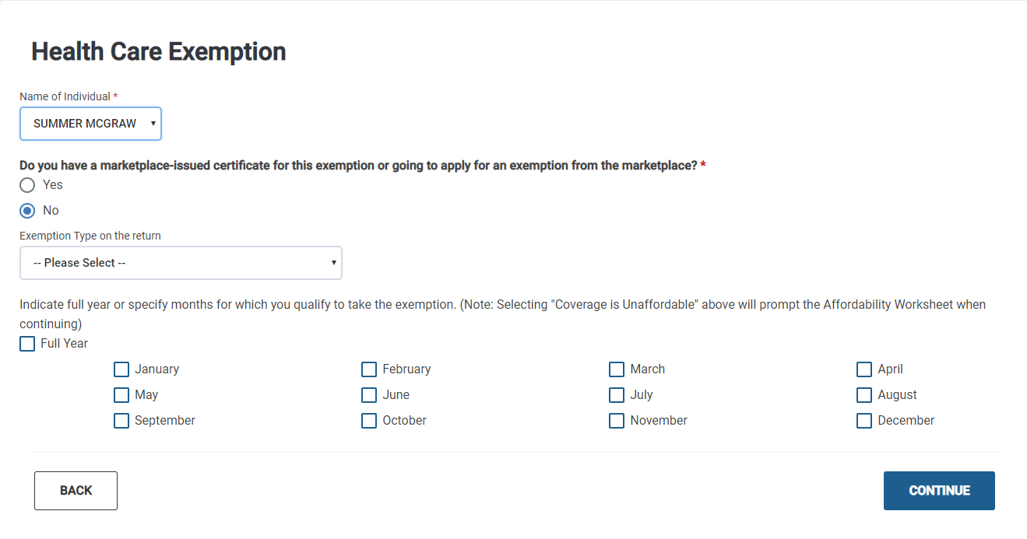
Entering All Other Exemptions in TaxSlayer

Slide 13
Full Exemption List
Coverage Exemption | Code
Insurance is considered unaffordable – Lowest premium would have cost more than 8.05% of household income | A
Short coverage gap – Uninsured for less than 3 consecutive months | B
Citizens living abroad and certain noncitizens – Includes people who are not lawfully present | C
Members of a health care sharing ministry | D
Members of an Indian tribe or eligible for services through an Indian health care provider or the Indian Health Service | E
Incarceration | F
Aggregate self-only coverage is considered unaffordable – Total cost of two or more family members’ aggregate self-only coverage is more than 8.05% of household income | G
Hardships, including Resident of a state that did not expand Medicaid | G
Member of the tax household born or adopted or died during the year | H

Slide 14
New General Hardship Exemptions* (Code G)
Did any of the following hardships prevent you from obtaining coverage?
Financial Hardship You were homeless You were evicted or face eviction or foreclosure You received a utility shut-off notice You filed for bankruptcy You had medical debt in the last 24 months You had unexpected increases in expenses caring for ill, disabled or aging relative You were determined ineligible for Medicaid in a state that did not expand Medicaid coverage You were without coverage while awaiting a decision on a marketplace appeal Plan Choice Hardship You lived in a county with only one issuer offering coverage and can show that the lack of choice precluded enrollment** | All affordable plans provide abortion coverage contrary to your beliefs** You experienced a personal circumstance that created a hardship, such as when no affordable plans provide access to needed specialty care** Personal Hardship You experienced a disaster that resulted in significant property damage You experienced domestic violence A close family member died Your child was denied Medicaid or CHIP and another person is required by court order to provide coverage for the child You experienced another hardship that prevented you from obtaining coverage
*Most of these exemptions were formerly claimed by submitting a marketplace application. The exemption is valid for the month(s) of the hardship and the month before and after. **New hardships Burden of proof: No specific proof is needed but it’s always advisable to keep something in the taxpayer’s record

Slide 15
New General Hardship Exemptions* (Code G)
https://www.kff.org/health-reform/issue-brief/insurer-participation-on-aca-marketplaces-2014-2019/

Slide 16
IRS Exemptions: Short Coverage Gap
Short coverage gap – Uninsured for less than 3 consecutive months | B
A coverage gap of less than 3 months (so, 1 or 2 months). If the coverage gap is 3 months or longer, none of the months in the gap qualify for exemption. Apply to the first gap in coverage.
Example: If Bob is uninsured January 1 to March 31, the exemption does not apply to any of those months because the gap is not less than 3 months.
Months covered by another exemption are treated like months with coverage.
Example: Bob has coverage January to March, is uninsured in April and May, and is eligible for the affordability exemption June to December. Even though Bob was uninsured April to December, he is eligible for a short gap exemption for April and May.
There is a look-back. Consecutive uninsured months at the end of 2017 count toward a gap at the start of 2018; uninsured months in 2019 do not.
Example: If Bob is uninsured Dec 2017, Jan and Feb 2018, he doesn’t qualify for this exemption in 2018 because the gap is not less than 3 months.

Slide 17
IRS Exemptions: Certain Noncitizens
Citizens living abroad and certain noncitizens – Includes people who are not lawfully present | C
This exemption applies to:
Individuals who are not U.S. citizens, nationals or lawfully present (i.e., undocumented immigrants)
Some other citizens living outside of the U.S., residents of territories, and 1040NR (or 1040NR-EZ) filers.
How do I identify someone who is eligible for this exemption?
Consult the list of immigration statuses that qualify a person for help with health costs. If the person’s status is not on this list, they are eligible for this exemption.
https://www.healthcare.gov/immigrants/immigration-status/
Does everyone with an ITIN get this exemption?
Many people with ITINs will be eligible for this exemption.
Some people with SSNs are eligible, too.
Example: A lawful social security number but not an eligible immigration status. E.g., a person who is a Deferred Action for Childhood Arrivals (DACA) grantee (“Dreamer”) can claim the exemption, despite having an SSN.

Slide 18
IRS Exemptions: Medicaid Coverage Gap
Resident of a state that did not expand Medicaid | G
Had household income below 138% FPL, and
Resided at any time during 2018 in a state that did not expand Medicaid
Adjusted Gross Income (AGI)
Non-Taxable Social Security Benefits
Tax-Exempt
Interest
Excluded Foreign Income
Dependent Income
Form 1040, Line 7
Form 1040, Line 5a - 5b
Form 1040, Line 2a
Form 2555, Lines 45, 50
Only if the dependent has a filing requirement
Family Size | 138% FPL (2018 coverage year)
1 | $16,643
2 | $22,411
3 | $28,180
4 | $33,948
Applies to people who lived at any time in 2018 in one of the following states:
Alabama
Florida
Georgia
Idaho
Kansas
Maine
Mississippi
Missouri
Nebraska
North Carolina
Oklahoma
South Carolina
South Dakota
Tennessee
Texas
Utah
Virginia
Wisconsin
Wyoming

Slide 19
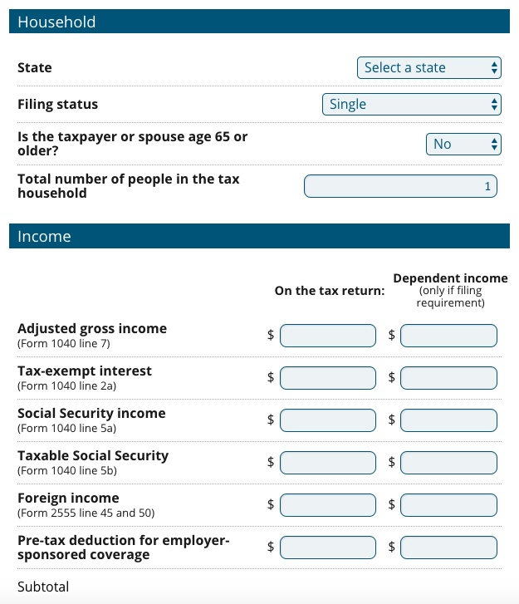
CBPP Tax Exemption Tool
Calculates exemptions based on income
Filing threshold
Medicaid coverage gap
Employer-coverage affordability
Marketplace affordability
Logic to prevent certain common errors
TY2018 Beta Version launched 11/14. Feedback requested!
www.healthreformbeyondthebasics.org/aca-exemptions-income-tool/

Slide 20
Example: Medicaid Coverage Gap Exemption
Rashid, Miriam and Leila
Rashid was uninsured for all of 2018
His wife, Miriam, had insurance all year through her employer
Leila was born in November and was covered by Medicaid
Household income for 2018: $25,000 (~122% FPL)
They live in South Carolina (a state that did not expand Medicaid)
Does Rashid qualify for an exemption?
YES, Rashid’s household income is below 138% FPL and in 2018, he lived in a non-expansion state
Rashid qualifies for this exemption for the entire year even if he had other insurance options, such as coverage through his wife’s employer or insurance in the Marketplace with PTCs
Rashid also qualifies for the entire year, even if he only lived in SC for one month before moving to Maryland (a state that did expand Medicaid)

Slide 21
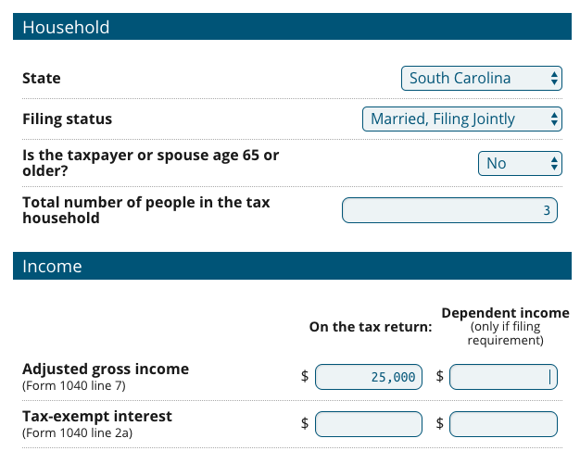
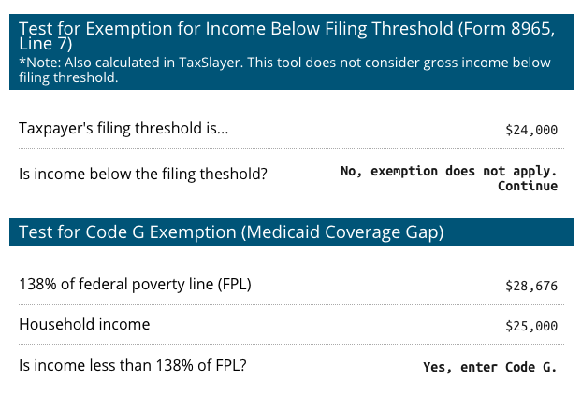
Example: Medicaid Coverage Gap Exemption
Rashid, Miriam, and Leila
Rashid was uninsured for all of 2018
His wife, Miriam, had insurance all year through her employer
Leila was born in November and was covered by Medicaid
Household income for 2018: $25,000 (~122% FPL)
They live in South Carolina (a state that did not expand Medicaid

Slide 22
Deep Dive: Affordability Exemption

Slide 23
IRS Exemptions: Affordability Exemption
Insurance is considered unaffordable – Lowest premium would have cost more than 8.05% of household income | A
Start by determining household income
Then determine the lowest-cost premium available to each person
Adjusted Gross Income (AGI)
Tax-Exempt
Interest
Excluded Foreign Income
Dependent Income
Any pre-tax deduction for ESI premiums
Household Income
Line 7
IRS Form 1040
Line 2b
IRS Form 1040
Lines 45 and 50
IRS Form 2555
Only if the dependent has a filing requirement
If eligible for employer-sponsored insurance:
As an employee: the lowest-cost self-only plan costs more than 8.05% of household income As a member of the employee’s family: the lowest-cost family plan costs more than 8.05% of household income
If not eligible for an offer of employer-sponsored insurance:
Lowest cost bronze plan (after PTCs) for all non-exempt members of the taxpayer’s family costs more than 8.05% of household income

Slide 24
Example 1: Affordability of ESI
Gregory and Alice are MFJ.
They lived in Oklahoma City, OK (Zip: 73111)
Both uninsured all year; no other exemption applies
Gregory
W-2, Box 1: $20,000
Self-only insurance offer: $50/mo
Family insurance offer: $350/mo
Alice
W-2, Box 1: $25,000
No insurance offered
How is affordability measured? (Use the first that applies for each family member)
Lowest-cost self-only plan offered to the employee by his or her employer
Lowest-cost family plan offered by the employer of a family member in the tax unit
Lowest-cost bronze plan in the marketplace, after accounting for PTC

Slide 25
Example 1: Affordability of ESI
Gregory and Alice are MFJ.
They lived in Oklahoma City, OK (Zip: 73111)
Both uninsured all year; no other exemption applies
Gregory
W-2, Box 1: $20,000
Self-only insurance offer: $50/mo
Family insurance offer: $350/mo
Alice
W-2, Box 1: $25,000
No insurance offered
Gregory
His lowest-cost self-only employer plan is $50/mo
Annualized cost is $600
Compared to annual income of $45,000
$600 / $45,000 = 1.3% of household income
Gregory is not eligible for the affordability exemption because his plan costs less than 8.05% of household income.

Slide 26
Example 1: Affordability of ESI
Gregory and Alice are MFJ.
They lived in Oklahoma City, OK (Zip: 73111)
Both uninsured all year; no other exemption applies
Gregory
W-2, Box 1: $20,000
Self-only insurance offer: $50/mo
Family insurance offer: $350/mo
Alice
W-2, Box 1: $25,000
No insurance offered
Alice
No offer of coverage through her own employer
Her lowest-cost family plan through Gregory’s employer is $350/mo
Annualized cost is $4,200
Compared to annual income of $45,000
$4,200 / $45,000 = 9.33% of household income
Alice is eligible for the affordability exemption because her offer of coverage costs more than 8.05% of income.

Slide 27
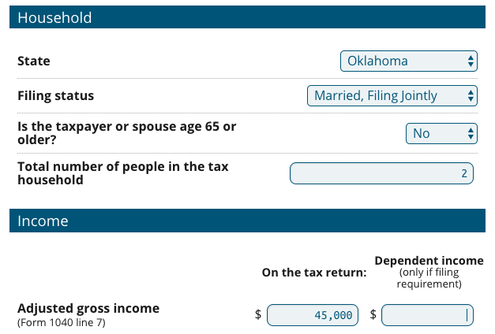
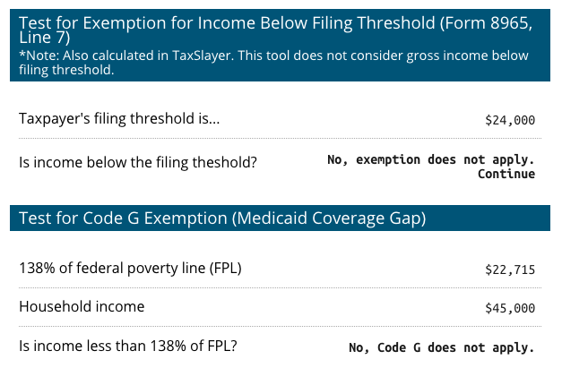
Gregory & Alice
Gregory and Alice are MFJ.
They lived in Oklahoma City, OK (Zip: 73111)
Both uninsured all year; no other exemption applies

Slide 28
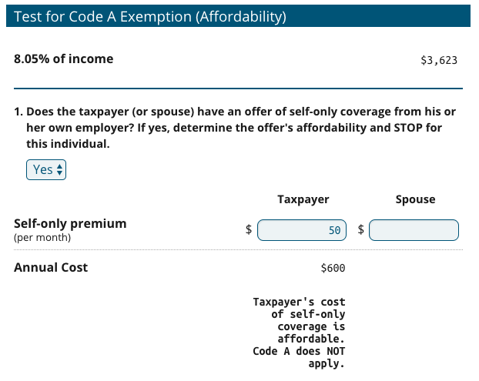
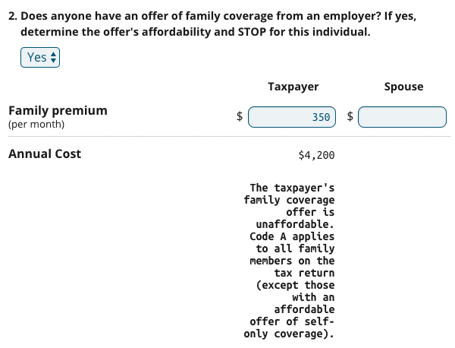
Gregory & Alice
Results:
Gregory: Code A does not apply
Alice: Code A does apply
Since Gregory and Alice each have an offer of employer-sponsored coverage, determine if it’s affordable then STOP. Don’t move on to marketplace affordability.

Slide 29
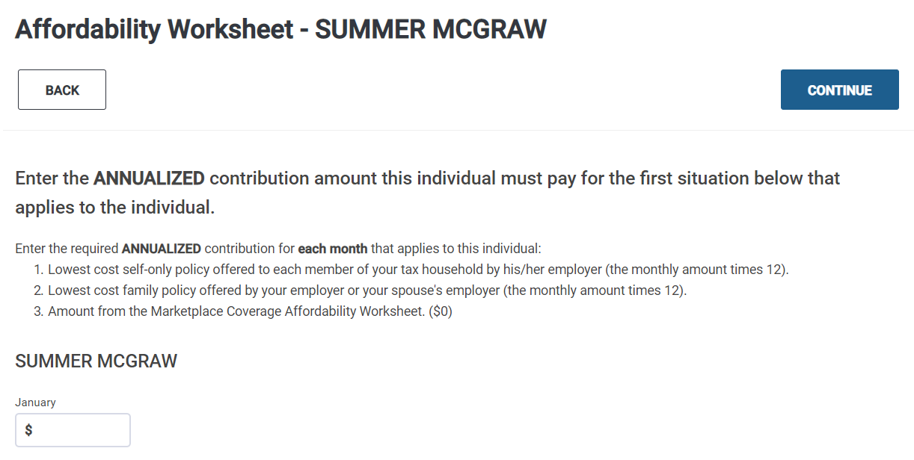
“Annualized Contribution”
Affordability is measured against annual income
Since income is annualized, premiums must be, too
Example:
Income = $24,000
Premium = $200/mo
Is it affordable?
Compare annualized premium to the annual income.
January = $2,400
February = $2,400

Slide 30
Example 1: Affordability of ESI
Gregory and Alice are MFJ.
They lived in Oklahoma City, OK (Zip: 73111)
Both uninsured all year; no other exemption applies
Gregory
W-2, Box 1: $20,000
Self-only insurance offer: $50/mo
Family insurance offer: $350/mo
Alice
W-2, Box 1: $25,000
Jan-June: No insurance offered
July-Dec: Alice enrolls in coverage at work
What if Alice is uninsured only part of the year?
No offer of coverage through her own employer for Jan-June.
Her lowest-cost family plan through Gregory’s employer is $350/mo ($4,200 annually)
$4,200 / $45,000 = 9.33% of household income
Look at the annual cost of coverage, even if you’re just determining eligibility for a month.
Alice is eligible for the affordability exemption January through June because her offer of coverage costs more than 8.05% of income.

Slide 31
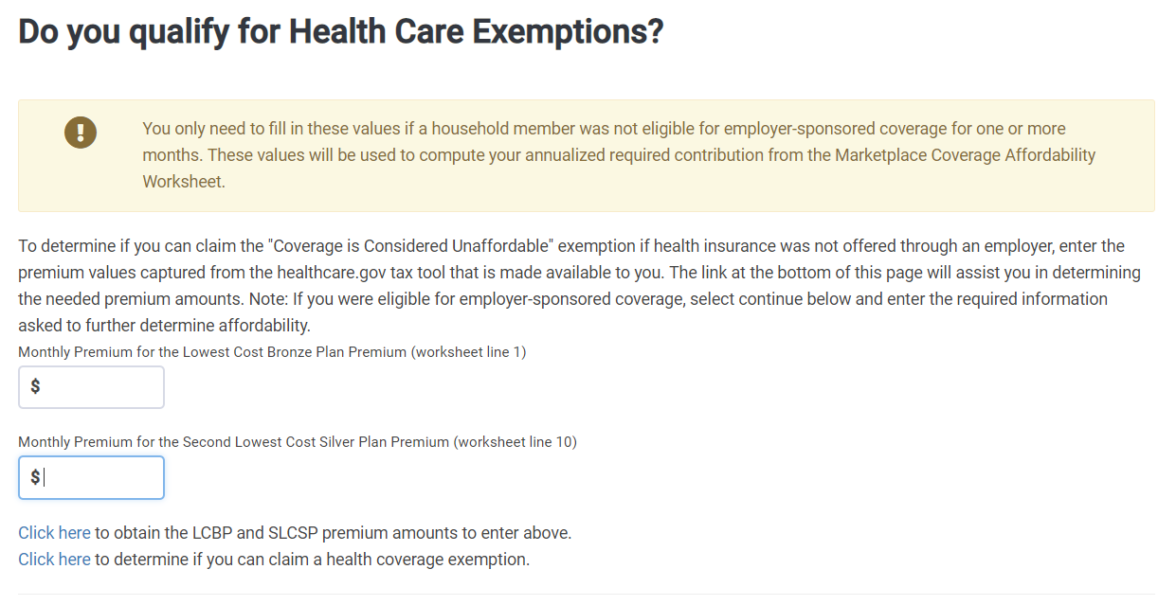
Marketplace Affordability Exemption
If there is no employer coverage offer, consider the affordability of marketplace coverage.
You’ll need to determine:
The lowest-cost bronze plan (LCBP)
The second-lowest cost silver plan (SLCSP) only if eligible for PTC
Find these values at:
For federal marketplace states: https://www.healthcare.gov/tax-tool/
For other states: State-based marketplaces

Slide 32
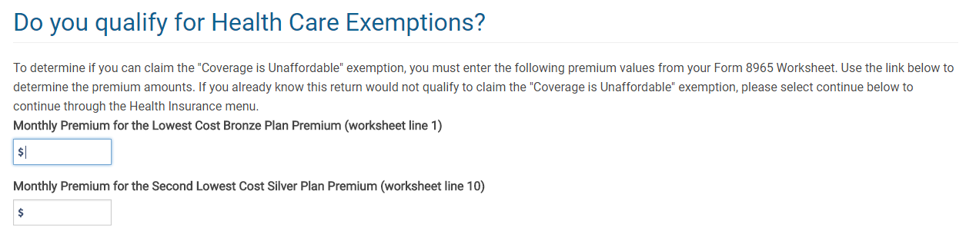
Affordability: Marketplace Coverage
Lowest Cost Bronze Plan (LCBP)
(Line 1 of Marketplace Coverage Affordability Worksheet)
Include:
Everyone claimed on the tax return
Unless they are:
Eligible for employer-sponsored coverage, or
Eligible for another exemption.
Note: You’ll include household members that have no coverage, Medicaid or Medicare coverage
Second Lowest Cost Silver Plan (SLCSP)
(Line 10 of Marketplace Coverage Affordability Worksheet)
Include:
Everyone claimed on the tax return
Unless they are:
Eligible for any other MEC (other than individual market), or
Eligible for another exemption.
Marketplace Coverage Affordability Worksheet, Form 8965, page 12

Slide 33
Example 2: Marketplace Affordability
Max is single with no dependents.
He was uninsured before getting a job with coverage starting April 21. (Employer paid entire cost – no pre-tax deduction.)
Residence: 22204, Arlington, VA; DOB: 7/21/84
W-2, Box 1 - $17,500
Step 1. Figure out coverage vs exemption months.
Covered: April-Dec
Needs exemption: Jan-Mar
Step 2. Does an easy exemption apply?
Short coverage gap?
Income below filing threshold?
Medicaid coverage gap?
Hardship exemption?
Step 3. Consider the affordability exemption.
First, did Max have an offer of employer-sponsored coverage? No
Then, consider marketplace affordability exemption.

Slide 34
Example 2: Marketplace Affordability
Max is single with no dependents.
He was uninsured before getting a job with coverage starting April 21.
Residence: 22204, Arlington, VA; DOB: 7/21/84
W-2, Box 1 - $17,500
www.healthcare.gov/Tax-Tool
Note: LCBP and SLCSP are for 2017

Slide 35
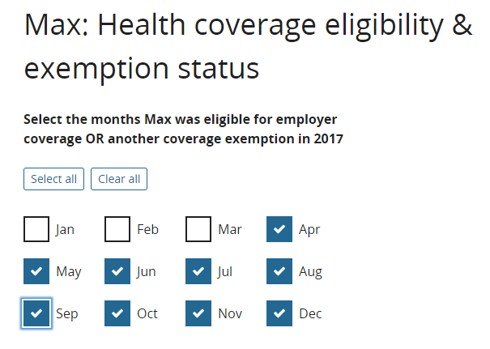
Example 2: Marketplace Affordability
Max is single with no dependents.
He was uninsured before getting a job with coverage starting April 21.
Note: LCBP and SLCSP are for 2017

Slide 36
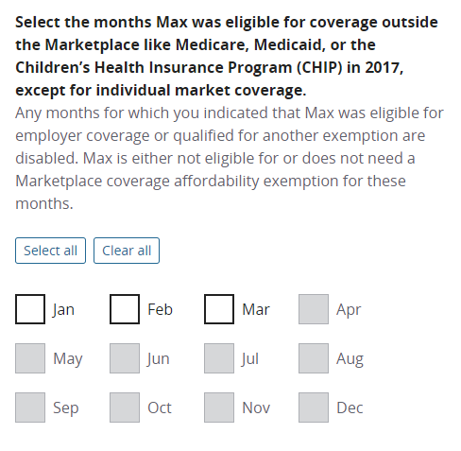
Example 2: Marketplace Affordability
Max is single with no dependents.
He was uninsured before getting a job with coverage starting April 21.
Note: LCBP and SLCSP are for 2016

Slide 37
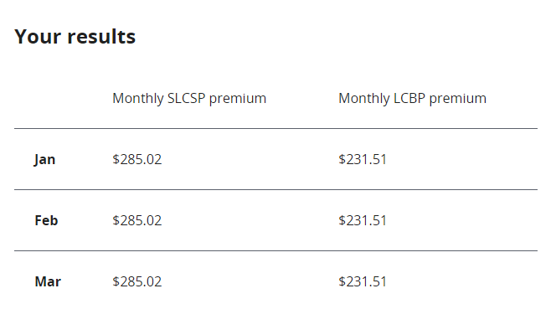
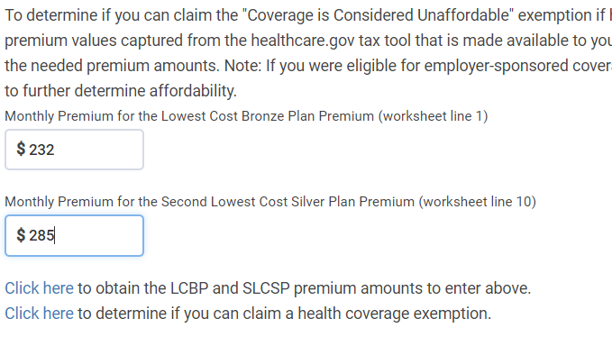
Example 2: Marketplace Affordability
Note: LCBP and SLCSP are for 2017

Slide 38
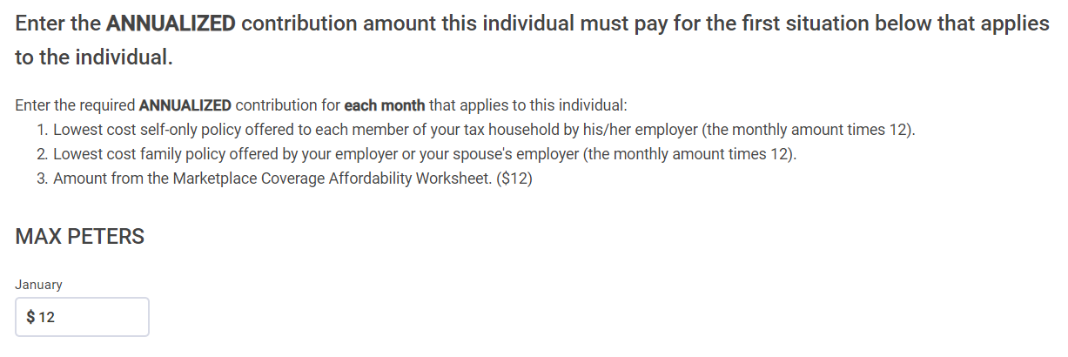
Example 2: Marketplace Affordability
This is the annual amount. Max could have enrolled in a plan for $1/mo! Enter $12 for each month we’re testing.
Note: LCBP and SLCSP are for 2017

Slide 39
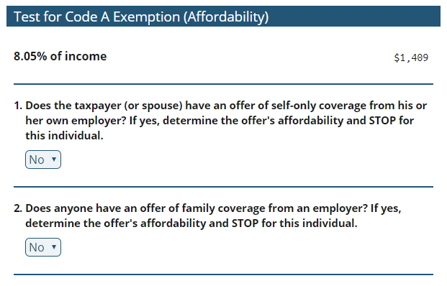
Example 2: Marketplace Affordability
What does this look like in the CBPP tool?
Max had an offer of employer-sponsored coverage April – December.
Here, we’ll answer no because he did not have an offer during the months we’re testing.
Note: LCBP and SLCSP are for 2017

Slide 40
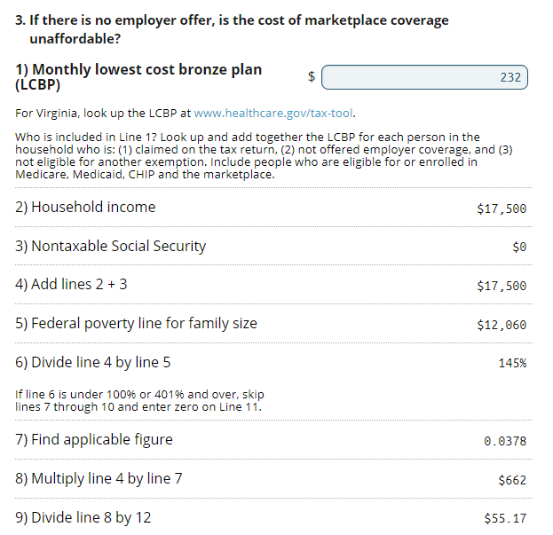
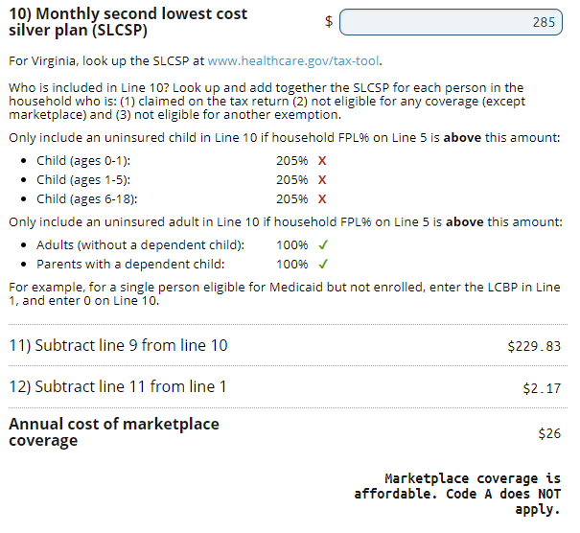
Example 2: Marketplace Affordability
Remember: We’re always testing using annual income, even if someone didn’t have income during the uninsured month.
Note: LCBP and SLCSP are for 2017

Slide 41
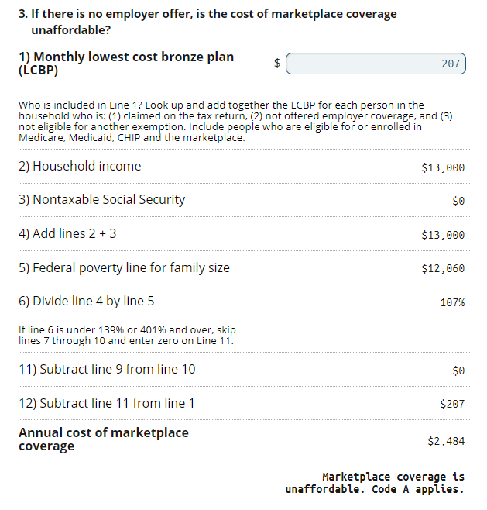
Example 3: Marketplace Affordability
Summer is single with no dependents.
She lived in Los Angeles, CA (90017) all year.
Uninsured all year. No offer of employer-sponsored coverage.
W-2, Box 1 - $13,000
Summer’s LCBP is $207. Her SLCSP is $276.
Does Summer qualify for an exemption?
Line 1: Summer’s LCBP is included because she is (1) not eligible for employer-sponsored coverage, and (2) not eligible for another exemption.
Line 10: At an income of 107% FPL (see Line 6) in a state that expanded Medicaid, she is eligible for Medicaid. Line 10 is zero so the exemption tool skips those lines.

Slide 42
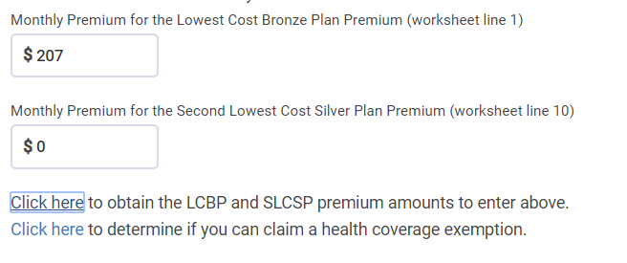
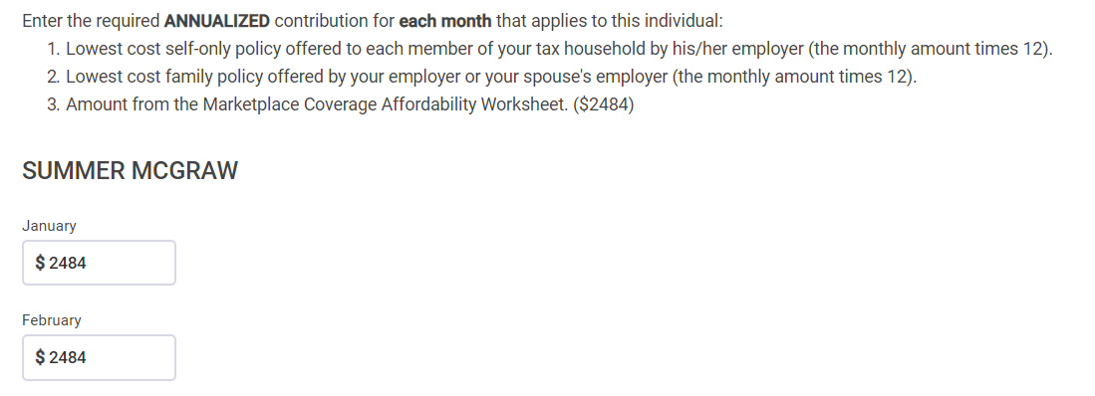
Example 3: Marketplace Affordability in TaxSlayer
The preparer needs to know when the SLCSP is zero. TaxSlayer doesn’t calculate that.

Slide 43
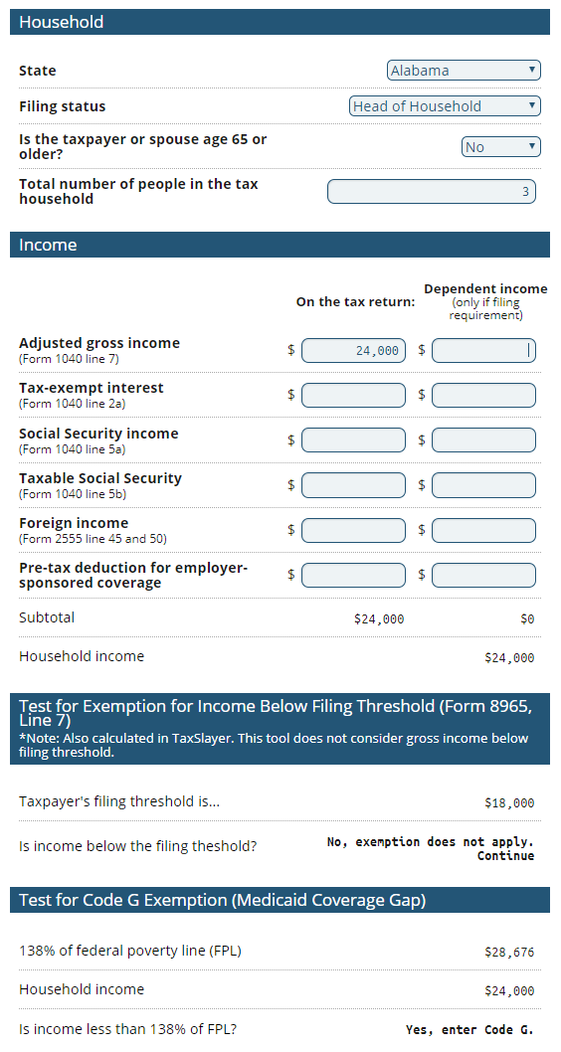
How to Integrate TaxSlayer, HealthCare.gov & CBPP Tool
Start in TaxSlayer with insurance coverage questions
Is there an easy exemption?
Income below the filing threshold?
Short coverage gap?
Non-citizen?
Hardship?
If you need to move to income-related exemptions, the CBPP tool can do the math.
If you need to use the affordability exemption, go to HealthCare.gov or your state’s marketplace
Enter figures in the CBPP tool to calculate exemption eligibility. Print the page for the taxpayer.
Then enter in TaxSlayer
[Example at: https://prosperitynow.org/blog/tax-prep-dispatch-you-cant-afford-overlook-affordability]

Slide 44
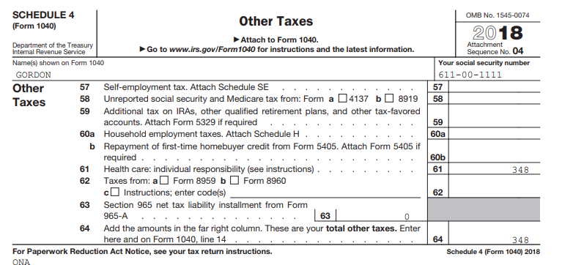
Always Preview the Return!

