Slide 1
VITA/TCE Advanced Topic:
Reconciling the Premium Tax Credit
Current as of December 11, 2019

Slide 2
Eligibility Criteria for the Premium Tax Credit (PTC)
To receive a premium tax credit, a person must:
Enroll in a Marketplace plan
Have income between 100 and 400 percent of the federal poverty line (FPL)
Individual: $12,140 - $48,560 Family of four: $25,100 - $100,400
Exception: People with income below 100% FPL can claim PTC if:
(1) They received APTC under the belief they would be income-eligible for the credit, or
(2) If they are lawfully-present immigrants ineligible for Medicaid.
Have an eligible filing status
PTC cannot be claimed by a person who is Married Filing Separately
Exception: Abused or abandoned spouses
PTC cannot be claimed on a dependent return (whoever claims an individual as a dependent can claim their PTC)
Not eligible for (or enrolled in) other minimum essential coverage (MEC)
Cannot be eligible for Medicare or most Medicaid/CHIP or affordable employer-sponsored coverage (regardless of whether the person is actually enrolled)
Exception: Some people may temporarily receive PTC despite eligibility for other coverage

Slide 3
Who Must File Form 8962
If a person received any advance payments of PTC (APTC), they must file a tax return!
File Form 8962 if:
Any member of the tax family received APTC, or
A member of the tax family purchased insurance in the Marketplace and did not receive PTC in advance but is eligible to claim it now, or
The taxpayer received advance payment of PTC for someone they thought would be claimed as a dependent but is not claimed and is on no one else’s tax return.
Example: Diane enrolls her 19-year-old son, Danny, in marketplace coverage, assuming she will claim him as a dependent. At the end of the year, Danny cannot be claimed as a dependent. Danny can file taxes, including Form 8962. But if he doesn’t file, Diane must reconcile the PTC.

Slide 4
Reconciliation
Get more: If no PTC is taken in advance, or if only a portion of the PTC is claimed in advance, the remainder is refundable and may be claimed on the tax return.
Pay back: If a taxpayer receives excess advance payments of the PTC, some or all of it must be paid back.
REPAYMENT LIMITS (TY 2019)
Income (as % of FPL) | SINGLE taxpayers will pay back no more than … | OTHER taxpayers will pay back no more than….
Under 200% | $300 | $600
At least 200% but less than 300% | $800 | $1,600
At least 300% but less than 400% | $1,325 | $2,650
400% and above | None: Full repayment | None: Full repayment

Slide 5
Form 1095-A
$1100
$1041
$925
This is the entire plan premium (minus certain “extra” benefits, such as adult dental)
This is the benchmark plan that helps establish the PTC amount.
It may be incorrect if:
(1) no APTC was paid, or (2) there was an unreported change.
If this is blank, that month’s PTC won’t calculate!
Get the correct figure at: healthcare.gov/Tax-Tool or from your state-based marketplace
Advance payment of PTC

Slide 6
Form 1095-A Corrections
What if the 1095-A is wrong?
If the SLCSP is wrong or missing, use the look-up tool to find the correct one to use on Form 8962 (healthcare.gov tool: www.healthcare.gov/tax-tool). The marketplace will not send a corrected Form 1095-A to correct a SLCSP.
Otherwise, the taxpayer should call the Marketplace for an amended form
Requests for amended forms don’t always require filing delays
If an error doesn’t affect the PTC calculation (e.g., incorrect address, social security number or birth date), seek a correction, but the consumer should file anyway. Don’t wait.
If an error does affect the PTC calculation, get corrected information before filing. The consumer may be able to get the information over the phone.

Slide 7
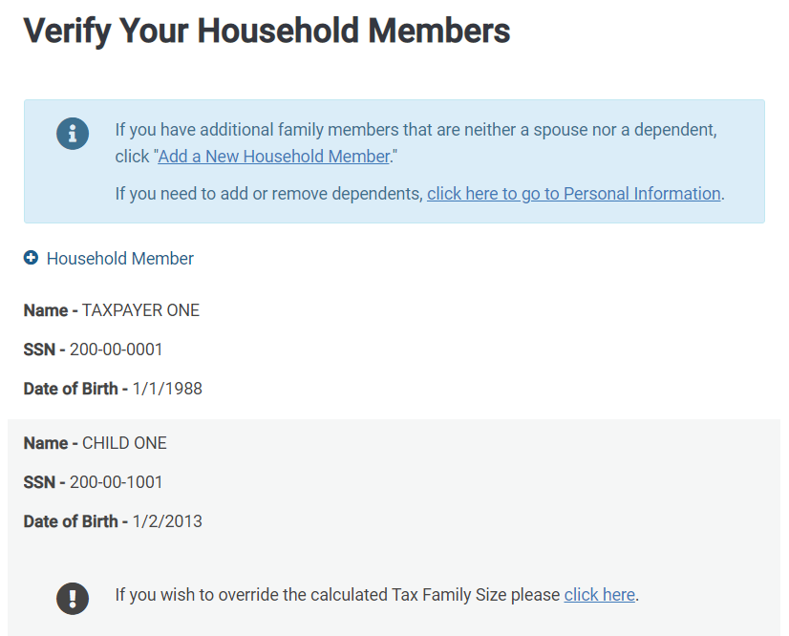
Confirm Insurance Status & Household
Add a New Household Member only if there is a non-filing, non-dependent whose credit the taxpayer must reconcile.
But be careful! If a non-dependent is listed on Form 1095-A and will be on another tax return, that’s a “shared policy allocation.”

Slide 8
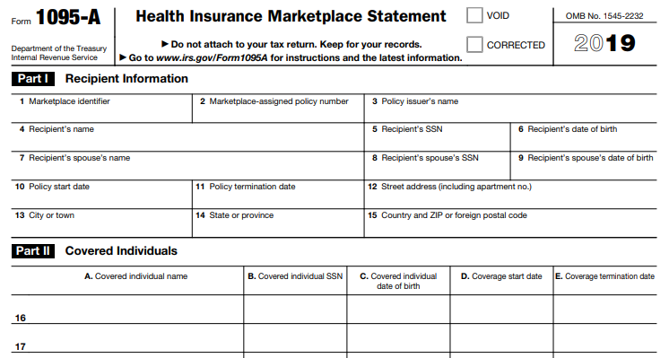
Form 1095-A

Slide 9
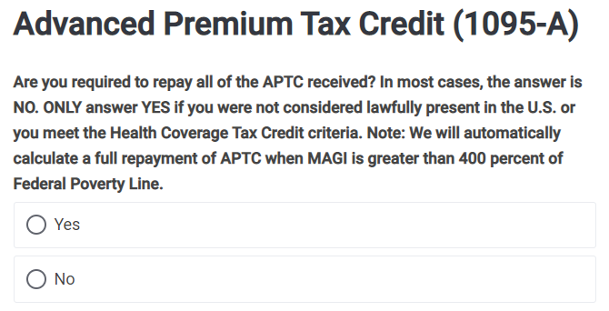
Requirement to Repay All APTC
Nearly everyone should answer NO
People who are eligible to claim the PTC
Most people who are NOT eligible to claim PTC, such as people who are married filing separately or who have other health insurance coverage – they have a repayment cap!
Very few people should answer YES to trigger repayment of all APTC
People who are not lawfully present and received APTC only for themselves.
If a citizen or qualified immigrant on the return also received APTC, the calculation is more complicated and is out of scope
People who received APTC and Health Coverage Tax Credit (HCTC) payments
People with income at 401% FPL or above (TaxSlayer will trigger repayment regardless of your answer here)

Slide 10
Requirement to Repay All APTC
Form 8962
Tip!
Line 28 should show a repayment cap when income is 400% FPL or below.
If it doesn’t show a repayment cap, check your answer to this question.

Slide 11
Income Below 100% FPL
Rule: A person with income under 100% FPL can claim the PTC if they were enrolled in marketplace coverage and received APTC.
NO triggers repayment for people with income below 100% FPL
TaxSlayer defaults to NO. This is the wrong answer for most clients!
YES applies to most people
Taxpayers fall into the noted exceptions if:
At application, the taxpayer projected having income above 100% FPL and received APTC on that basis, or
The person is a lawfully present immigrant who is ineligible for Medicaid due to immigration status.

Slide 12
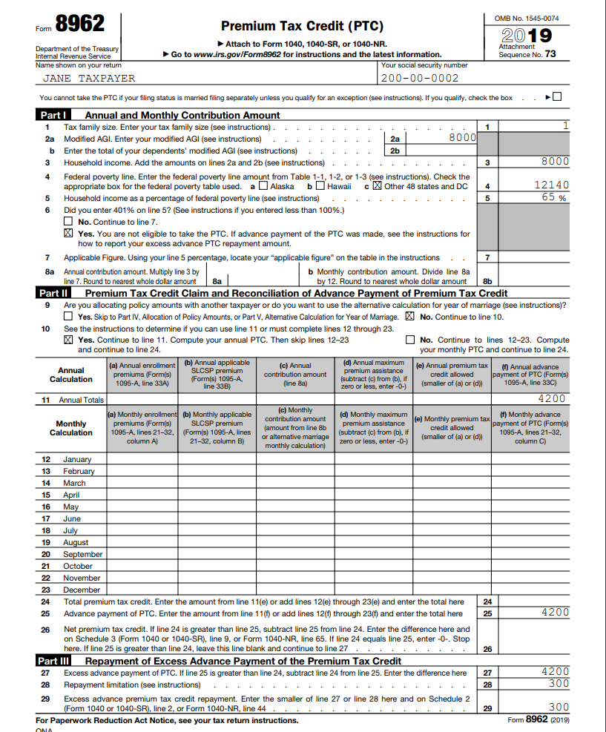
Income Below 100% FPL
Double-check this question if a person with income below 100% FPL has any repayment.

Slide 13
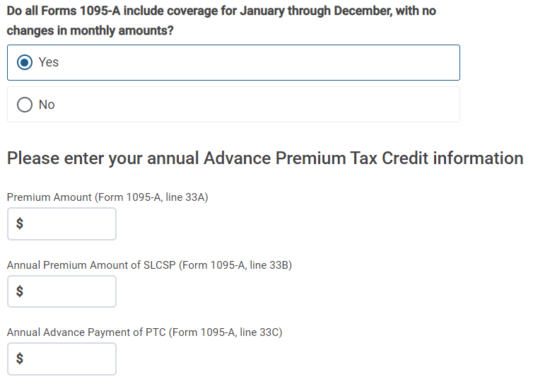
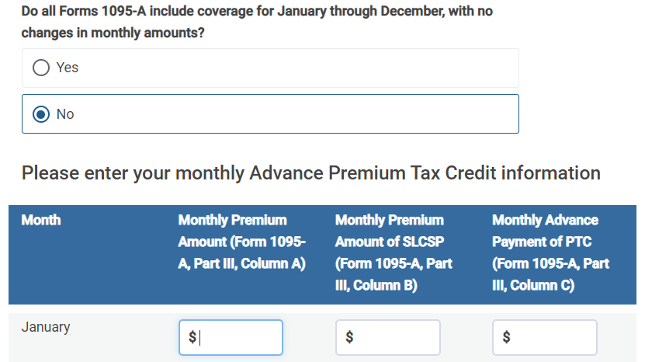
Entering Form 1095-A

Slide 14
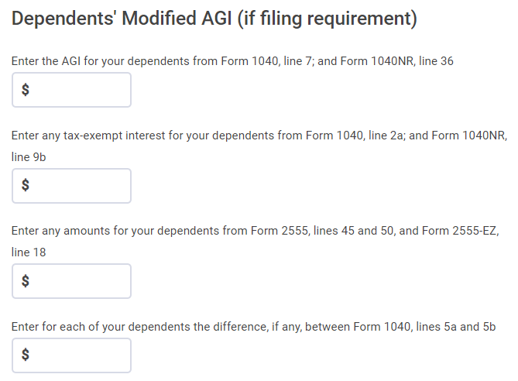
Dependent MAGI
Note: The higher dependent filing threshold means very few dependents have a tax filing requirement so this screen should almost always be blank.
Tax Dependent Filing Requirement (2019)
A single dependent under age 65 has a tax filing requirement if any of the following are true:
Unearned income is more than: | Earned income is more than: | Taxable gross income is more than the larger of:
$1,100 | $12,200 | $1,100 | Earned income (up to $11,850) + $350

Slide 15
Complex Form 1095-A Issues

Slide 16
Issue: I thought I would file jointly but I’m MFS
Rule: In general, a taxpayer cannot claim PTC if Married Filing Separately.
Two exceptions
*Each exception can be used for a maximum of 3 years
Domestic abuse: The taxpayer lives apart from the spouse and is unable to file a joint return because of domestic abuse
Abandoned spouse: The taxpayer lives apart from the spouse and is unable to locate spouse with reasonable diligence
Safety valve
If the taxpayer is MFS and no exception applies, the taxpayer is still protected by the repayment cap (if income is below 401% FPL.)

Slide 17
Example: MFS with APTC
Alma hasn’t seen her husband in over a year. When she applied for health coverage, she said she was single. She was awarded APTC.
At tax filing, you inform Alma that her filing status is married filing separately.
Explain that a person cannot claim PTC if MFS. To avoid repayment, ask if the domestic violence or abandonment exceptions apply.
Here, abandonment might apply. Has she used due diligence to locate him?
Alma: He lives with his new girlfriend in Arlington. I could call him on his cell phone. But I don’t have any interest in filing taxes with him.
Exception does not apply. Enter 1095-A as it appears. TaxSlayer will trigger payback of the APTC received (up to the repayment cap).
Form 8962

Slide 18
Issue: Multiple Forms 1095-A
Many people have multiple 1095-As.
Sometimes it’s because of an actual change in plan selection. Other changes, like a change in income, can also trigger a new form.
Form 1095-A
Add the premiums together
If same state, SLCSP should be the same.
If different states, add them.
Or use tool.
Add the APTC together
See Form 8962 Instructions for details.

Slide 19
Example: Multiple Forms 1095-A
Felicia and Murphy properly claim their 27-year-old daughter, Gwen, as a dependent. They enroll together as a household in the same plan but cannot be on the same policy. They get separate Form 1095-As.
Form 1095-A for Felicia and Murphy
$12,000
$10,800
$4,800
Form 1095-A for Gwen
$3,600
$10,800
$1,200
15,600
$12,000 + $3,600
10,800
6,000
$4,800 + $1,200

Slide 20
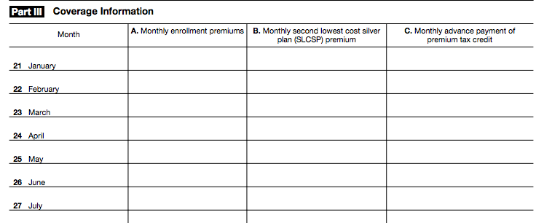
Issue: Failure to Pay Premiums
Form 1095-A
$545
$545
$545
$525
$525
$525
$525
$450
$450
$450
$450
If the taxpayer misses a premium, the monthly enrollment column will be blank.
If there are multiple months of APTC without a premium in column A, this is likely an error. Call the marketplace.
Two options:
Taxpayer must repay the APTC for that month of nonpayment, or
The taxpayer can pay the premium for the month prior to the tax deadline.
Here, the enrollee’s share of the premium is $95 ($545 - $450) so it will be less expensive to pay the insurer one month of premium than to repay one month of APTC ($450).

Slide 21
Example: Failure to Pay Premiums
Greg had an unexpected car repair in March and could not afford to make his April insurance premium. He made no other payments and his coverage was canceled, retroactive to the end of April.
Form 8962
TaxSlayer will trigger a repayment* of $980 in APTC received for April. (*up to repayment cap)
Alternative to repayment:
Greg can pay his portion of the April premium ($52, which is the monthly enrollment premium minus the monthly APTC) to claim APTC for April.
After he pays, he should request a new 1095-A from the marketplace.

Slide 22
Issue: Only Column A of Form 1095-A is Completed
Form 1095-A
$300
$300
$200
$300
$300
$200
$300
$300
$200
$300
$300
If the taxpayer didn’t receive APTC in a month, the SLCSP column may be blank. The software won’t calculate PTC for those months, even if the taxpayer is eligible.
Determine PTC eligibility for any months a premium was paid.
If she is eligible for the PTC, enter a SLCSP.
Use the SLCSP for the other months if the household is the same, or
Look up the correct SLCSP at healthcare.gov/Tax-Tool (or your state marketplace)

Slide 23
Example: Only Column A of Form 1095-A is Completed
Carolina failed to reconcile her APTC for 2017 and so wasn’t eligible for APTC in early 2019. She eventually filed her 2017 tax return and APTC was reinstated starting in March.
Form 1095-A
X
$300
$300
$300
$300
$200
$300
$300
$200
$300
$300
$200
Even though she didn’t receive APTC in January and February, she meets all the eligibility criteria for PTC.
In TaxSlayer, enter the SLCSP for January and February. This is the only part of Form 1095-A you should change.
Leave the APTC column BLANK for January and February since she didn’t receive the advance credit for those months.

Slide 24
Forms 1095-A, B, and C
Form 1095-A
Form 1095-A
Issued by the Marketplace to people who enrolled in Marketplace coverage.
Necessary to prepare Form 8962, which is required for people who received Advance Premium Tax Credits
Corrections? Call the Marketplace that issued the form
Form 1095-B
Form 1095-B
Issued by Medicaid, Medicare, insurers, and others who offer coverage.
Useful in determining the months a person had coverage.
Form 1095-C
Form 1095-C
Issued only by large employers (employers with 50 or more full-time EEs)
Useful in determining the months a person had coverage or an offer of coverage and the cost of the offer of individual coverage.
Not foolproof! Eligibility for affordable employer-sponsored coverage doesn’t necessarily mean someone is ineligible for PTC.

Slide 25
Overlapping Coverage
In general, to be eligible for PTC, the taxpayer must not be eligible for (or enrolled in) other minimum essential coverage (MEC). There are many exceptions.
General Exception
People who are eligible for PTC on the first day of the month are considered eligible for the full month (even if they become eligible for other coverage later that month.)
Medicaid Exception
If a person is enrolled in APTC but later determined eligible for Medicaid:
The taxpayer is generally eligible for PTC for the entire calendar year even if also enrolled in Medicaid for some of those months
PTC is allowed for months of retroactive Medicaid coverage
IRS: Return Preparer Best Practices Resolving Information Form 1095 Conflicts

Slide 26
Overlapping Coverage
Medicare Exception
A taxpayer who becomes eligible for Medicare loses PTC eligibility on the first day of the fourth full month after they became eligible for Medicare, whether or not they enrolled.
Example: Freddie is enrolled in Marketplace coverage with APTC. His 65th birthday is May 17, and he becomes eligible to enroll in Medicare.
If he continues in the Marketplace with APTC all year:
He’ll owe back APTC for Sept–Dec.
And when he enrolls in Medicare Part B, he’ll pay a higher premium.
May
Jun
Jul
Aug
Sep
Eligible for Medicare
Three full months
NOT eligible for PTC
IRS: Return Preparer Best Practices Resolving Information Form 1095 Conflicts

Slide 27
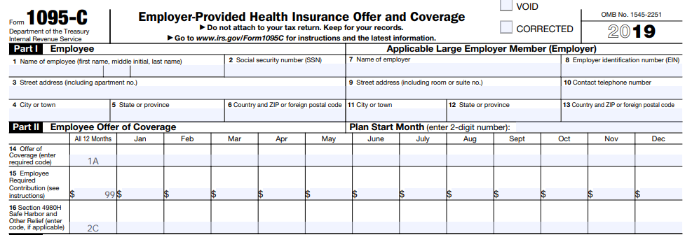
Overlapping Coverage
Eligibility for Employer-Sponsored Coverage
In general, a person is not eligible for PTC if they have an affordable offer of coverage from an employer.
For large employers, the coverage offer will be indicated on Form 1095-C. (There is no similar record for small employers.)
Safe Harbor: If the taxpayer informed the marketplace of the cost of employer-sponsored coverage, and it awarded APTC anyway, the taxpayer can claim PTC.
Ask: Did you provide accurate information about the cost of employer-sponsored coverage?
IRS: Return Preparer Best Practices Resolving Information Form 1095 Conflicts

Slide 28
QSEHRA Eligibility
Qualified Small Employer Health Reimbursement Arrangement (QSEHRA) ​
A small employer can fund a tax-free employee account for reimbursement of medical expenses, including a marketplace plan​
If the QSEHRA is affordable, no PTC is allowed. ​
If the QSEHRA is unaffordable, PTC is allowed but is reduced by the amount in the QSEHRA​.
If the marketplace awarded PTC, the affordability safe harbor applies. The only question is what amount of PTC the taxpayer can claim.
To determine PTC, subtract the QSEHRA contribution from the otherwise-allowed PTC
The QSEHRA contribution is reported on W-2, Box 12, with Code FF
This can’t be done in TaxSlayer
See Publication 974
​

Slide 29
Review Tips

Slide 30
Always Preview the Return!

Slide 31
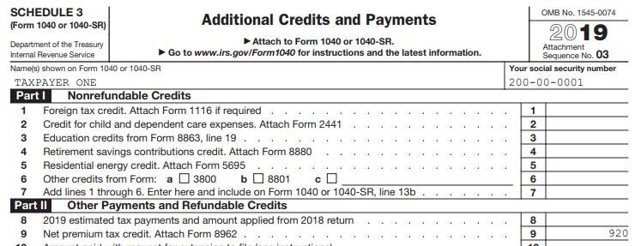
Review the Return Carefully

Slide 32
Form 8962 Review
If MFS, PTC is disallowed and APTC is repaid, up to the cap. Does this taxpayer qualify for an exception?
Spousal abandonment
Domestic abuse

Slide 33
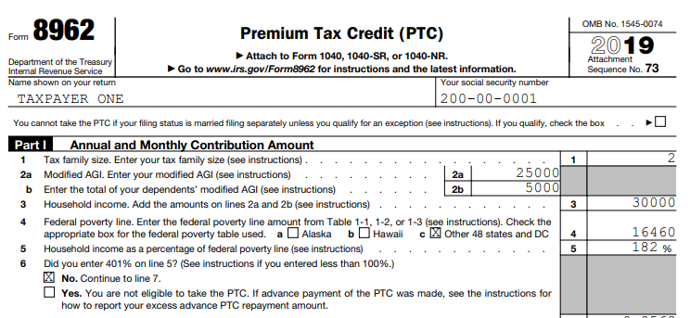
Form 8962 Review
Did I enter dependent income inappropriately?
Only enter if dependent has a filing requirement
Tax Dependent Filing Requirement (2019)
A single dependent under age 65 has a tax filing requirement if any of the following are true
Unearned income is more than: | Earned income is more than: | Taxable gross income is more than the larger of:
$1,100 | $12,200 | $1,100 | Earned income (up to $11,850) + $350

Slide 34
Form 8962 Review
Form 8962
Line 6: If YES is checked on Form 8962, line 6, it’s probably wrong!
A taxpayer can claim the PTC with income below 100% FPL if:
At application, the taxpayer projected having income above 100% FPL and received an advance credit on that basis.
The person is a lawfully present immigrant who is ineligible for Medicaid due to immigration status.

Slide 35
Form 8962 Review
Form 8962
If income is 401% FPL, the taxpayer must repay all APTC.
Did you consider:
Married filing separately?
Adjustments such as making a deductible IRA contribution or contributing to a health savings account?

Slide 36
Form 8962 Review
Form 8962
Line 9: Is there an out-of-scope issue to consider?
Double check that everyone on Form 1095-A is on the tax return. If someone is on Form 1095-A but filing a separate return, it’s a shared policy allocation.
If the taxpayer must repay PTC, did he or she get married in 2019? If so, the person may qualify to use the alternative marriage calculation.
Shared policy allocation: Multiple tax families are on one Form 1095-A.
Taxpayers divorced or legally separated in 2019, or
Taxpayers are married but filing separate returns, or
No APTC is calculated, or
Other situations (typically involving a non-dependent child on the parent’s marketplace policy)

Slide 37
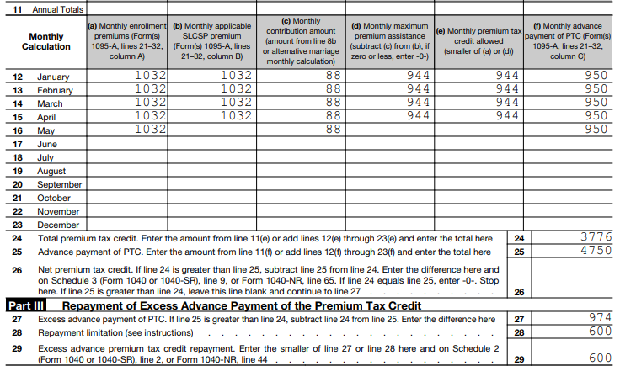
Form 8962 Review
If a credit was not allowed in a month, do I understand why? Can the taxpayer take steps to avoid repayment?
Form 8962

Slide 38
Form 8962 Review
If there’s a repayment, can it be minimized?
Be sure repayment caps are applied!
Lowering household income:
Contribute to a deductible IRA?
Make an HSA contribution?
Changing filing status:
If the taxpayer’s income is over the repayment cap, is it beneficial for the taxpayer to file as MFS instead of MFJ to bring income under 400% FPL?
If the taxpayer’s income is under the repayment cap, is it beneficial for the taxpayer to file as Single to get the lower cap?
Form 8962

Slide 39
What Can a Tax Preparer Tell a Person with a Repayment?
Try to determine why the taxpayer’s advance payment was too high:
Do you suspect the Form 1095-A is incorrect?
Did they make an error in estimating their income or their dependent’s income?
Was there an error in calculating family size?
Has their filing status changed?
Has a dependent joined or left the family?
Encourage taxpayers to take less than the maximum APTC in future years.
Remind taxpayers to promptly report changes in income and family size to the Marketplace.
If the taxpayer has Marketplace coverage for 2020, encourage them to report their most recent income/dependent information to improve the accuracy of the 2020 income and household projection.

Slide 40
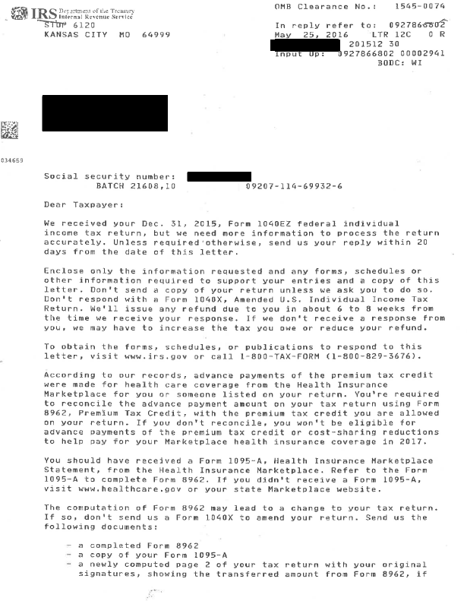
Failure to Reconcile
Delays in Return Processing
Many taxpayers received Letter 12C to request more information
Generally, send Form 1095-A, Form 8962, and page 2 of Form 1040
Do not amend
If someone did not respond, their return may have been sent to exams for review and assessment
Consider amending the tax return

Slide 41
Contact Information
Tara Straw
Center on Budget and Policy Priorities
tstraw@cbpp.org

